Slide 1
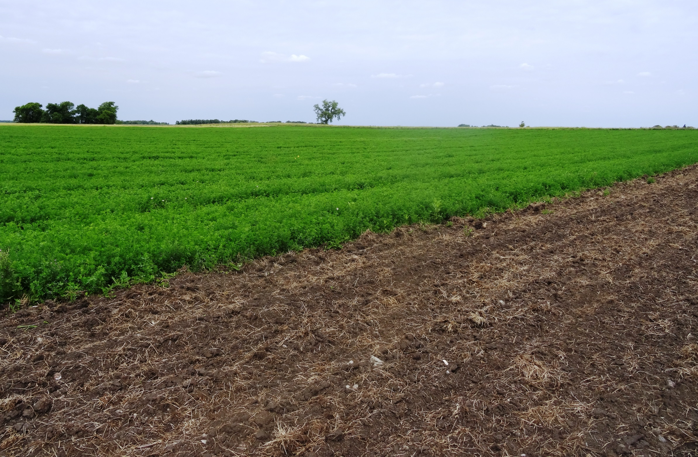
Soils (Part 1): Fertility in Organic Systems
Authors
Adria Fernandez
John Lamb
Kristine Moncada
Constance Carlson
Craig Sheaffer
This material is based upon work that is supported by the National Institute of Food and Agriculture, U.S. Department of Agriculture, under grant number 2013-51106-21005.
Notes:
Narration: Welcome to Part 1 of our Soils module – Soil Fertility in Organic Systems. Image: Kristine Moncada, University of Minnesota

Slide 2
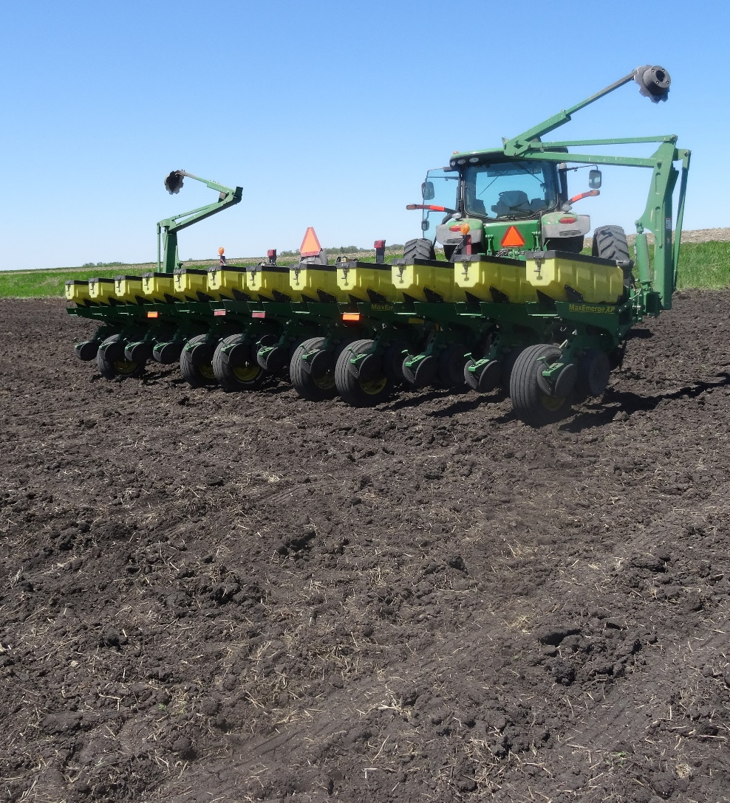
Fertility in Organic Systems
Crop nutrition
Organic fertility principles
Meeting organic standards
Building fertility through transition
Notes:
Narration: The first portion of this module will be an overview of soil fertility practices in organic systems. We will discuss crop nutrition, organic fertility principles, ways of meeting organic standards, and how to build fertility through your organic transition.
Image: Kristine Moncada, University of Minnesota

Slide 3
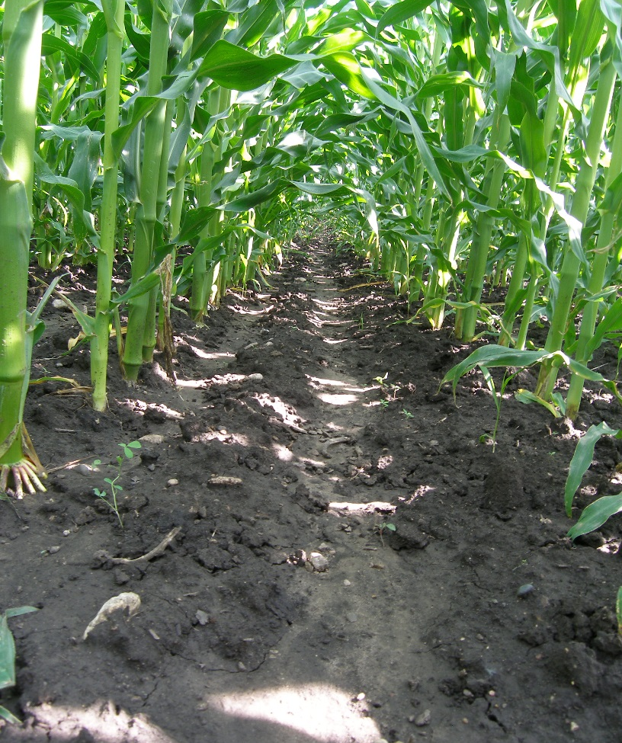
Crop Nutrition
Macronutrients and micronutrients
Nutrient deficiency
Nutrient availability
Adjusting pH
Notes:
Narration: First, we’ll talk a little about crop nutrition. We’ll discuss the macronutrients and micronutrients that crops need to survive, the effects of nutrient deficiency, nutrient availability in soils, and how to adjust soil pH.
Image: Carmen Fernholtz

Slide 4
Soil-Derived Macronutrients
Macronutrients (need larger amounts)
Nitrogen
Phosphorus
Potassium
Calcium
Magnesium
Sulfur
Notes:
Narration: Every crop will need a slightly different balance of nutrients. The nutrients that plants need in larger quantities are called macronutrients. Nitrogen, phosphorus, and potassium, or N-P-K, are the “big three” or primary nutrients that plants obtain from soil. However, calcium, magnesium, and sulfur are also essential macronutrients for all plants.
Image: Offnfopt, Wikipedia (public domain)

Slide 5
Soil-Derived Micronutrients
Zinc
Copper
Molybdenum
Nickel
Micronutrients (need smaller amounts)
Chlorine
Iron
Boron
Manganese
Notes:
Narration: Micronutrients are crucial to plant health, but are needed only in very small quantities. They include chlorine, iron, boron, manganese, zinc, copper, molybdenum, and nickel.
Image: Offnfopt, Wikipedia (public domain)

Slide 6
Crop Nutrition
Macronutrients and micronutrients
Nutrient deficiency
Nutrient availability
Adjusting pH
Notes:
Narration: What happens when plants don’t get enough of the nutrients they need?
Image: Carmen Fernholtz

Slide 7
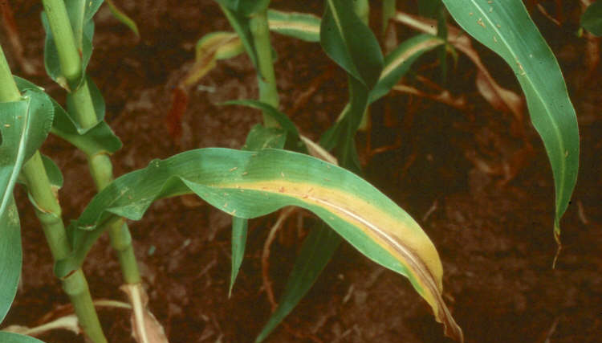
Nutrient Deficiencies
Occur when nutrients are either not present or unavailable
Symptoms can often be observed
N deficiency in corn
P-deficient corn seedlings
Notes:
Narration: When crops do not get as much as they need of a particular nutrient, either because it is not present in the soil, or because it is present but not available to the plant, you may observe symptoms of nutrient deficiency. These will often include yellow, discolored, or curling leaves, and stunted growth.
Images: John Lamb, University of Minnesota (N deficiency); R.L. Croissant, Colorado State University (P deficiency).

Slide 8
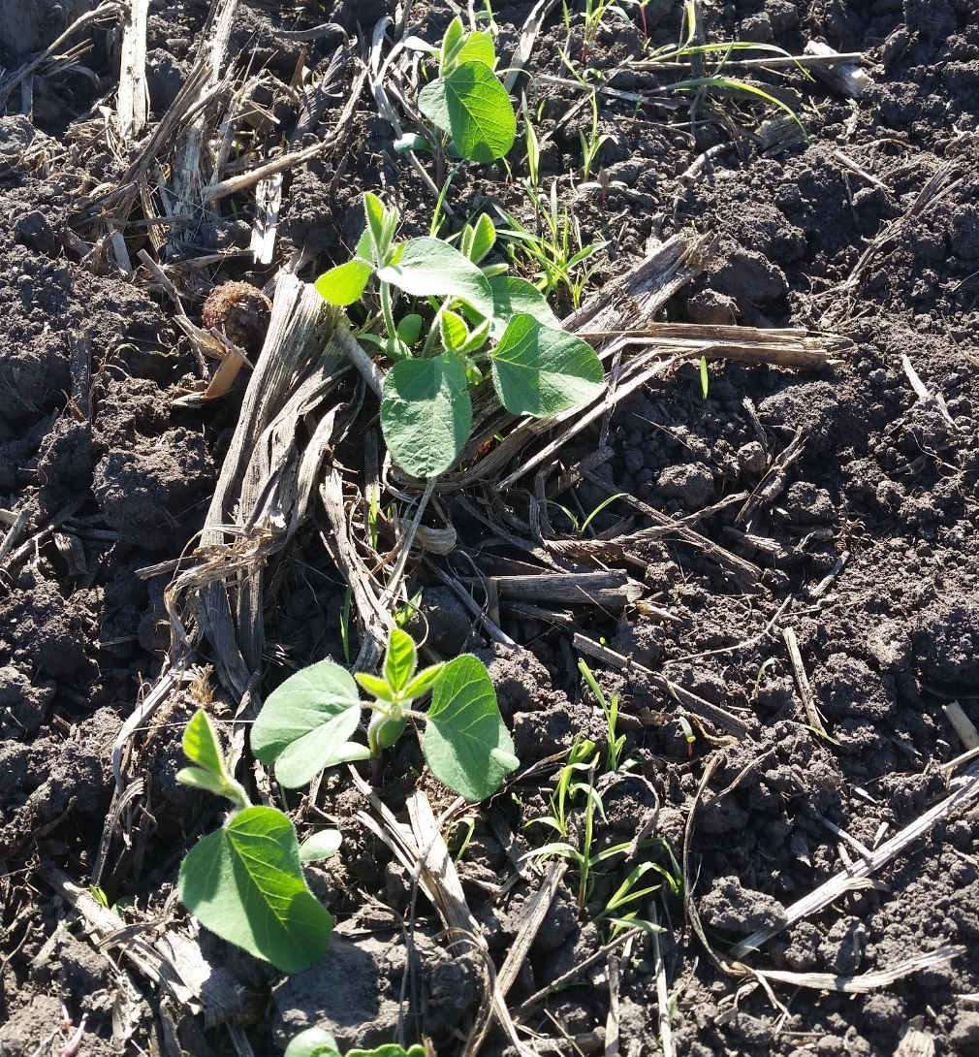
Nutrient Deficiencies
Documented by tissue testing
Should confirm with soil tests before amending
Notes:
Narration: Sometimes deficiencies can be diagnosed by their symptoms, but in some cases you may wish to confirm and document the deficiency with laboratory testing of plant tissue. Tissue test results are not necessarily conclusive by themselves, and should be confirmed by comparing soil nutrient levels between symptomatic and healthy portions of the field.
Image: Carmen Fernholz

Slide 9
Crop Nutrition
Macronutrients and micronutrients
Nutrient deficiency
Nutrient availability
Adjusting pH
Notes:
Narration: Sometimes nutrients are in the soil, but they are just not available for the plant to use.
Image: Carmen Fernholtz

Slide 10
Nutrient Availability
Accessible chemical forms
Nutrients in forms that can reach and be taken up by roots
pH
Affects nutrient binding to soil
Notes:
Narration: The availability of soil nutrients for plant uptake depends on several factors, three of which we will discuss here. First, the accessibility of the nutrient—whether it is in a chemical form that can reach and be taken up by the root. Second, pH—the pH of the soil controls how much of the nutrient will be bound to mineral particles in the soil, and therefore inaccessible.
Image: PHscalenolang.png: myself, PatríciaRderivative work: Chris828 (talk) - PHscalenolang.png, CC BY-SA 2.5, https://commons.wikimedia.org/w/index.php?curid=5874975

Slide 11
Nutrient Availability
3. Timing
Nutrient release from fertilizers must coincide with crop need
Notes:
Narration: The third factor affecting nutrient availability is timing. Nutrient release from fertilizers and organic matter must coincide with the crop’s need for that nutrient. For example, in this figure, which shows corn uptake of nitrogen throughout the season, we see that crop N increases steeply in the late stages of vegetative development, indicating that corn has a strong need for soluble, accessible nitrogen at that time. If nitrogen is released from fertilizer too soon or too late, it will not be available when the corn needs it.

Slide 12
Crop Nutrition
Macronutrients and micronutrients
Nutrient deficiency
Nutrient availability
Adjusting pH
Notes:
Narration: In some cases, nutrient availability can be improved by adjusting soil pH. Image: Carmen Fernholz

Slide 13
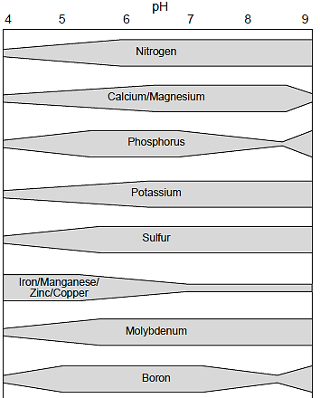
Adjusting pH
Different nutrients respond differently
Crop pH needs differ
Target is 6.0 for most crops; 6.5 for alfalfa
Most common intervention is raising pH (reducing acidity) with lime
Notes:
Narration: Soil pH affects the availability of all soil nutrients. Each nutrient responds slightly differently to pH, but most are maximally available at a pH of between 6 and 7. The optimum soil pH of different crops also differs. A good pH target for most crops is 6.0, but a target of 6.5 is more appropriate for alfalfa. Many soils will benefit from raising the pH, which means reducing the acidity of the soil, by applying agricultural lime.
Image: University of Minnesota Extension

Slide 14
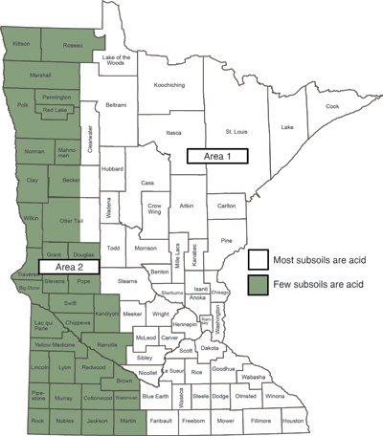
Lime Application
Lime often needed in eastern MN
Apply appropriate rates
Lime also supplies calcium (some sources include magnesium)
Choose permitted lime sources
Area 1
Most subsoils are:
Acid
Area 2
Not acid
Notes:
Narration: Lime application is most likely to be needed in eastern MN, where most subsoils are acidic. You should sample your soils according to testing lab guidelines and consult the lab’s recommendations and Extension guidelines to determine appropriate lime application rates for your soils. When applying lime, be aware that it will also supply soil calcium, and some lime sources include magnesium as well. Not all available lime sources are permitted under the National Organic Rule.
Image: University of Minnesota Extension

Slide 15
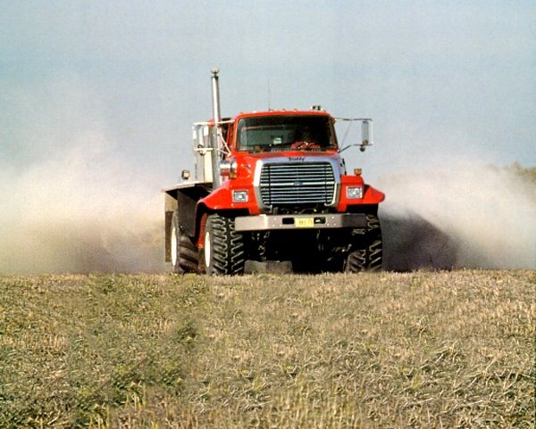
Lime Sources
Allowed
Prohibited
Limestone (mined calcium carbonate)
Dolomite (magnesium carbonate)
Quicklime (calcium oxide)
Burnt dolomite (magnesium oxide)
Slaked lime (calcium hydroxide)
Milk of magnesia (magnesium hydroxide)
Lime from paper mill sludge or other recycled materials
Synthetic additives (e.g. anti-caking agents)
Notes:
Narration: Permitted liming materials in organic agriculture are limestone, or mined calcium carbonate, and dolomite, or magnesium carbonate. You are not permitted to use quicklime, burnt dolomite, slaked lime, milk of magnesia, lime derived from paper mill sludge, or lime that contains synthetic additives such as anti-caking agents.
Image: University of Minnesota

Slide 16
Fertility in Organic Systems
Crop nutrition
Organic fertility principles
Meeting organic standards
Building fertility through transition
Notes:
Narration: Next, we’ll discuss the general principles of organic soil fertility.
Image: Kristine Moncada, University of Minnesota

Slide 17
Organic Fertility Principles
Managing fertility through rotation
Building soil organic matter
Slow-release nutrient sources
Conserving nutrients
On-farm nutrient sources
Notes:
Narration: Every organic farmer manages soil fertility a little differently, but organic fertility practices are based on very different principles than conventional crop fertilization. As an organic farmer, you are responsible for managing fertility through your rotations, which will build a foundation of soil organic matter. Organic nutrient sources tend to be slow-release, and organic practices focus on conserving nutrients on the farm and deriving fertility from on-farm sources, such as livestock manures and nitrogen-fixing legumes, as much as possible.
Image: David L. Hansen, University of Minnesota

Slide 18
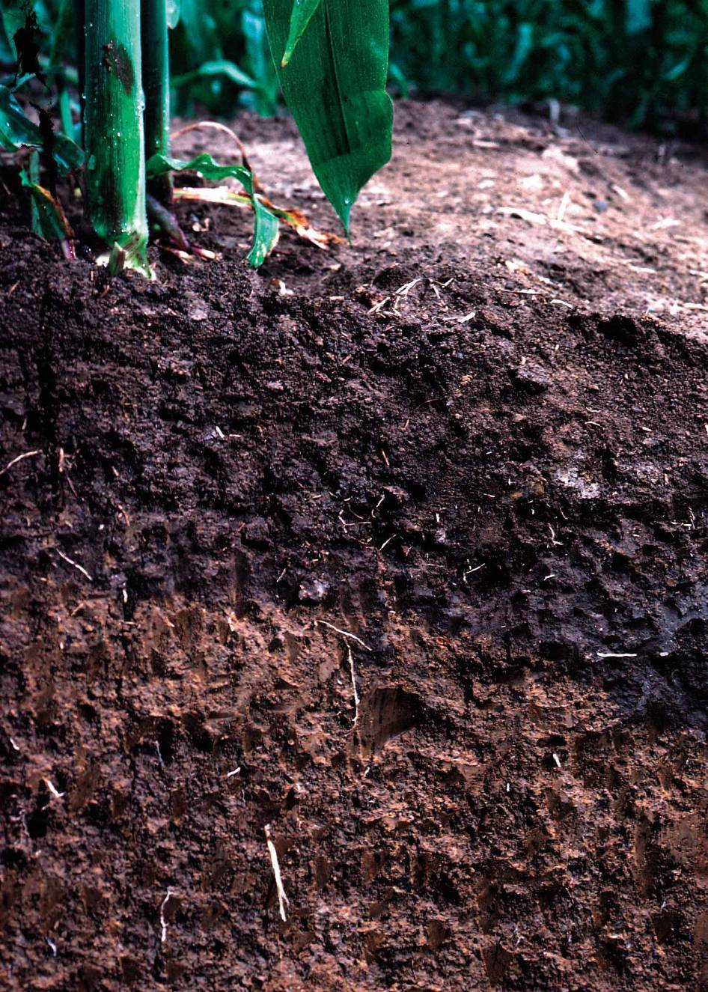
“Feed the soil, not the crop”
Notes:
Narration: One theme that you will hear repeated over and over in organics is “Feed the soil, not the crop.” Your focus should be on managing soil fertility by creating rotations that build and protect the long-term health and integrity of the soil. This generally includes some fertilizer inputs, but the overarching goal is to manage your whole system in ways that promote fertile soil.
Image: Lynn Betts, USDA-NRCS

Slide 19
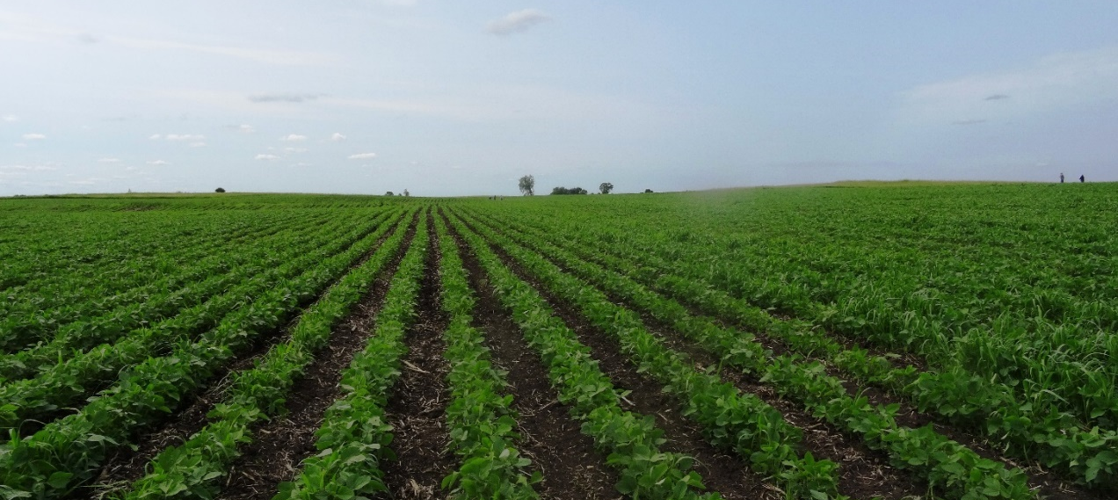
Managing Fertility through Rotation
Diverse crops for diverse functions
Managing fertilizer demand
Biological N fixation
Holding nutrients in system
Keeping soil covered and protected
Notes:
Narration: When building an organic rotation, you will choose diverse crops that can carry out diverse soil-building functions. By carefully choosing crops for your rotation, you can manage fertilizer demand; for example, by balancing heavy-feeding crops with crops with more modest nutrient needs. A good rotation can also facilitate biological nitrogen fixation, hold nutrients in your system, and keep your soils covered and protected. You will notice that a diversity of crops in your rotation addresses many of the fertility principles of organic agriculture.
Image: Kristine Moncada, University of Minnesota

Slide 20
Soil Organic Matter
Carbon-based material derived from decomposition of biomass
Basis for nutrient cycling
Supports decomposer organisms
Nutrients present in varying forms and levels of availability
Notes:
Narration: The foundation of soil fertility is soil organic matter, the carbon-based materials derived from decomposition of plant, animal, and microbial biomass. This material is the basis for nutrient cycling in the soil, supporting the decomposer organisms that digest and release nutrients from organic materials, from microscopic bacteria and fungi to larger organisms like earthworms. This mixture of materials in various stages of decomposition will contain nutrients in varying forms and levels of availability.
Image: David L. Hansen, University of Minnesota

Slide 21
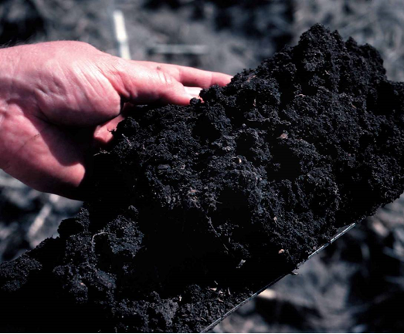
Humus
Stable soil organic matter
Reservoir of nutrients
Supports good soil tilth
Soil structure and ease of tillage
Aeration
Water infiltration and water holding capacity
Resistance to erosion
Notes:
Narration: Soil organic matter that is relatively stable is known as humus. Humus serves as a reservoir of nutrients in the soil, and its presence supports good soil tilth, a collection of properties including soil structure and ease of tillage, aeration, water infiltration and water holding capacity, and resistance to erosion.
Image: Lynn Betts, USDA-NRCS

Slide 22
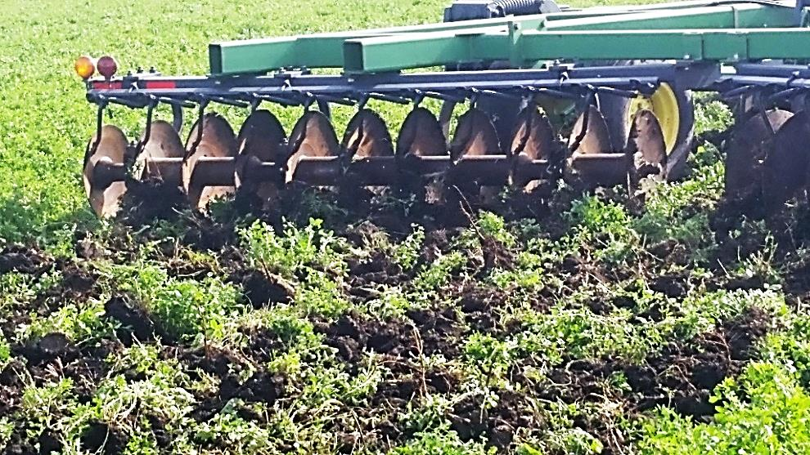
Slow-release Nutrient Sources
Low soluble nutrient content
Plant residues
Compost
Nutrients gradually released by microbes into plant-available forms
Notes:
Narration: In general, the materials that are used for soil fertility in organic farming are slow-release nutrient sources. Materials like plant residues and compost have low concentrations of soluble nutrients compared to synthetic fertilizers. Instead, their nutrient content is released over the course of months to years into plant-available forms through microbial decomposition processes. Image: Carmen Fernholz

Slide 23
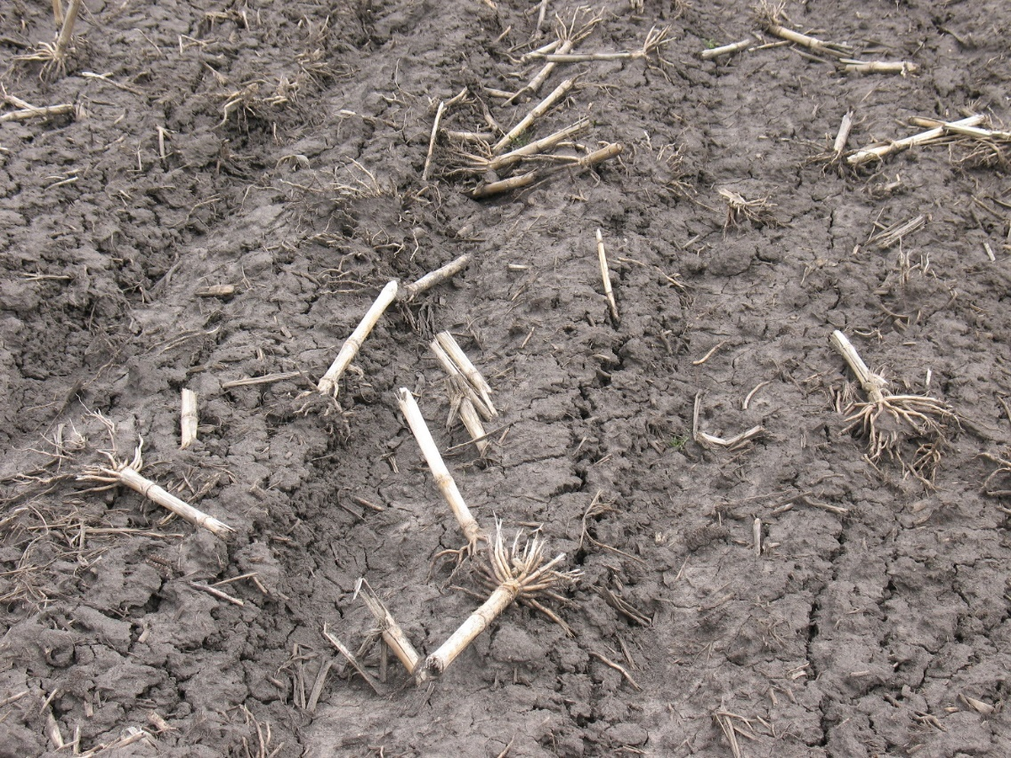
Conserving Nutrients
Nutrients are exported in crop harvest
Retain straw, stover, residues, and other biomass on-farm
Notes:
Narration: Good organic fertility practices include measures to conserve the nutrients that are already present in the soil. Nutrients are inevitably exported from the farm whenever you harvest a crop, but you can retain as much as possible of the straw, stover, residues, and other biomass that is produced on the farm, and return their nutrients to the soil.
Image: University of Minnesota

Slide 24
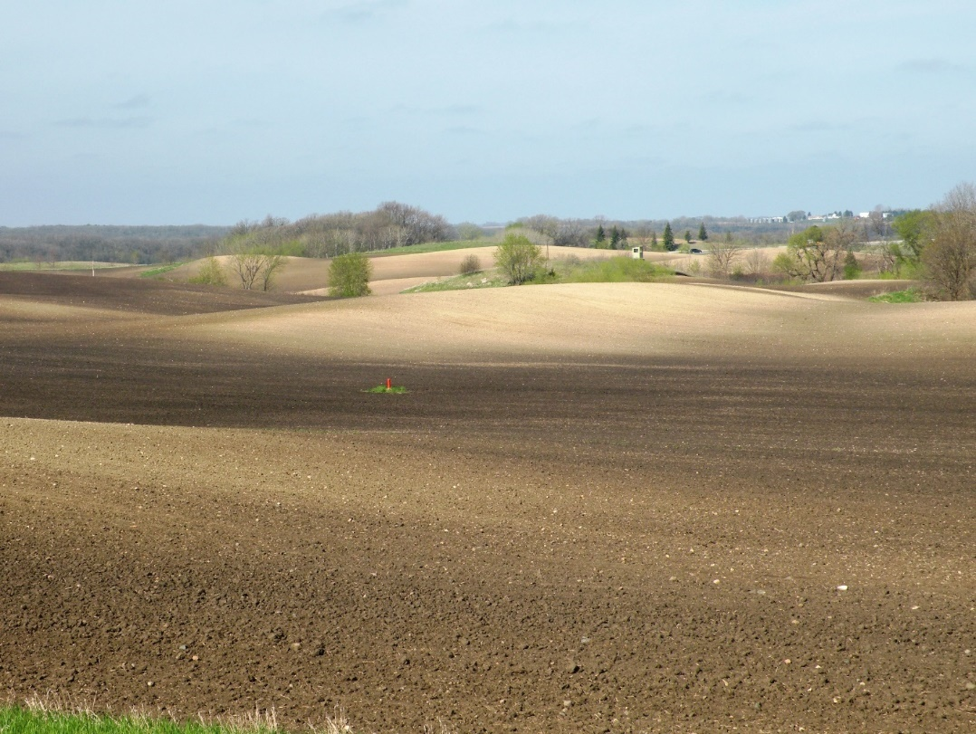
Conserving Nutrients
Prevent erosion, runoff, and leaching
Cover crops and perennials provide physical protection
Winter-hardy crops scavenge and hold nutrients
Conservation tillage prevents soil loss
Eroded topsoil
Notes:
Narration: An important aspect of nutrient conservation is preventing soil and nutrients from leaving your farm through erosion, runoff, or leaching. Including cover crops and perennials in your rotation will provide physical protection for your soil from wind and water erosion. Winter-hardy crops can use the late fall and early spring to scavenge and hold excess nutrients in their biomass that might otherwise have been vulnerable to loss. And conservation tillage practices can also prevent the loss of fertile topsoil. Conservation tillage practices are those that retain greater than 30% crop residue on the soil surface.
Image: Craig Sheaffer, University of Minnesota

Slide 25
On-Farm Nutrient Sources
Legumes (N from atmosphere)
Livestock (nutrients from crops/pasture via manure)
Notes:
Narration: Many organic farmers try to rely as much as possible on on-farm nutrient sources. These can include legumes, which partner with symbiotic Rhizobium bacteria to biologically fix nitrogen from the atmosphere; and livestock, which take in nutrients from feed crops, forages, and pasture, and return them to the soil in the form of manure. We will cover biological nitrogen fixation in more detail in Part 2 of our Soils module series.
Image: David L. Hansen, University of Minnesota

Slide 26
Fertility in Organic Systems
Crop nutrition
Organic fertility principles
Meeting organic standards
Building fertility through transition
Notes:
Narration: The National Organic Rule has stringent standards for how soil fertility needs can be met in organic systems.
Image: Kristine Moncada, University of Minnesota

Slide 27
Meeting Organic Standards
Organic requirements
Permitted inputs
Prohibited inputs
Notes:
Narration: We will briefly discuss the legal requirements for organic fertility, and will outline which inputs are permitted and which are prohibited.
Image: USDA

Slide 28
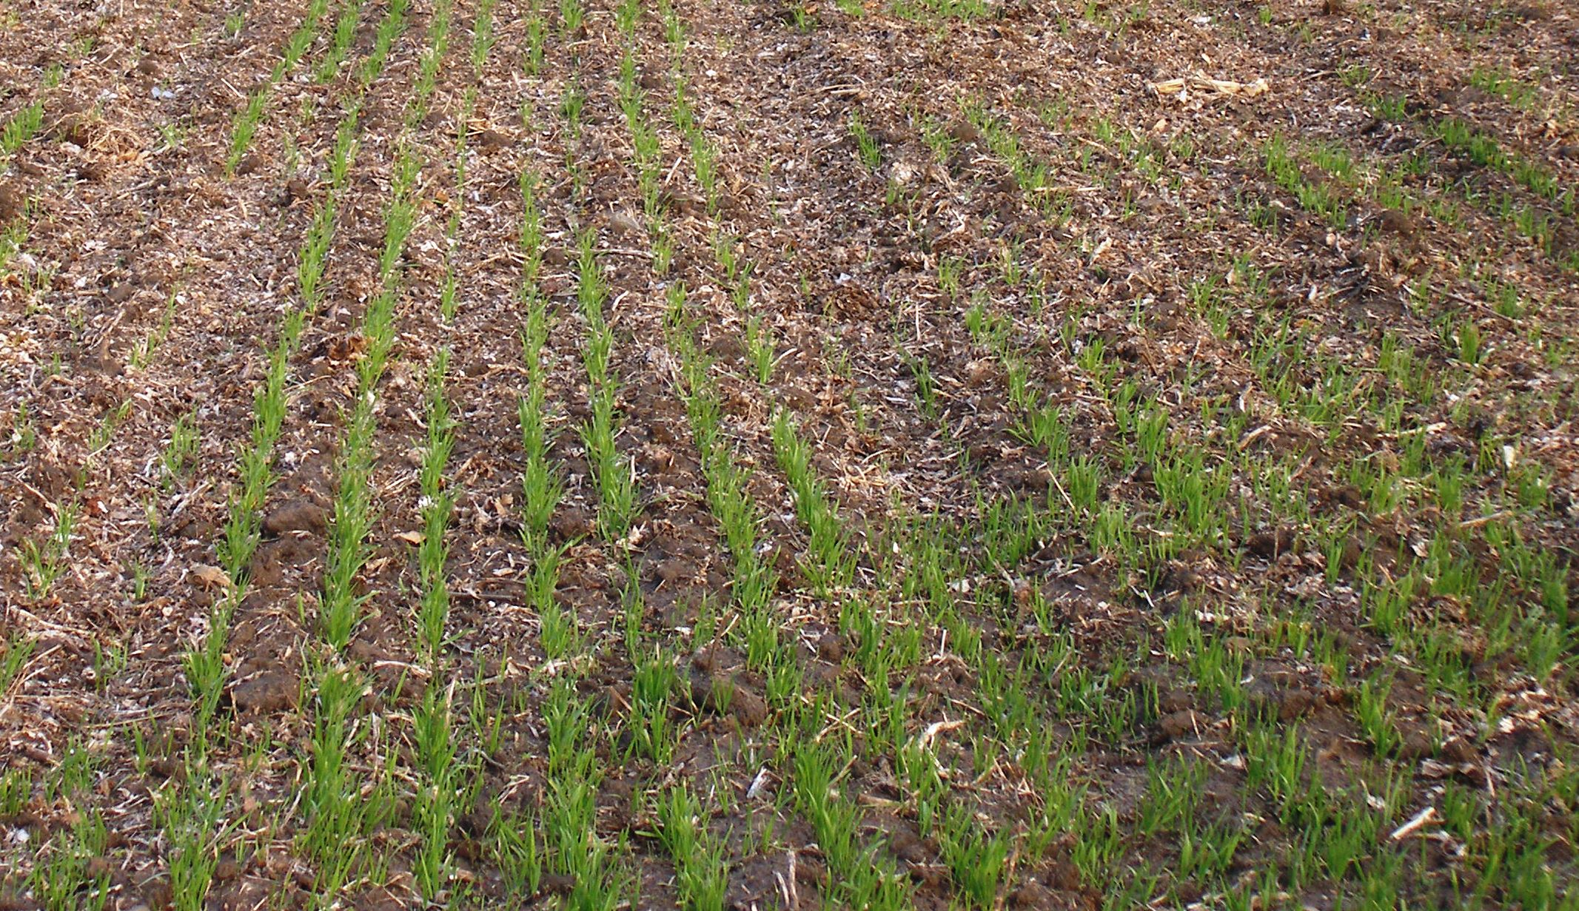
Organic Requirements
“Must manage crop nutrients and soil fertility through rotations, cover crops, and the application of plant and animal materials”
“Must manage plant and animal materials to maintain or improve soil organic matter content”
Notes:
Narration: The National Organic Program states that organic farmers “must manage crop nutrients and soil fertility through rotations, cover crops, and the application of plant and animal materials.” Specifically, you must “manage plant and animal materials to maintain or improve soil organic matter content.”
Image: Carmen Fernholz

Slide 29
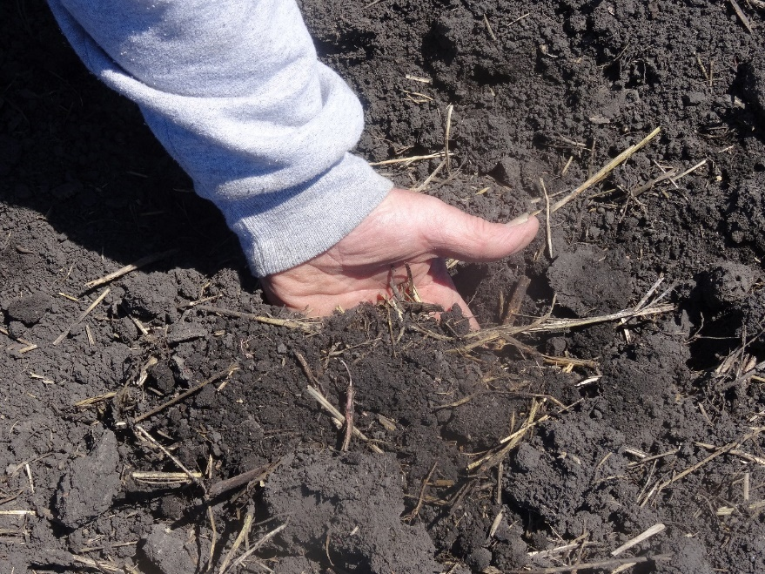
Meeting Certification Requirements
All applications of fertilizers, lime, other amendments must be documented in your Organic System Plan
Certifiers may differ in interpretation of guidelines: when in doubt, ask!
Notes:
Narration: To verify that you are meeting organic certification requirements, you must document all applications of fertilizer, lime, or other soil amendments in your Organic System Plan. Certifiers may have differing interpretations of exactly which amendments are allowable under what circumstances: when in doubt, ask your certifier before applying.
Image: Kristine Moncada, University of Minnesota

Slide 30
Organic Standards: Permitted Materials
Naturally occurring, non-synthetic substances
Limited specific exemptions for synthetic substances
Organic Materials Review Institute (OMRI) provides updated status of generic and commercial products
Notes:
Narration: The organic standards permit you to manage crop and soil health using naturally occurring, non-synthetic substances. The rule also provides limited specific exemptions for certain synthetic substances. The best source of guidance on the status of particular substances is the Organic Materials Review Institute, which provides regularly updated lists of generic and commercial products permitted for use in organic farming.
Image: Organic Materials Review Institute

Slide 31
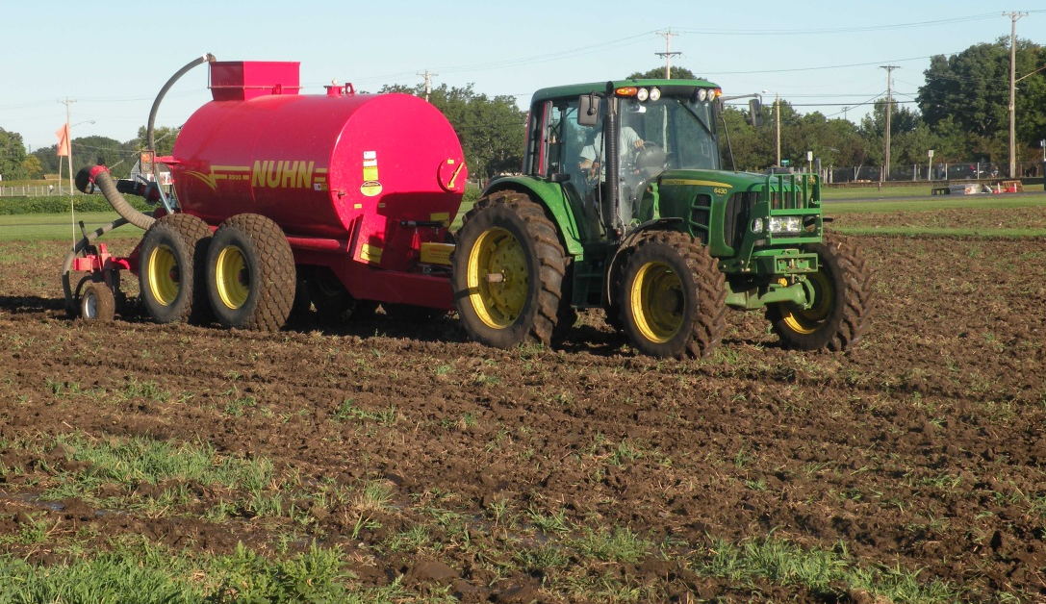
Use of Permitted Materials
May not cause contamination of crops, soil, or water
Use may be restricted even if substance is not prohibited
Manure application timing is restricted
Highly soluble mined fertilizers permitted only in defined amounts and circumstances
Some nutrients only when deficient
Notes:
Narration: The National Organic program states that materials cannot be used in a manner that will cause contamination of crops, soil, or water. This means that, even if a substance is not prohibited, its use may be restricted. For example: the timing of application of raw animal manures is subject to restrictions, certain highly soluble mined fertilizers such as Chilean nitrate are permitted only in defined amounts and circumstances, and some nutrients can be applied only if you have tests documenting a deficiency.
Image: University of Minnesota

Slide 32
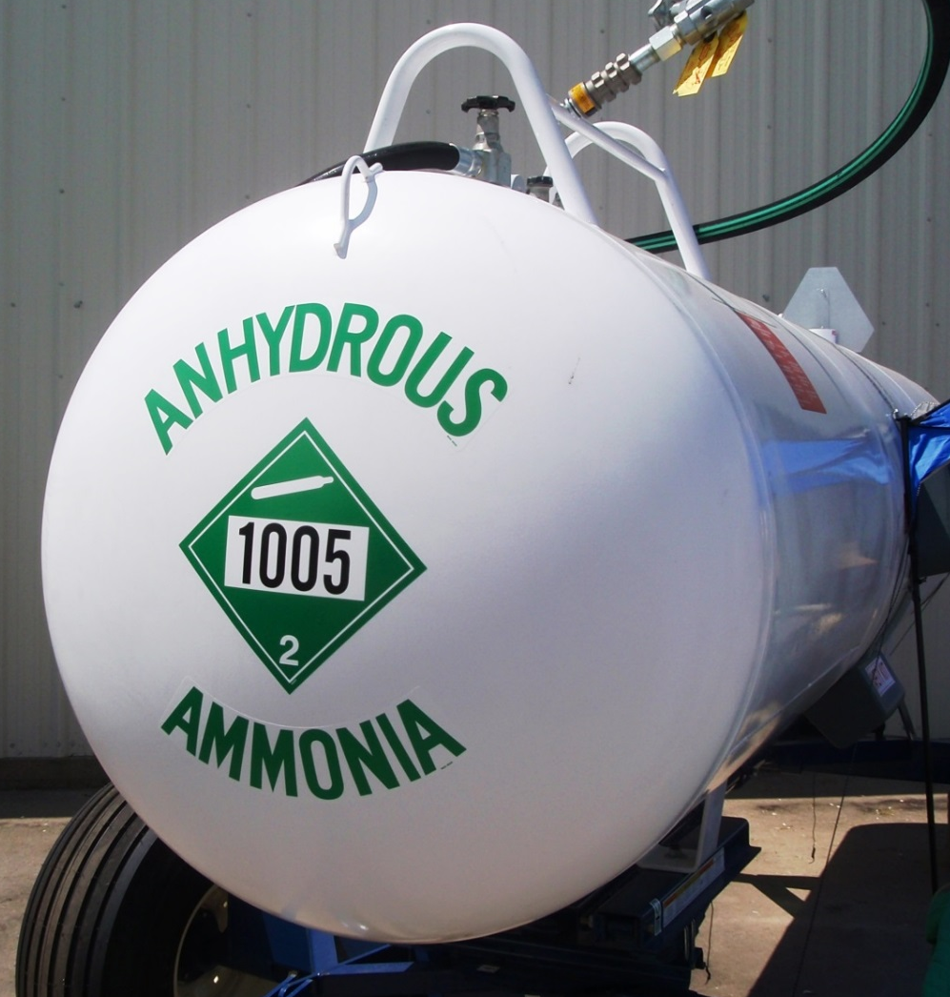
Organic Standards: Prohibited Materials
Synthetic substances unless specifically exempted
Sewage sludge
Substances derived from GMOs
Certain toxic natural substances
Notes:
Narration: The organic standards prohibit the use of all synthetic substances except for specifically defined exemptions. This includes common conventional fertilizers like anhydrous ammonia, urea, and superphosphate. Sewage sludge is not a permitted fertilizer, nor are substances derived from genetically modified organisms, or GMOs. Certain toxic natural substances, like arsenic, are also specifically prohibited.
Image: Jeff Coulter, University of Minnesota

Slide 33
Fertility in Organic Systems
Crop nutrition
Organic fertility principles
Meeting organic standards
Building fertility through transition
Notes:
Narration: Next we’ll discuss how to build soil fertility through your transition to organic.
Image: Kristine Moncada, University of Minnesota

Slide 34
Building Fertility through Transition
Supporting crop yields
Monitoring soil health
Finding appropriate recommendations
Notes:
Narration: Building fertility in transitional soils involves supporting crop yields, monitoring soil health, and finding appropriate recommendations.
Image: David L. Hansen, University of Minnesota

Slide 35
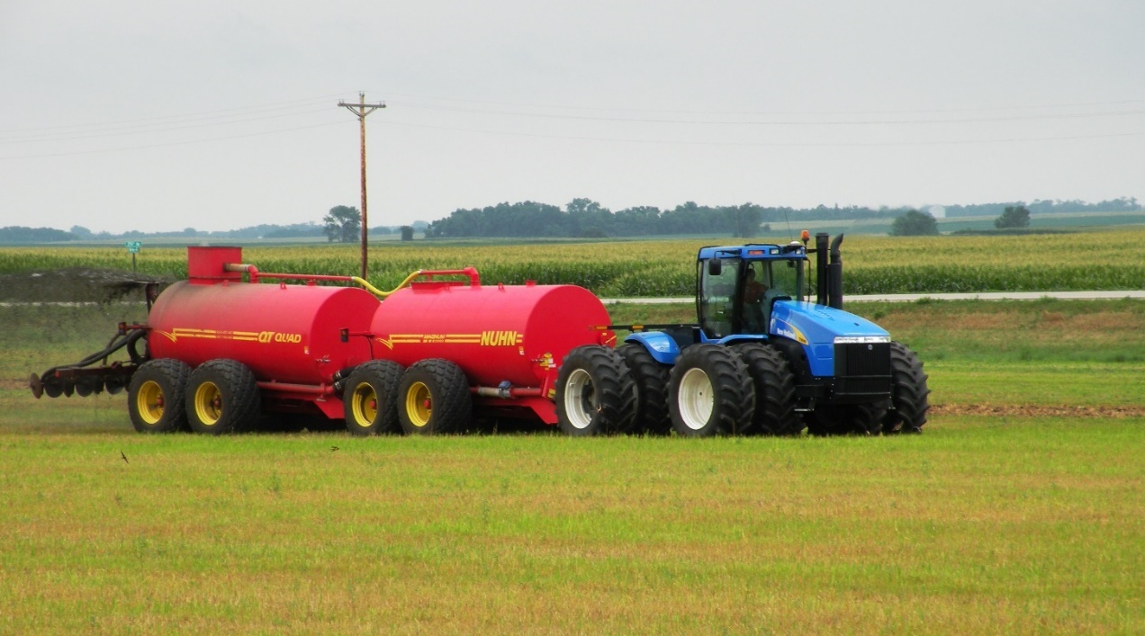
Supporting Crop Yields
Fertility can dip in transition as the soil is beginning to be “fed”
Ensure adequate nutrients to crops during transition
Notes:
Narration: You may find that your soil nutrient levels will dip somewhat during the transition period. This is the time when application of conventional, highly available fertilizers has stopped, but the soil is still just beginning to be “fed” with the organic materials that will build the soil organic matter that promotes long-term stable fertility. During this less-fertile period, you will need to ensure that your crops are provided with adequate supplies of available nutrients in the form of manures and other permitted inputs.
Image: University of Minnesota.

Slide 36
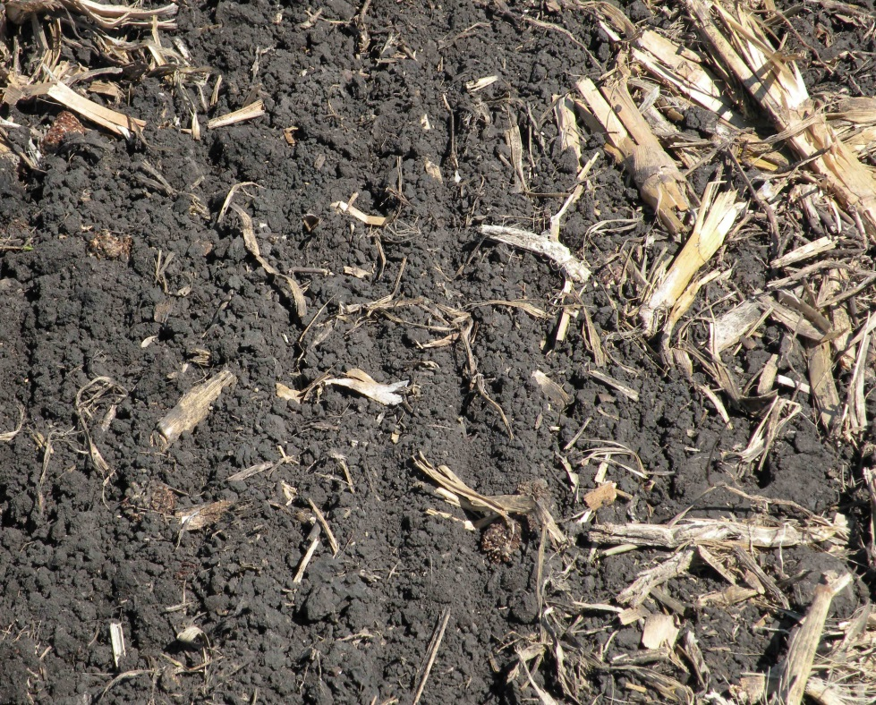
Monitoring Soil Health
Must maintain or improve soil health
Must record outcomes of soil health practices
Track by:
Yield trends
Soil testing
Plant tissue testing
Metrics recommended by your certifier
Notes:
Narration: Your Organic System Plan must describe how you intend to maintain or improve soil health, and the outcomes of your soil health and fertility practices must be recorded. Your certifier may have particular ways that they want you to use to monitor soil health, but you will definitely want to document yield trends in your fields, as well as the results of all soil and plant tissue tests, so that outcomes can be tracked over time.
Image: Craig Sheaffer, University of Minnesota.

Slide 37
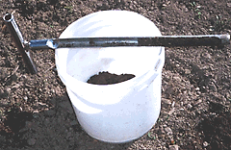
Soil Testing
Helps to determine existing fertility
Can guide crop choice in transition
Monitor fertility throughout transition and afterward
Ensure that practices are improving fertility long-term
Notes:
Narration: Soil testing is a valuable guide during transition. Soil tests will help you determine the baseline fertility that you are starting from, both in terms of nutrient levels and organic matter. With these test results in hand, you can choose crops that are suited to your soil’s nutrient levels, and will contribute to building organic matter. You can continue to monitor soil fertility by testing throughout your transition and afterward, to ensure that your practices are succeeding in improving fertility in the long term.
Photo: John Lamb, University of Minnesota

Slide 38
When and How to Test Soil
Test before planting
Manage nutrient deficiencies proactively
When crop deficiency symptoms appear, yield has already been lost
Notes:
Narration: The best time to test your soil is before planting, so that you can manage any nutrient deficiencies proactively. When you start seeing nutrient deficiency symptoms on your crops, you’ve waited too long—yields will already have been reduced.
Image: Kristine Moncada, University of Minnesota

Slide 39
When and How to Test Soil
Representative sample of field
Divide field into uniform areas (<20 A for level fields; <5 A for hilly)
Collect 15-30 cores in a zigzag pattern across each area
Sample to 6-8 inches
Sampling pattern for rectangular area
Notes:
Narration: To obtain a representative sample of your field, divide it into areas that are relatively uniform. Each area should be no more than about 20 acres on level ground, or 5 acres on hilly or variable land. Submit a sample from each area consisting of 15-30 soil cores taken to a depth of 6-8 inches in a zigzag pattern across the area.
Image: John Lamb, University of Minnesota

Slide 40
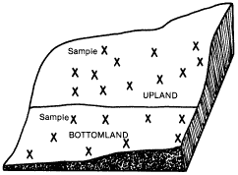
Field Sampling Pattern
Field divided into appropriate areas
Notes:
Narration: An appropriate sampling pattern in the field might look something like this.
Image: John Lamb, University of Minnesota

Slide 41
Finding Appropriate Recommendations
Testing labs
May recommend amendments (lime, minerals) and rates based on test results
Some amendments in organic require tests documenting deficiency
University Extension
Not all recommendations will be appropriate for organic
When in doubt, ask your certifier!
Notes:
Narration: In many cases, the results that soil testing labs provide will include recommendations for nutrient, lime, or other amendment applications. As we mentioned, some amendments are only permitted in organics if you have test results documenting the need for them. The University Extension is also a good source for recommendations for amendments and application rates. However, it’s important to keep in mind that laboratory and University recommendations are rarely targeted specifically to organic farmers, so you must still stay within the bounds of the organic standards. If you have any doubt about whether a recommended application is permitted, ask your certifier.

Slide 42
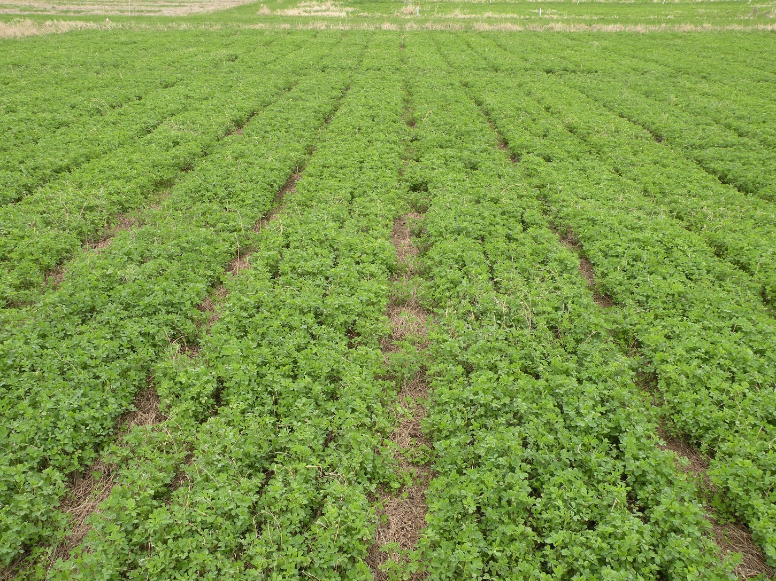
Summary – Soils (Part 1)
Build and maintain soil organic matter
Test to address deficiencies proactively
Check with your certifier!
Notes:
Narration: We hope this module has helped you understand how to build healthy, fertile soils as you transition your farm to organic. Here are some key points to remember: focus on building and maintaining soil organic matter, the foundation of organic fertility. Use soil tests to identify and tackle nutrient deficiencies pro-actively. And, whenever you are uncertain about an input or practice, check in with your certifier.
Image: University of Minnesota

Slide 43
Resources
National List of allowed and prohibited substances for organic farming
List of manure testing labs – Minnesota Department of Agriculture
Field soil sampling instructions – University of Minnesota
Worksheet for calculating manure application – University of Minnesota
Composting instructions – eXtension
Organic Production Guide – ATTRA
Guide to permitted inputs – NRCS
Can I Use this Input on My Organic Farm? – eXtension
Notes:
Narration: Here are some resources you may find helpful to learn more about topics we covered in this module.

Slide 44
Fertility in Organic Systems
Crop nutrition
Organic fertility principles
Meeting organic standards
Building fertility through transition
Notes:
Narration: Thank you for watching! Please continue with the Soils Part 2: Sources of Organic Nutrients module to complete the Soil series.
Image: Kristine Moncada, University of Minnesota

Slide 45
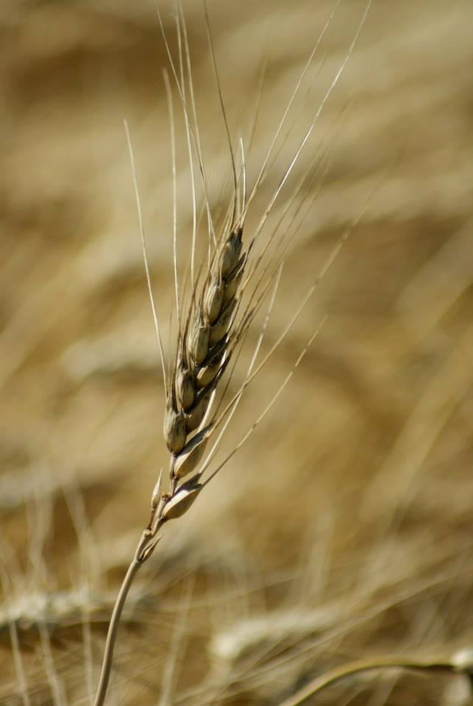
© 2017 Regents of the University of Minnesota. All rights reserved. The University of Minnesota is an equal opportunity educator and employer.
This material is based upon work that is supported by the National Institute of Food and Agriculture, U.S. Department of Agriculture, under grant number 2013-51106-21005.
Notes:
Narration: This material is based upon work that is supported by the National Institute of Food and Agriculture.
Image: Constance Carlson, University of Minnesota

Slide 46
References
Baker, B. 2009. Can I Use this Fertilizer on My Organic Farm? http://www.nrcs.usda.gov/Internet/FSE_DOCUMENTS/nrcs144p2_045863.pdf
Eghball, B., and J. F. Power. 1999. Phosphorus-and nitrogen-based manure and compost applications corn production and soil phosphorus. Soil Science Society of America Journal 63: 895-901.
Evans, J., et al. 2001. Net nitrogen balances for cool-season grain legume crops and contributions to wheat nitrogen uptake: a review. Australian Journal of Experimental Agriculture 41: 347-359.
Fernandez, A. L., C. C. Sheaffer, D. L. Wyse, C. Staley, T. J. Gould, and M. J. Sadowsky. (2016). Associations between soil bacterial community structure and nutrient cycling functions in long-term organic farm soils following cover crop and organic fertilizer amendment. Science of the Total Environment, 566: 949-959.
Kaiser, D., Fernandez, F., Lamb, J.A., Coulter, J.A., and B. Barber, 2016. Fertilizing corn in Minnesota. University of Minnesota Extension AG-FO-3790-D. University of Minnesota, St. Paul, MN.

Slide 47
References (cont.)
Kumar, K., and M. G. Kuan. 2000. Biological nitrogen fixation, accumulation of soil nitrogen and nitrogen balance for white clover (Trifolium repens L.) and field pea (Pisum sativum L.) grown for seed. Field Crops Research 68: 49-59.
Lamb, J., S. Huerd, and K. Moncada. 2010. Soil Health. Chapter 3 in Risk Management for Organic Producers. Moncada, K. and C. Sheaffer, editors. University of Minnesota, St. Paul, MN.
Lamb, J., C. Sheaffer, and K. Moncada. 2010. Soil Fertility. Chapter 4 in Risk Management for Organic Producers. Moncada, K. and C. Sheaffer, editors. University of Minnesota, St. Paul, MN.
Peterson, T. A, and M. P. Russelle. 1991. Alfalfa and the nitrogen cycle in the Corn Belt. Journal of Soil and Water Conservation 46: 229-235.
USDA-AMS. 2017. National Organic Program. 7 C.F.R. §205.

