Slide 1
Small Grains
This material is based upon work that is supported by the National Institute of Food and Agriculture, U.S. Department of Agriculture, under grant number 2013-51106-21005.
Authors
Nicole Tautges
Kristine Moncada
Constance Carlson
Craig Sheaffer
For Organic Systems
Notes:
Narration: Welcome to Small Grains for Organic Systems module.
Image: David L. Hansen, University of Minnesota

Slide 2
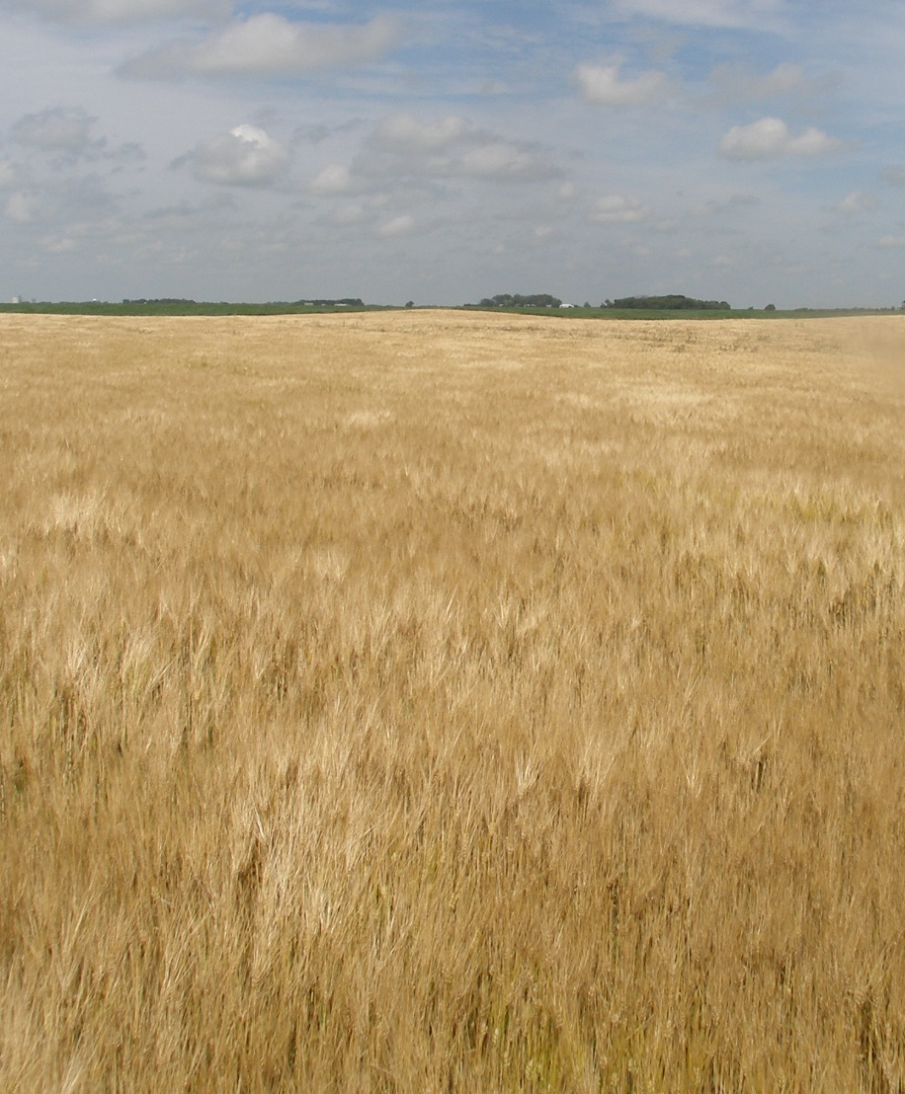
Small Grains
Introduction
Planting
Weed management
Disease management
Insect pest management
Fertility management
Harvest and storage
Marketing
Notes:
Narration: Many organic farmers find small grains to be a beneficial addition to their rotations. In this module we will discuss growing small grains organically in the Upper Midwest.
Image: Carmen Fernholz

Slide 3
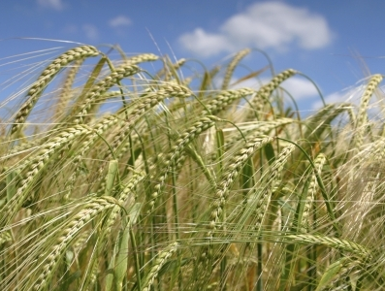
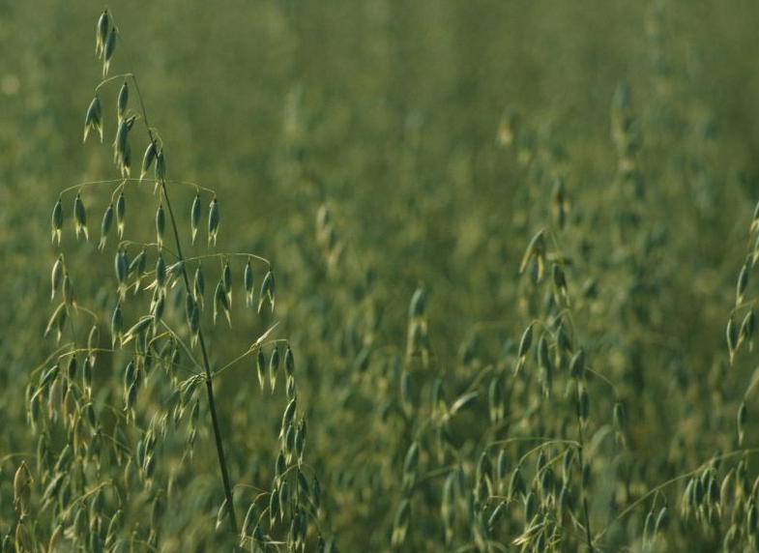
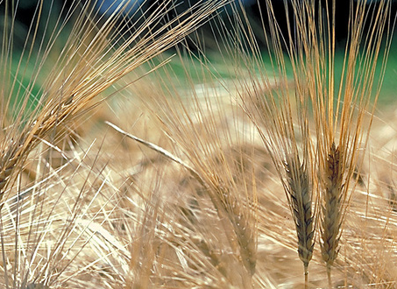
Small Grains in the Midwest
RYE
(Secale cereale)
WHEAT
(Triticum aestivum)
OAT
(Avena sativa)
BARLEY
(Hordeum vulgare)
Notes:
Narration: The most common small grains grown in the Midwest are rye, wheat, oats, and barley. While these small grains look similar, management practices, quality considerations, and marketing differ markedly among small grains species.
Images: David L. Hansen, University of Minnesota (oat, wheat); USDA (rye, barley)

Slide 4
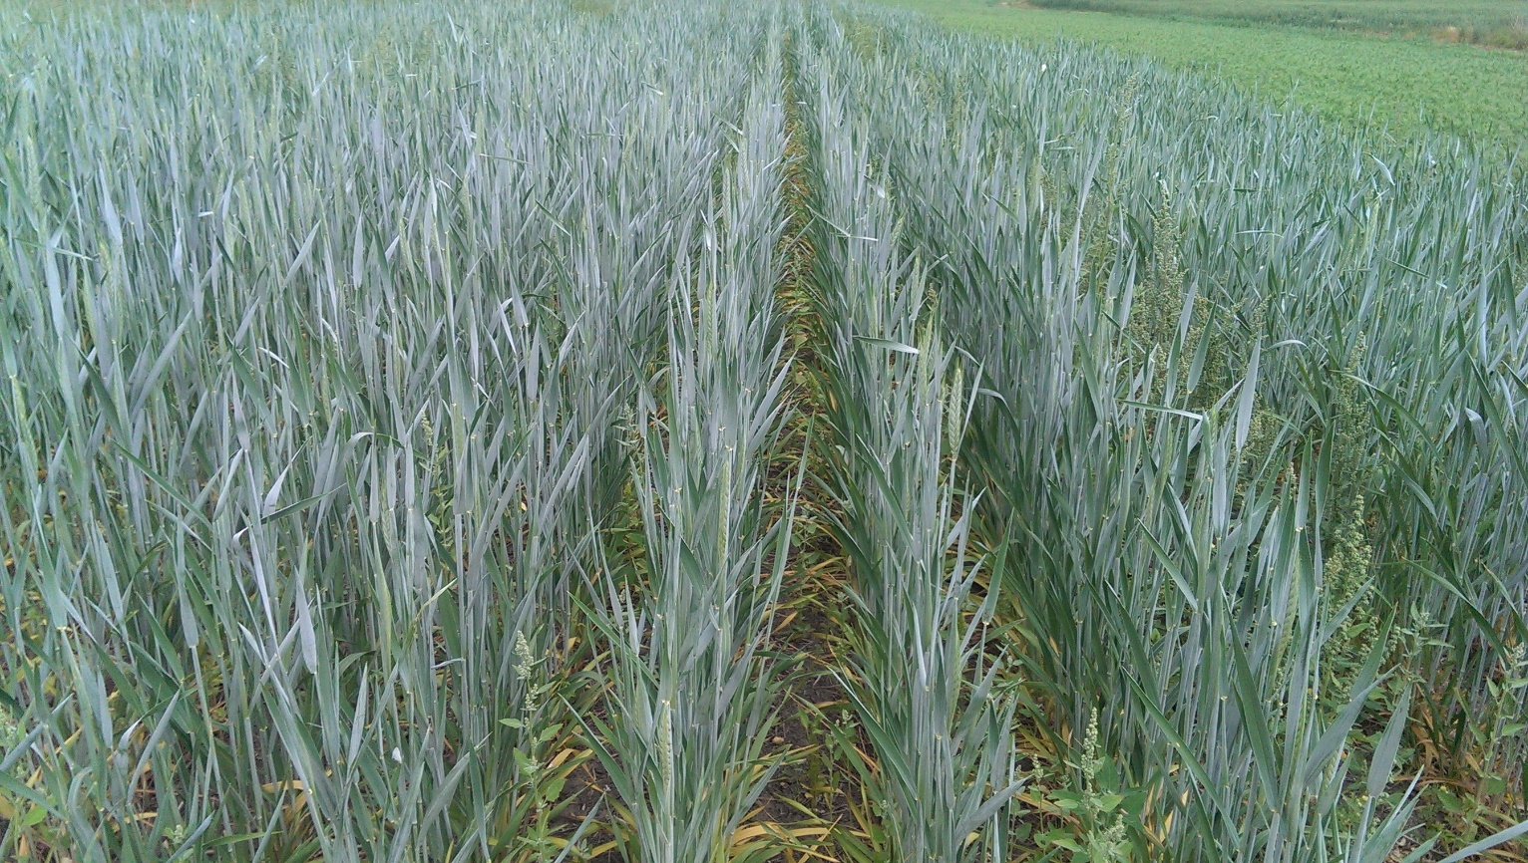
Small Grains in the Midwest
TRITICALE
(x Triticosecale)
Notes:
Narration: In addition to these commonly grown small grains, triticale is a newer small grain crop, and is the product of a man-made cross between rye and wheat. Triticale grain makes good poultry feed, and is also popular for forage production, whether cut fresh and ensiled or hayed. Triticale is useful in organic systems due to its high biomass production, forage quality, and competitiveness with weeds.
Image: N.E. Tautges, University of Minnesota

Slide 5
Why Include Small Grains in Transition to Organic Systems?
A. Diverse marketing opportunities
Notes:
Narration: Small grains can be very useful, from an agronomic standpoint, in transition-to-organic crop rotations. There are a number of end uses for small grains, especially wheat, which can be milled into flour for baking many food products. While rye, barley, and oats are usually used for lower-value animal feed, food-grade markets may be available for organic and transitioning grains. Also, within each of the small grain species, growers should consider the variety that is appropriate for the target market or end-use.
Image: David L. Hansen, University of Minnesota

Slide 6
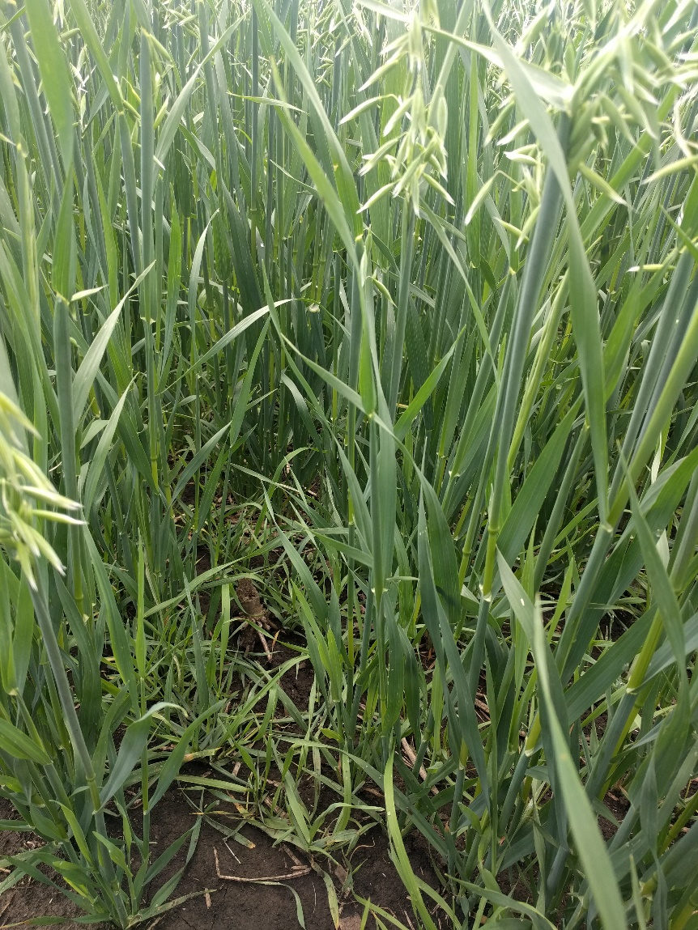
Why Include Small Grains in Transition to Organic Systems?
B. Weed control
C. Soil organic matter building
Notes:
Narration: The competitiveness of small grains with weeds is very important for transitioning systems, where there is a learning curve associated with organic weed management, and it is important to keep weed pressure low to insure success once the land is certified. Small grains, especially when fall-sown, accumulate high levels of biomass, which is a benefit for building soil organic matter and improving soil quality, important goals of transitioning systems. Selecting the right species for your rotation will involve consideration of marketing, weed competitiveness needs, and residue management strategies.
Image: N.E. Tautges, University of Minnesota

Slide 7
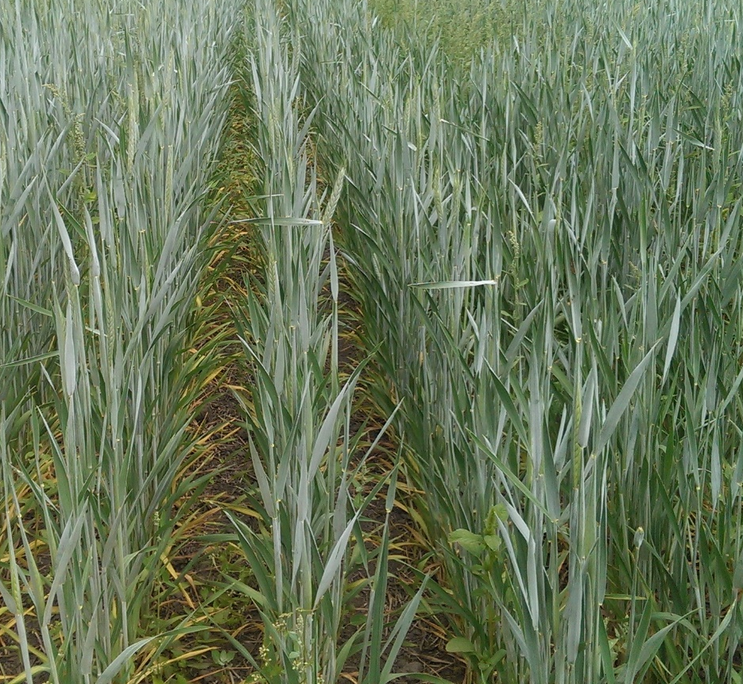
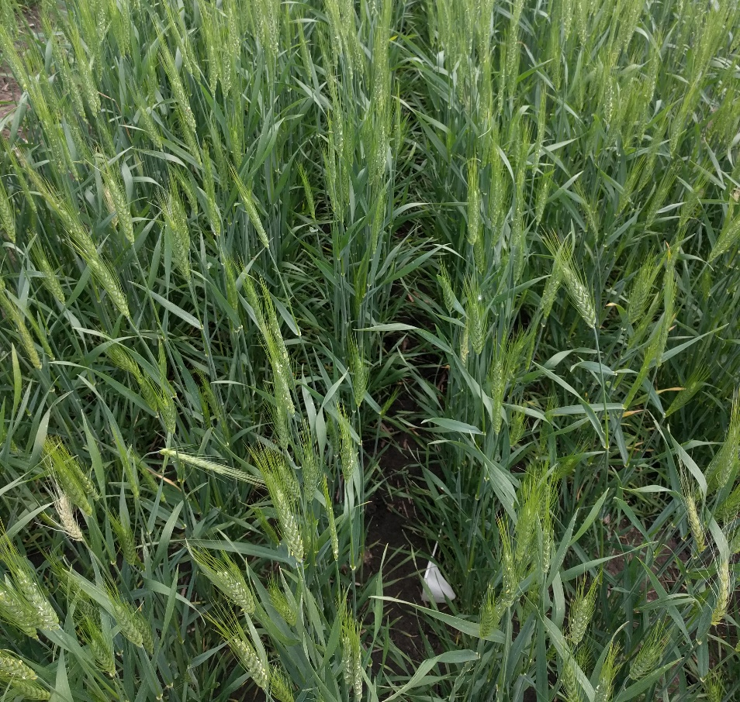
Small Grains Competitiveness with Weeds
Rye = triticale > barley = oat > wheat
Triticale
Wheat
Notes:
Narration: Small grains can be very useful in transition to organic rotations, due to their superior competitiveness with weeds compared with other crops. However, there are differences in competitiveness among small grain crop species. Generally, rye (and triticale) are considered the most competitive with weeds, followed by barley and oats, followed by wheat as the least competitive with weeds. Rye is believed to have allelopathic properties.
Images: N.E. Tautges, University of Minnesota

Slide 8
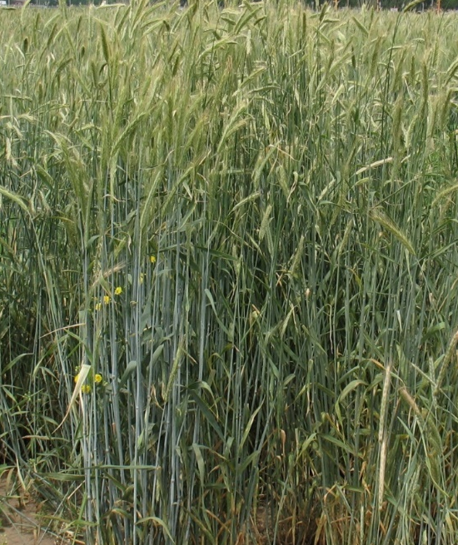
Allelopathy
Rye
The ability of a plant to produce biochemical that can affect germination, growth, survival, and reproduction of other plants
Weed
Allelochemicals
Roots secrete allelochemicals
Notes:
Narration: Allelopathy (Al-le-la-pathy) is the ability of a plant to produce biochemicals that can affect the germination, growth, survival, and reproduction of other plants. In this case, rye’s allelopathic properties can be exploited to reduce weed pressure in transitioning systems. Other small grains like barley have also demonstrated allelopathic potential. Regardless, the rapid germination and growth of small grain species makes them highly competitive with weeds. Increasing the seeding rate by up to 1.5 times the normal rate is recommended for increasing small grain competitiveness with weeds.
Image: N.E. Tautges, University of Minnesota

Slide 9
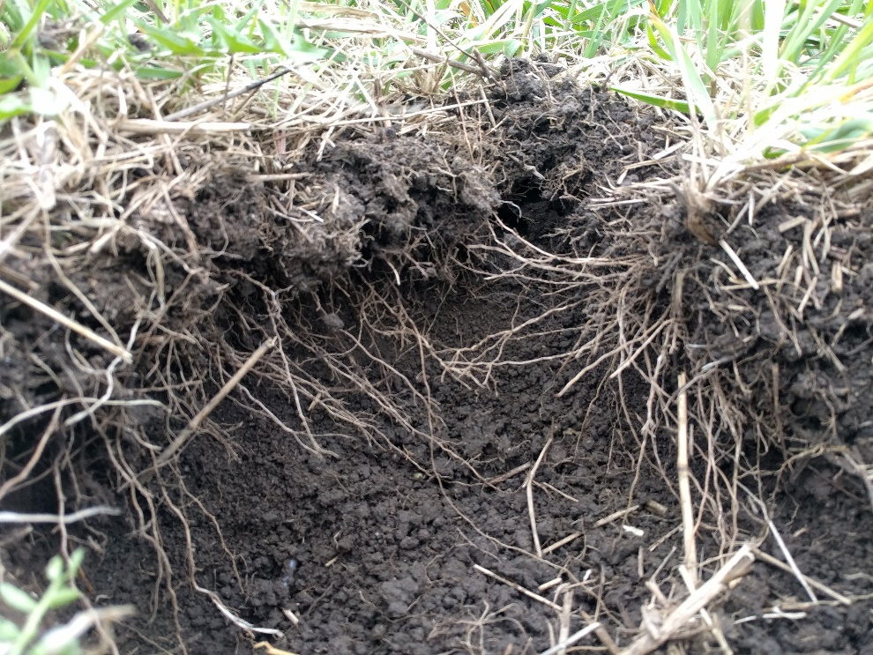
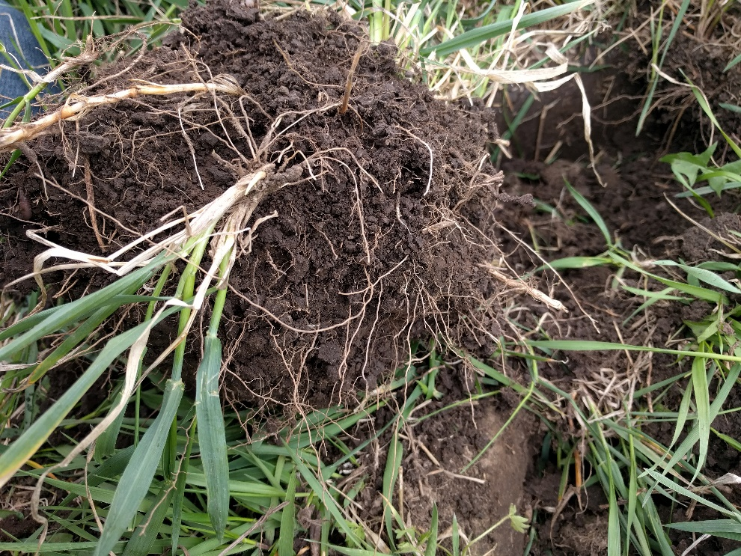
Soil Organic Matter Building with Small Grains
Greater contributions to soil organic matter
Nutrients requirements lower than corn
Notes:
Narration: Building up soil organic matter levels, which are generally lower in conventional systems, is extremely important during the transition to organic period. As organic-approved fertilizer inputs generally release nutrients more slowly than conventional chemical fertilizers, it is important to have a stock of nutrients already within soils, stored in soil organic matter. Small grains have fibrous root systems, which contribute to soil organic matter to a much greater extent than larger roots like those of corn and soybean. Therefore, by including small grains in organic rotations, you can “bank” nutrients more effectively for future crops than other crops can. Furthermore, nutrient requirements of small grains are generally lower than those of corn.
Images: N.E. Tautges, University of Minnesota

Slide 10
Small Grains
Introduction
Planting
Weed management
Disease management
Insect pest management
Fertility management
Harvest and storage
Marketing
Notes:
Narration: We will start our discussion of organic small grains production with planting.
Image: Carmen Fernholz

Slide 11
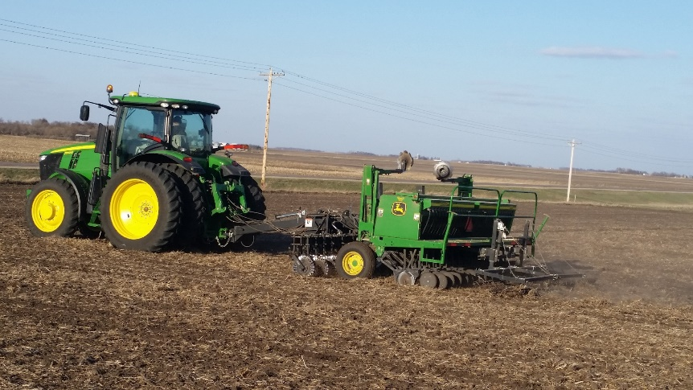
Planting Small Grains
1.5 – 2 inch depth
Winter grains will benefit being planted into stubble
Avoid planting after another grass crop
Notes:
Narration: Small grains are generally planted with a grain drill. Small grains should be planted at a depth of 1.5 to 2 inches into a uniform, level seedbed to maximize emergence and stand uniformity. Planting winter grains into standing stubble or residue protects small grain plants from wind and ice and greatly decreases the risk of winterkill. It is also advisable to plant small grains in rotation after a legume or brassica crop rather than following a grass crop like corn, to decrease disease pressure and nutrient input requirements.
Image: Carmen Fernholz

Slide 12
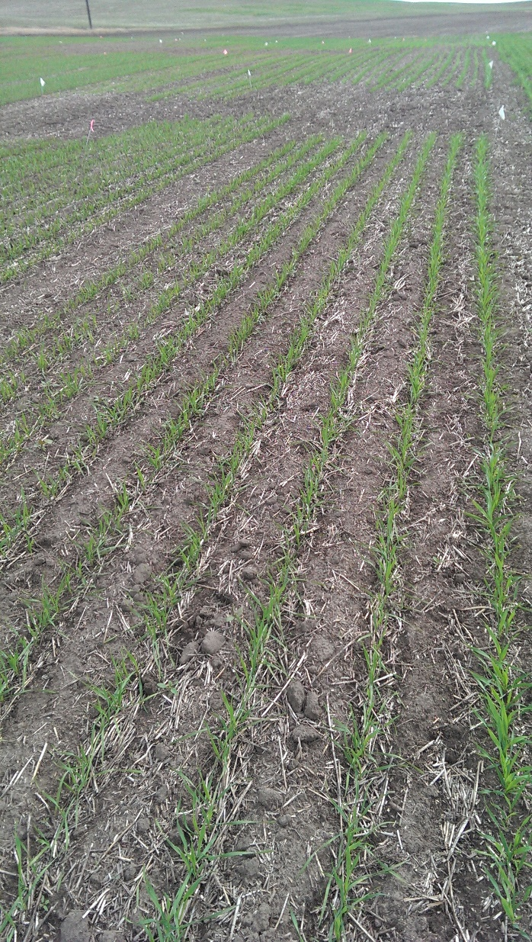
Row Spacing
Narrow row spacing increases crop competition
Decreases weed pressure
As narrow as 6”
Notes:
Narration: It is recommended for organically managed small grains that row spacing be kept narrow to increase crop competition with weeds. Many have observed this practice to decrease weed pressure and increase grain yields. Some organic farmers in our region have been successful with spacing as narrow as 6 inches.
Image: N.E. Tautges, University of Minnesota

Slide 13
High Seeding Rates for Organic
Small Grain Spp. | Conventional Seeding Rates
Barley, Oat, Winter Wheat | 150 to 200 lb/acre
Rye | 120 to 175 lb/acre
Triticale (winter) | 140 to 190 lb/acre
Triticale (spring) | 175 to 250 lb/acre
Wheat (spring) | 175 to 225 lb/acre
Notes:
Narration: Seeding rates differ among small grain species. Seeding rates identified for conventional systems using a 7-inch row spacing are shown here. Organic growers should seed at the higher end of these ranges and follow recommendations according to specific variety recommendations. Spring-planted grain seeding rates are generally greater than fall-planted rates.

Slide 14
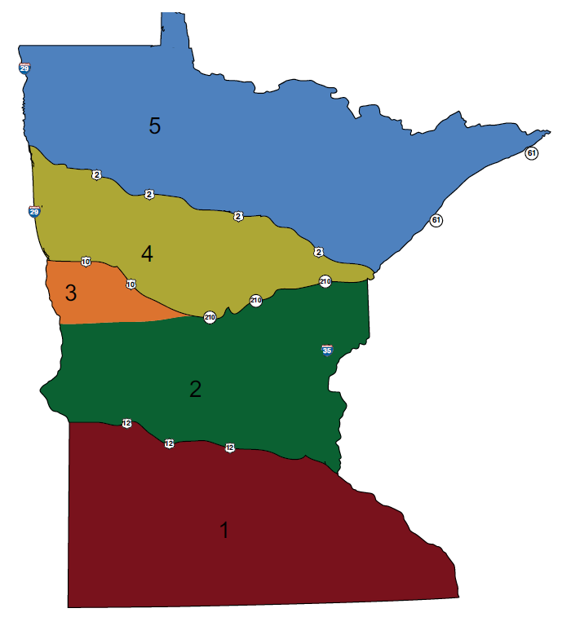
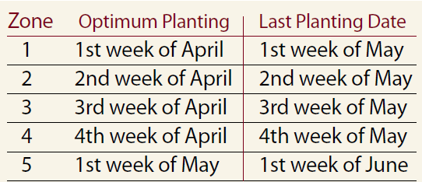
Spring Grains –
Seeding Date
Wiersma, et al, 2010.
Notes:
Narration: For spring grains, optimum planting dates are shown here for the state of Minnesota, and typically, it is recommended that spring grains be planted as early as possible to avoid hot summer temperatures and to maximize yields. Planting later than the last planting dates shown here will likely result in yield loss. Delayed planting as a weed management tactic should not be used for small grains. For those of you in other parts of the region, follow local extension recommendation for planting.

Slide 15
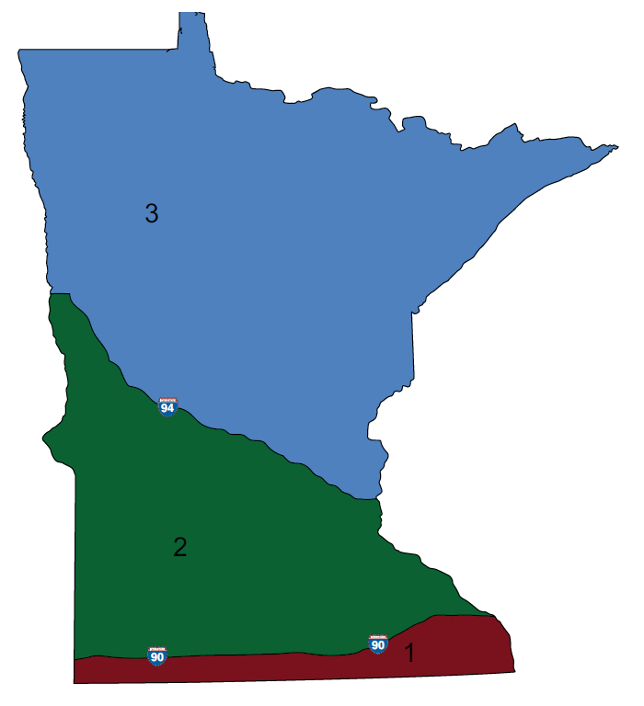
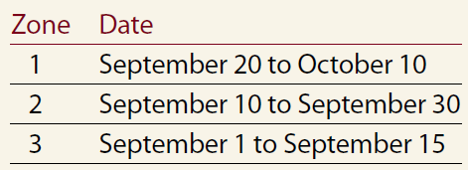
Fall Grains – Seeding Date
Wiersma, et al, 2010.
Notes:
Narration: Planting at the proper time is essential for prevention of disease and yield loss. Winter rye, triticale, and wheat should be planted between September 20th and October 10th in northern Minnesota, September 10th to 30th in central to southern Minnesota, and September 1st to September 15th in areas south of Rochester. Planting earlier than these recommended dates increases risk of disease.

Slide 16
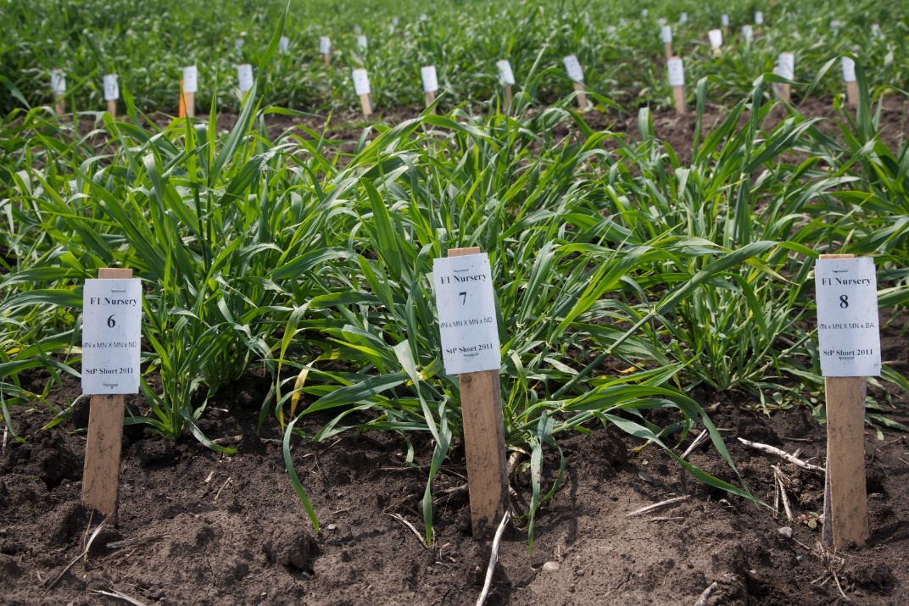
Variety Selection
Emphasis on:
Early maturing
Disease resistance
Grain quality
Winter hardiness
Locally-tested and verified
Notes:
Narration: Variety selection is important for all crops planted on a farm. Seed is an investment and purposefully selecting a variety to fit your farm’s needs will provide the best return on your seed investment. Small grain varieties should be selected on the basis of early maturity, disease resistance, and grain quality. While yield is important, high yields but low quality can decrease returns. Winter grains should be selected on the basis of proven winter hardiness in your region. Seeking out certified seed will decrease the risk of weed seed contamination during crop establishment. Always be sure to use organic-approved seed, and check with your certifier.
Image: David L. Hansen, University of Minnesota

Slide 17
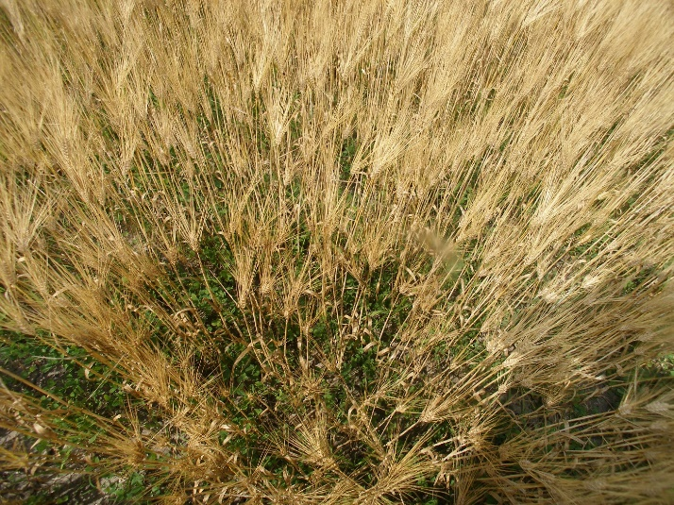
Alternative Establishment Strategies:
Underseeding
Underseed with red clover
Notes:
Narration: Another option for organic small grains cultivation is to underseed with a legume like red clover. The red clover can be mowed for forage or for weed control, or grazed after small grain harvest. Using a straight-point chisel in red clover in the fall will set red clover back and prevent too heavy of clover pressure and competitiveness with your cash crop in the spring.
Image: Carmen Fernholz

Slide 18
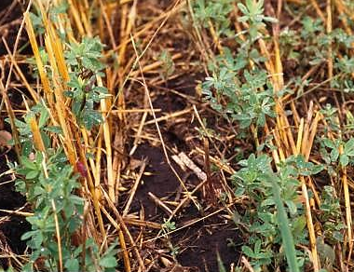
Alternative Establishment Strategies:
Underseeding/Nurse Crop
Underseed as nurse/ companion crop for alfalfa establishment
Notes:
Narration: A grower planning on following a small grain with alfalfa, a great crop for the transition period, can drill alfalfa at a depth of a ¼ inch with winter or spring grains. This practice decreases weed pressure during the small grain phase and the establishing alfalfa phase, where weed pressure can be a challenge. The small grain crop can be harvested over the top of the alfalfa, which will then be left to grow for subsequent years of the rotation.
Image: Craig Sheaffer, University of Minnesota

Slide 19
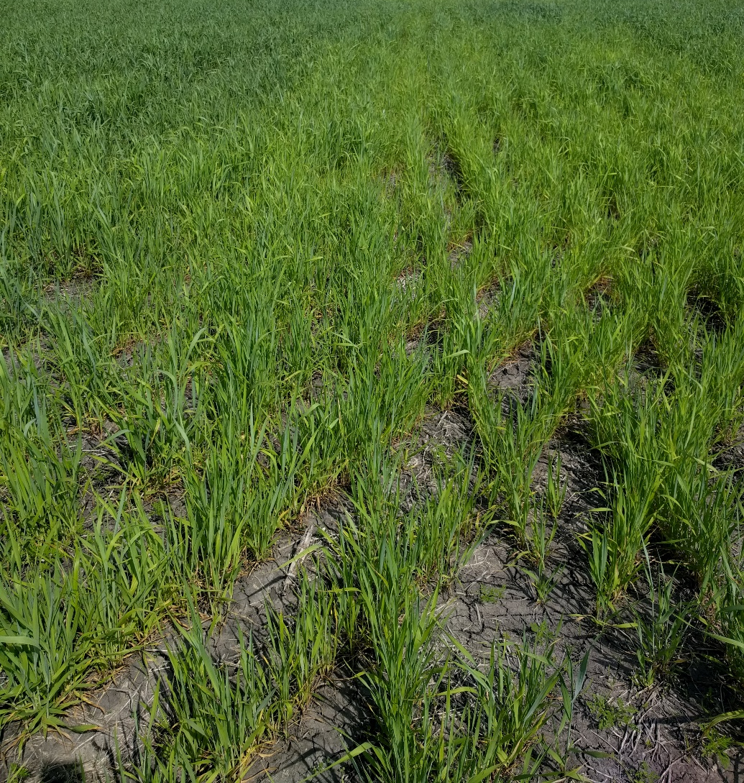
Alternative Establishment Strategies:
Double/Cross Planting
Plant with double passes at 45 or 90 degree angles
Notes:
Narration: Organic management often requires out-of-the-box strategies to increase crop competitiveness with weeds. Some organic growers will drill small grains twice across the field, with rows at 45- or 90-degree angles, to increase crop plant density. Organic growers report that this practice usually decreases weed pressure.
Image: N.E. Tautges, University of Minnesota

Slide 20
Small Grains
Introduction
Planting
Weed management
Disease management
Insect pest management
Fertility management
Harvest and storage
Marketing
Notes:
Narration: While small grains are more competitive against weeds compared to many other crops, it doesn’t mean problems with weeds will never occur!
Image: Carmen Fernholz

Slide 21
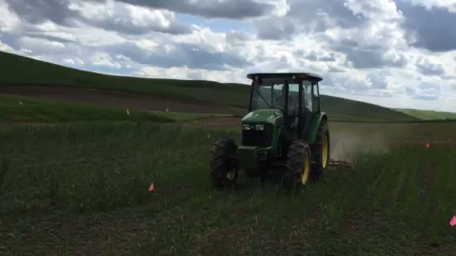
Tine Weeder in Small Grains
Notes:
Narration: It may be necessary to control weeds post-emergence in small grain stands. A tine weeder is a popular implement for this task, and can be used to uproot small-seeded weeds without uprooting the crop, if proper depth and down-pressure settings are used. Tine weeders work best in loose or lightly crusted soil without long-stemmed residue1, and can be used until small grains are jointing, after which weeding should be avoided as to not damage the growing point. They are normally operated between 4 and 8 mph1. Harrows are similar to tine weeders, but can be more aggressive and cause crop damage.
Video: N.E. Tautges, University of Minnesota

Slide 22
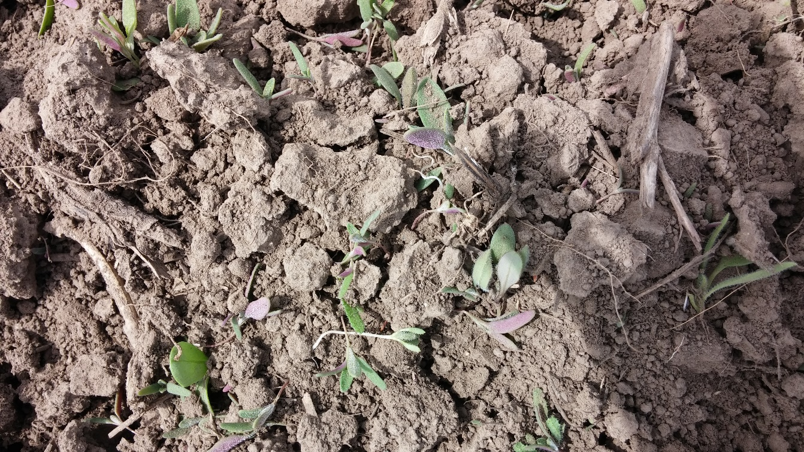
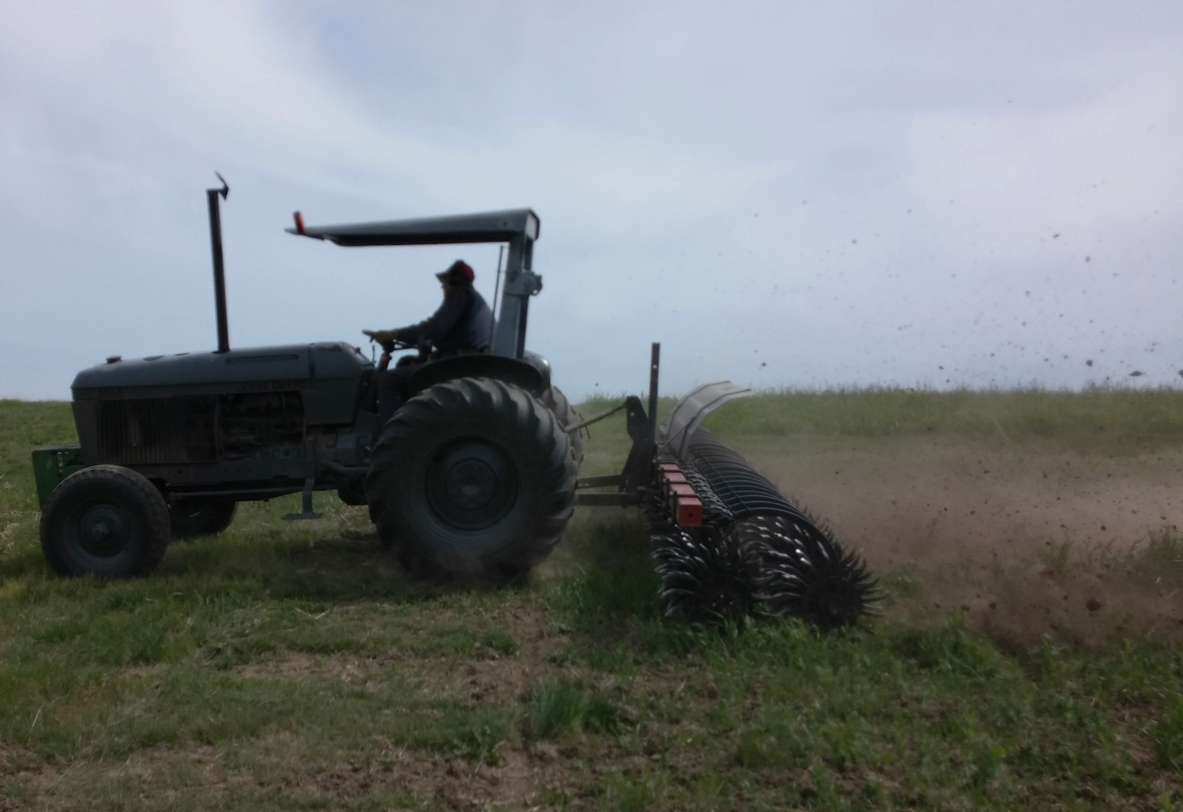
Rotary Hoe in Small Grains
Notes:
Narration: Rotary hoes are another postemergence weeding implement popular for organic systems. Rotary hoes are generally operated at speeds from 5 to 15 mph, with surface aggressiveness increasing and soil penetration decreasing as speeds increase. They can also be used to aerate crusted soils. Some growers will use both tine weeders and rotary hoes in the same crop, as they have different weeding actions that are effective for different weed species.
Images: N.E. Tautges, University of Minnesota

Slide 23
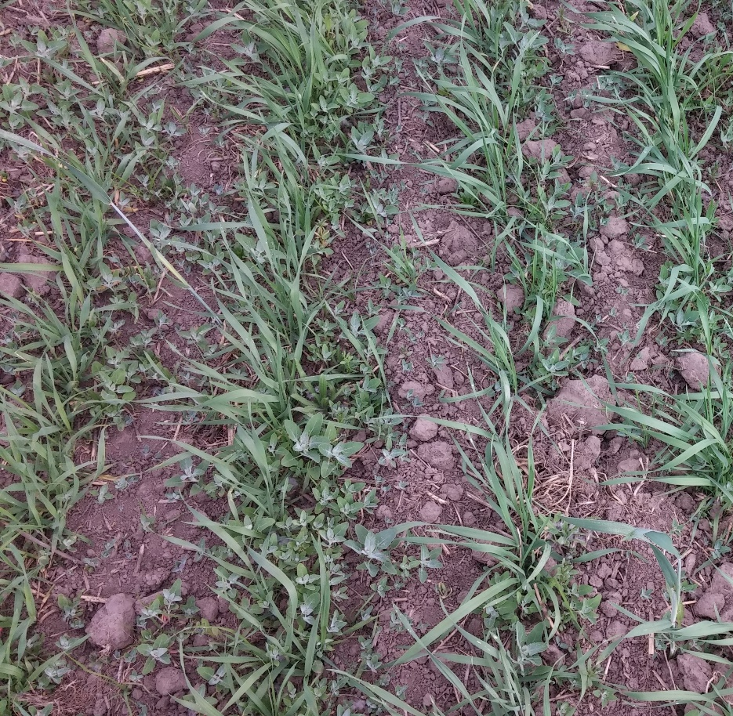
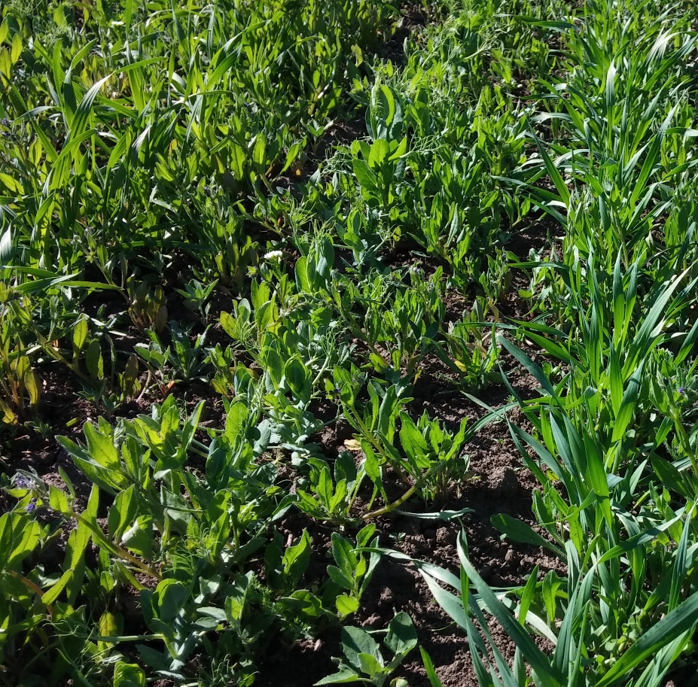
Timing of Mechanical Weeding
Weed size possible to control with post-emergence tillage
Weeds too large for
post-emergence tillage
Notes:
Narration: Timing of postemergence weeding is crucial for effectiveness. Tine weeders and rotary hoes should be used when soil is moist enough for penetration but not moist enough for compaction to occur. These implements are most effective when weeds are just emerging, and are not effective when weed roots have developed. However, if performed with the right timing, these implements can greatly decrease weed pressure and benefit crop yields.
Images: N.E. Tautges, University of Minnesota

Slide 24
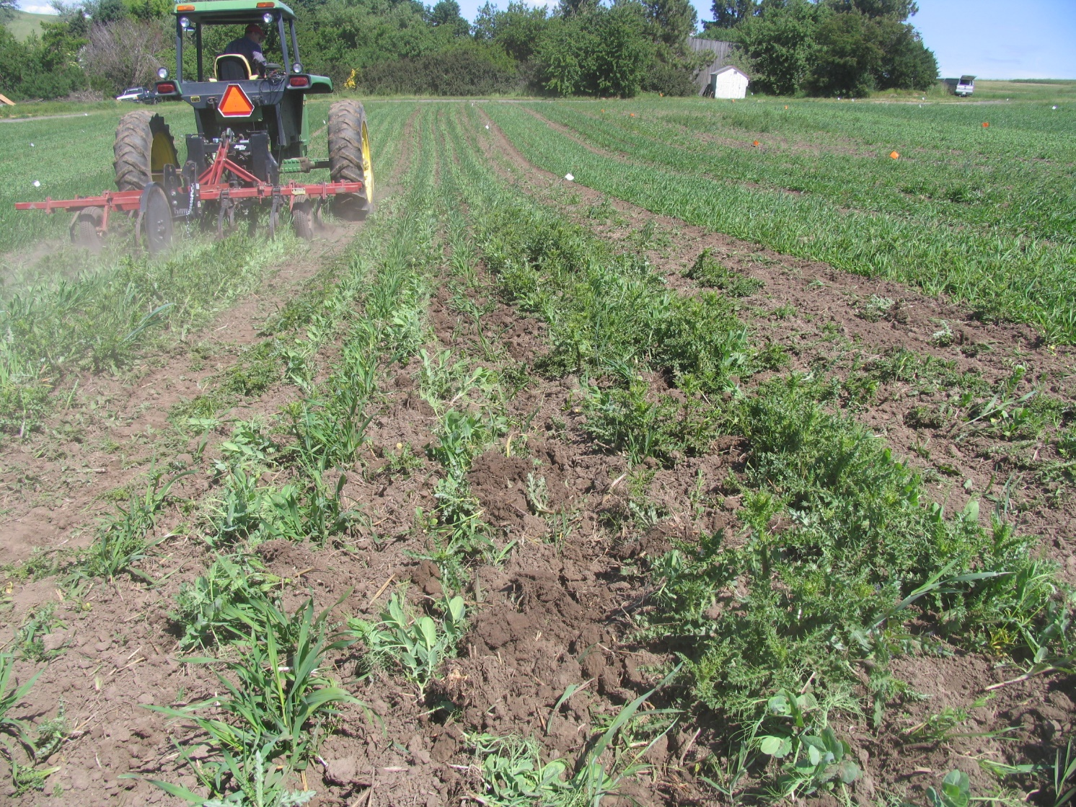
Test Weeding Implements First!
Crop damage from mechanical weeding operation
Notes:
Narration: Test passes should be performed on a small corner of each field to adjust settings depending on soil firmness and crop and weed response to tine pressure. Any implement used for postemergence weed control should be tested at the intended operating speed in a small area of the field and adjusted, so as not to cause crop damage throughout the entire field.
Image: N.E. Tautges, University of Minnesota

Slide 25
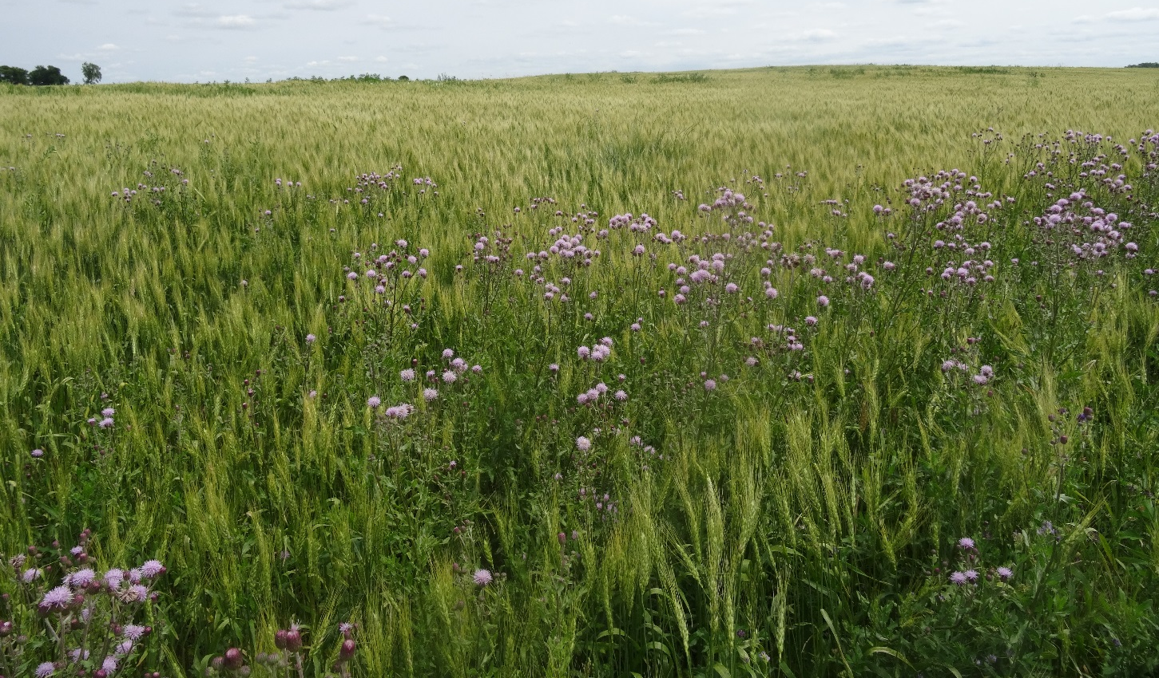
Perennial Weeds
Notes:
Narration: Perennial weeds like Canada thistle are often the most troublesome weeds for organic growers, especially in small grain crops. High densities of perennials like Canada thistle can cause yield losses of up to 90%. Repeated mowing or aggressive tillage (like a rototiller) performed bimonthly in perennial weed patches can alleviate pressure over the course of two to three years, but require large time investments. If possible, establishment of a perennial crop like alfalfa will increase crop competition with perennial weeds and may reduce pressure for subsequent grain crops in rotation.
Image: Kristine Moncada, University of Minnesota

Slide 26
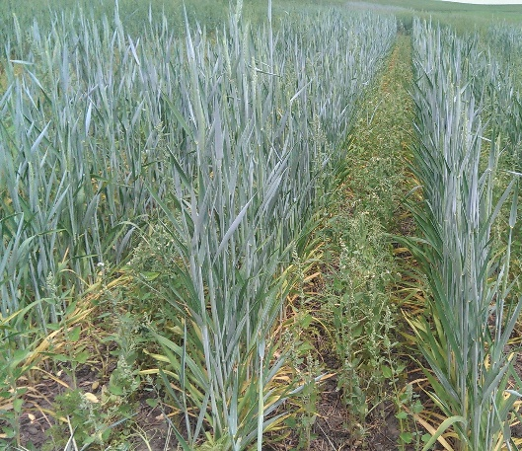
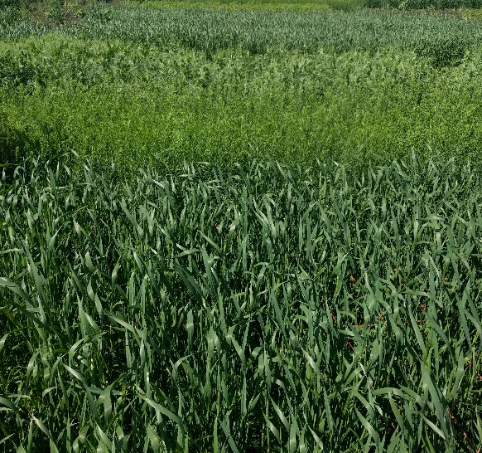
Crop Rotation for
Pest Management
Notes:
Narration: Using diverse rotations that mix crops with different life cycles (like perennial vs. annual), different planting times (like winter vs. spring crops), and different harvest cycles (like mowing for forage vs. harvesting grain) is the best way to prevent weed, disease, and insect pressure from building up, and is highly encouraged in organic systems. Without the ability to use pesticides, prevention is key in organic systems.
Images: N.E. Tautges, University of Minnesota

Slide 27
Small Grains
Introduction
Planting
Weed management
Disease management
Insect pest management
Fertility management
Harvest and storage
Marketing
Notes:
Narration: There are different diseases that can affect small grains. In this section, we will cover a few of them briefly.
Image: Carmen Fernholz

Slide 28
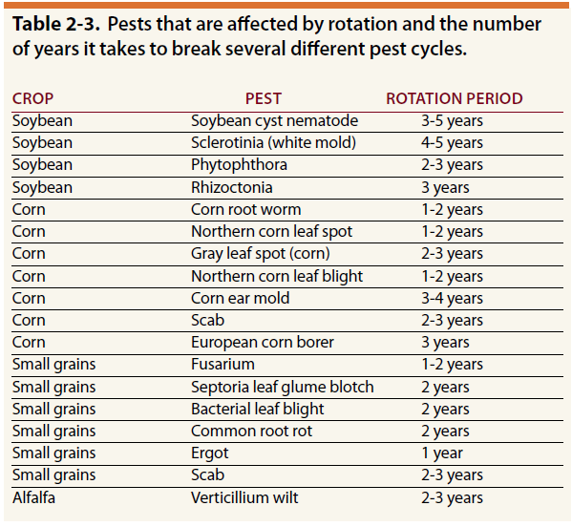
Managing Diseases with Rotation
Wiersma, et al, 2010.
Notes:
Narration: Research has been done on several pests and how long they persist in fields without their hosts. Here are just a few examples. With the exception of scab, most small grain diseases fail to persist in a field without a small grain host after 2 years, meaning that 2 years of crop rotation away from small grain cultivation should be sufficient to keep disease pressure low. However, rotating to a different crop alone is not sufficient; producers must understand which crops can serve as hosts to which diseases, and avoid growing these crops adjacent in rotations.

Slide 29
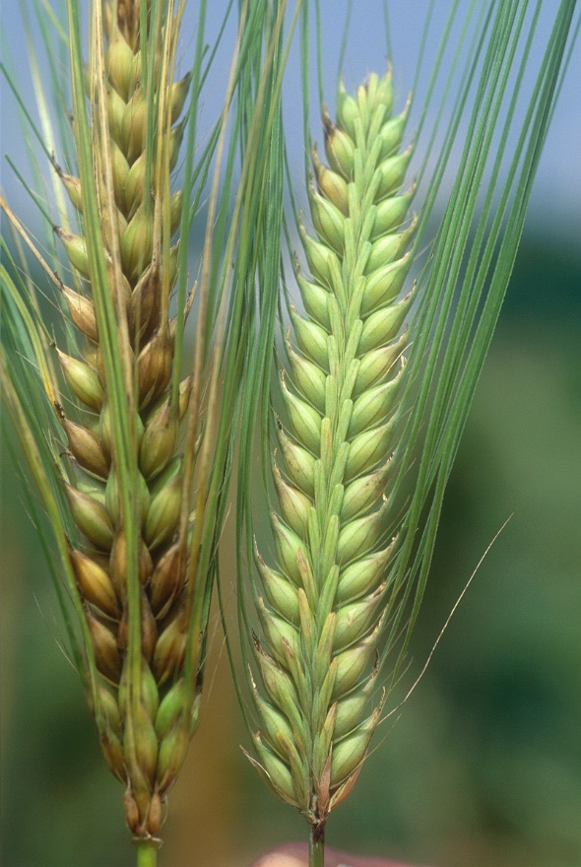
Managing Diseases with Rotation
Healthy resistant barley (right) and susceptible barley showing symptoms of Fusarium head blight (left).
Notes:
Narration: For example, Fusarium, the fungus that causes Fusarium Head Blight, can overwinter in corn or other warm-season grass residues. In general, growers should avoid growing small grains after corn, sudangrass, millet, and other small grains in rotation. Growers should grow small grains after pea, sunflower, alfalfa, soybean, or other legume crops.
Image: Brian Steffenson, University of Minnesota

Slide 30
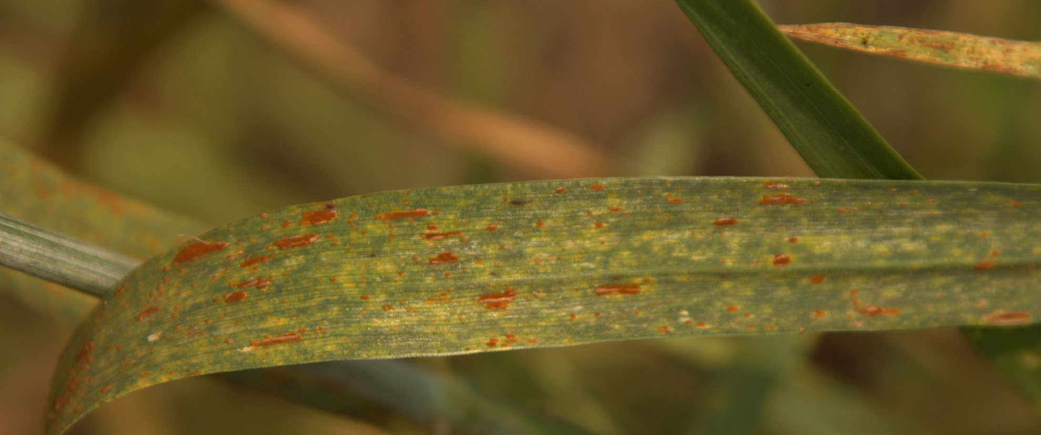
Fungal Diseases
Rust
Notes:
Narration: Fungal diseases are generally the most troublesome in small grain production. The rusts reduce yields by reducing the photosynthetic leaf area of the plant, and by increasing plant water loss. In other regions, spores overwinter on straw and can infect subsequent crops by dispersing from the straw, but do not generally survive the winter in Minnesota. Spores of the fungus that causes rust are usually brought to Minnesota via wind. Rust-resistant varieties are available and should be selected if a grower has observed rust on their farm in the past. Growers should rotate rust-resistant varieties, as resistance in one variety can break down under heavy disease pressure.
Image: Brad Kinkaid, University of Minnesota

Slide 31
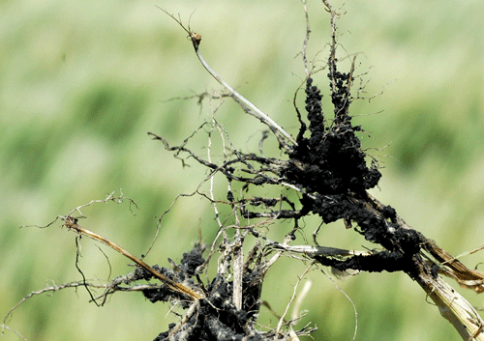
Fungal Diseases
Healthy Root
Root Rot
Diseased Root
Michael McMullen, North Dakota State University
Notes:
Narration: Root rots have also been observed in Minnesota wheat, caused by a number of soil-borne fungi. Plants infected with root rots often occur in patches and are easily pulled from the soil. Root rot causes moisture and nutrient stress in plants, and reduces grain yields, sometimes causing wheat heads to be white and empty of filled grain. Currently, rotation is recommended to limit root rot in wheat and barley crops in Minnesota—do not plant small grains into small grain stubble or unburied residue. Ensure seed saved from small grain crops for later planting comes from fields where no disease was observed.
Image: Michael McMullen, North Dakota State University

Slide 32
Small Grains
Introduction
Planting
Weed management
Disease management
Insect pest management
Fertility management
Harvest and storage
Marketing
Notes:
Narration: The last type of small grains pest we will cover are insect pests.
Image: Carmen Fernholz

Slide 33
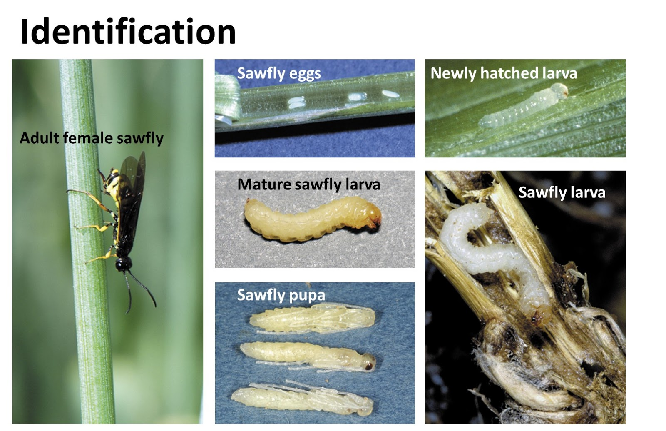
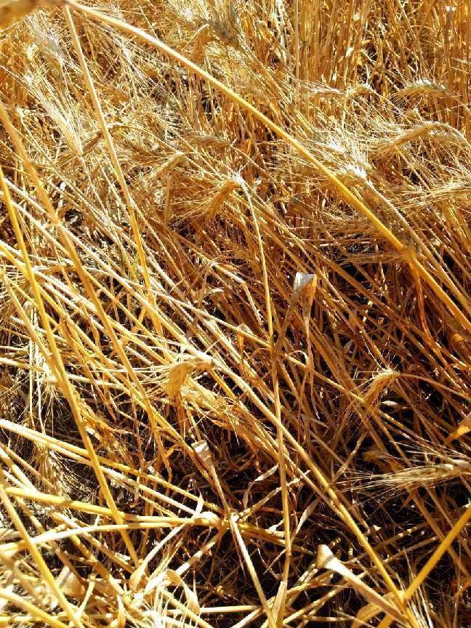
Insect Pests
Lodged wheat stems from wheat stem sawfly
Phil Glogoza, University of Minnesota Extension
Notes:
Narration: Wheat stem sawfly and Hessian fly are the two most common insect pests in small grains, especially wheat in Minnesota. In organic systems, fly pest pressure is usually prevented by using long rotations, similar to those used to prevent diseases, and with resistant varieties. Wheat stem sawflies usually damage wheat the most, as their name suggests, and cause less damage in barley and oat. In wheat, larvae hatched from eggs laid inside the wheat stem hatch and chew around the inside of wheat stem, causing lodging or breakage.
Images: Phil Glogoza, University of Minnesota Extension

Slide 34
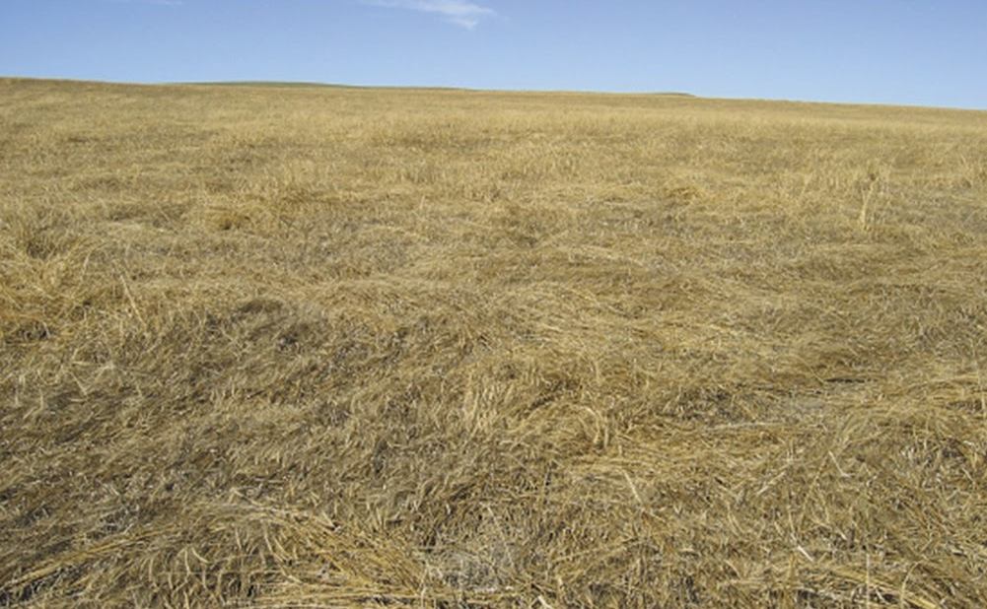
Wheat Stem Sawfly
Lodged wheat stems from wheat stem sawfly damage
Phil Glogoza, University of Minnesota Extension
Notes:
Narration: Detection and scouting for wheat stem sawflies can be performed by sampling wheat stems around a field, paying attention to the field edges where insect pressure often occurs. Stems can be split open and the percentage containing S-shaped sawfly larvae calculated1. If infestation levels exceed 15%, producers can use a stripper header to pick lodged stems up from the ground at harvest.
Images: Phil Glogoza, University of Minnesota Extension

Slide 35
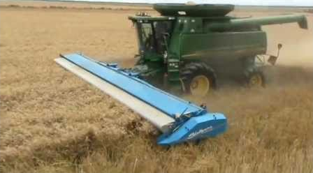
Wheat Stem Sawfly
Notes:
Narration: Stripper headers can also leave taller stubble, which is beneficial for parasitic wasps that can serve as a biological control for wheat stem sawfly. Some solid-stemmed wheat varieties are resistant to sawfly and also support parasitoid wasps, which can be beneficial for controlling sawfly. If you wish to use a hollow-stem variety but know that sawflies will be present, plant a solid-stemmed variety of wheat around the edge of your field as a trap crop.
Image: N.E. Tautges, University of Minnesota

Slide 36
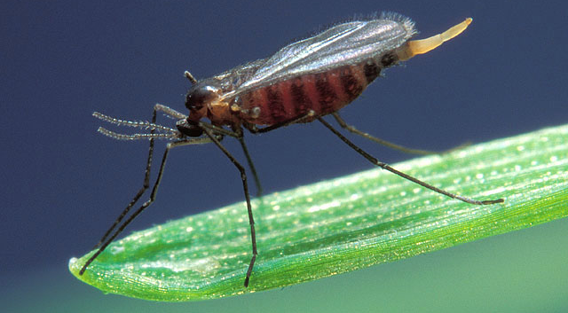
Hessian Fly
Notes:
Narration: Hessian flies are a pest that often causes damage to winter wheat in Minnesota. The best way to prevent Hessian fly infestation is to practice good crop rotation and destroy small grain volunteers in other crop phases of a rotation prior to planting winter wheat, as they can harbor the Hessian fly.
Image: Scott Bauer, USDA-ARS

Slide 37
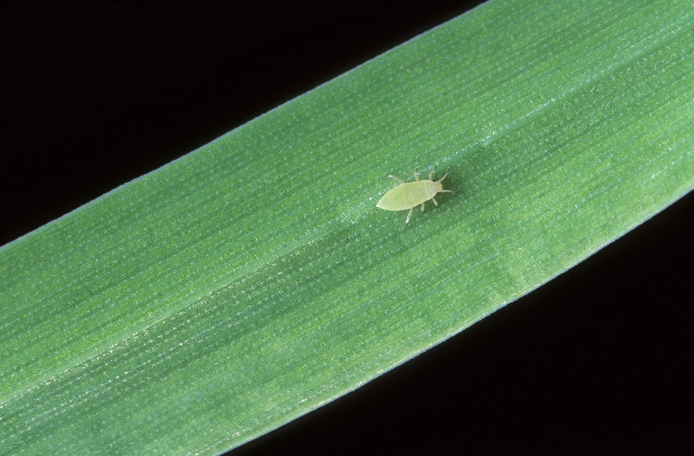
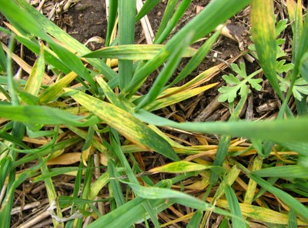
Aphids and Mites
Aphid
Wheat Streak Mosaic Virus
Notes:
Narration: Aphids are troublesome pests in small grains because they serve as vectors for diseases like barley yellow dwarf virus, which affects most small grain species. Mites serve as vectors for wheat streak mosaic virus on large acreages of winter wheat, which causes stunting, lack of head production, and poor grain fill. Control grass volunteers to prevent aphid and mite infestations, and do not plant winter wheat within 1/8 mile of fields known to be infested.
Image: Washington State University

Slide 38
Integrated Pest Management
Chemical
Biological
Increasing degree
of system disturbance
Physical/Mechanical
Cultural/Rotation
Prevention
Notes:
Narration: Integrated pest management is a management approach that is highly encouraged and likely essential for successful organic small grains production. The concepts encompassed by integrated pest management are applicable for managing weeds, diseases, and insect pests, and the method emphasizes preventative over response measures. Prevention of pest outbreaks is the best way to manage pests in organic systems, as “response” measures in organic systems generally only work to a limited extent on some pest species.
Image: N.E. Tautges, University of Minnesota

Slide 39
Integrated Pest Management for Small Grains
Prevention
Cultural Controls
Resistant Varieties
Biological Controls
Trap Crops
Crop Rotation
Volunteer Control
Increased Seeding Rate
Soil Fertility Management
Approaches:
Response
Chemical Controls
Mechanical Controls
Notes:
Narration: A number of cultural controls and methods contribute to crop protection. Trap crops are crops planted strategically on a crop field or landscape to draw pests away from the crop and onto the trap crop. The value of using crop rotation, volunteer control increased seeding rates, and resistant varieties was previously discussed and should be emphasized again. Ultimately, a healthy crop stand is your best defense against yield-reducing pest outbreaks. Therefore, another important cultural control is maintaining good soil fertility for crop nutrient needs.

Slide 40
Small Grains
Introduction
Planting
Weed management
Disease management
Insect pest management
Fertility management
Harvest and storage
Marketing
Notes:
Narration: Let’s move on from pests to fertility management in organic small grains.
Image: Carmen Fernholz

Slide 41
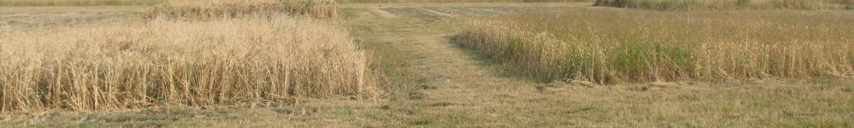
Organic Soil Fertility Management
Kristy Borrelli, Pennsylvania State University
Fertilized w/ manure
Non-fertilized
Nitrogen is often most limiting nutrient
Nitrogen deficiency contributes to yield losses from weed competition
Notes:
Narration: Nitrogen is often the most limiting nutrient in organic systems. Low nitrogen fertility in soils, leading to nitrogen deficiency in crops, can result in weak crop stands that are not competitive with weeds. This trend is evident in the picture, where weed competition in non-fertilized wheat is much greater than weed competition in wheat that had received livestock manure as fertilizer. Wheat yields were reduced in the non-fertilized plot by almost 50%. This illustrates the importance of soil nitrogen management for both crop nutrition and competitiveness.
Image: Kristy Borrelli, Pennsylvania State University

Slide 42
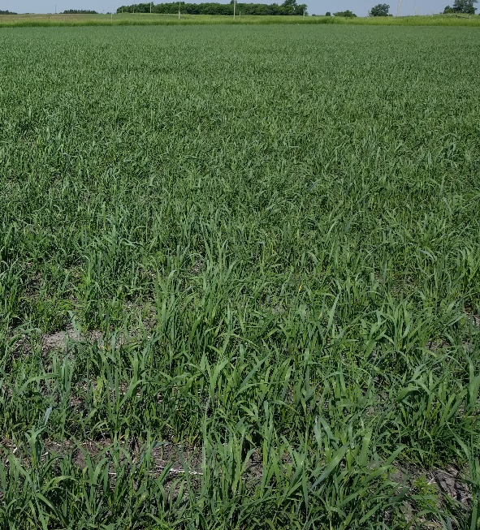

Organic Soil Fertility Management
N deficiency symptoms:
Yellowing
Stunting
Deficiency
Healthy Stand
Notes:
Narration: Crop nitrogen deficiency is usually characterized by yellowing of leaves and stands, and it can be seen especially in low areas where nitrogen is susceptible to loss. Soil fertility should be managed to prevent these symptoms, as they represent yield loss. If organic fertilizer inputs are being applied, nitrogen requirements of a crop are generally calculated with yield goals in mind. As a general rule, 1 to 2 lb of nitrogen is needed to make 1 bushel of wheat.
Images: N.E. Tautges, University of Minnesota

Slide 43
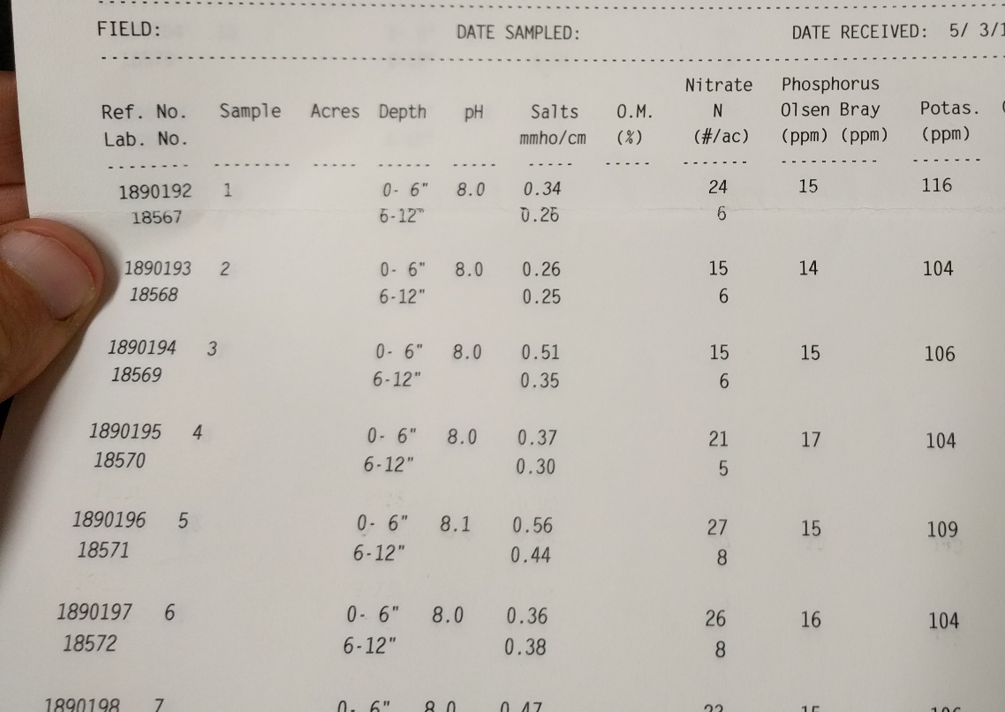
Organic Soil Fertility Management
Fertilizing Considerations:
Immediately available N (nitrate + ammonium) vs. N available in long term
At planting + tillering
Notes:
Narration: Soil tests should be conducted to measure soil nitrogen prior to planting the crop, and soil nitrate and ammonium levels should be subtracted from the fertilizer needed to meet your yield goal. Estimating release of nitrogen from manures and composts is complex, but obtaining a nutrient test for the organic input will help you to determine how much plant available (ammonium and nitrate) N is present in the manure, and how much total nitrogen it contains. Small grains take up the most nitrogen in the growth stages that span from tillering to early flowering, so fertilizer application and release should be planned to correspond with these growth stages.
Image: N.E. Tautges, University of Minnesota

Slide 44
Green Manures or Legumes in Rotation
Kaiser, et al., 2013
Notes:
Narration: Soil fertility in organic systems should be managed first with rotation, along with any additional fertilizer inputs. Nitrogen fertility can be built up by incorporating legumes into rotations prior to small grain crops. The nitrogen credits for several legumes shown here represent the estimated nitrogen input from the crop that is available to a following small grain crop. Legumes species differ markedly in their ability to fix atmospheric nitrogen, and in release of this N into the soil for subsequent crops in the rotation.

Slide 45
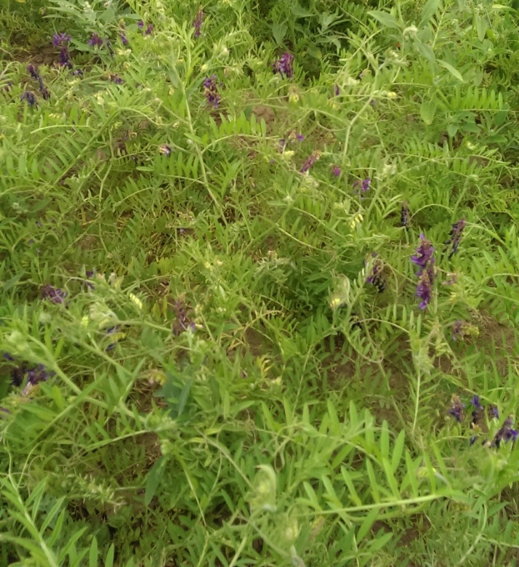
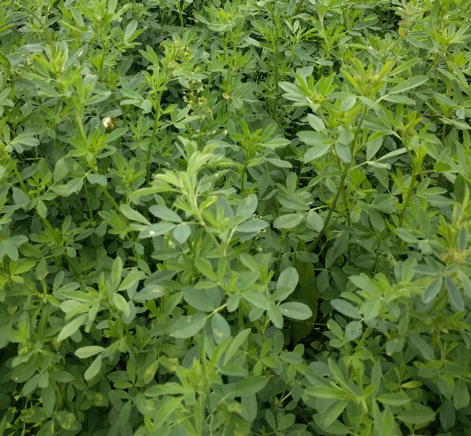
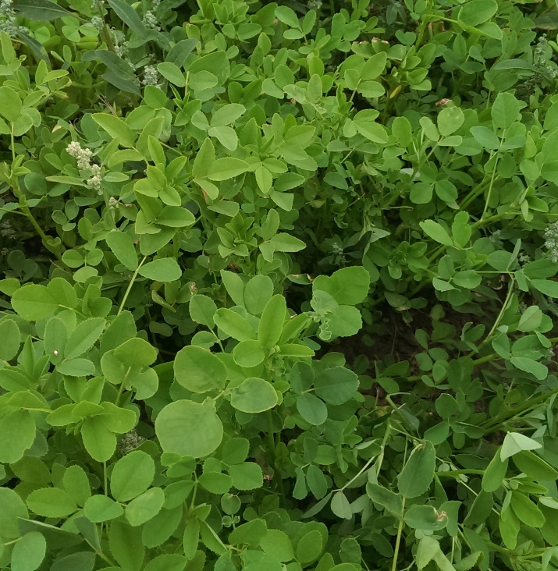
Green Manures or Legumes in Rotation
Hairy Vetch
Alfalfa
Sweet Clover
Notes:
Narration: Some growers sacrifice a year of crop production to produce a green manure crop, where a legume is grown and then tilled into the soil prior to planting the small grain crop. This is a good option for growers who may not have a use for forage on their farms, for whom turning under the biomass and keeping the nitrogen in the legume tissue in their field, rather than exporting nitrogen in forage tissue, is worth more than selling forage. Alfalfa, sweet clover, and hairy vetch, are legume spp. that fix high levels of N. However, as these legumes are highly persistent, care must be taken at termination, as they can become weeds in subsequent crops if not killed completely prior to planting the small grain.
Images: N.E. Tautges, University of Minnesota

Slide 46
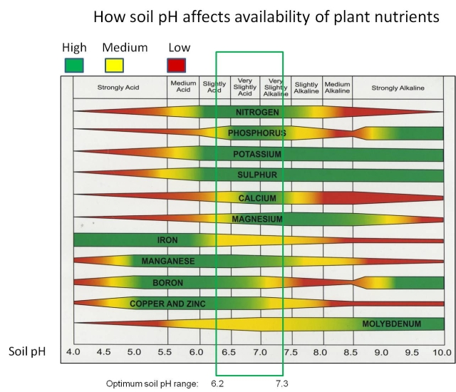
Phosphorus
Notes:
Narration: While soil nitrogen management is of perpetual concern in the short term of organic systems, phosphorus is of more concern in the long term. Phosphorus is ubiquitous in soils but only a small portion of the total soil phosphorus pool is available to plants. More soil phosphorus becomes available at lower soil pH (more acidic soils), but plant and soil microbial growth is reduced at low pH, representing a tradeoff between hospitable conditions for plants and phosphorus bioavailability.

Slide 47
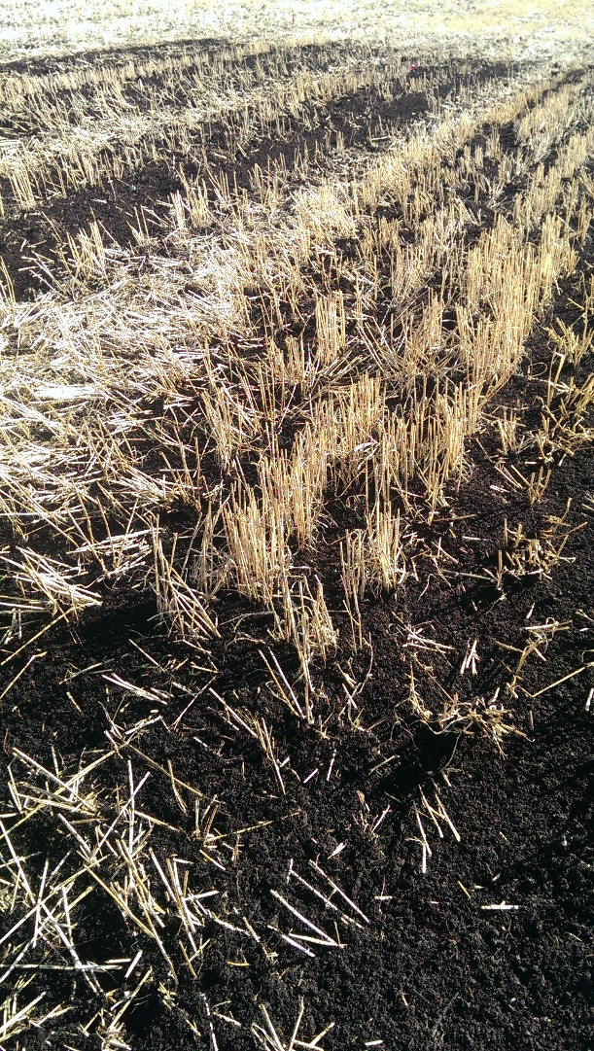
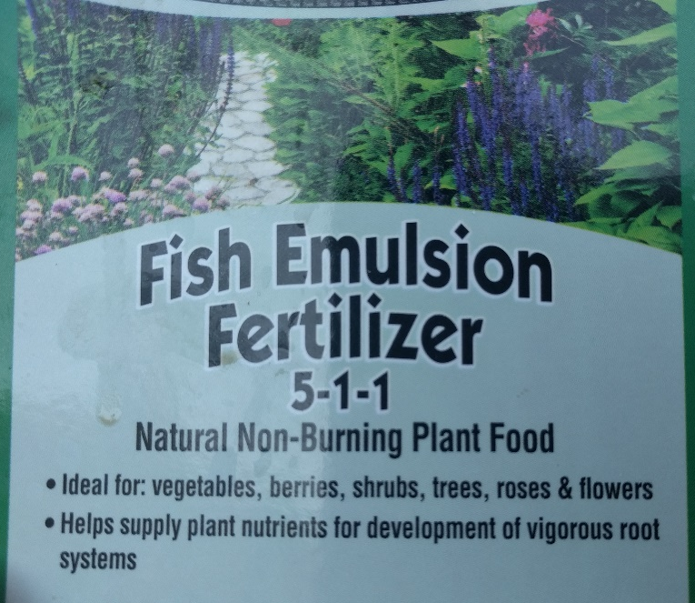
Phosphorus Fertilizers
Rock phosphate
Manure
Compost
Fish emulsion
Bone meal
Compost
Notes:
Narration: Long-term observations of organic farming systems indicate that the soil bioavailable phosphorus pool is depleted over time through the export of P in crop biomass and grain, and exported P must be replaced if organic operations are to remain productive in the long term. External fertilizer inputs may be necessary to amend soil P. Rock phosphate is mined phosphorus from natural deposits, and is certified organic-approved for use. However, rock phosphate reserves are finite and being depleted; therefore, reliance on rock phosphate for P for organic systems is not encouraged. Other good sources of phosphorus are livestock or poultry manure, compost, fish emulsion, and bone meal.
Images: N.E. Tautges, University of Minnesota

Slide 48

Rotating for Phosphorus
Notes:
Narration: There is some evidence that legumes purposefully exude organic acids from their roots to make phosphorus available in soil, though it is unclear if this has carryover effects into the next crop in rotation. Nonetheless, diverse crop rotations have been found to be beneficial for soil phosphorus fertility in organic systems. Application of composts or manure and diverse crop rotations should result in adequate levels of potassium and micronutrients, requiring no additional management.
Image: N.E. Tautges, University of Minnesota

Slide 49
Small Grains
Introduction
Planting
Weed management
Disease management
Insect pest management
Fertility management
Harvest and storage
Marketing
Notes:
Narration: Small grains can be harvested for forage or for their grain.
Image: Carmen Fernholz

Slide 50

Harvesting for Forage
Good quality hay or silage
Harvest at boot stage or dough stage
Notes:
Narration: Small grain biomass cut prior to heading can make excellent forage., with dry matter digestibilities of 65 to 70% and crude protein levels around 15%. Small grain forage quality is greatest at the boot stage, before the head has emerged from the sheath. Dry matter yields are greater if a grower waits until the dough stage, though quality is reduced relative to the boot stage. Forage quality decreases rapidly after the dough stage, after which forage harvest is not advisable.
Image: David L. Hansen, University of Minnesota

Slide 51

Harvesting for Forage
Grazing harvest
Weed control
Notes:
Narration: Grazing off small grains provides quality forage for cattle, and can contribute to system diversification and nutrient cycling in your system, as cattle will deposit manure as they graze. This can contribute to soil fertility for subsequent crops. Graze small grains intensively, leaving short stubble, to discourage regrowth. Grazing could also control certain weed species if they are palatable to your grazing livestock
Image: N.E. Tautges, University of Minnesota

Slide 52

Harvesting Small Grains
Swath when stalk 1 inch below the spike is yellow
Swath when grain moisture is 35 to 40%
Notes:
Narration: Most growers who produce small grains, however, harvest them for grain, as their name suggests. Small grains can be swathed and left to dry in the field in windrows, which speeds up the grain drying time and is performed in crops that are susceptible to lodging, if grain is left to dry while the plant is still standing. Swathing is also beneficial when there are many green weeds in the field when the small grain crop is drying down—letting the stand dry in windrows will allow weed biomass to dry down and not clog up the combine like they will when they are still green.
Image: Carment Fernholz

Slide 53
Harvesting Small Grains
Combine when grain moisture <15%
Use a Draper combine header
Notes:
Narration: After the windrows are dry, a combine with a Draper header, which is easier on the plant and leads to less shattering than an auger header, is used to pick up the windrow. Swathing should not be used ahead of precipitation, and rain on a small grain windrow can cause pre-harvest sprouting and reduce grain quality. Direct combining has become more common as combine horsepower has increased, and when fields are clean of weeds. Swathing will likely remain useful in organic systems where weeds are common and quick dry-down is important.
Image: Lauren Young, Washington State University

Slide 54


Quality Control
Notes:
Narration: To increase quality of the grain lot, hand weed patches of mustards and other weeds that can impart an off-flavor to the harvested grain. Clean grain with a rotary screen immediately after harvest to remove green material from the seed lot, which can increase moisture and impart off-flavors in storage. Seed cleaning can also be conducted with a gravity table.
Images:: N.E. Tautges, University of Minnesota (weeds in wheat); University of Minnesota Extension (weed-contaminated oats)

Slide 55

Storage
Target moisture: 13%
Damaging temperatures for airflow rates of 100-150 cubic feet/minute/square foot
160 degrees for 16% moisture
140 degrees for 20% moisture
120 degrees for 24% moisture
Notes:
Narration: If drying is required after direct combining or from a swathed windrow, 13% grain moisture is a good target for most small grains. Blowing air should be kept at low temperatures so as to not damage the proteins in the grain. Blowing air temperatures should not exceed 160 degrees F for grain at 16% moisture, 140 degrees F for grain at 20% moisture, and 120 degrees for grain at 24% moisture.
Image: Suraj, Pixabay

Slide 56
Small Grains
Introduction
Planting
Weed management
Disease management
Insect pest management
Fertility management
Harvest and storage
Marketing
Notes:
Narration:
Image: Carmen Fernholz

Slide 57
Grain Quality
Quality Parameters:
Pre-harvest sprouting
Protein
Vomitoxin content
Notes:
Narration: End users of small grains are increasingly demanding in-depth quality analyses of grain, especially for food grade grains. End users are interested in the falling number for wheat, triticale, rye, and barley, which indicates the degree of pre-harvest sprouting and starch degradation in the grain. Low falling numbers indicate pre-harvest sprouting and degraded grain quality. High protein is generally good for bread making in wheat, and increases the value of feed-quality grain. Vomitoxins are compounds that result from fungal contamination of the grain, which can result from high moisture while grain is either in the field or in storage after harvest. As the name suggests, vomitoxins are toxins and very low levels are tolerated in a seed lot. Do not harvest infected areas of your field with the rest of the seed lot.
Image: David L. Hansen, University of Minnesota

Slide 58

Selling Organic Grain
Marketing occurs on individual basis
Notes:
Narration: Finding a buyer for your organic grain takes extra work beyond conventional grain marketing, as few organic grain elevators exist. Most organic growers spend a significant amount of time making contacts with buyers and on direct marketing. This extra time can pay off, as organic grains often command a price at least 2 times that of conventional small grains. However, it is important to keep marketing labor in mind when transitioning to organic production. See the “Marketing” module for more information.
Image: C.S. Frahm and J.M. Jungers, University of Minnesota

Slide 59

Alternative Small Grain Crops
“Ancient Grains”
Spelt
Notes:
Narration: “Ancient grains,” refer to ancient lines of small grains that have not undergone significant breeding efforts in the last few centuries, unlike wheat, rye, oat, and barley. Ancient grains related to wheat include einkorn, emmer, kamut, and spelt, and the market is growing for these grains in the health foods sector. They are purported to be more nutritious than wheat, though there is little scientific evidence to support these health claims. Nonetheless, if markets are available, organic growers might investigate growing these; however, it might be best to first establish a test plot to do a preliminary evaluation of how they grow in a specific environment. Please consult our Growing a New Crop and Alternative Crops modules for steps to take when considering alternative small grains.
Image USDA-GIPSA

Slide 60

Alternative Small Grain Crops
“Ancient Grains”
Einkorn
Notes:
Narration: Cultivation of these crops is generally similar to that of other small grains, though they tend to be taller than modern-day wheat and barley cultivars. Grain yield potential of these ancient grains is generally much lower than modern cereals; therefore, producers should negotiate a higher price for organically grown ancient grains than for organic wheat, barley, oats, or rye.
Image: Kristine Moncada, University of Minnesota

Slide 61

Conclusions
Life cycle diversity
Competitive with weeds
Efficient nutrient users
Diverse end uses
Notes:
Narration: Small grains are beneficial in organic rotations as they add crop life cycle diversity, are competitive with weeds, are efficient nutrient users, and have diverse end uses. Whether a grower chooses a winter-hardy variety to sow in the fall, providing ground cover over winter and greater yields earlier the following year, or spring-planted oats for forage, incorporation of small grains can add diversity to corn-soybean or alfalfa hay rotations. Small grain residues can be left on the soil surface as a protective mulch, tilled in for organic matter, or even grazed. Small grains can contribute to soil organic matter and build soil health for your organic rotation in the long term.
Image: C.S. Thompson, University of Minnesota

Slide 62
Small Grains
Introduction
Planting
Weed management
Disease management
Insect pest management
Fertility management
Harvest and storage
Marketing
Notes:
Narration: Thanks for watching our Small Grains module!
Image; Carmen Fernholz

Slide 63


© 2017 Regents of the University of Minnesota. All rights reserved.
The University of Minnesota is an equal opportunity educator and employer.
This material is based upon work that is supported by the National Institute of Food and Agriculture, U.S. Department of Agriculture, under grant number 2013-51106-21005.
Notes:
Narration: This material is based upon work that is supported by the National Institute of Food and Agriculture.

Slide 64
References
Bowman, G. (ed.) 2002. Steel in the field: a farmer’s guide to weed management tools. Sustainable Agriculture Network, U.S. Department of Agriculture. Beltsville, MD.
Beres et al. 2010. Weed-competitive ability of spring and winter cereals in the Northern Great Plains. Weed Technology 24:108-116.
Dawson, J. 2017. Food-grade organic grain production OGRAIN Workshop Jan 2017. Department of Horticulture, UW Madison.
Kaiser, D.E., Lamb, J.A., Sims, A., and Wiersma, J. 2013. Nutrient management: fertilizing wheat in Minnesota. AG-FO-3814-C. University of Minnesota Extension.
Knodel, J., Shanower, T., and Beauzay, P. 2016. Integrated pest management of wheat stem sawfly in North Dakota. North Dakota State University Extension Service, E1479. https://www.ag.ndsu.edu/publications/crops/integrated-pest-management-of-wheat-stem-sawfly-in-north-Dakota
Mohler, C.L. and S.E. Johnson (editors). 2009. Crop Rotation on Organic Farms: A Planning Manual, NRAES 177. Natural Resource, Agriculture, and Engineering Service.

Slide 65
References (cont.)
Moncada, K.M. and Sheaffer, C.C. 2010. Risk management guide for organic producers. University of Minnesota, St. Paul, MN.
Simmons, S., Oelke, E., and Anderson, P. Growth and development guide for spring wheat. University of Minnesota Extension. https://www.extension.umn.edu/agriculture/small-grains/growth-and-development/spring-wheat/
Tallman, S. 2011. Disease and insect management in organic small grains. National Sustainable Agriculture Information Service (ATTRA). http://foodsystems.msu.edu/uploads/files/disease-and-insect-management-in-organic-small-grains.pdf
Wiersma, J., K. Moncada, and M. Brakke. 2010. Small Grains. Chapter 11 in Risk Management for Organic Producers. Moncada, K. and C. Sheaffer, editors. University of Minnesota, St. Paul, MN.
Wiersma, J.J., Durgan, B.R., Hollingsworth, C., MacRae, I.V., and Rehm, G. 2012. Winter wheat in Minnesota. Small Grains Production. University of Minnesota Extension. https://www.extension.umn.edu/agriculture/small-grains/production-guides-and-cropping-systems/winter-wheat-in-minnesota/
Wiersma, J.J., and J.K. Ransom (editors). 2005. Small Grains Field Guide. University of Minnesota Extension Service, St. Paul, MN and North Dakota State University Extension Service, Fargo, ND.

