Slide 1
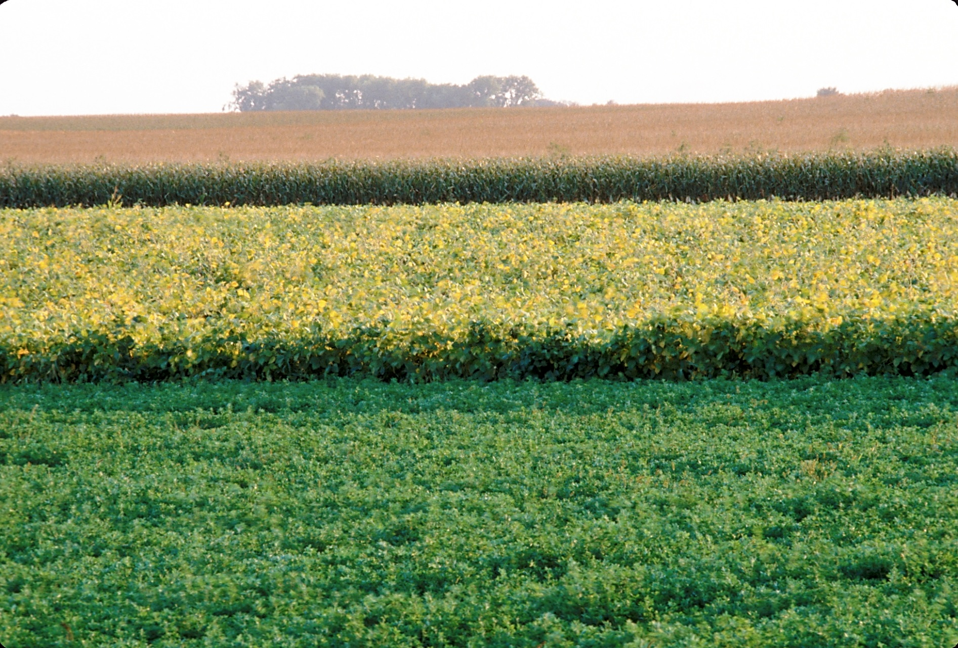
Rotations for Organic Grain Cropping Systems
This material is based upon work that is supported by the National Institute of Food and Agriculture, U.S. Department of Agriculture, under grant number 2013-51106-21005.
Authors
Kristine Moncada
Constance Carlson
Gigi DiGiacomo
Craig Sheaffer
Notes:
Narration: Welcome to our Rotations for Organic Grain Cropping Systems module. Image: David L. Hansen, University of Minnesota

Slide 2
Rotation
Definition
Benefits
NOP Standards
Planning
Examples
Year 2
Year 3
Year 4
Year 1
Notes:
Narration: Organic farmers are required to utilize rotations under the National Organic Program rules. Let’s start with how rotation is defined under NOP regulations.

Slide 3
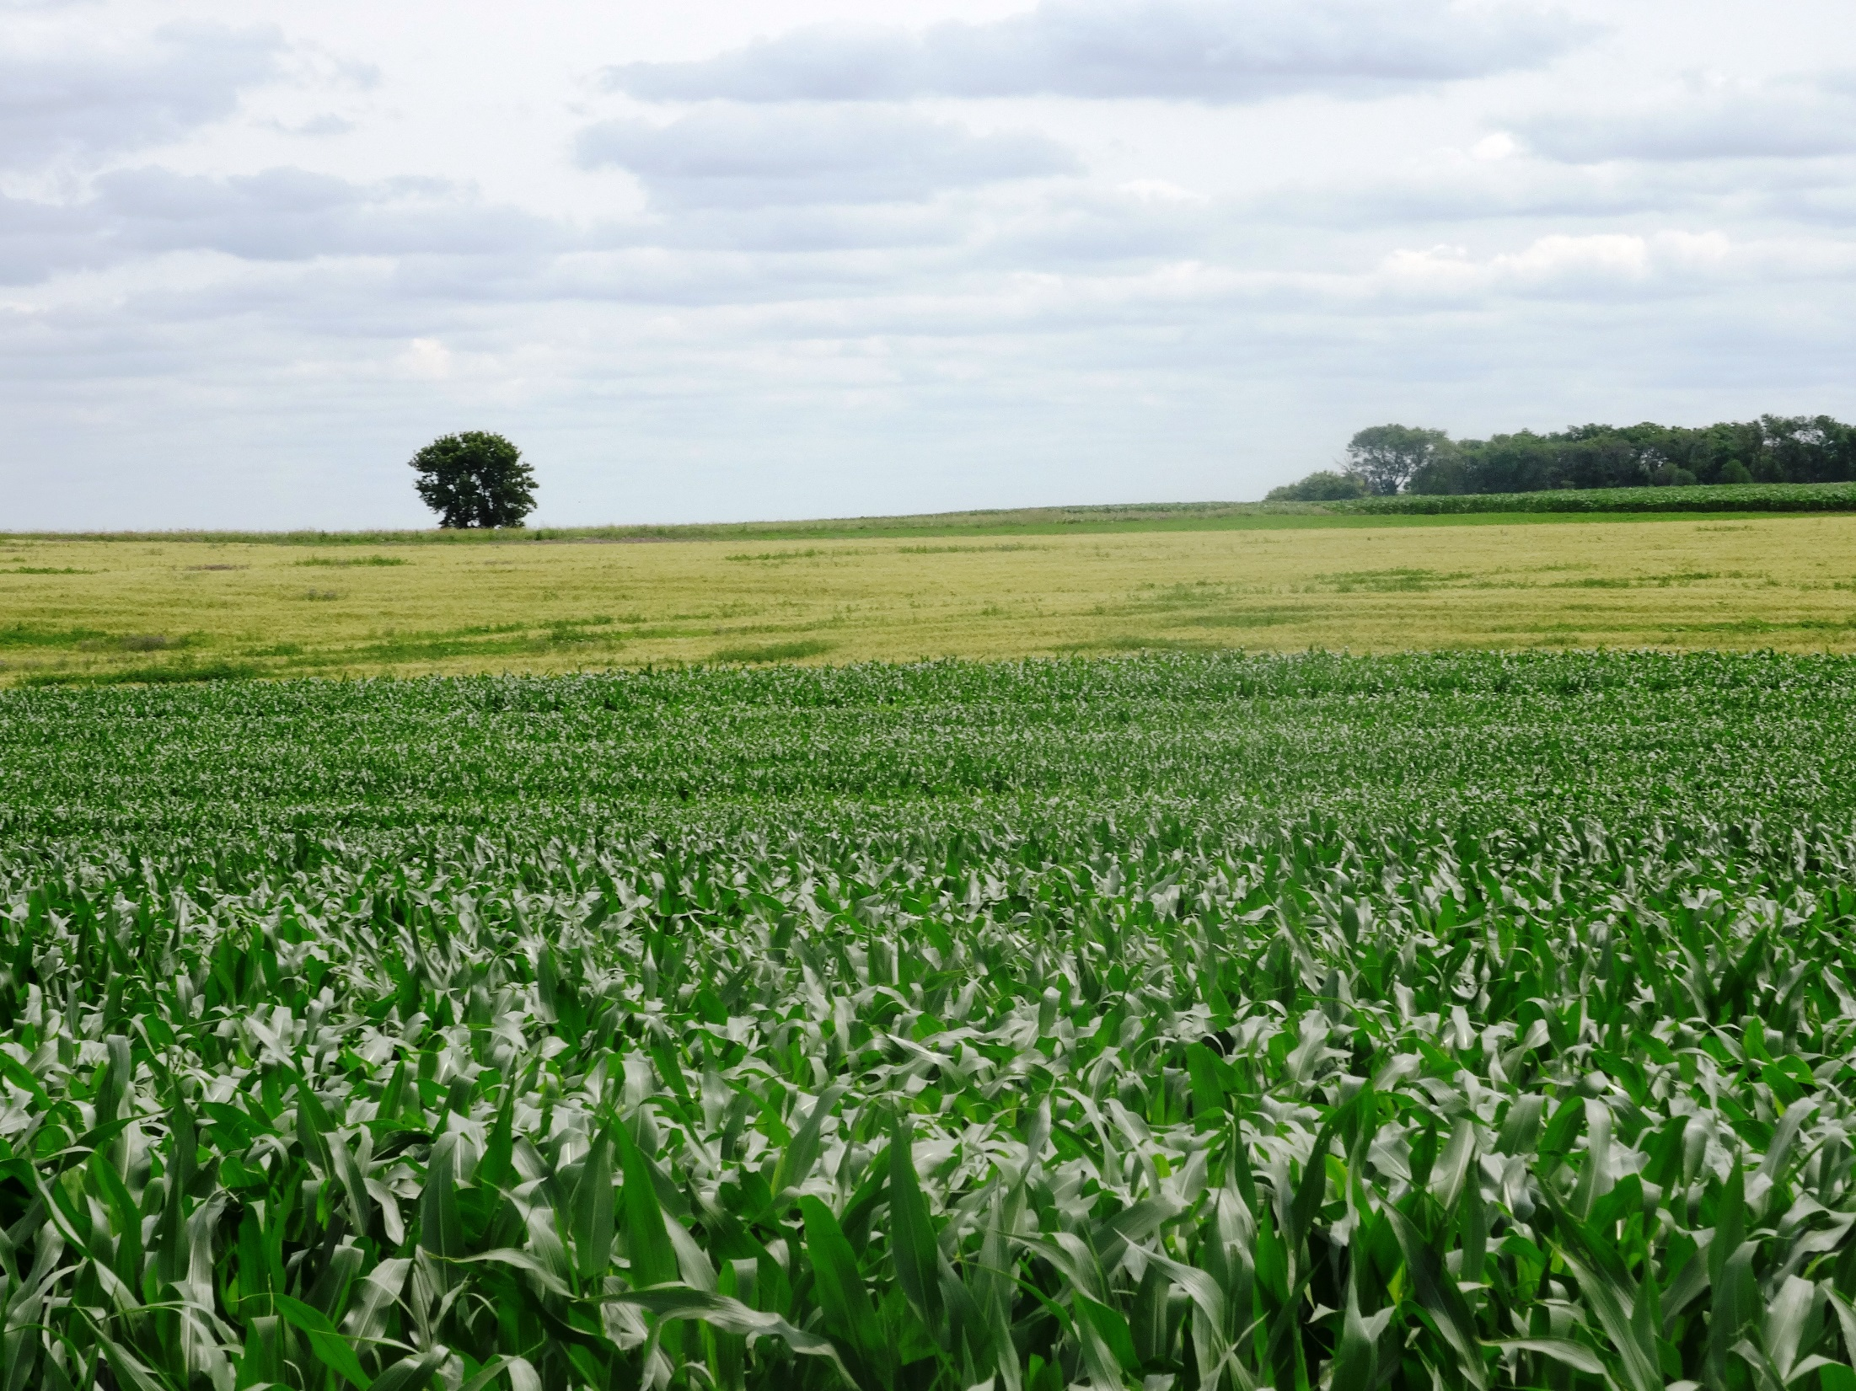
Rotation Definition – NOP 205.205
A rotation is the “alternating of annual crops grown on a specific field in a planned pattern or sequence in successive crop years”
Thus, “crops of the same species or family are not grown repeatedly without interruption on the same field”
Notes:
Narration: As defined by the NOP, a rotation is the “alternating of annual crops grown on a specific field in a planned pattern or sequence in successive crop years.” This means that “crops of the same species or family are not grown repeatedly without interruption on the same field.” Image: Kristine Moncada, University of Minnesota

Slide 4
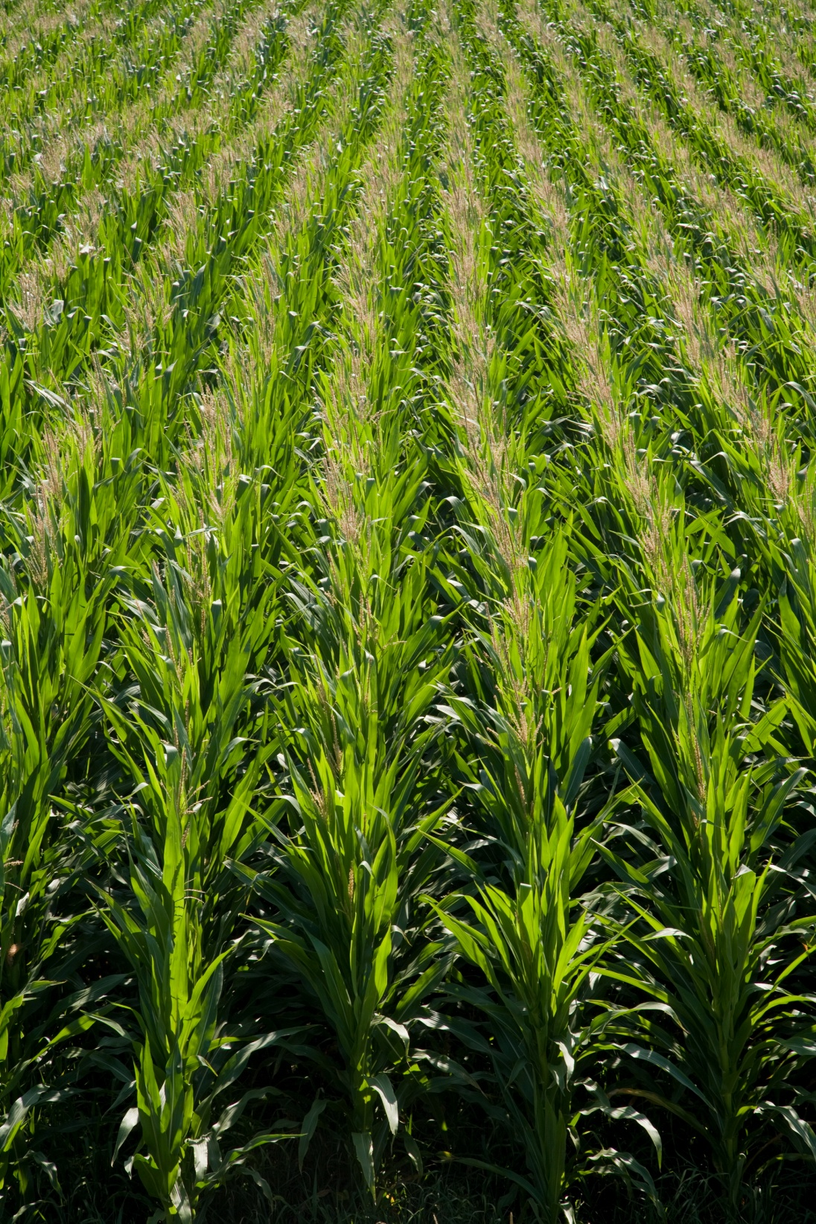
Continuous Cropping
Example: growing corn in the same field every year
Growing any annual crop two years in a row on the same field is not allowed in organic systems
Notes:
Narration: The opposite of a rotation is “continuous cropping”. One example of this is growing corn in the same field for more than one season. This would not be allowed in organic systems. Continuous cropping does not provide rotation benefits. We will discuss this later in this module.
Image: Jeff Coulter, University of Minnesota

Slide 5
Rotation Types
Corn
Soybean
Wheat
Corn
Wheat
Alfalfa
Alfalfa
Soybean
Alfalfa
Vary in length and diversity
Vary by region based on crop adaptation
Notes:
Narration: We know that growing the same crop in the same field over and over is not a rotation. However, rotations can vary in length and diversity. So that leaves many options of crops that can be included in a rotation and the number of years that a rotation can span. Rotations can also vary by region based on the crops that are adapted to that area.

Slide 6
2 crops
2 years
3 crops
3 years
4 crops
5 years
Corn
Soybean
Corn
Soybean
Wheat
Corn
Alfalfa
Alfalfa
Soybean
Wheat
ROTATION BENEFITS INCREASE
Notes:
Narration: As rotation length and crop diversity increases, rotation benefits also increase. What exactly are these benefits?

Slide 7
Rotation
Definition
Benefits
NOP Standards
Planning
Examples
Year 2
Year 3
Year 4
Year 1
Notes:
Narration: In this section, we will describe the benefits of rotation in more detail.

Slide 8
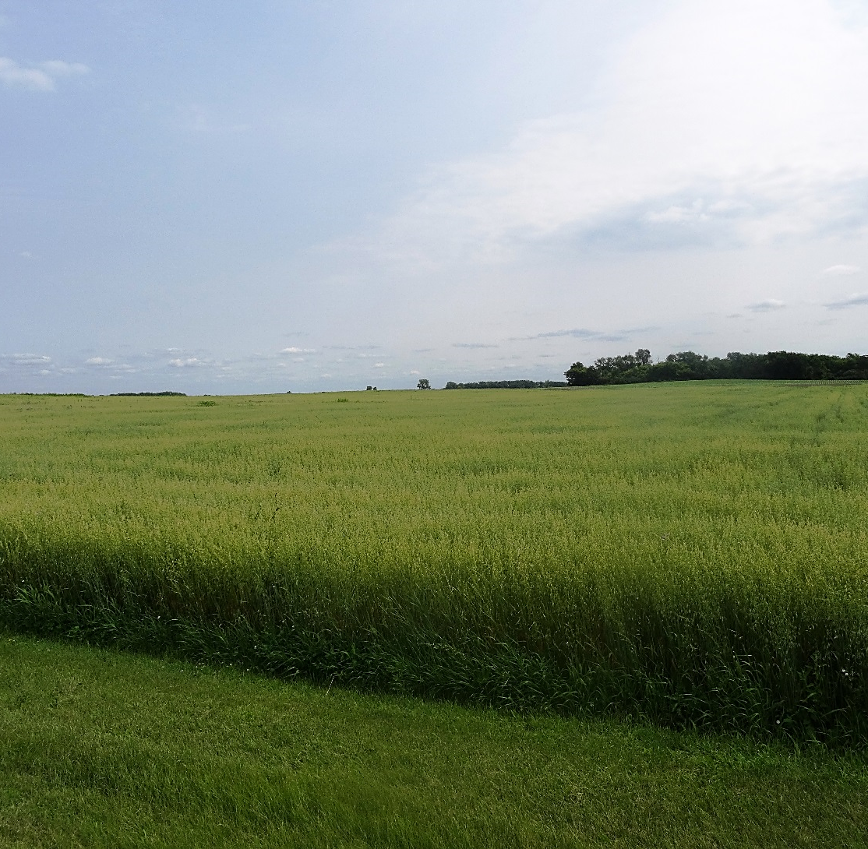
Benefits of Diverse Rotations
Soil quality and fertility
Weed management
Disease and insect management
Other benefits
Notes:
Narration: Soil health, weeds, and pests are some of the biggest challenges organic farmers face. Diverse rotations can have an impact on many of these issues. Image: Kristine Moncada, University of Minnesota

Slide 9
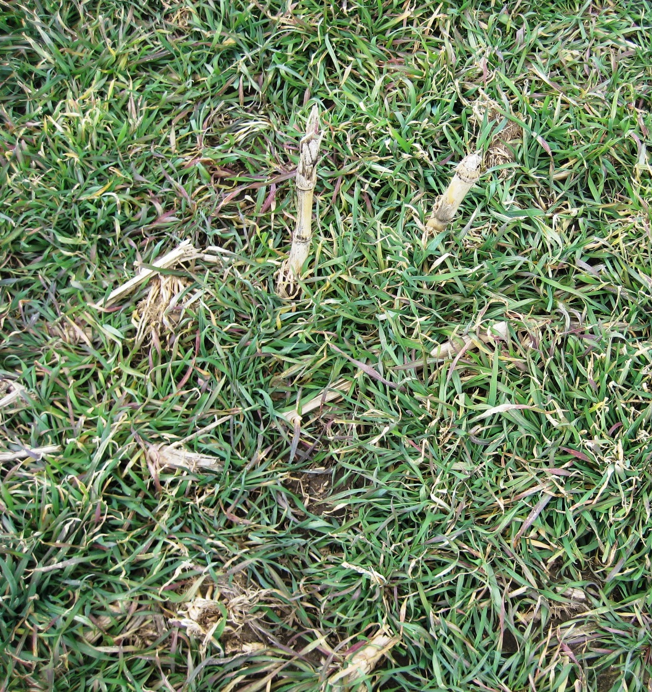
Soil Quality
Diverse rotations with perennials can increase soil organic matter
Perennials and cover crops can overwinter for reduced soil erosion
Winter rye cover crop, spring growth
Notes:
Narration: Diverse rotations that include perennials and cover crops can improve soil quality by contributing to soil organic matter. Crops that overwinter can also protect soil from erosion.
Image: Jill Sackett Eberhart

Slide 10
Organic Rotation Experiment
2-year rotation = corn-soybean
4-year rotation = corn-soybean-oat-alfalfa
Greater number of large soil aggregates in 4-year rotation
Kuratomi et al., 2004
Notes:
Narration: An organic research study conducted in Minnesota compared 2-year and 4-year rotations. In this chart, you can see the difference in the percentage of large soil aggregates, an indicator of soil quality, in two different organic rotations. The longer, four-year rotation with corn, soybean, oat and alfalfa had a larger percentage of aggregates compared to a 2-year corn-soybean rotation. Larger amounts of aggregates may be an indicator of greater soil quality.

Slide 11
Increased Soil Fertility
Legumes (crops, cover crops, and green manures) add N to soils by nitrogen fixation
Corn after alfalfa will often have all the nitrogen needed for good yields
Notes:
Narration: Legumes, especially alfalfa, can supply nitrogen to subsequent crops in the rotation. Corn grown after alfalfa will generally not need additional nitrogen fertilizer. Image: Craig Sheaffer, University of Minnesota

Slide 12
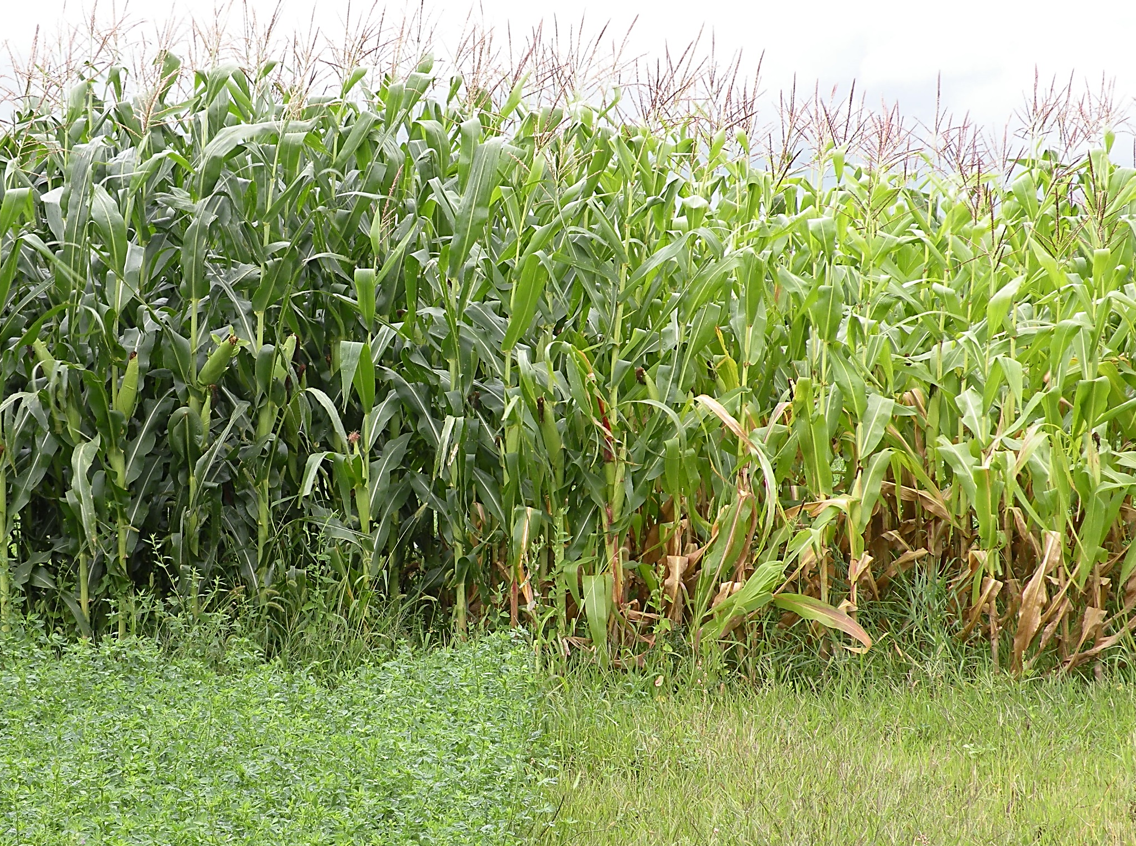
Plot 1
Plot 2
Grown after alfalfa
Grown after wheat
Notes:
Narration: Take a close look at these two research plots in Minnesota The corn looks quite different in each plot, doesn’t it? The corn in Plot 1 is green and healthy-looking, while the corn in Plot 2 is showing signs of nutritional deficiencies. Neither plot was fertilized, but the corn in Plot 1 was grown after a year of alfalfa, while the corn in Plot 2 was grown after wheat.
Image: University of Minnesota

Slide 13
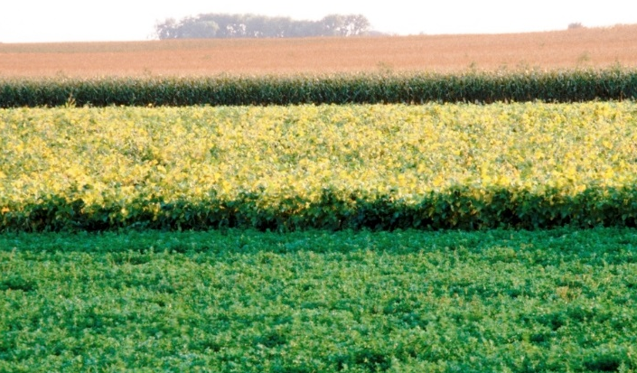
Rotation Effect
Yields in rotations are greater than those in continuous cropping
Above that associated with increased N from legumes in rotation
Exact reason why is unknown!
Notes:
Narration: The rotation effect shows that yields in rotations are greater than those in continuous cropping, even when the factors such as increased nitrogen due to legumes are taken into consideration. In other words, if you just rotate crops, whether they add nitrogen or not, you get a yield benefit. The exact reason why is unknown.
Image: David L. Hansen, University of Minnesota

Slide 14
Benefits of Diverse Rotations
Soil quality and fertility
Weed management
Disease and insect management
Other benefits
Notes:
Narration: Another benefit of diverse rotations that is particularly helpful in organic farming is weed management.
Image: Kristine Moncada, University of Minnesota

Slide 15
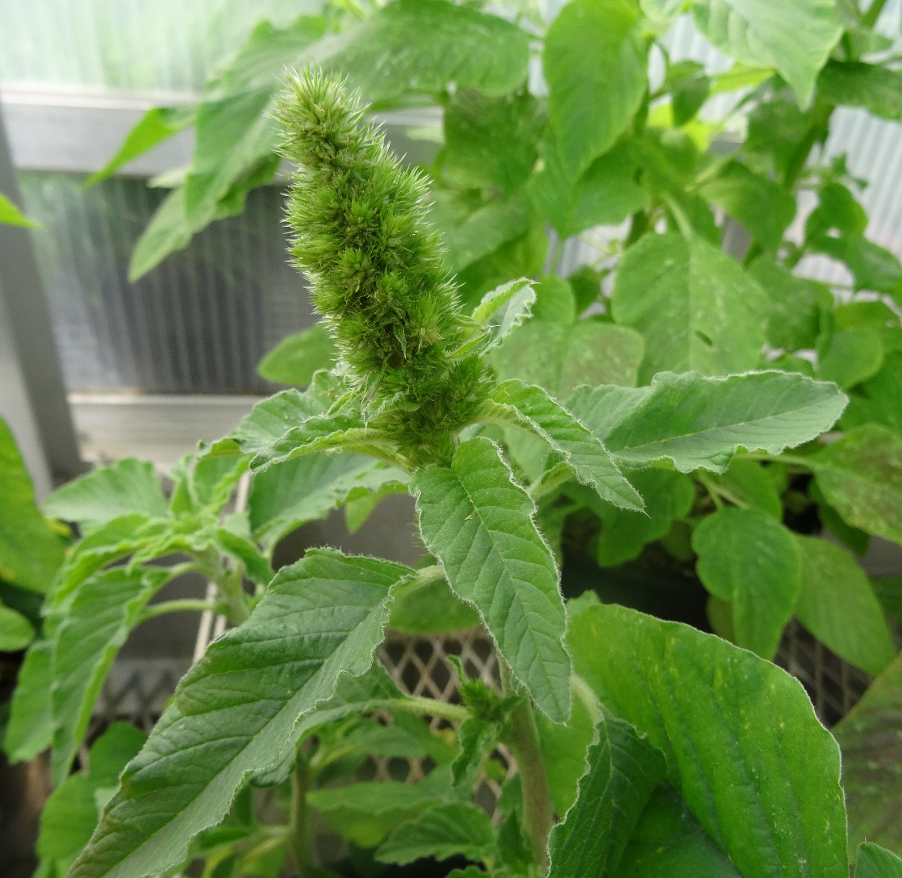
Rotation Diversity and Weeds
Repeatedly growing crops with similar production practices will lead to weeds adapted to those practices
Examples in corn and soybean: pigweeds and foxtails
Redroot Pigweed
Notes:
Narration: By diversifying the types of crops planted, rotations can be used to break up weed cycles. Having mainly row crops such as corn and soybean will lead to weeds adapted to that system because they have similar planting dates and mechanical weed control operations. Examples of weeds that are prone to becoming problematic in corn and soybean are pigweeds and foxtails.
Image: Kristine Moncada, University of Minnesota

Slide 16
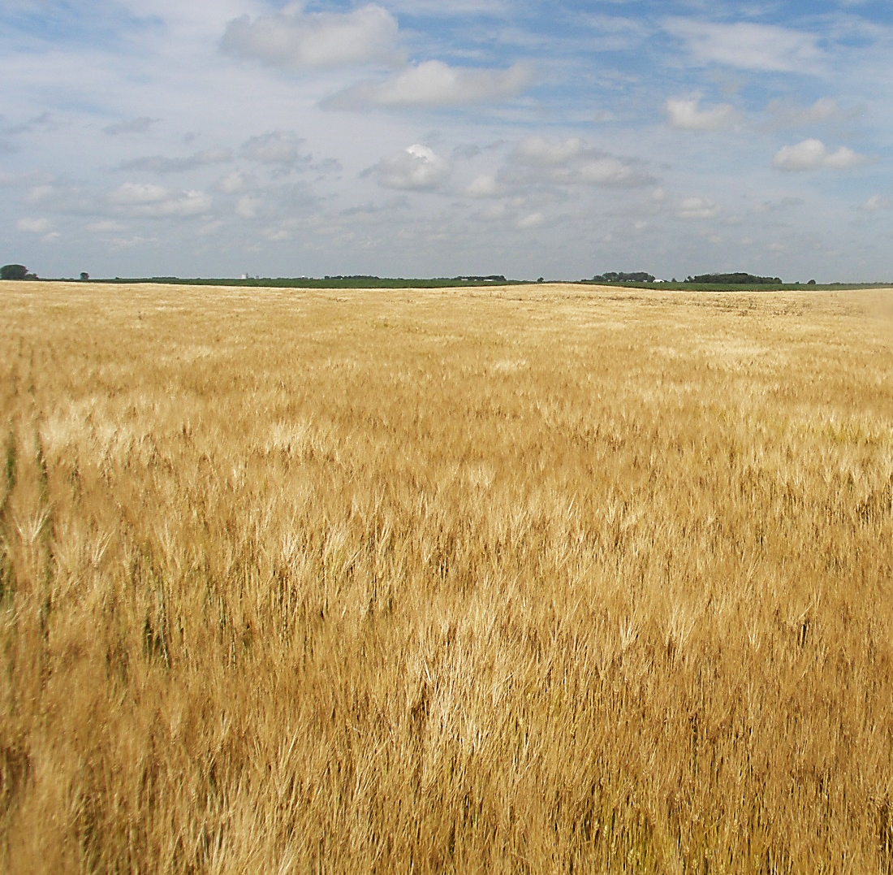
Small Grains in Rotation
Cool season crops
Have different times of planting and harvesting
May help reduce weeds that thrive in row crop production
Notes:
Narration: Cool season small grains such as wheat, barley and oats may combat the weeds that thrive in row crops. They can crowd out warm-season weeds and many of the weeds that do grow get chopped down during harvest before they can set seed. Can you see any annual weeds in this field of organic barley?
Image: Carmen Fernholz

Slide 17
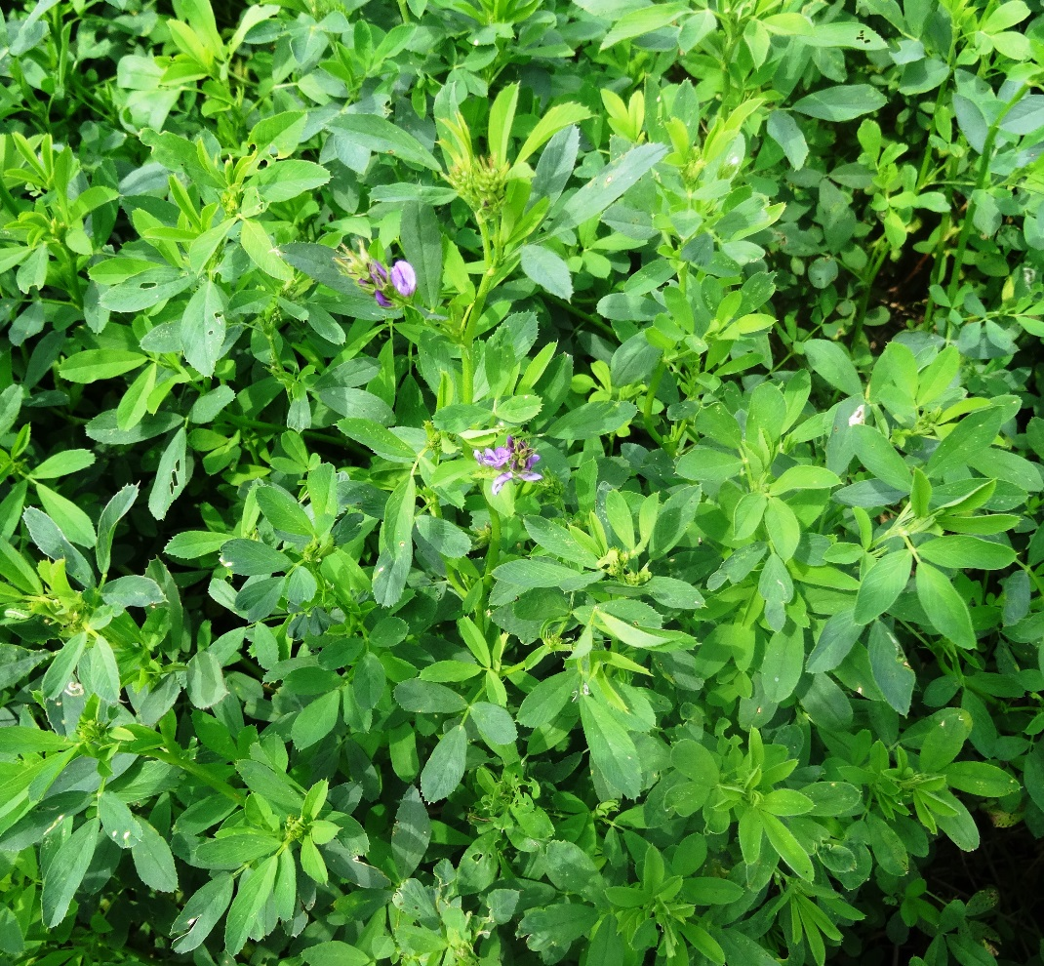
Perennial Forages
Provide continuous soil cover to inhibit weeds from germinating
Multiple harvest times can set back annual and perennial weeds
Notes:
Narration: Perennials such as alfalfa provide continuous soil cover to inhibit weeds from germinating. They can be particularly effective in managing annual weeds that plague row crops. Harvesting forage mows weeds several times a season, which can prevent seed production of annual weeds and deplete the root reserves of perennial weeds.
Image: Kristine Moncada, University of Minnesota

Slide 18
Rotation and Weed Seed Study
Foxtail seeds in the soil were lower in a 4-year rotation that included oats and alfalfa
Haar et al., 2008 (unpublished data)
Notes:
Narration: In a long-term study conducted at Lamberton, MN, organic rotations that included a small grain and alfalfa had lower amounts of foxtail seeds in the weed seed bank as compared to a corn-soybean rotation.
References: Haar, M., L. Klossner, and K. Belina. 2008. Weed seed dynamics in VICMS. Unpublished data.
Risk Management Guide

Slide 19
Benefits of Diverse Rotations
Soil quality and fertility
Weed management
Disease and insect management
Other benefits
Notes:
Narration: Organic farmers can’t use synthetic pesticides to control disease and insects, so rotation can be a valuable tool in pest management.
Image: Kristine Moncada, University of Minnesota

Slide 20
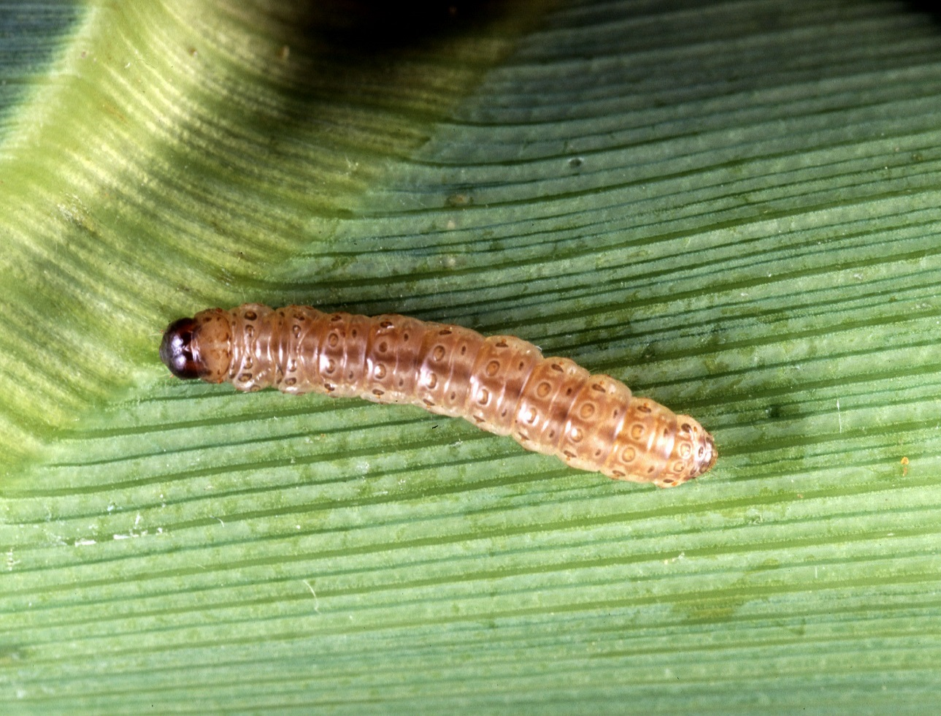
Disease and Insect Management
European corn borer
Rotation breaks up disease and insect cycles
Notes:
Narration: Longer rotations can break up disease and insect cycles. While rotations may not eliminate disease pathogens and insect pests, a proper rotation can decrease some pests to sustainable and less-damaging levels. This is because after a long enough time without a host, many pest populations decline. Image: Keith Weller, USDA-ARS

Slide 21
Soybean Cyst Nematode Research
Rotation | SCN (eggs/100cc of soil)
Soybean once every 2 years | 3657
Soybean once every 3 years | 1306
Soybean once every 4 years | 496
No soybean in rotation | 0
Threshold for damage > 500 eggs/100cc
Chen et al., 2012
The more soybean is grown in a field, the more prevalent SCN becomes
Notes:
Narration: In research conducted in organic fields in Minnesota, the number of soybean cyst nematode eggs was examined in different lengths of rotation. With 500 eggs per 100 cubic centimeters of soil as the threshold for damage, it was found that soybean cyst nematode reached damaging levels when soybean was grown every other or every two years in rotations.

Slide 22
Examples
Crop | Pest | Rotation Period
Corn | Corn root worm | 1-2 years
Soybean | Soybean cyst nematode | 3-5 years
Small grains | Scab | 2-3 years
Notes:
Narration: Research has been done on several pests and how long they persist in fields without their hosts. Here are a few examples where insects or disease incidence can be reduced by lengthening the time between the susceptible crops in the rotation. For more on pest management, please watch our modules on individual crops.

Slide 23
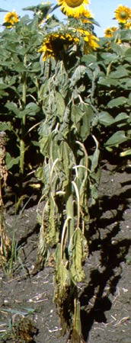
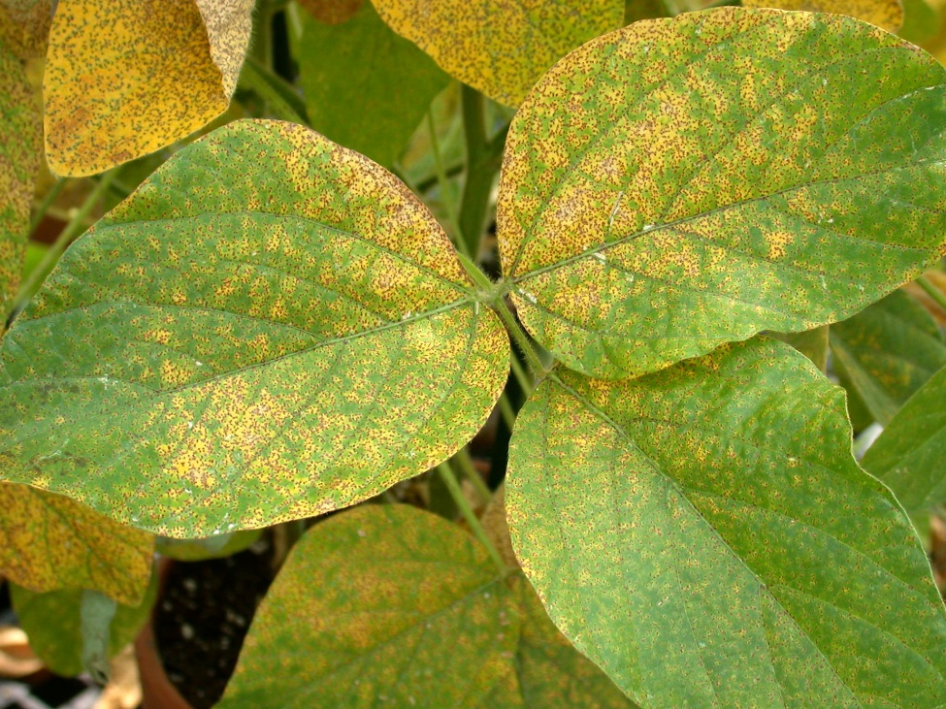
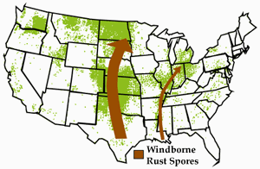
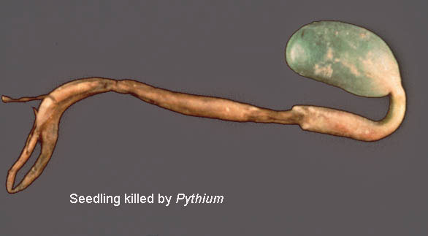
Some Pests Can’t Be Managed with Rotation
Some pests travel – Ex. soybean rust
Some pests are ubiquitous – Ex. lesion nematode
Some persist for many years – Ex. Sclerotinia
Some disease survives without hosts – Ex. Pythium
Lesion nematode
Soybean rust
Soybean rust
Sclerotinia
Notes:
Narration: Not all insects and diseases can be managed with rotation. For example, soybean rust travels via the wind to infect crops. The distances rust travels can be quite extensive. Some pests such as lesion nematode infect a wide range of hosts and are ubiquitous in the environment. Some disease pathogens such as Sclerotinia and also some nematodes have dormancy structures that persist for many years. Some disease organisms like some types of Pythium don’t need hosts and survive in the soil on their own. Images: Christine Stone, USDA-ARS (Soybean with rust); N.A. Cobb, USDA-ARS (Lesion nematode); USDA-ARS (Sclerontinia – sunflower; University of Minnesota Extension (Soybean w/ Pythium); Cereal Disease Lab, USDA-ARS (Map of rust travel)

Slide 24
Benefits of Diverse Rotations
Soil quality and fertility
Weed management
Disease and insect management
Other benefits
Notes:
Narration: Some benefits of diverse rotations are unrelated to production. Image: Kristine Moncada, University of Minnesota

Slide 25
Reduced Financial Risk
Diverse rotations can reduce financial risk from:
Crop failure
Price swings
Notes:
Narration: Diverse rotations can spread out financial risk. If one crop fails in a given year, perhaps due to an insect or disease pest, there will be other crops in other fields that provide income. Crops can experience price swings depending on markets. If the price crashes for one crop, having other crops can lessen the loss.

Slide 26
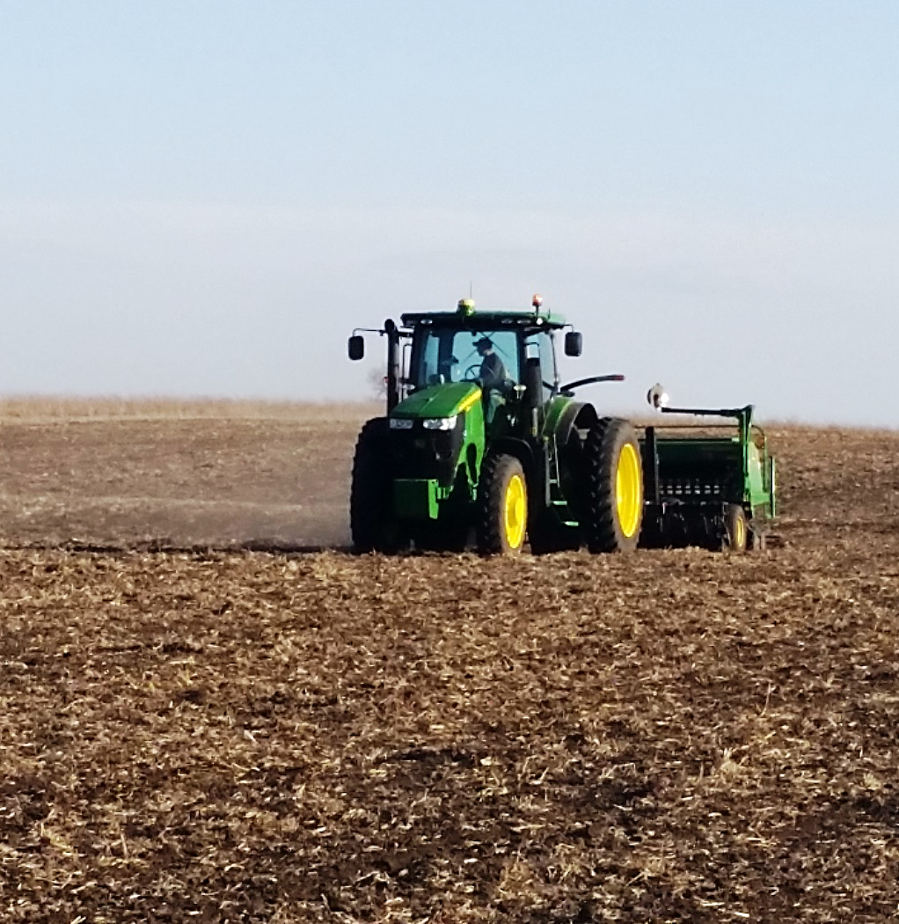
Diversify Field Operations
Spreads out work over the field season
Reduces the risk of not having enough time to perform timely operations
Notes:
Narration: When a farm has diversified rotations across fields, this also diversifies field operations. Different crops have different times for planting, weed control and harvesting. This can help spread out work over time and can reduce the risk of not having labor to perform field operations when they most need to be done. Image: Carmen Fernholz

Slide 27
Rotation
Definition
Benefits
NOP Standards
Planning
Examples
Transition
Year 2
Year 3
Year 4
Year 1
Notes:
Narration: The many benefits of we have just discussed support the rotation standards and guidelines of the National Organic Program.

Slide 28
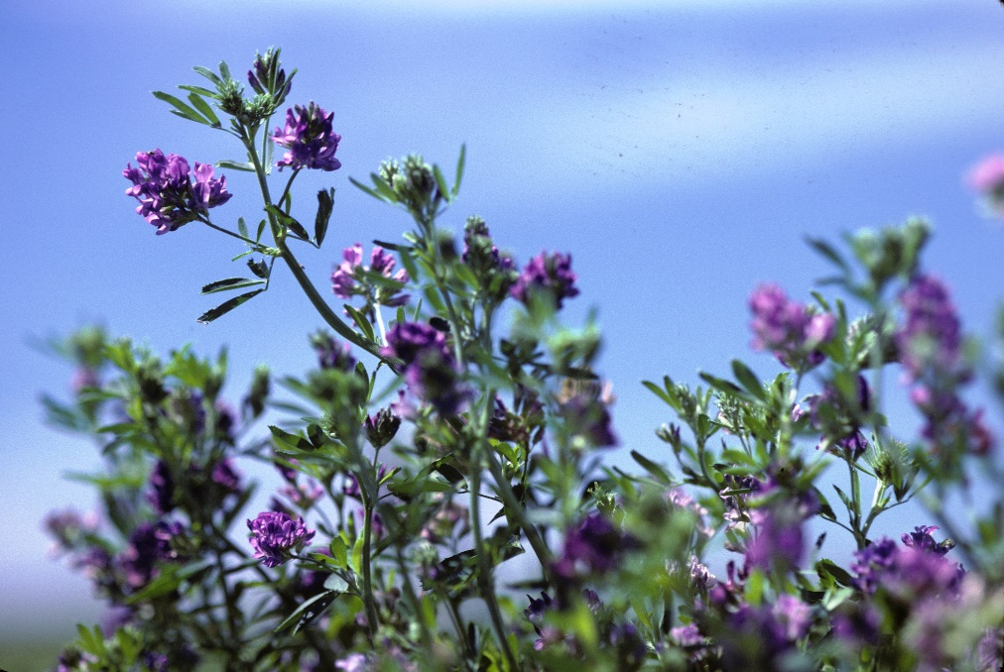
Rotation Goals – NOP
The National Organic Program has a strong emphasis on diverse rotations because rotation is one of the strongest management tools an organic farmer has.
Notes:
Narration: The National Organic Program emphasizes diverse rotations because it is one of the strongest tools to manage many concerns.
Images: David L. Hansen, University of Minnesota

Slide 29
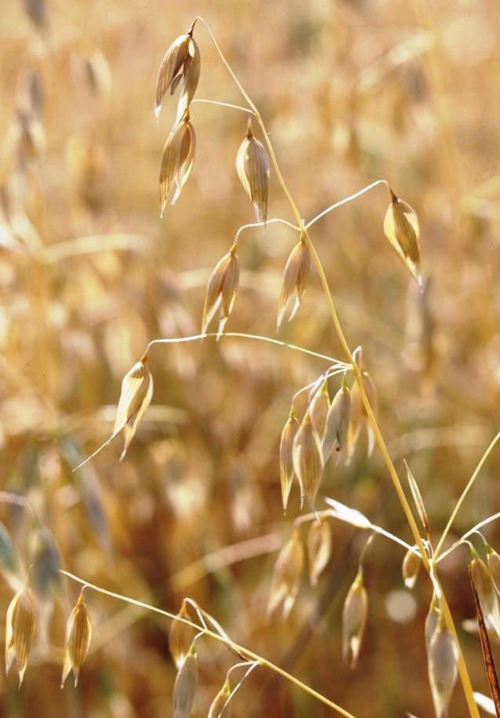
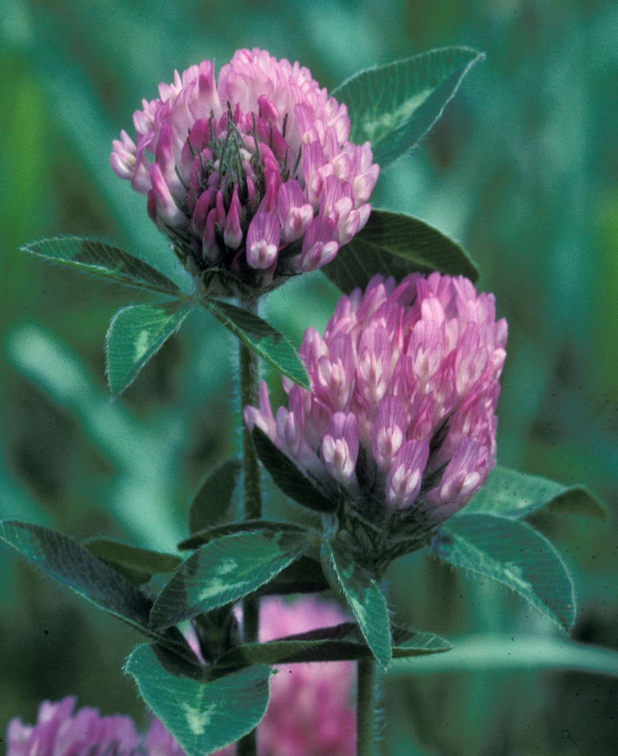
NOP Rotation Standards
Legumes
Diversity of species and plant families
Crops with different rooting systems
Crops with different pest pressures
Green manure and cover crops
Notes:
Narration: The NOP has recommendations for what to incorporate in organic rotations. These include legumes to add nitrogen, a diversity of plant species and plant families to break up pest cycles, crops with different rooting systems to improve soil quality, crops with different pest pressures to reduce pest proliferation, and green manures and cover crops to suppress weeds.
Images: All David L. Hansen, University of Minnesota; except for Craig Sheaffer, University of Minnesota (alfalfa root)

Slide 30
NOP Rotation Standards
5 Years
Crop 1
Crop 2
Crop 3
Minimum of 3 crops within 5-year period for field crop systems
Can’t follow an annual crop with the same annual crop in the subsequent year
Notes:
Narration: Once you are certified, there are National Organic Program rotation standards that must be followed. For field cropping systems, generally there must be a minimum of 3 different crops within a 5-year period for the same field. The same annual crop can’t be grown two years in a row in the same field.

Slide 31
Exception 1
Corn
Two crops if one is a perennial grown for more than 2 years
4-year
Rotation
Alfalfa
Notes:
Narration: There are a few exceptions to the rule. A rotation can have only two crops if one of the crops is a perennial that is grown for more than two years. For example, alfalfa grown for 3 years followed by a year of corn.

Slide 32
Exception 2
Oat
Two crops, plus a cover crop
Cover Crop
Soybean
Corn
Rye
NOTE: ask Jim about whether certifiers can deny 2nd option
Notes:
Narration: The second exception is if two annual crops are grown with a cover crop in between. For example, a corn and soybean rotation with oat and winter rye cover crops. However, this example is not at all diverse and carries more risk. Why might this be so? Despite the inclusion of cover crops, this ultimately is a corn-soybean rotation with similar hazards as we discussed earlier in this module. Additionally, a certifying agency may not be amenable to the least diverse cropping systems.

Slide 33
Rotation
Definition
Benefits
NOP Standards
Planning
Examples
Year 2
Year 3
Year 4
Year 1
Notes:
Narration: Now that you know benefits and standards for rotations, how will you plan your rotation?

Slide 34
Important Considerations
Markets
Your Operation
Crop Sequence
Flexibility
Notes:
Narration: Let’s go over what to consider when planning your rotation and take a look at why farmers rotations can differ from one another.
Image: Carmen Fernholz

Slide 35
Planning Your Rotation
Balancing profits with soil health and other rotation benefits is key to finding crop rotations that work best for your operation
$
Notes:
Narration: Every crop is not equally profitable and every crop is not equally beneficial to soil health. For example, alfalfa has many soil-building properties, but it is generally not as profitable as corn. Producers need to balance profit with potential rotation benefits such as soil health to find the best crop rotation for their operations.

Slide 36
Markets
ALFALFA
WINTER RYE
Notes:
Narration: The number one thing to consider when adding a new crop to your rotation is whether you have a market for that crop. It may depend on your location. For example, we often recommend alfalfa in rotations, but if a producer doesn’t have livestock or a nearby market for hay, it can be difficult to justify including alfalfa. Other less commonly-grown organic grain crops such as winter rye have very small markets where it is difficult to find buyers.
Images: Kristine Moncada, University of Minnesota (alfalfa); Craig Sheaffer, University of Minnesota (winter rye)

Slide 37
Other Modules to View
Marketing
Growing a New Crop
Notes:
Narration: We consider marketing and topics relating to growing a new crop so important that we have two modules devoted to the subject! Please watch our modules on “Marketing” and “Growing a New Crop” for more information.

Slide 38
Important Considerations
Markets
Your Operation
Crop Sequence
Flexibility
Notes:
Narration: Another important consideration is: will the crop perform well under your conditions?
Image: Carmen Fernholz

Slide 39
Your Operation – Crop Adaptation
Consider:
Disease prevalence
Soil conditions
Wheat infected with fusarium head blight (scab)
Notes:
Narration: Not all crops will grow successfully on your farm. Small grains are beneficial to include in row crop rotations, but these crops may not work for some producers who are located in areas that have serious disease. An example is how regions with hot and humid conditions can have greater incidence of fusarium head blight, which can cause crop failure. Or, some crops may not be adapted to your specific conditions such poorly drained soils.
Image: USDA-ARS

Slide 40
Your Operation – Equipment
Do you have equipment or access to
custom work?
Notes:
Narration: Another critical consideration for new crops is whether you have the proper planting and harvesting equipment or if custom work is available for their production.
Image: University of Minnesota

Slide 41
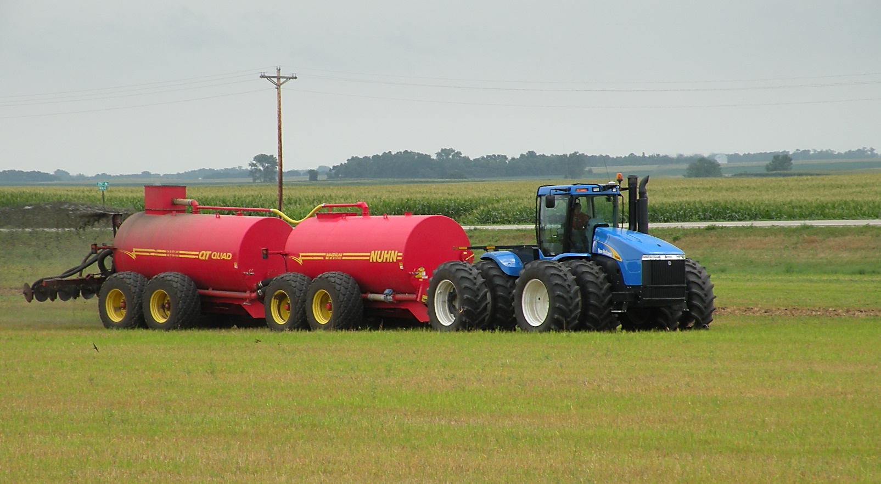
Your Operation – Manure Availability
Notes:
Narration: Some crops such as corn have high fertility requirements. Without alfalfa in the rotation, they certainly will require a source of nutrients such as manure, compost or another amendment. Do you have an economical and nearby source? Image: Carmen Fernholz

Slide 42
Important Considerations
Markets
Your Operation
Crop Sequence
Flexibility
Notes:
Narration: The order of crops in your rotation is important and some crop sequences are more optimal than others.
Image: Carmen Fernholz

Slide 43
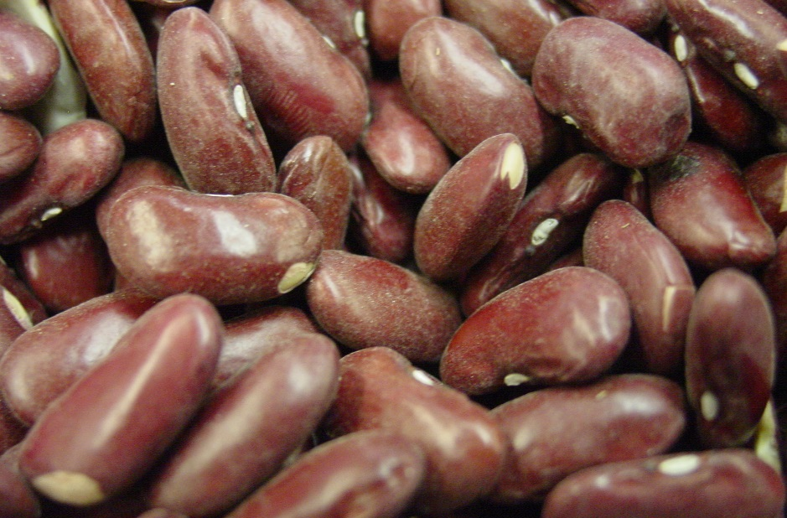
Crop Sequence
Host crops for the same diseases should not be grown after one another
Notes:
Narration: Here are some general rules when planning your crop rotation. Crops that are susceptible to the same diseases should not be grown after each other. For example, soybean should not be followed with field beans (or barley would not be followed by wheat) because they are susceptible to the same diseases. For more information on specific diseases and their hosts, please visit your local Extension Service website.
Images: Lynn Betts, USDA-NRCS; Joshua Larson, University of Minnesota
References: Chapter 2, Risk Management Guide
Crop Rotation on Organic Farms: A Planning Manual, NRAES 177, Charles L. Mohler and Sue Ellen Johnson, editors, Published by NRAES, July 2009

Slide 44
Crop Sequence
Crops that fix nitrogen should be followed by crops with high N needs
Notes:
Narration: Crops that fix nitrogen such as alfalfa should be followed by crops that can get the most use of that nitrogen such as corn.
Images: David L. Hansen, University of Minnesota

Slide 45
Crop Sequence
Less competitive should alternate with competitive crops
Notes:
Narration: Weed pressure may build in crops that don’t compete well with weeds. So, less competitive crops such as flax should alternate with competitive crops such as a small grain. Asking other farmers who have grown a specific crop can help you gauge how competitive a crop is.
Images: David L. Hansen, University of Minnesota

Slide 46
Important Considerations
Markets
Your Operation
Crop Sequence
Flexibility
Notes:
Narration: Because of the greater complexity of organic rotations, the ability to adapt will be useful for new organic farmers.
Image: Carmen Fernholz, University of Minnesota

Slide 47
Need for Flexibility
Weather conditions
Market changes
Disease prevalence
Notes:
Narration: Just like all farmers, organic farmers will need to be flexible in their rotations due to weather, markets, and disease forecasts. You may have decided your rotation long in advance, but plans sometimes need to be changed.
Image: Keith McCall, USDA-NRCS

Slide 48
If You Need to Make Changes
Notes:
Narration: What happens if you need to make changes? Your Organic System Plan indicates what you intend your rotation to be, but of course, you are allowed to make some changes when necessary.
Image: geralt, Pixabay

Slide 49
If You Need to Make Changes
All changes follow NOP rules
Notify your certifier of changes
Track changes in records including your Organic System Plan (OSP)
Notes:
Narration: Changes still need to adhere to NOP rules for rotations (for example, corn can’t follow corn). It is very important to notify your certifier of changes prior to making them. Keep track of any rotation changes in all records including your OSP.
Image: USDA

Slide 50
Rotation
Definition
Benefits
NOP Standards
Planning
Examples
Year 2
Year 3
Year 4
Year 1
Notes:
Narration: In this section, we will focus on rotations with common field crops in our region including corn, soybean, small grains, forages and several other crops.

Slide 51
Rotation Examples
Year 1
Year 2
Year 3
Year 1
Year 2
Year 3
Year 4
Year 1
Year 2
Year 3
Year 4
Year 5
Notes:
Narration: Rotations can vary in length from three to five years or even longer.
Images: David L. Hansen, University of Minnesota (corn and alfalfa); Scott Bauer, USDA-ARS (wheat and soybean)

Slide 52
3-Year Rotation – Example 1
Year 1 Corn
Year 2 Soybean
Year 3 Small Grain
Underseeded w/ red clover
Common rotation in regions without livestock
Small grain often underseeded with red clover
Compost or manure will likely be necessary
Rotation is less diverse
Notes:
Narration: In this rotation, we have corn, soybean, and a small grain, which could be either be oat, barley or spring wheat. This is a common rotation in regions without livestock where alfalfa or hay markets are not present. Organic farmers will often underseed the small grain with red clover. The red clover is terminated in the fall or spring before the next crop. The red clover will supply some nitrogen, but supplemental compost or manure will be necessary for the corn crop. This rotation is less diverse and some of the benefits of a longer rotation will be lost.

Slide 53
3-Year Rotation – Example 2
Year 1 Corn
Year 2 Soybean
Year 3 Field Pea
Similar to previous example
Field peas are harvested early and allow time for planting a fall cover crop
Notes:
Narration: This rotation is similar to the previous one and may provide an alternative in regions where small grains are disease prone. Field peas, like small grains, are harvested early and allow ample time for a fall-planted cover crop.

Slide 54
4-Year Rotation – Example 1
Year 1 Corn
Year 2 Soybean
Year 3 Small Grain
Year 4 Alfalfa
Good rotation for producers without manure
Small grain underseeded with alfalfa
Alfalfa will provide most of the N for the corn
Alfalfa provides many benefits
Notes:
Narration: This four-year rotation is a good one for producers who don’t have access to manure, but it also requires them to have a market for the alfalfa hay. The alfalfa is underseeded with the small grain in the spring. Perennial legume crops such as alfalfa provide many soil benefits and can help control weeds.

Slide 55
5-Year Rotation – Example 1
Similar to previous example
An additional year of alfalfa
Should provide all of the N for the corn
Notes:
Narration: This is the same rotation as the previous slide, but with an additional year of alfalfa. Two years of alfalfa in most cases will provide all the nitrogen necessary for corn.

Slide 56
5-Year Rotation – Example 2
2 years of high-value corn
Year 3 corn will require fertilizer
3 years of row crops not ideal
Notes:
Narration: This 5-year rotation provides another high value crop by adding an extra year of corn. The corn in Year 3 will need supplemental fertilizer for good yields. One negative to this rotation is that 3 years of row crops can lead to pest management problems, especially with weeds.

Slide 57
Rotation Examples
Year 1
Year 2
Year 3
Year 1
Year 2
Year 3
Year 4
Year 1
Year 2
Year 3
Year 4
Year 5
These are examples
that you can adjust to your own needs and experiences
Notes:
Narration: Consider the rotation examples that we present here to be templates you can adjust to your own needs and experiences. Images: David L. Hansen, University of Minnesota (corn and alfalfa); Scott Bauer, USDA-ARS (wheat and soybean)

Slide 58
Farmer Profile – Rotation
3-year rotation = corn-soybean-small grain underseeded with red clover
6-year rotation = corn-soybean-small grain-alfalfa-alfalfa-alfalfa
Small grain underseeded with legume
Notes:
Narration: Let’s look a real world example. An organic farmer in Lac Qui Parle County in Western Minnesota, usually has a 3-4 year rotation of corn, soybean, and small grains underseeded with red clover. However, when a field needs soil building or better weed management, he will add 2 or 3 years of alfalfa to that rotation. Thus, his rotation is sometimes as long as 6 years.

Slide 59
Rotations – Farm Scale
 | Year 1 |  |  |  |  | Year 2 |  |  |  | Year 3 |  |  |  | Year 4 |  |  |  | Year 5
 | SP | SU |  | FA | WI | SP | SU | FA | WI | SP | SU | FA | WI | SP | SU | FA | WI | SP | SU | FA | WI
Field 1: 5-yr rotation | Corn |  |  |  |  | Soybean |  |  |  | Oat |  | Alfalfa
Field 2: 3-yr rotation | Wheat |  |  | Red Clover |  | Corn |  |  |  | Soybean |  |  |  | Oat |  | Red Clover |  | Corn
Field 3: 3-yr rotation | Soybean |  |  |  |  | Barley |  | Red Clover |  | Corn |  |  |  | Soybean |  |  |  | Wheat |  | Red Clover
Different rotations for different fields
Rotations are staggered
Notes:
Narration: So far, we have focused on rotations for a single field, but farms have multiple fields, which can make planning rotations for the whole farm more complex. Here is an example of a farm with three fields. Notice how the rotations are staggered so that each field has a different crop in a given year.

Slide 60
Resources
Pioneering Illinois farmer recounts transition to organic – Rodale
Tipsheet: Crop Rotation in Organic Farming Systems – ATTRA
Crop Rotation on Organic Farms – SARE
Risk Management for Organic Producers – Rotation
Notes:
Narration: Here is a list of recommended resources for you to find more information on organic crop rotations.

Slide 61
Rotation
Definition
Benefits
NOP Standards
Planning
Examples
Year 2
Year 3
Year 4
Year 1
Notes:
Narration: We’ve reached the end of our Rotation module. We hope you have discovered some useful information to help in planning your own rotations.

Slide 62
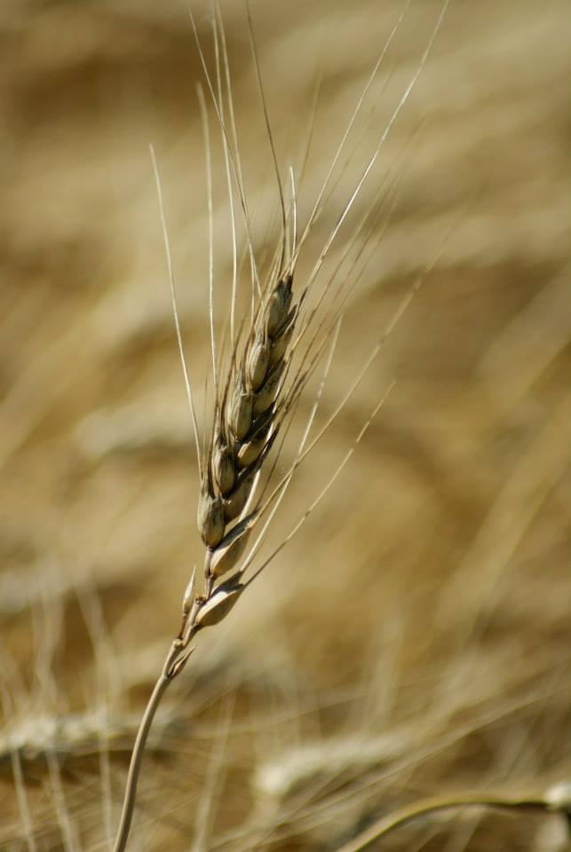
© 2017 Regents of the University of Minnesota. All rights reserved. The University of Minnesota is an equal opportunity educator and employer.
This material is based upon work that is supported by the National Institute of Food and Agriculture, U.S. Department of Agriculture, under grant number 2013-51106-21005.
Notes:
Narration: This material is based upon work that is supported by the National Institute of Food and Agriculture.

Slide 63
References
Chen, S.Y., C.C. Sheaffer, D.L. Wyse, P. Nickel, and H. Kandel. 2012. Plant-parasitic Nematode Communities and Their Associations with Soil Factors in Organically Farmed Fields in Minnesota. J Nematol. 44:361-369.
Kuratomi, M., D. Allan, and E. Dyck. 2004. Long term effects of crop management: Soil quality. Results from VICMS study at the Southwest Research and Outreach Center in Lamberton, Minnesota. http://greenlandsbluewaters.net/Long_term_soil_quality.pdf
Larsen, D. 2015. Small grains offer many benefits in crop rotation. Midwest Organic and Sustainable Education Service. https://mosesorganic.org/small-grains/
Midwest Cover Crops Council. 2016. Integrating Cover Crops in Soybean Rotations Challenges and Recommendations for the North Central Region. http://mccc.msu.edu/wp-content/uploads/2016/10/ALL_2015_Integrating-cover-crops-in-soybean-rotations.pdf
Mohler, C.L. and S.E.Johnson. 2009. Crop Rotation on Organic Farms: A Planning Manual. Published by NRAES. http://www.sare.org/Learning-Center/Books/Crop-Rotation-on-Organic-Farms

Slide 64
References (cont.)
Moncada, K. and C. Sheaffer. 2010. Rotation. Chapter 2 in Risk Management for Organic Producers. Moncada, K. and C. Sheaffer, editors. University of Minnesota, St. Paul, MN. https://organicriskmanagement.umn.edu/sites/organicriskmanagement.umn.edu/files/rotation.pdf
Sheaffer, C. and K. Moncada. 2012. Introduction to Agronomy: Food, Crops, and Environment. 2nd edition. Clifton Park, NY: Cengage Learning.
USDA-NRCS. 2010. Organic Production: Using NRCS Practice Standards to Support Organic Growers. https://www.nrcs.usda.gov/Internet/FSE_DOCUMENTS/stelprdb1043183.pdf
U.S. Government of Publishing Office. 2017. Electronic Code of Federal Regulations. §205.205 Crop rotation practice standard. http://www.ecfr.gov/cgi-bin/text-idx?SID=d85d56330bbb8f4faab941184bb2eccc&mc=true&node=se7.3.205_1205&rgn=div8

