Slide 1
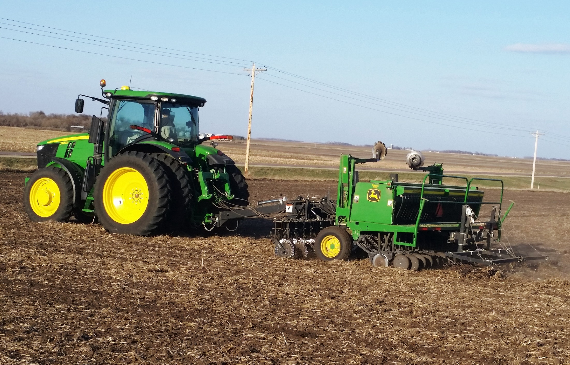
Growing and Marketing a
New Crop
Authors
Gigi DiGiacomo
Kristine Moncada
Adria Fernandez
Constance Carlson
Craig Sheaffer
This material is based upon work that is supported by the National Institute of Food and Agriculture, U.S. Department of Agriculture, under grant number 2013-51106-21005.
Notes:
Narration: Welcome to our module “Growing and Marketing a New Crop”. Image: Carmen Fernholz

Slide 2
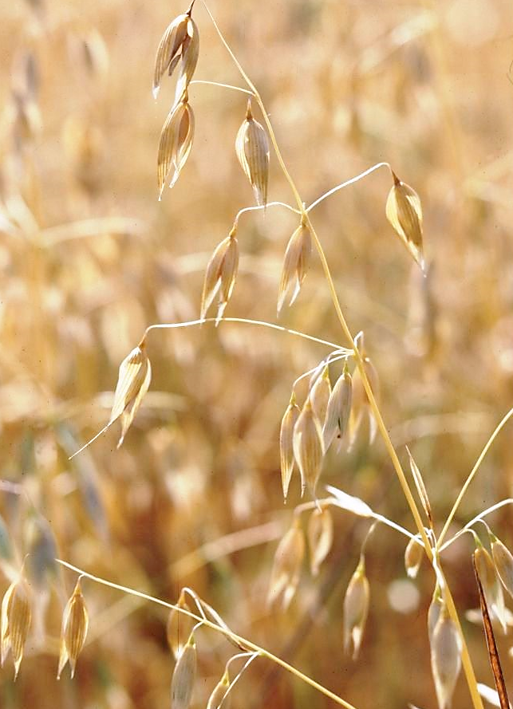
Growing and Marketing a New Crop
Introduction
Soil and climate
Markets
Enterprise budgets
Other things to consider
Notes:
Narration: Organic certification rules require that organic farmers plant a rotation of crops to replenish their soil and build organic matter. How do you know which crop or rotation of crops are good for your farm and your business? In this module we’ll offer a few tips on how best to evaluate new rotation crops by looking at soils and climate, market, and finance conditions. Image: David L. Hansen, University of Minnesota

Slide 3
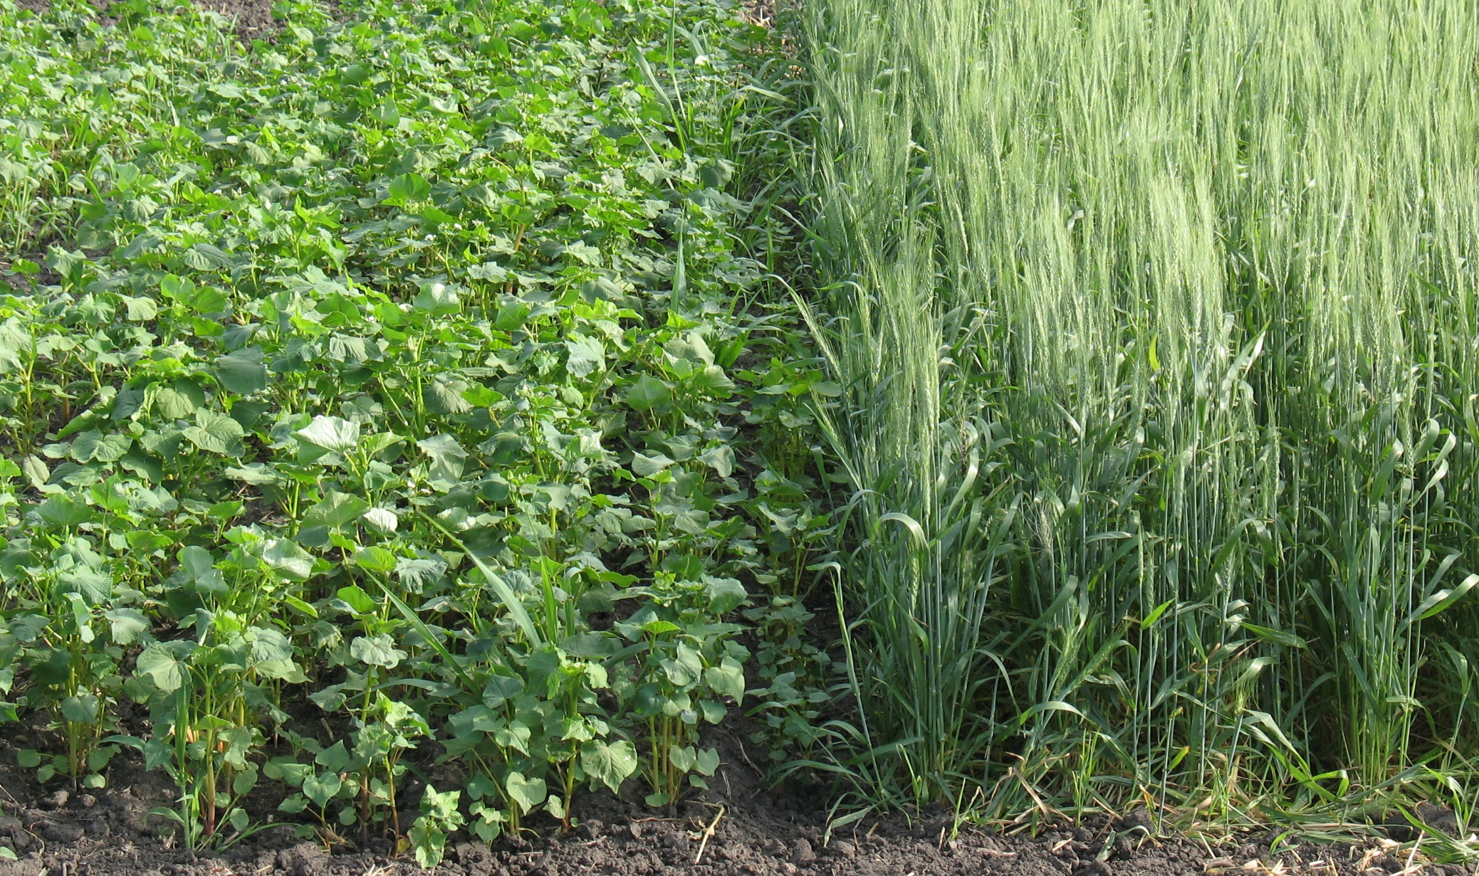
Introduction
What will you include in your organic rotation? Will it be a new crop?
Notes:
Narration: What will you include in your organic rotation? Organic rotations are more diverse and include other crops in addition to corn and soybean. If coming from a conventional corn-soybean rotation, you may be unfamiliar with crops such as small grains, legumes, and forages. You may need to start growing a crop that is new to you. For the purposes of this module, we are calling crops that are new to you a “new crop”. Image: University of Minnesota

Slide 4
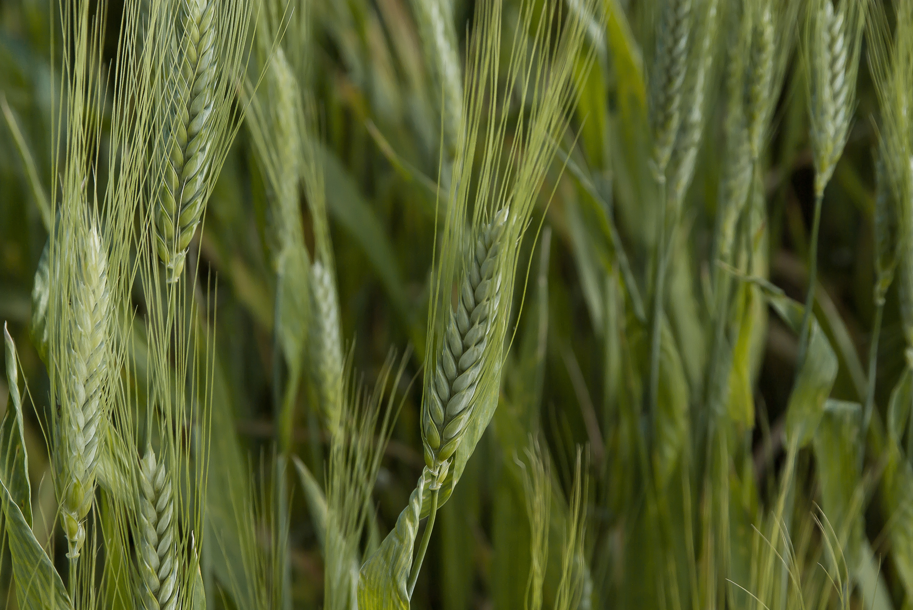
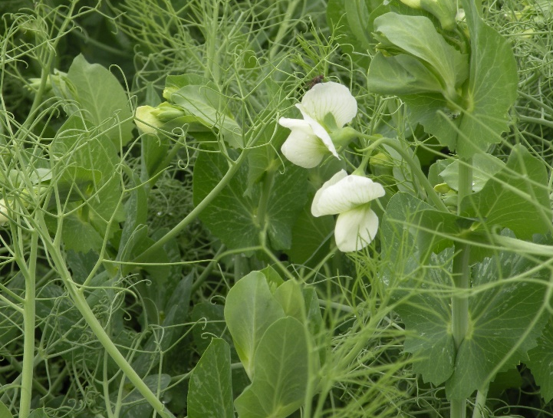
Crops for Organic Rotations
Wheat
Barley
Flax
Buckwheat
Field peas
Oats
Alfalfa
Sunflowers
Notes:
Narration: Examples of organic crops for the Upper Midwest that may be unfamiliar to you but you may want to consider include wheat, barley, flax, buckwheat, field peas, oats, alfalfa, and sunflowers. All have different attributes that may make them more suitable for your specific conditions. Images: Pixabay (wheat; oats); Adria Fernandez, University of Minnesota (field pea)

Slide 5
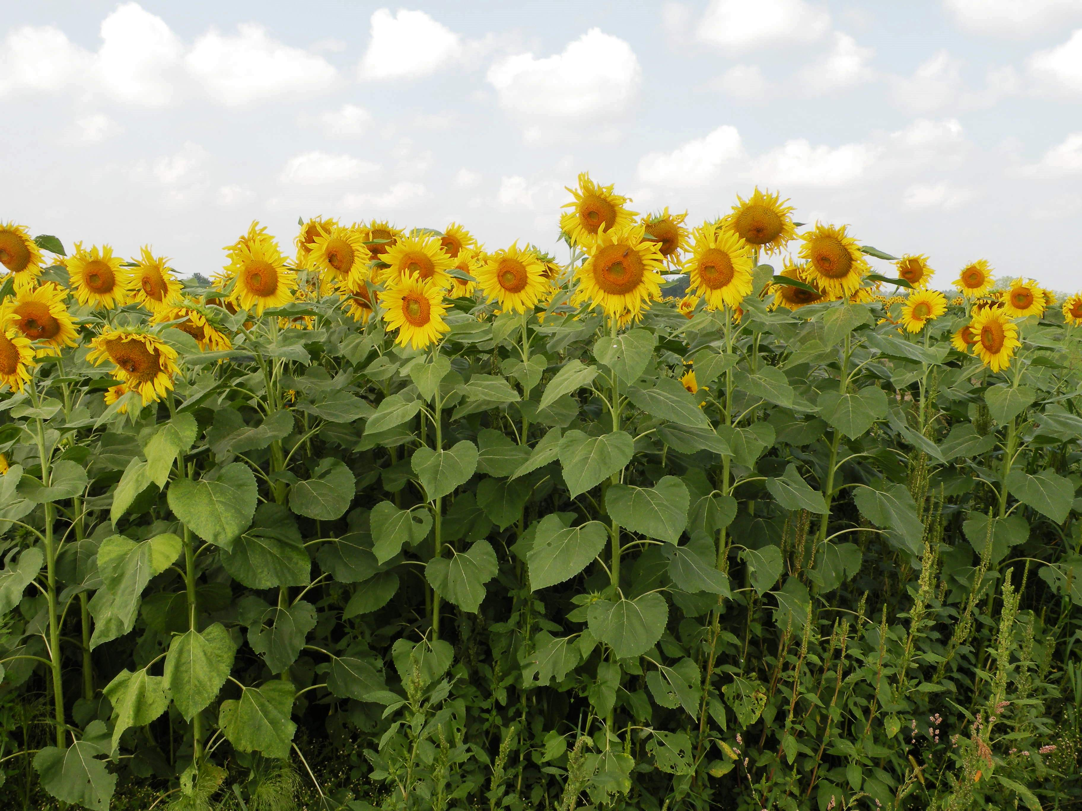
How to Identify New Crops for Your System?
Ask other farmers in your area
Contact local extension educators
Attend field days featuring new crops
Go to organic conferences
Notes:
Narration: If you are looking for other ideas, try asking other organic farmers in your area about what crops have been successful on their farms. Contact local extension educators and ask for recommendations. You might also consider attending field days and organic conferences that feature new crops and workshops on how to produce them. Image: University of Minnesota

Slide 6
Other Modules in Our Series
Forages
Small Grains
Alternative Crops
Notes:
Narration: If you prefer to learn from your desk, check out other modules in this series that discuss how to raise forages, small grains, and other less commonly-grown crops.
Image: Clipartfest.com

Slide 7
How Will You Decide What New Crop to Plant?
Agronomic factors?
Markets?
Finances?
Notes:
Narration: Once you’ve identified a new crop or two, you’ll need to evaluate whether or not each is good fit for your farm. This can be a difficult question to answer. It’s not always easy to find crops that equally satisfy your agronomic needs, market needs, and financial needs. You will need to consider all three when exploring new crops.
Image: Clipartkid.com

Slide 8
Growing and Marketing a New Crop
Introduction
Soil and climate
Markets
Enterprise budgets
Other things to consider
Notes:
Narration: Let’s begin with agronomic questions – specifically those that concern your current rotation, soil and climate conditions.
Image: David L. Hansen, University of Minnesota

Slide 9
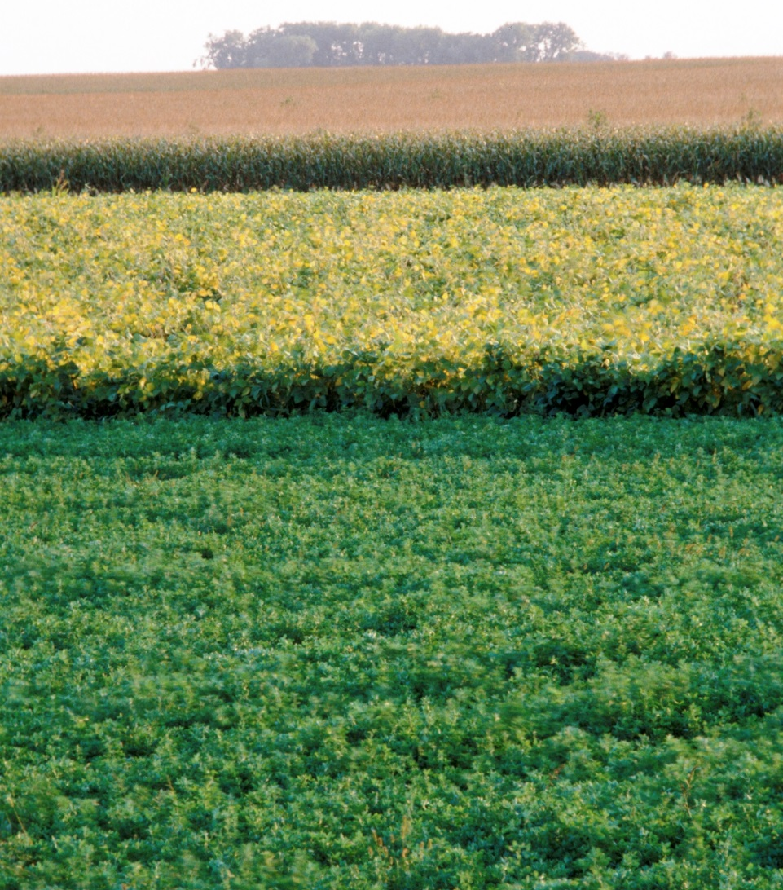
Finding New Crops that Complement Your Rotation
Legumes such as alfalfa can provide nitrogen for subsequent crops
Small grains and alfalfa can suppress weeds
Notes:
Narration: What new crops might work best in your rotation? For a corn-and-soybean rotation, a legume such as alfalfa may provide additional benefits such as fixing nitrogen and crops such as a small grain or alfalfa can function to suppress weeds. For more information on choosing rotations and NOP rules on rotations, please watch the Rotation module. Image: David L. Hansen, University of Minnesota

Slide 10
Choose new crops that are adapted to your conditions
Notes:
Narration: An important factor in choosing a new crop is making sure it will thrive in the conditions on your farm.
Image: David L. Hansen, University of Minnesota

Slide 11
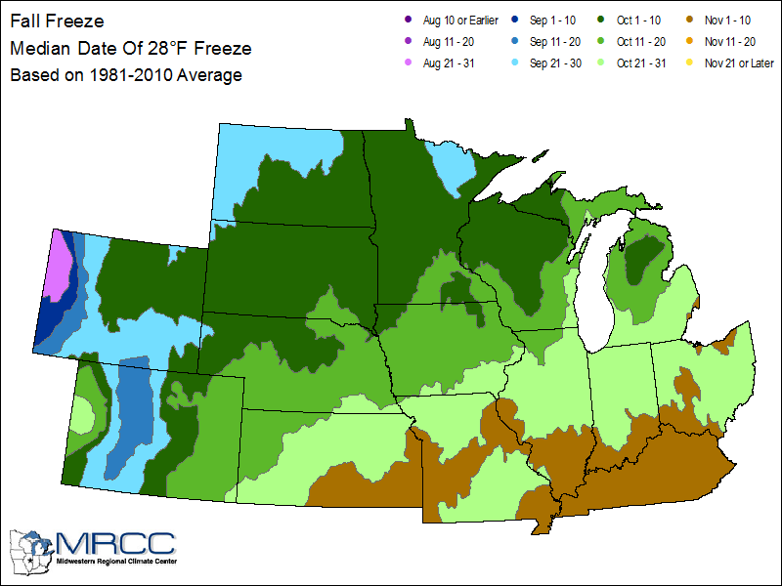
Crop Adaptation Factors
Temperature
Moisture
Relative maturity
Nutrient requirements
Median Date of 28° F Freeze
Source: Midwestern Regional Climate Center
Notes:
Narration: Just like corn and soybean, all crops have specific conditions that will optimize their growth. They may vary in their temperature and moisture requirements, relative maturity, and nutrient requirements. For example if you are planning to overwinter a crop such as alfalfa or winter wheat, you will need to determine whether it will survive the long Minnesota winters. Image: Midwestern Regional Climate Center - http://mrcc.illinois.edu/CLIMATE

Slide 12
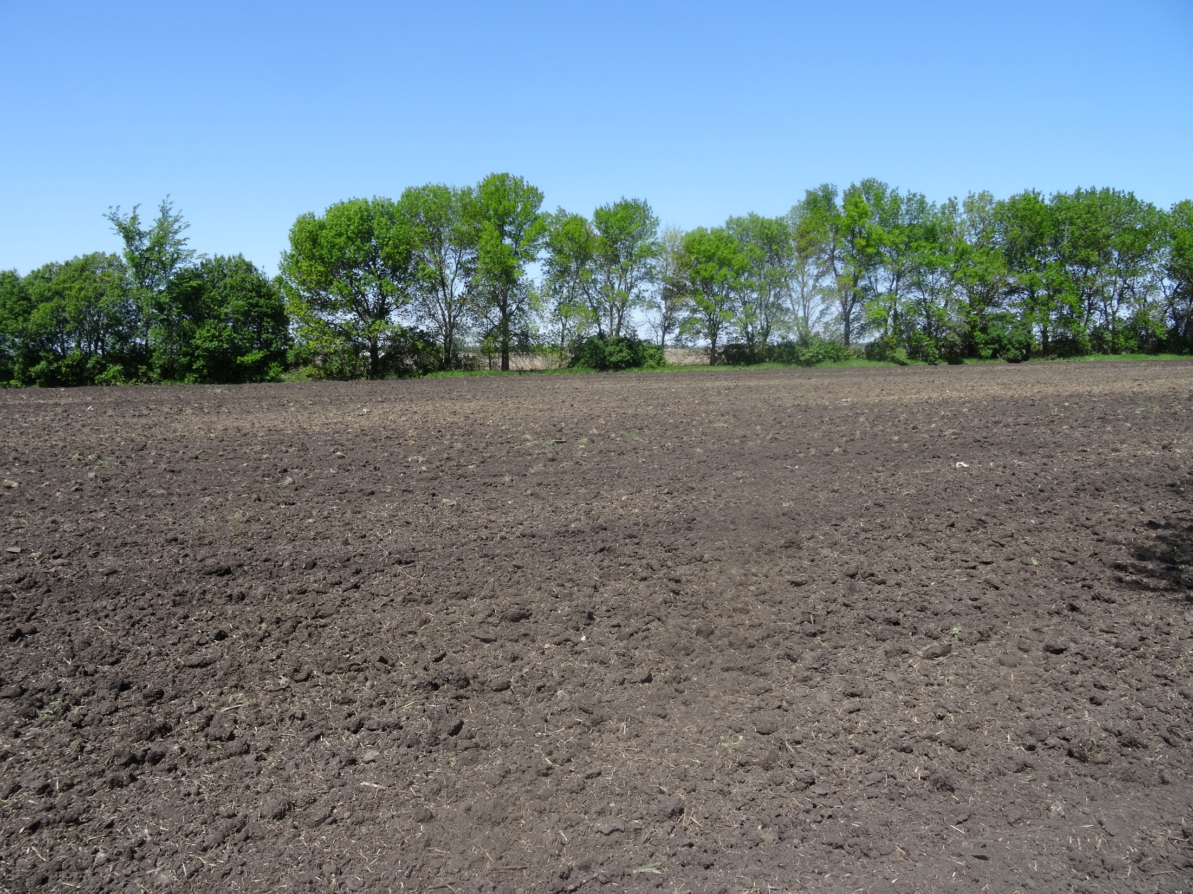
Consider Soil Conditions
Adjust the pH with lime to match needs of crop
Add organic fertilizers to suit new crop needs
Notes:
Narration: New crops may require additional preparation before including them in your operation. pH may need to be adjusted with lime and organic fertilizers may need to be incorporated to optimize yields. Please watch our module on Soil Fertility for more information. Image: Kristine Moncada, University of Minnesota

Slide 13
Take Your New Crop for “Test Run”
Size plots to accommodate field equipment
Test different varieties
Take notes: weather conditions, input expenses, labor, yield
Notes:
Narration: It’s important to make sure that your crop will yield well and that you have the knowledge and skill needed to grow it. That’s why it’s a good idea to talk with other farmers and Extension educators first and then take your crop for a “test run”. We strongly suggest doing a bit of your own on-farm research by growing field-scale plots, maybe even testing a few varieties over more than one year. Be sure to take notes about weather conditions, inputs, and yield. You will want some record of what worked and what didn’t when making a final decision.
Image: Pixabay

Slide 14
Growing and Marketing a New Crop
Introduction
Soil and climate
Markets
Enterprise budgets
Other things to consider
Notes:
Narration: Next let’s talk about markets. If you can’t sell the new crop you’re considering – or use it on farm - you probably shouldn’t grow it!
Image: David L. Hansen, University of Minnesota

Slide 15
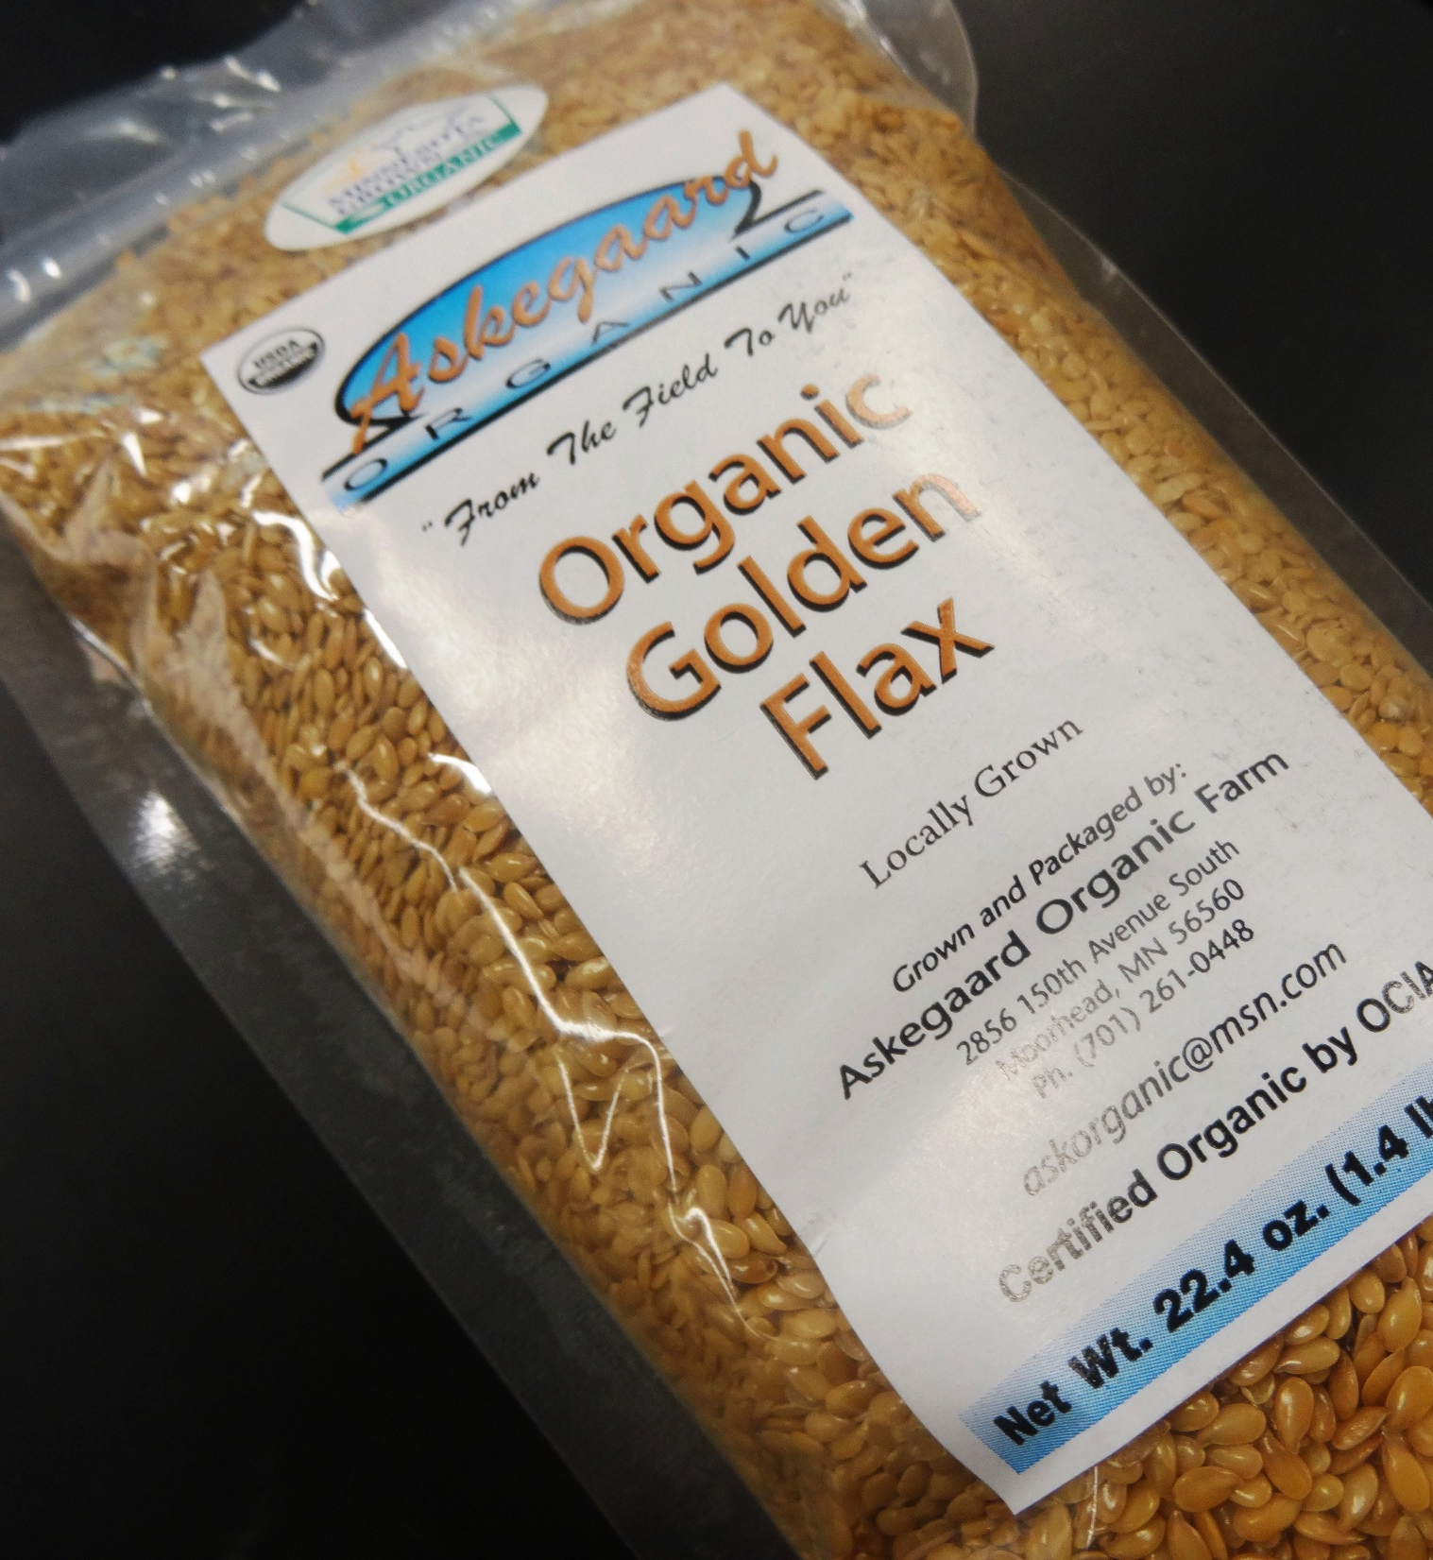
Is There a Market for Your New Crop?
Can be a challenge to find markets for crops other than corn and soybean
What crops are buyers looking for?
Notes:
Narration: As you might imagine, markets for some crops are quite small. (See the Marketing module for our discussion of liquidity). Therefore finding buyers for alternative commodities can be difficult and may not bring much, if any, premium even when certified organic. This is why so many transitioning and newly certified organic farmers consider it challenging to identify markets for rotation crops and small grains. The best way to overcome this hurdle is to spend more time connecting with buyers. You may even uncover an opportunity to supply a new niche market!
Image: Kristine Moncada, University of Minnesota

Slide 16
Buyers
Brokers
Marketing groups
Farmer cooperatives
Organic trade shows
Specialized auctions
Other farmers
Organic
Grain Buyer
https://mercaris.com/
Notes:
Narration: One of the first things you’ll notice when going organic, is that there are far fewer processing facilities and grain elevators that handle organic products. As a result, finding buyers for transitioning and organic crops – especially small grains, forages, and legumes – can be difficult. Many transitioning and newly certified organic farmers find themselves looking to brokers, specialized marketing groups, farmer cooperatives, and trade shows for help with selling grain and lining up buyers. Some farmers are beginning to participate in emerging electronic auctions, like the one operated by Mercaris, to market their rotation crops.
Image: Pixabay

Slide 17
Identifying Buyers – Organic Trade Shows
Iowa Organic Conference (IA)
Illinois Specialty Crops, Agritourism and Organic Conference and Trade Show (IL)
Minnesota Organic Conference (MN)
Northern Plains Sustainable Ag Society Annual Conference (SD)
MOSES Organic Farming Conference (WI)
Notes:
Narration: One of the best ways to identify organic buyers is by visiting trade shows in your state or region. Trade shows, usually held in conjunction with skill-building workshops and other conference events, are well attended by organic buyers who sometimes offer contracts for transitional and/or non-GMO grain in addition to forward contracts for organic grains and oilseeds. We’ve listed a few of the more well-known conferences in the Upper Midwest here and strongly suggest attending one or more shows as you explore transitional and organic markets.
Image: Midwest Organic and Sustainable Education Service

Slide 18
What Questions Should You Ask Buyers?
Do you offer contracts or buy cash only?
What price will you pay?
How much will you purchase?
When will you expect delivery?
Notes:
Narration: When talking with buyers about a new crop, you’ll want to ask four basic questions: 1) Do you offer contracts or buy cash only? (If you are unfamiliar with these options, see our Marketing module). Next, be sure to ask what price the buyer is offering and how many bushels or tons they might be interested in purchasing. You’ll need to know this information when considering how much to plant. Finally, ask when the buyer might take delivery. In other words, will you be expected to store the crop after harvest? All of this information is needed to explore the financial feasibility of your new crop.
Image: Pixabay

Slide 19
Is There a Viable Market for Your New Crop?
Notes:
Narration: After doing some market research, you should be able to judge whether there’s a viable market for your new crop. If the answer is “yes,” put your new crop through one last important feasibility test. Explore your finances and examine enterprise budgets.
Image: Sean McGuire, gratisography.com

Slide 20
Growing and Marketing a New Crop
Introduction
Soil and climate
Markets
Enterprise budgets
Other things to consider
Notes:
Narration: In this next section we’ll take a look at how to develop an enterprise budget for your new crop and calculate potential profit. After all, farmers, like most business owners, can’t afford to lose money. Even if planting a crop purely for it’s soil building capacity, your goals should include breaking even on that enterprise. Image: David L. Hansen, University of Minnesota

Slide 21
Enterprise Budget
Gross Income
Direct Expenses
Overhead Expenses
Net Return
Subtract
Notes:
Narration: An enterprise budget can help you determine whether or not your new crop will turn a profit, break even, or lose money. An enterprise budget lists your income and expenses. Your profit or loss is simply calculated by subtracting direct and overhead expenses from gross income. Let’s take a closer look at how the enterprise budget works using an example.

Slide 22
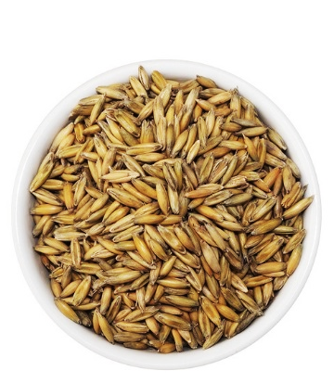
Gross Income
Organic Oat Example
Yield (bushels) | 47.75
Value/Bu | $6.33
Total Crop Return/Acre | $302.26
Other Income/Acre | $44.87
Gross Income/Acre | $347.13
47.75 bu X $6.33/bu = $302.26
$302.26 + $44.87 = $347.13
Data: Center for Farm Financial Management, FINBIN Database, Average Expenses and Returns for 2011-2015.
Notes:
Narration: For our example we will calculate the income potential of organic oats. We begin by calculating total crop return per acre - by multiplying expected yield by expected value. In this case, the expected organic oat yield is 47.75 bushels per acre. The expected value is $6.33 per bushel. Multiplying these together produces a gross return of $302.26 per acre. Next, we add in any additional income such as government payments and crop insurance which, in this example, is equal to $44.87. Adding crop returns and other income together, we arrive at gross income per acre which is equal to $347.13. Image: Pixabay

Slide 23
Direct Expenses
Seed | $33.31
Fertilizer | $10.15
Crop Insurance | $4.33
Storage | $0.40
Fuel & Oil | $22.18
Repairs | $34.80
Custom Hire | $9.64
Hired Labor | $4.99
Land Rent | $77.64
Machinery Leases | $2.89
Utilities | $1.28
Hauling and Trucking | $1.27
Organic Certification | $1.98
Operating Interest | $4.27
Other | $3.14
Total Direct Expenses/Acre | $212.27
Organic Oat Example
Data: Center for Farm Financial Management, FINBIN Database, Average Expenses and Returns for 2011-2015.
Notes:
Narration: Next, draft a list of all input expenses – the direct or variable costs associated with growing your new crop. In this example, notice that we’ve included obvious costs such as seed, fertilizer, fuel and oil, land rent, and hired labor. However, don’t forget to include the costs associated with organic certification fees and hauling and trucking – these could be more than you’re used to with conventional crops. When added together, total direct costs per acre equal $212.27. Image: Pixabay

Slide 24
Overhead Expenses
Organic Oat Example
Family labor, management | $45.25
Building leases | $2.19
Property Taxes | $7.25
Farm Insurance | $5.73
Utilities | $4.03
Dues & Prof Fees | $2.43
Interest | $24.69
Mach & Bldg Depreciation | $33.83
Other | $6.15
Total Overhead/Acre | $131.55
Data: Center for Farm Financial Management, FINBIN Database, Average Expenses and Returns for 2011-2015.
Notes:
Narration: Finally, you’ll want to factor in overhead costs to get an accurate estimate of new crop returns. Overhead costs are those expenses incurred, such as farm insurance and property taxes, regardless of whether you take on a new crop. Overhead expenses are distributed proportionately across all crop enterprises. In the example here, overhead expenses total $131.55 per acre.
Image: Pixabay

Slide 25
Enterprise Budget – Oat Example
Gross Income
Direct Expenses
Overhead Expenses
Net Return
$347.13 - $212.27 - $131.55 = $3.31
Notes:
Narration: We subtract these direct and overhead expenses from gross income to arrive at “net returns per acre” equal to $3.31.

Slide 26
Average Net Return/Acre for Select Organic Crops, Midwest Farmers, 2012-2015
Crop | # Farms | Avg. # Acres | Avg. Net Return/Acre*
Barley | 59 | 72 | $62.85
Oats | 74 | 52 | $42.87
Rye | 7 | 37 | ($18.26)
Spring Wheat | 40 | 128 | $209.67
Hay, Alfalfa | 141 | 127 | $201.54
* Does not include government payments or cost of overhead labor & management.
Source: Center for Farm Financial Management, FINBIN database, 2012-2015
Notes:
Narration: Many small grain crops, like oats, are not big money makers even when organic premiums are factored in. Others, however, do quite well depending on market conditions. The chart here shows average net returns for organic rotation crops as reported during the years of 2012-2015 by Midwest farmers and recorded in the Center for Farm Financial Management’s FINBIN database. Given the range of returns, it’s important to crunch numbers and explore the profit potential of various new crops before making your final planting decisions.

Slide 27
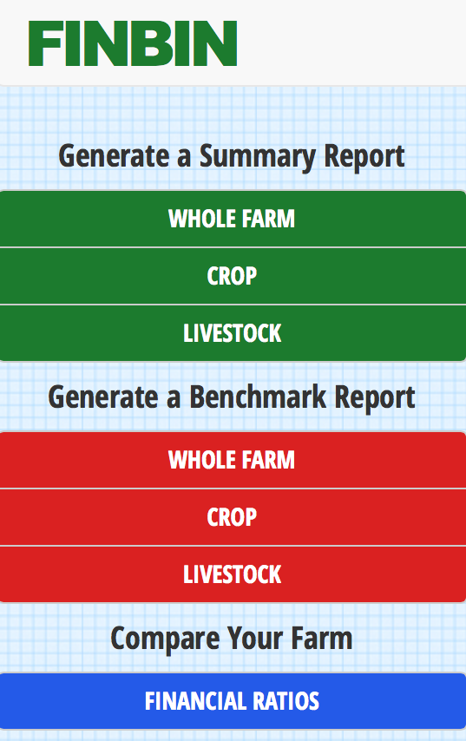
FINBIN Database
Direct expenses
Overhead expenses
Yields
Market prices
Net returns
FINBIN.umn.edu
Notes:
Narration: If you’re growing a crop you haven’t grown before, you’ll be relying on information from other farmers and buyers for input expense, yield, and price information. Another information source is the Center for Farm Financial Management’s FINBIN database, as mentioned in the previous slide. FINBIN aggregates actual financial data from thousands of farms in the Upper Midwest identified as conventional, transitional, and organic. This is a great place to start if you are looking for average input expenses, yields, market prices, and net returns for a large variety of Midwest grains, forages, oilseeds, and vegetables. Image: finbin.umn.edu

Slide 28
Growing and Marketing a New Crop
Introduction
Soil and climate
Markets
Enterprise budgets
Other things to consider
Notes:
Narration: We will cover a few other important things to consider when marketing a new crop. Image: David L. Hansen, University of Minnesota

Slide 29
Take a Close Look at New Costs
74% of Minnesota farmers purchased new equipment when transitioning
28% of Minnesota farmers hired custom services when transitioning
Storage and drying costs may increase
Source: "Intake Survey Results," Tools for Transition Intake Survey Cumulative Results, Tools for Transition Project. Updated 9.6.12. http://eorganic.info/toolsfortransition
Notes:
Narration: When developing an enterprise budget, pay close attention to new costs you may incur. Many farmers require new investments when transitioning and/or diversifying crop enterprises. A recent survey of Minnesota farmers found that 74 percent purchased new equipment and 28 percent hired custom services when first transitioning to organic. Talk with an extension educator and other farmers to learn more about what may be needed to plant your new crop, manage weeds, and harvest. You will also want to explore whether or not additional storage capacity is required when growing a new crop. Image: Carmen Fernholz

Slide 30
Carefully Estimate Labor Expenses
34% of Minnesota farmers hired labor when first transitioning
Diversified systems take more time to manage and market (learning curve)
Source: "Intake Survey Results," Tools for Transition Intake Survey Cumulative Results, Tools for Transition Project. Updated 9.6.12. http://eorganic.info/toolsfortransition
Notes:
Narration: Similarly, many transitioning farmers observe an increase in labor requirements when first going organic. In fact, in one survey, 34% of Minnesota farmers surveyed reported hiring additional farm labor when transitioning. Why the extra labor? Diversified systems can take more time to manage and organic marketing is typically more time consuming than conventional marketing. Think carefully about potential labor requirements when growing a new crop and, again, account for these in your enterprise budget.
Image: Carmen Fernholz

Slide 31
Risk Analysis
Explore how changes in the following affect financial performance:
Interest rates
Input costs
Yield
Notes:
Narration: Lastly, when developing an enterprise budget for a new or unfamiliar crop, it’s very important to see how net returns hold up when exposed to various risks. Examples of various risks include: changes in interest rates that can affect an operating or intermediate loan for new machinery. Shortages in organic seed that can dramatically affect input costs, and inclement weather that affects yields. Even your own learning curve when planting a crop for the first time is a risk that can affect your net return. Image: Pixabay

Slide 32
Exploring Changes
Vary input expenses, yields and market prices in enterprise budget by 5-20%
Budget Item | Percent Change | Impact | Net Return/Acre
Seed | 10% increase | $3.30/acre increase | $7.70
Land rent | 10% increase | $7.70/acre increase | $3.30
Yield | 10% decrease | -4.7bu/acre | -$19.37
Market price | 10% decrease | -$0.63/bu | -$19.37
Notes:
Narration: Risk management advisors suggest varying interest rates, individual input expenses, yields, and market prices in your enterprise budget by 5-20% to see how well it performs financially under different conditions. It’s simple and easy to do as shown in the example where we varied each budget item, individually, by 10%. You might be surprised how much a relatively small change can affect the bottom line. How well will your new crop perform financially when exposed to different risks?

Slide 33
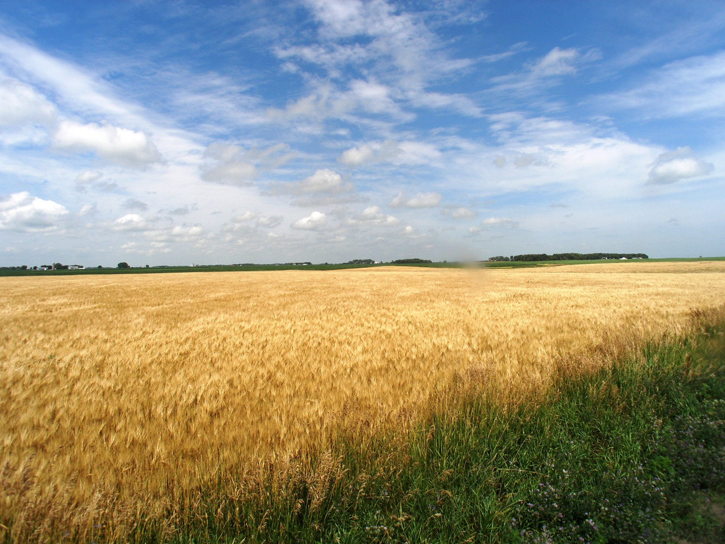
Questions to Ask
Do I have the right growing conditions?
Is there a buyer in the market?
Can I break-even or make a profit?
Will my new crop break-even under different risk conditions?
Notes:
Narration: Are you ready to grow a new crop? Before you do, make sure you know the answers to the following questions: Do I have the right growing conditions? Is there a buyer in the market? Can I break even or make a profit? Will my new crop still break-even under different risk conditions?
Image: Carmen Fernholz

Slide 34
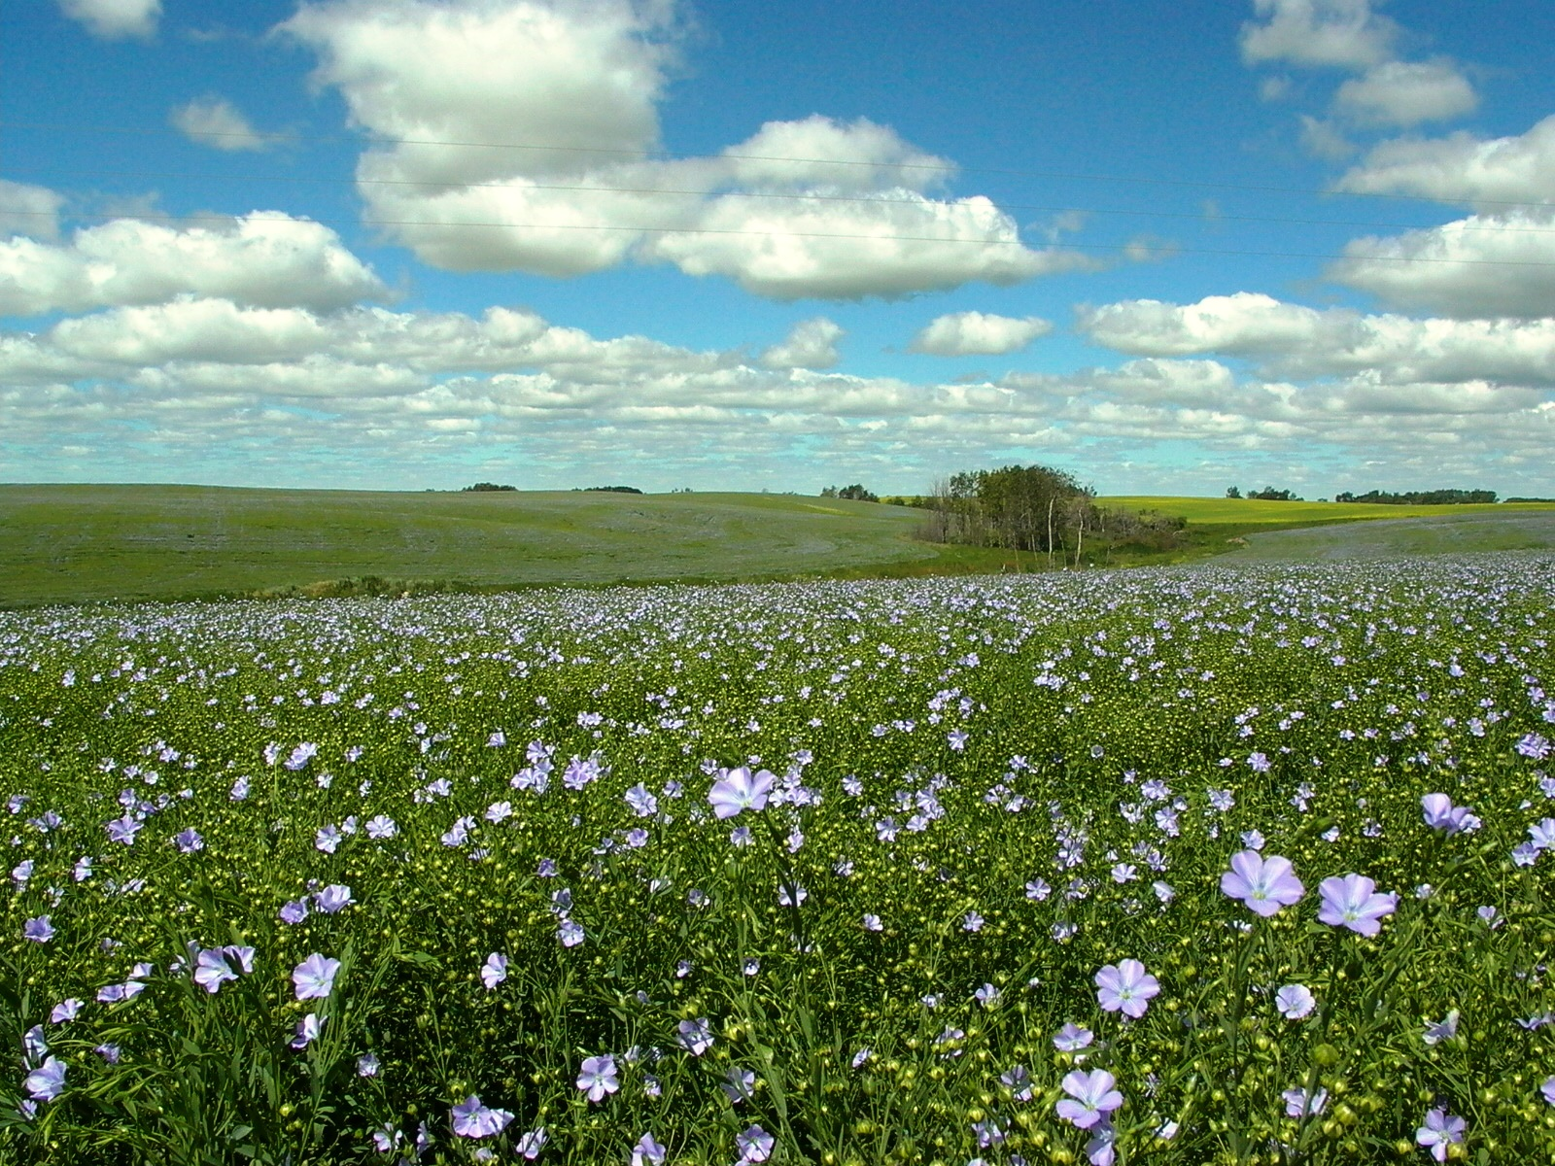
Evaluating a New Crop
Do I have the resources needed to grow a new crop?
Am I confident that I can grow the new crop?
Will the new crop help build resources for the future (e.g. soil quality, finances)?
How will the new crop benefit the farm operation?
Notes:
Narration: Another way of thinking about and evaluating a new crop is to ask yourself: 1) Do I have the resources needed to grow a new crop? If not, do you have access to financing to purchase needed resources, can you hire them, or arrange to share them with another farmer? Second, ask yourself, “Am I confident that I can grow the new crop?” Did you take your crop for a test run? How did it turn out? Ultimately, you’ll want to ask, will the new crop benefit the farm operation and if so, how? Will you build soil quality? Will you improve finances?
Image: Jim Stordahl, University of Minnesota

Slide 35
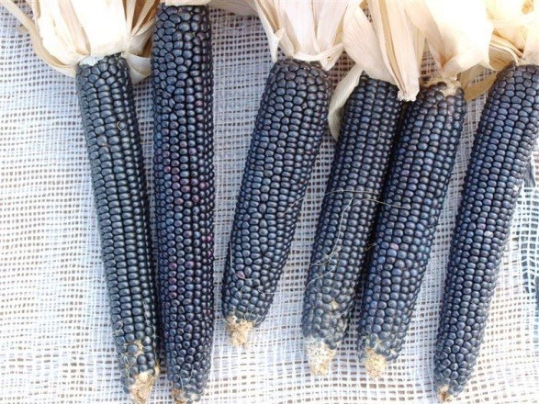
Good luck with your new crop!
Notes:
Narration: Good luck with your new crop!
Image: David L. Hansen, University of Minnesota (sunflower, flax); Amol Nankar, New Mexico State University (blue corn); Adria Fernandez, University of Minnesota (field pea)

Slide 36
Growing and Marketing a New Crop
Introduction
Soil and climate
Markets
Enterprise budgets
Other things to consider
Notes:
Narration: We’ve reached the end of our New Crop module. Don’t forget to watch other modules in our series!
Image: David L. Hansen, University of Minnesota

Slide 37
Resources
Organic Crop Production Enterprise Budgets – Iowa State University
Organic Crop Production Enterprise Budgets – Oregon Tilth
Crop Budgets – University of Minnesota
Organic Grain Enterprise Budgets for ND, SD, and MT Tools for Transition – The Organic Center
Tools for Transition Project – University of Minnesota
Notes:
Narration: Here are some resources we recommend for exploring enterprise budgets and transitioning economics.

Slide 38
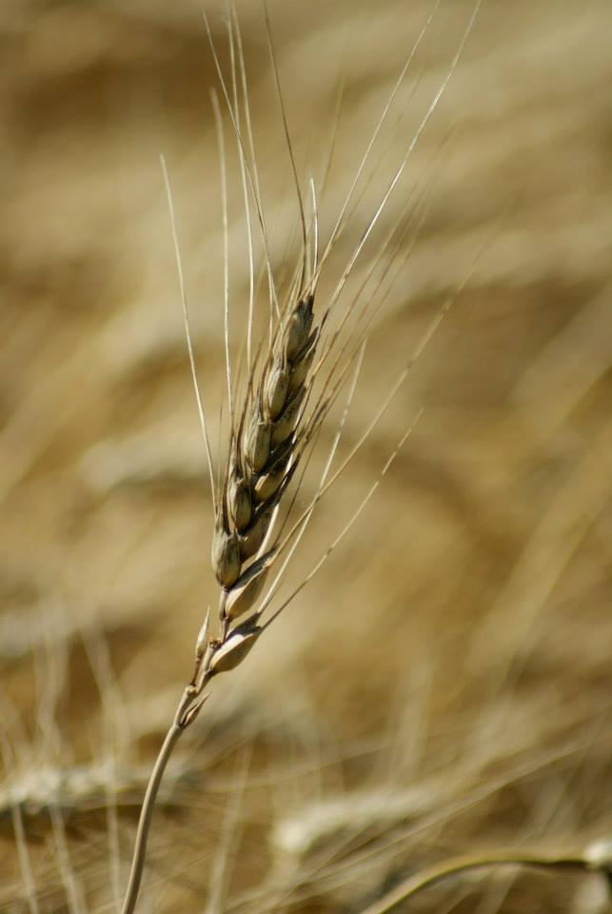
© 2017 Regents of the University of Minnesota. All rights reserved. The University of Minnesota is an equal opportunity educator and employer.
This material is based upon work that is supported by the National Institute of Food and Agriculture, U.S. Department of Agriculture, under grant number 2013-51106-21005.
Notes:
Narration: This material is based upon work that is supported by the National Institute of Food and Agriculture.
Image: Constance Carlson, University of Minnesota

Slide 39
References
FINBIN database. Center for Farm Financial Management. https://www.cffm.umn.edu/products/FINBIN.aspx. Accessed 6.29.17
Mercaris https://mercaris.com/
Tools for Transition Intake Survey Cumulative Results, Tools for Transition Project. Updated 9.6.12 http://eorganic.info/toolsfortransition

