Slide 1
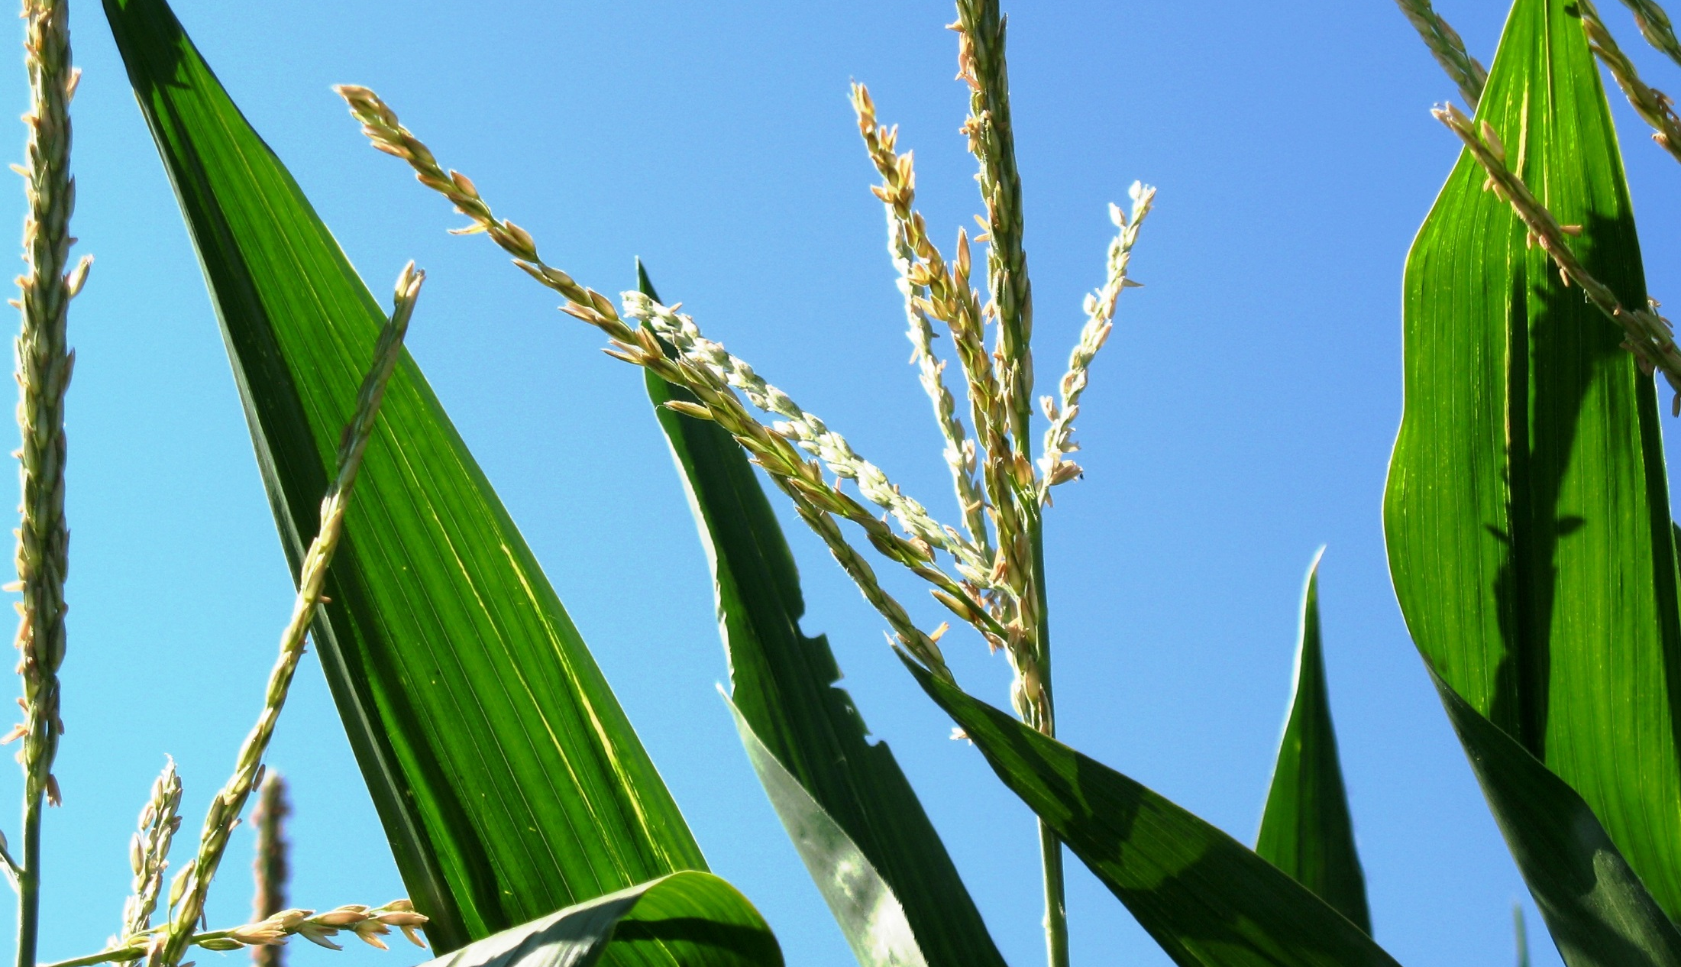
Preventing GMO Contamination
This material is based upon work that is supported by the National Institute of Food and Agriculture, U.S. Department of Agriculture, under grant number 2013-51106-21005.
Authors
Adria Fernandez
Jim Riddle
Kristine Moncada
Constance Carlson
Craig Sheaffer
Narrated by
Constance Carlson
Notes:
Narration: Welcome to our module on preventing GMO contamination.
Image: Kristine Moncada, University of Minnesota

Slide 2
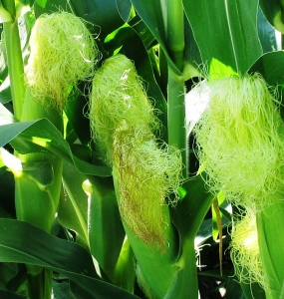
Preventing GMO Contamination
What is a GMO?
GMOs and organic agriculture
How contamination occurs
Consequences
Protecting yourself
Resources
Notes:
Narration: There are six parts to this module: What is a GMO, GMOs and organic, how contamination occurs, what the consequences are, how to protect yourself, and resources for more information. First, we’ll talk a little about what exactly a GMO is. We’ll define some key terms that are often used in discussions of GMOs, and we’ll go over the current status of GMO crops.
Image: Kristine Moncada, University of Minnesota

Slide 3
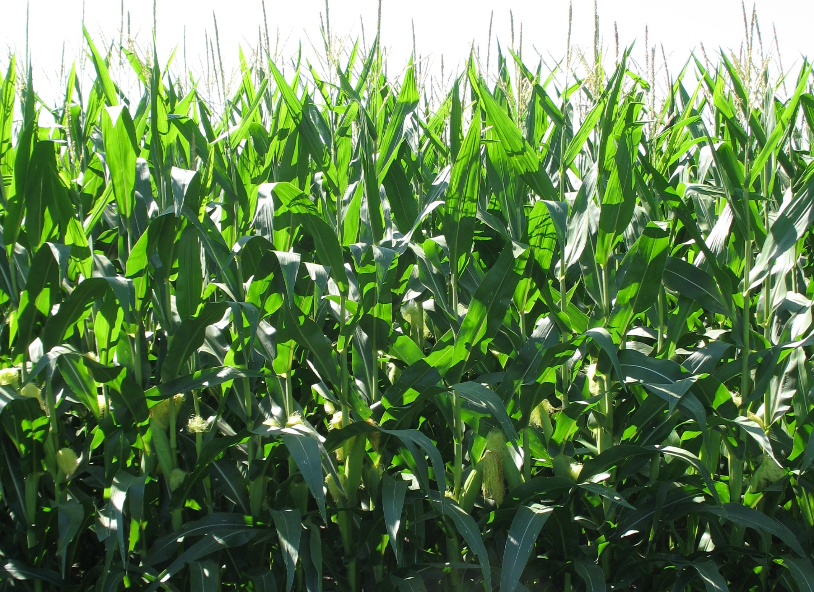
What Is a GMO?
Genetically Modified Organism
A plant or other organism bred using genetic engineering techniques
  National Organic Program defines excluded methods
Notes:
Narration: GMO stands for Genetically Modified Organism. The term can be defined in different ways. Most simply, a GMO is an organism—often a plant, but it can also apply to animals, bacteria, or fungi—that has been bred using methods that directly alters the genetic material using genetic engineering techniques. The USDA’s National Organic Program provides a specific list of breeding techniques that are not permitted under organic standards.
Image: Kristine Moncada, University of Minnesota

Slide 4
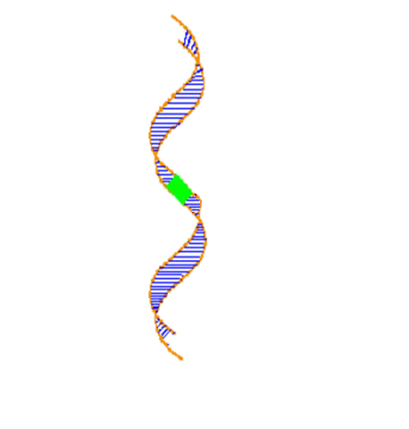
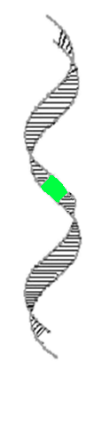
Other Terms to Know
Gene from one species is transferred to new species
Genetic engineering/genetic modification (GE or GM)
Transgenic: containing DNA from another species (transgenes)
Species 1
Species 2
Notes:
Narration: Genetic engineering is used as a synonym for genetic modification, so you will see the terms “genetically engineered” and “genetically modified” used interchangeably. Another term that is sometimes used interchangeably is transgenic. Transgenic is a type of genetic modification that means the DNA that was transferred came from an organism of a different species—by extension, transgenes are the inserted genes that came from another species. We will discuss some of the specific genes from other species that are inserted into crops later.
Image: USDA-ARS

Slide 5
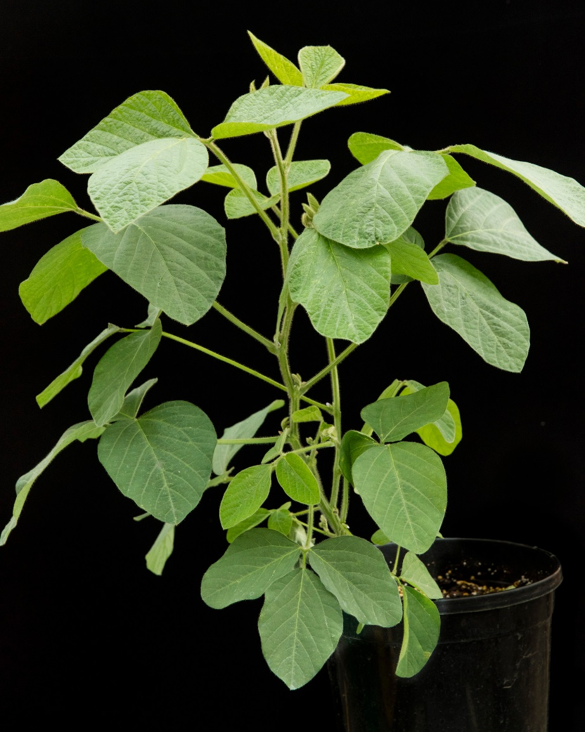
Patented gene or trait
Gene (or trait) whose use can be restricted by patent holder
Trait is specific characteristic arising from transgene
Examples
  Herbicide resistance: allows crop to survive herbicide application
  Bt: bacterial-derived insecticide
Notes:
Narration: The insertion of a transgene into an organism is considered a patentable invention, and therefore the use of transgenic crops can be restricted by terms dictated by the patent holder, to ensure that no one can grow crops with the engineered trait unless they pay a licensing fee to the patent holder. A trait can mean any characteristic of an organism, but in the context of genetic engineering, “trait” generally refers to the specific characteristic arising from the transgene. In the crop plants that we’ll be discussing, the traits involved are generally herbicide resistance or production of the insecticide Bt.
Image: David L. Hansen, University of Minnesota

Slide 6
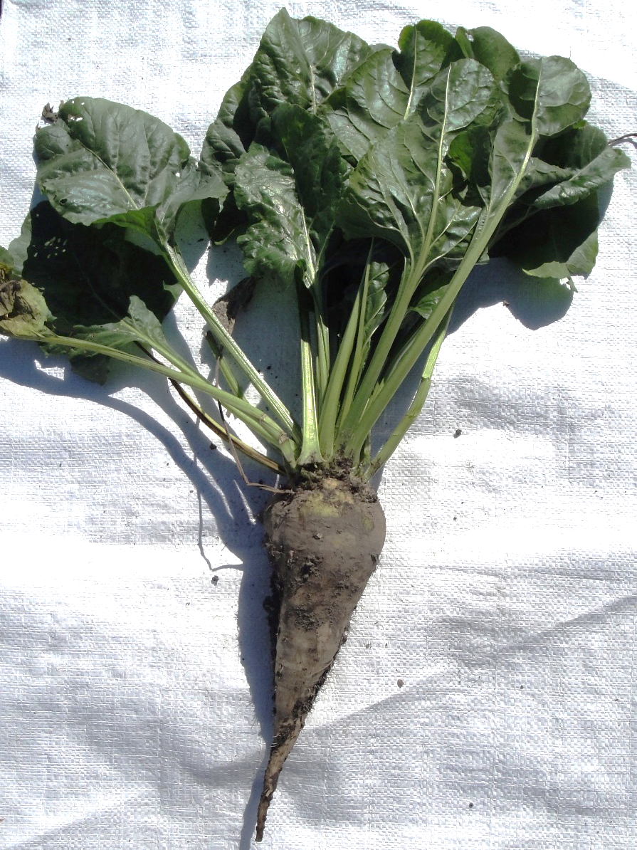
Which Crops Have Been Genetically Modified?
Corn (field and sweet)
Soybean
Alfalfa
Sugarbeet
Canola
Cotton
Some vegetables and fruits
Notes:
Narration: Not all crops have been genetically modified. The most widespread GMO crops are corn and soybean, but there are also commercially produced varieties of GMO alfalfa, sugarbeet, canola, cotton, and several fruits and vegetables including potato and papaya.
Image: John Lamb, University of Minnesota

Slide 7

Which Crops Have NOT Been Genetically Modified?
Wheat, oats, and other small grains
Dry edible beans
Peas
Sunflowers
Cover crops
Most fruits and vegetables
Notes:
Narration: There are currently no GMO varieties being marketed for small grains, dry edible beans, peas, sunflowers, common cover crop species, or most fruits and vegetables.
Image: David L. Hansen, University of Minnesota

Slide 8
Preventing GMO Contamination
What is a GMO?
GMOs and organic agriculture
How contamination occurs
Consequences
Protecting yourself
Resources
Notes:
Narration: In this next section, we will discuss how GMOs are addressed under National Organic Program rules.
Image: Kristine Moncada, University of Minnesota

Slide 9

Organic Definition of GMO
Breeding using “Excluded Methods”
  Cell fusion, microencapsulation and macroencapsulation
  Recombinant DNA technology = gene deletion, gene doubling, changing the positions of genes, and introducing a foreign gene (transgene)
Notes:
Narration: A GMO is specifically defined and addressed under National Organic Program regulations. In order to obtain organic certification, farmers cannot grow crops or use products that were produced using “Excluded Methods.” Excluded methods consist of cell fusion, microencapsulation, macroencapsulation and recombinant DNA technology that includes gene deletion, gene doubling, changing the position of genes and introducing a foreign gene.
Image: Peggy Greb, USDA-ARS

Slide 10
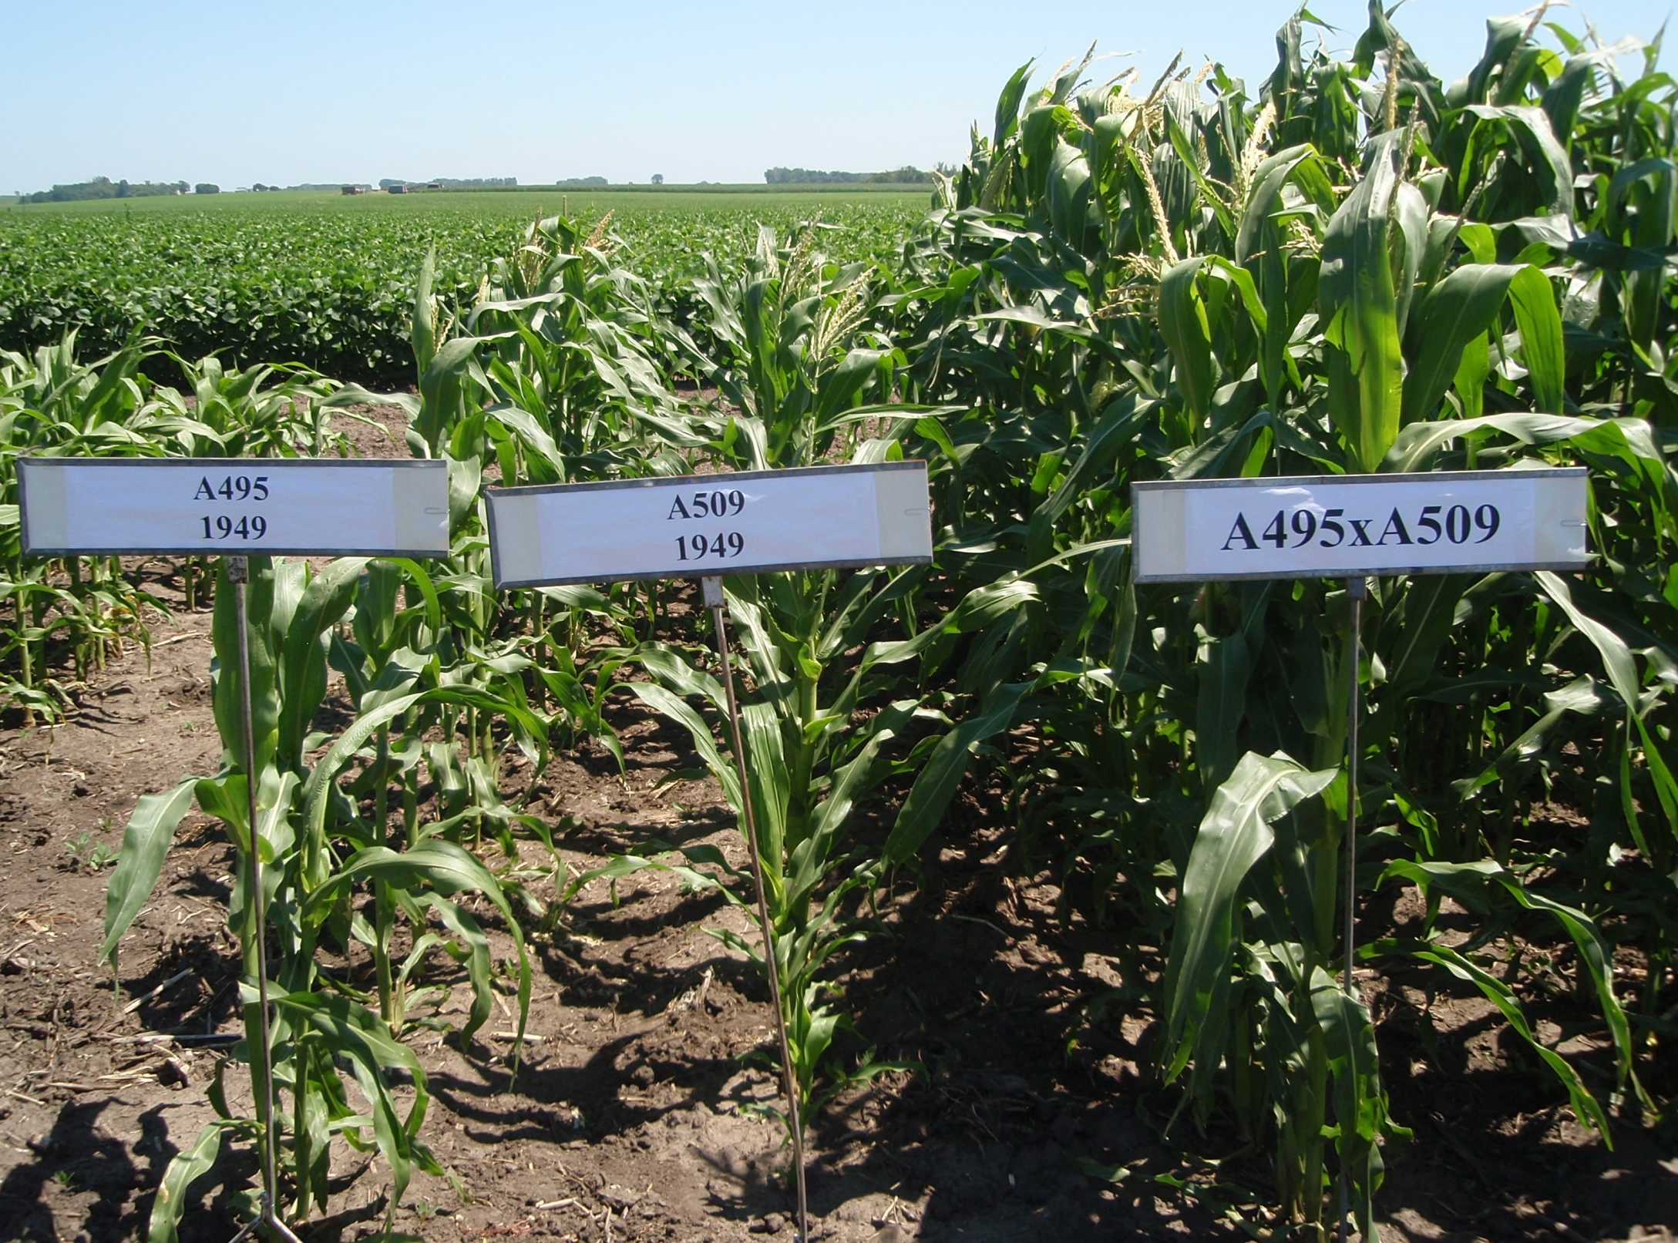
Traditional Hybrids ARE Allowed
INBRED 1
INBRED 2
HYBRID
Notes:
Narration: Breeding using hybridization is NOT an excluded method, and traditional hybrid varieties are allowed in organic production.
Image: Jeff Coulter, University of Minnesota

Slide 11
GMOs – Prohibited in Organic Agriculture
Cannot plant GMO crop seed
Cannot use GMO inputs
  Legume inoculants
  Biocontrol insecticides
  Growth hormones (livestock)
Verify non-GMO status of products before use
Notes:
Narration: GMOs are prohibited in all areas of certified organic production, under the definition of “Excluded Methods.” Organic farmers cannot knowingly plant GMO seed. They also cannot apply inputs that are GMO, such as genetically modified rhizobia in legume inoculants or genetically modified Bacillus thuringiensis bacteria in biocontrol insecticides. However, there are non-GMO versions of these inputs that may be allowed in organic. To know for certain whether an input is approved or non-GMO, you can check the listings maintained by OMRI, the Organic Materials Review Institute.
Image: David L. Hansen, University of Minnesota

Slide 12
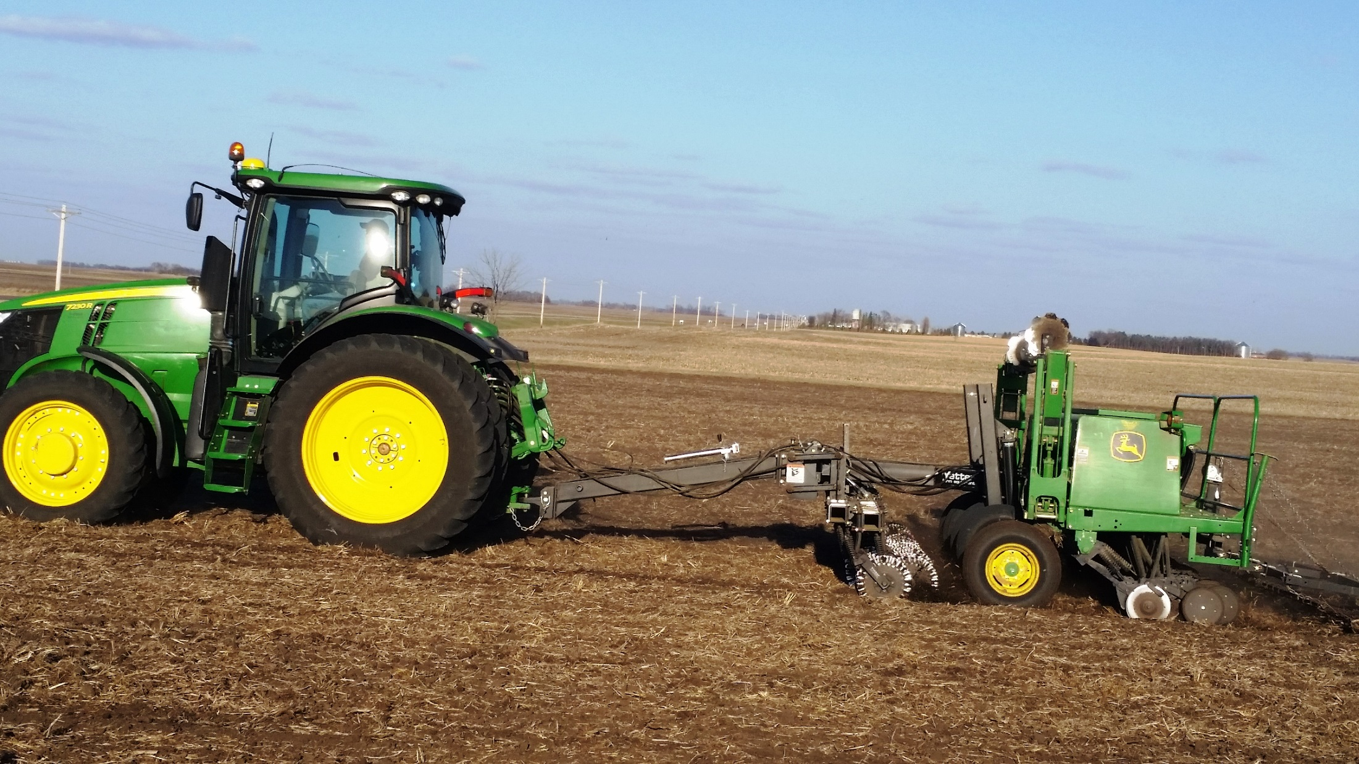
GMOs during Transition
No prohibited substances, including GMOs
Non-GMO premium possible in some crops
Notes:
Narration: During the 36-month transition period prior to organic certification, producers must use organic practices, including non-GMO seeds and inputs, but do not receive organic premiums. Some buyers offer a non-GMO premium, especially for crops such as soybean and corn. As a result, when you are transitioning new land from conventional to organic, it is important not only to avoid using GMOs yourself, but to prevent contamination from other sources, as we will discuss in the next slides.
Image: Carmen Fernholz

Slide 13
Preventing GMO Contamination
What is a GMO?
GMOs and organic agriculture
How contamination occurs
Consequences
Protecting yourself
Resources
Notes:
Narration: In this section, we will discuss how GMO contamination from outside sources can occur.
Image: Kristine Moncada, University of Minnesota

Slide 14
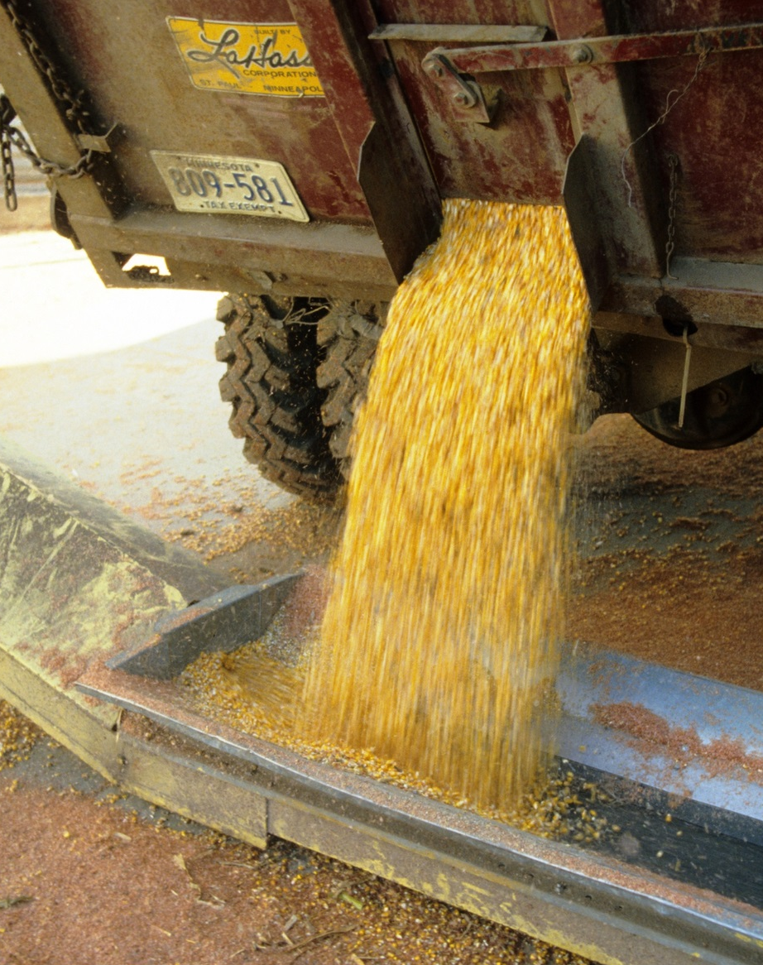
GMO Contamination
Planting stock
Pollen drift
Volunteer plants
Equipment
Notes:
Narration: So how can GMO contamination make its way into your products? There are several avenues for this to occur: planting stock, pollen drift, volunteer plants, and equipment.
Image: David L. Hansen, University of Minnesota

Slide 15
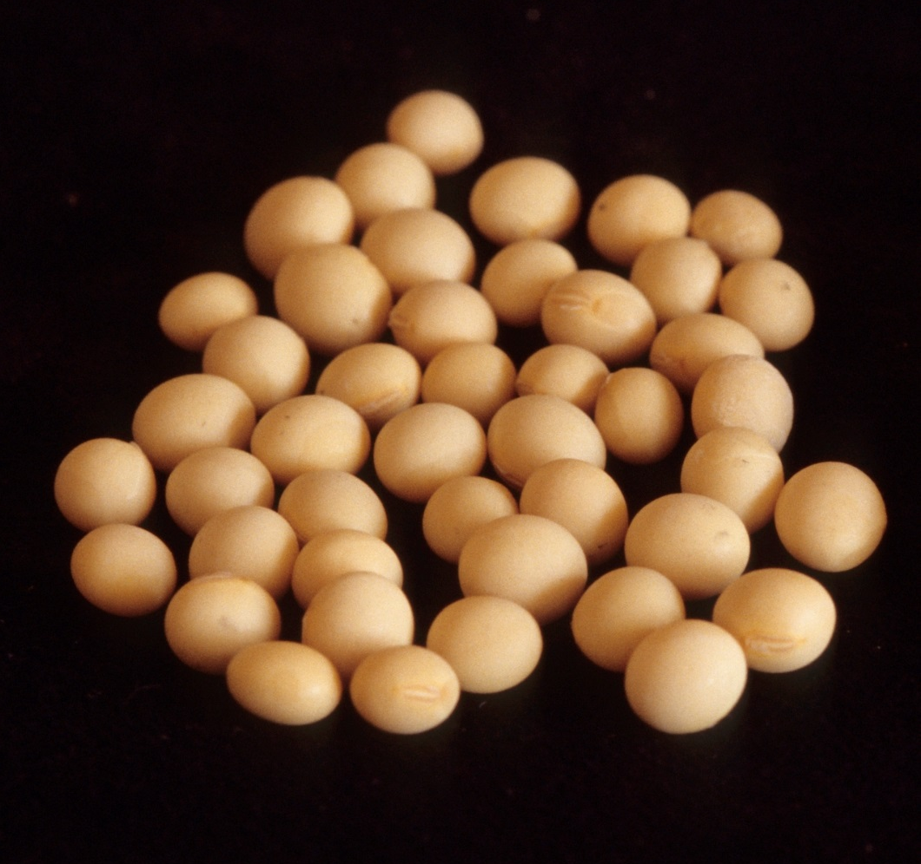
Planting Stock
Avoid use of contaminated seed
Can be from supplier or saved seed
Notes:
Narration: The first step to avoid GMOs is to not plant contaminated seed. Contaminated seed means that your seed stock contains some percentage of seeds that are GMO, so you are unintentionally planting a GMO crop. This can happen if a supplier sells you contaminated seed, or if you replant seed from your own crop that was contaminated by pollen drift or was somehow mixed with GMO seed in storage.
Image: David L. Hansen, University of Minnesota

Slide 16
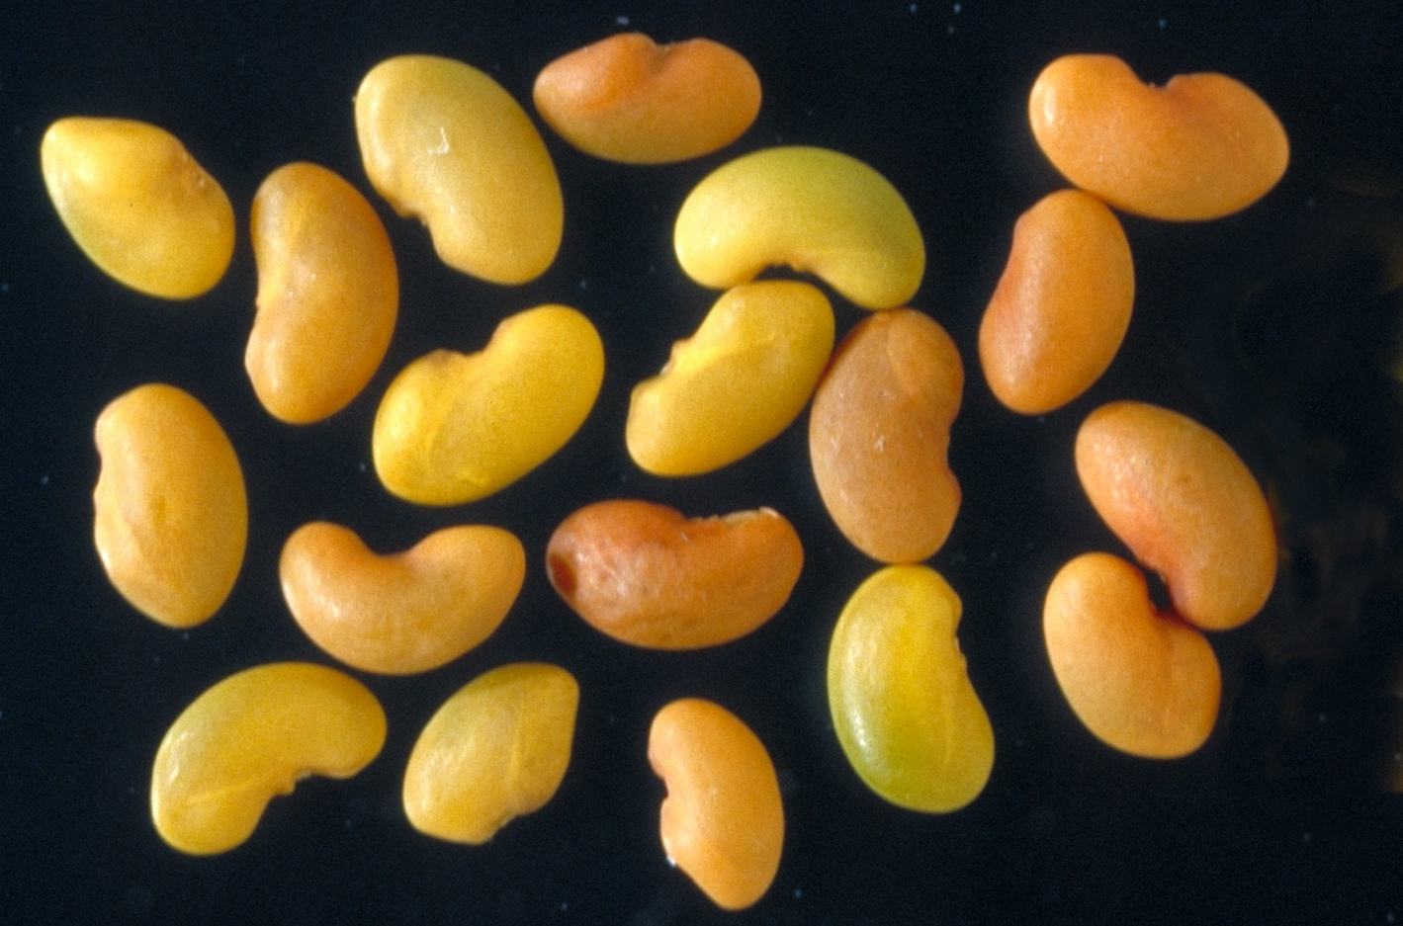
Seed Suppliers
GMO?
Ask for GMO test results from seed supplier prior to purchase
Notes:
Narration: You can request GMO test results from seed suppliers. There is no way to visually distinguish GMO from non-GMO seed. Only a genetic test can say for certain whether transgenes are present in a seed.
Image: David L. Hansen, University of Minnesota

Slide 17
GMO Contamination
Planting stock
Pollen drift
Volunteer plants
Equipment
Notes:
Narration: Pollen drift is the second, and perhaps most difficult to prevent, source of contamination. Because pollen is genetic material, it can carry GMO traits that will be transferred to the plants it fertilizes. This occurs when GMO pollen from nearby fields is carried by wind or insects to your field, where it fertilizes your crop, producing grain that is a GMO hybrid.
Image: David L. Hansen, University of Minnesota

Slide 18
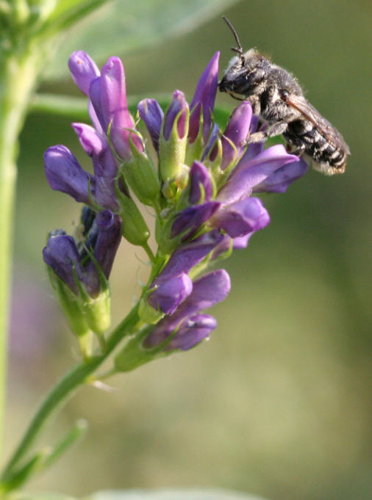
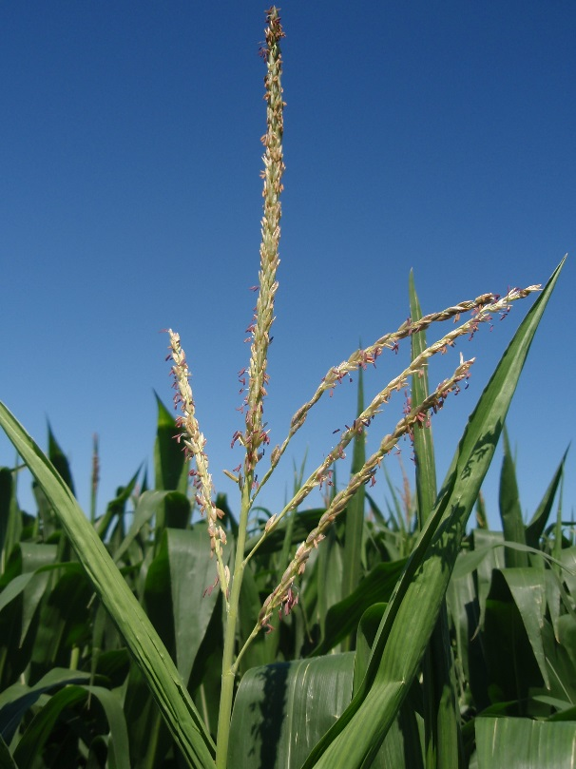
What Traits Make Crops Susceptible to GMO Pollen Drift?
Same species or relation to a GMO crop
Grown in proximity to GMO counterpart
Breeding system where outcrossing likely (cross-pollinating)
Wind-pollinated
Insect-pollinated
Notes:
Narration: Several circumstances must be in place for GMO drift to occur. First, there has to be a GMO counterpart to the crop (see earlier in this presentation for a list of current GMO crops). Next, that GMO crop must be grown near a susceptible crop. And lastly, the crop should have a breeding system where outcrossing or cross-pollination is likely. Cross-pollination is the transfer of pollen from one plant to a different plant, either by wind or by insect pollinators..
Image: USDA-ARS (Logan, Utah; leafcutter bee); Jeff Coulter, University of Minnesota

Slide 19
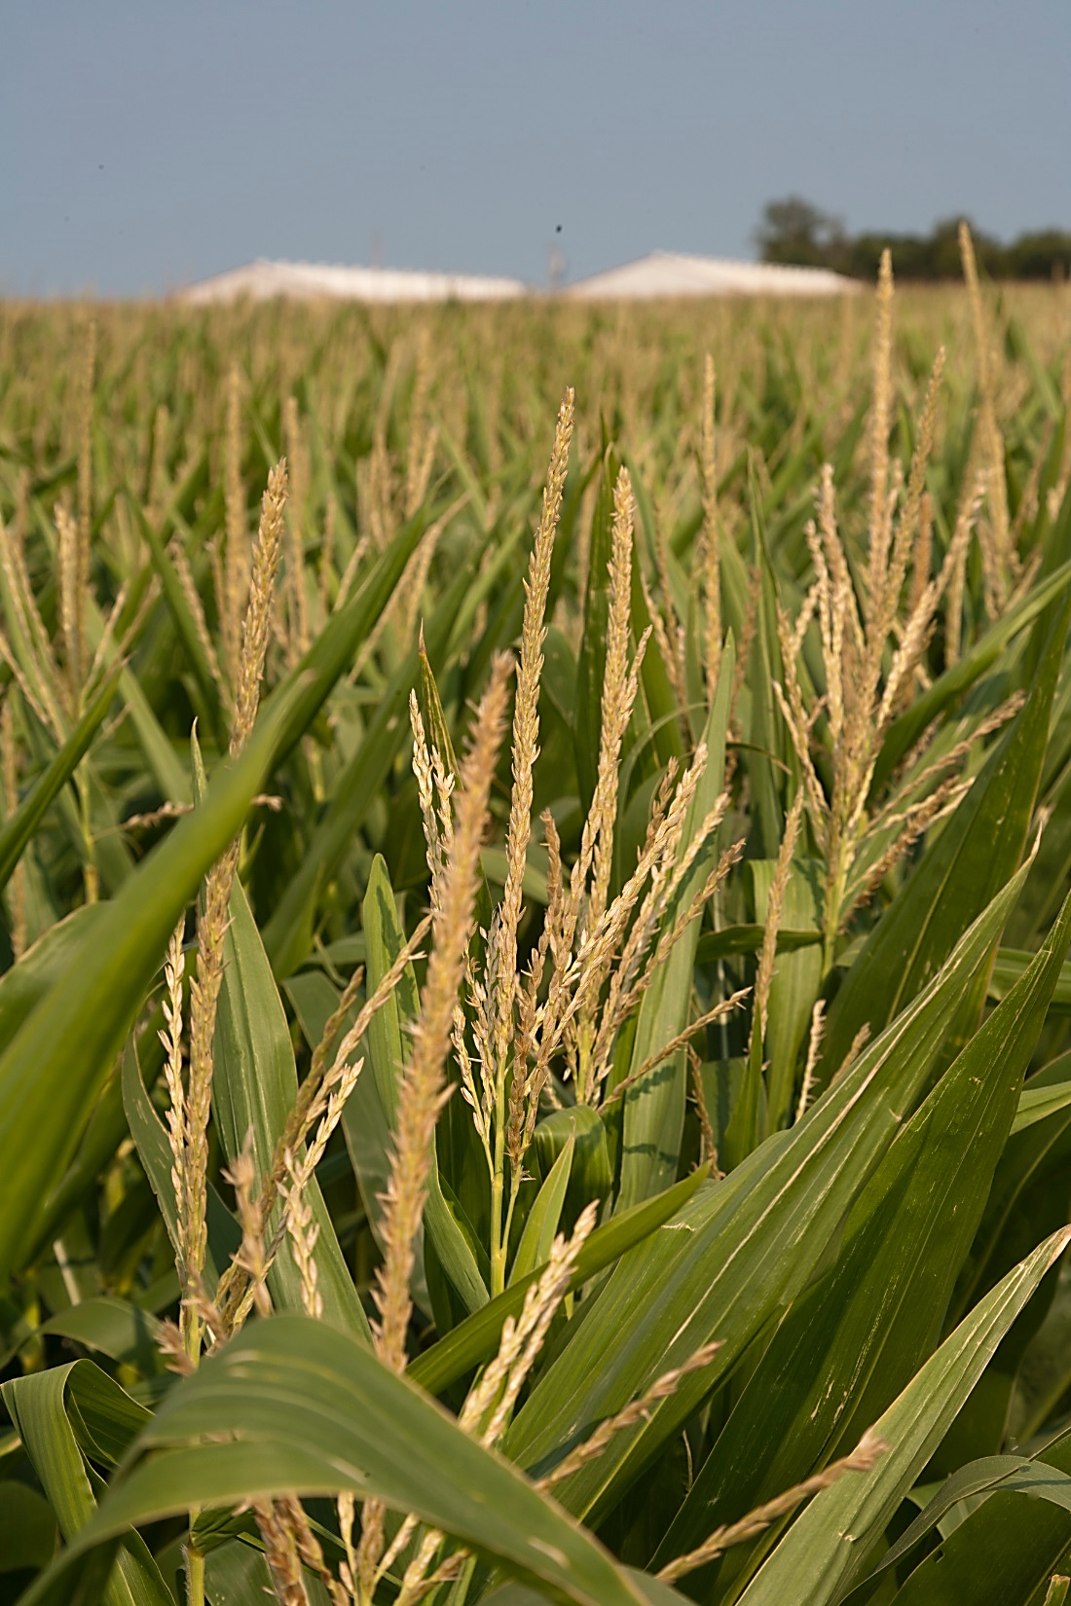
Crops Susceptible to Pollen Drift
Alfalfa
Canola
Sugarbeet
Corn
NOT soybean
Notes:
Narration: The organic crops with highest potential for GMO pollen drift in the Upper Midwest are alfalfa, canola, sugarbeet and corn. Corn, alfalfa, sugarbeet, and canola are all outcrossing crops that are pollinated by wind or insects. Soybean, because it is self-pollinated, is not generally considered to be vulnerable to GMO pollen drift.
Image: David L. Hansen, University of Minnesota

Slide 20
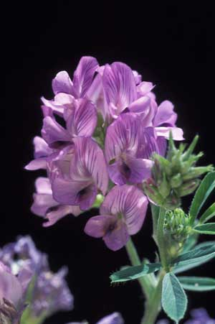
Alfalfa and
GMO Drift
Bigger risk in seed production regions
Usually not an issue in hay production
Notes:
Narration: For the most part, pollen drift in alfalfa is primarily a risk in the Western U.S. where seed production occurs. If you are cutting alfalfa for hay before any of the plants set seed, then contamination will not be an issue. However, if even a few plants are going to seed in your field or around field margins, there is the potential for GMO-contaminated alfalfa populations to persist in your field.
Image: David L. Hansen, University of Minnesota

Slide 21
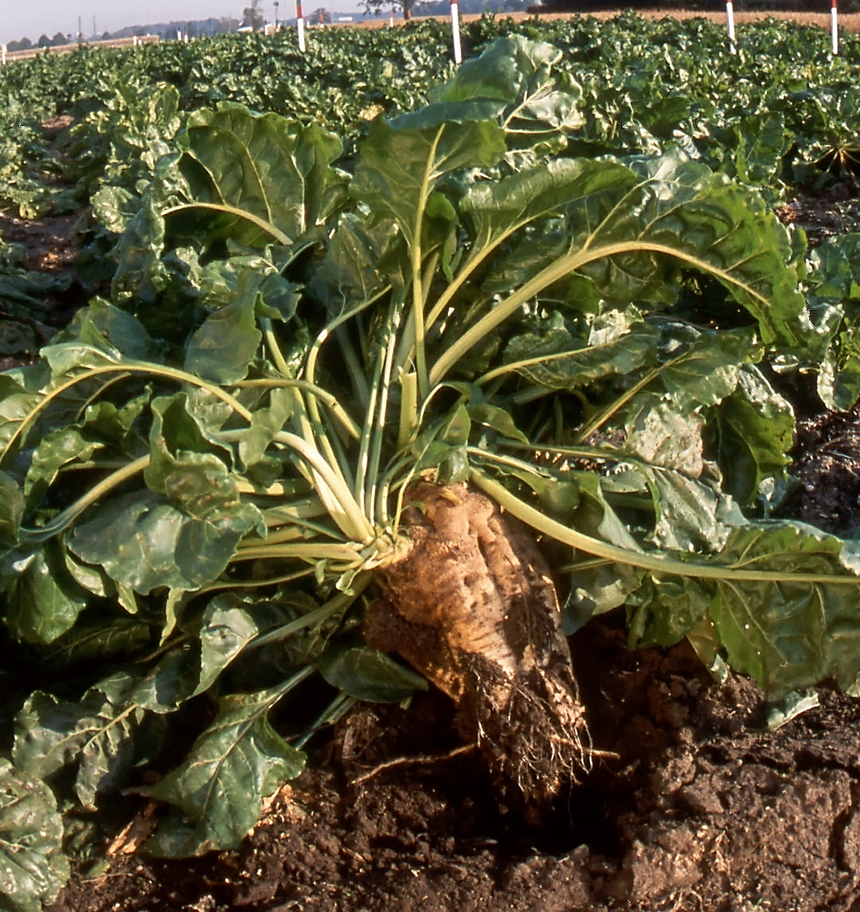
Sugarbeet and
GMO Drift
Only a concern in seed production regions
Notes:
Narration: Sugarbeet is normally harvested before flowering, so contamination is not normally a concern unless you are raising it for seed.
Image: Peggy Greb, USDA-ARS

Slide 22
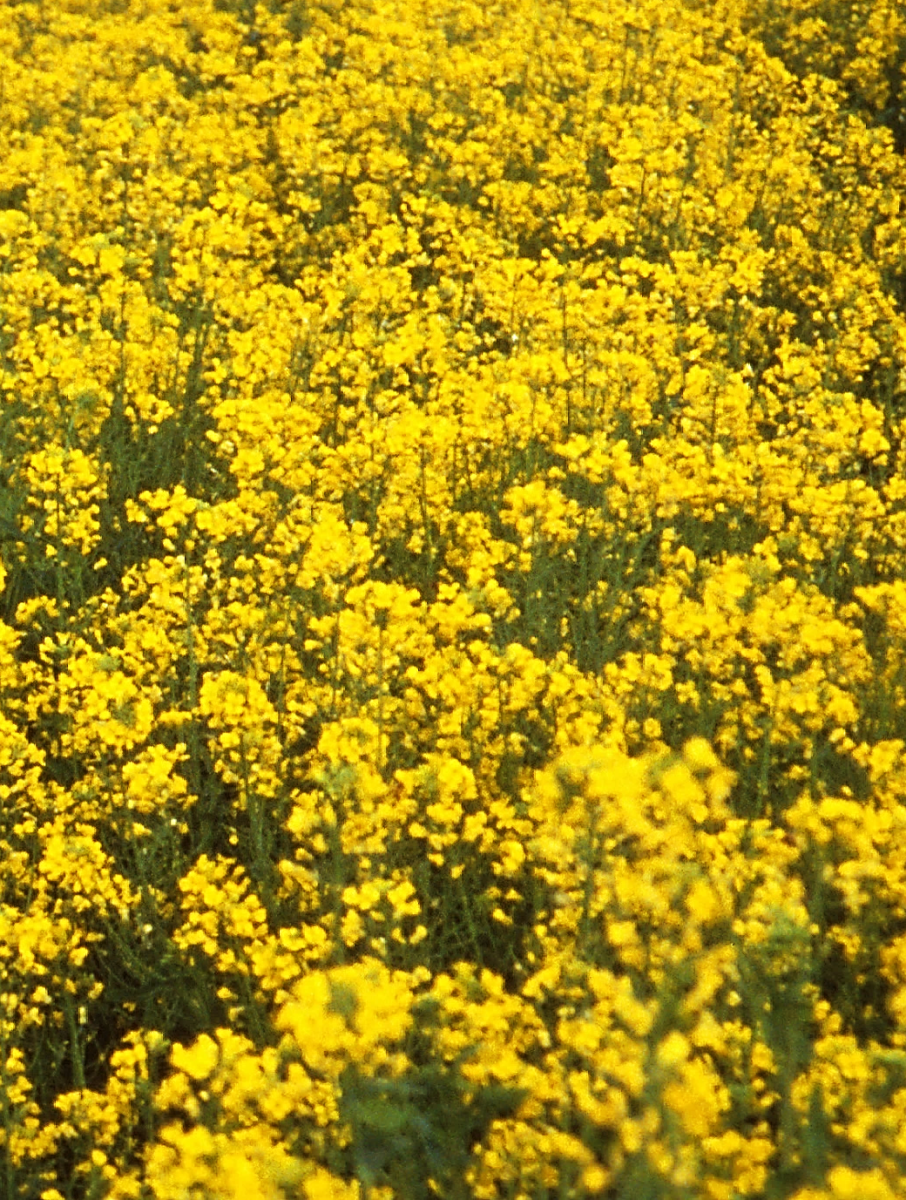
Canola and
GMO Drift
Concern in canola-growing regions
Canola GMO pollen can also cross with related weeds
Notes:
Narration: Canola is not widely grown in the Upper Midwest, but in the areas it is grown, GMO pollen drift is definitely a concern. In the case of both canola and sugarbeet, it is also possible for GMO pollen to fertilize crops or weeds of related species. This can lead to weed populations that also produce GMO pollen, which may cross back into a subsequent canola crop.
Image: Hanna Castle, USDA-ARS

Slide 23

Corn and
GMO Drift
Crop of most concern
Widely grown
Likely to be tested for GMOs
Notes:
Narration: Corn is generally the crop most likely to be of concern for GMO pollen drift, so most of our discussion from now on will focus on corn, but many of the same principles will apply to crops such as canola. Also, because corn is so widely grown, it is most likely to be tested for contamination and rejected by buyers if GMOs are found.
Image: Kristine Moncada, University of Minnesota

Slide 24
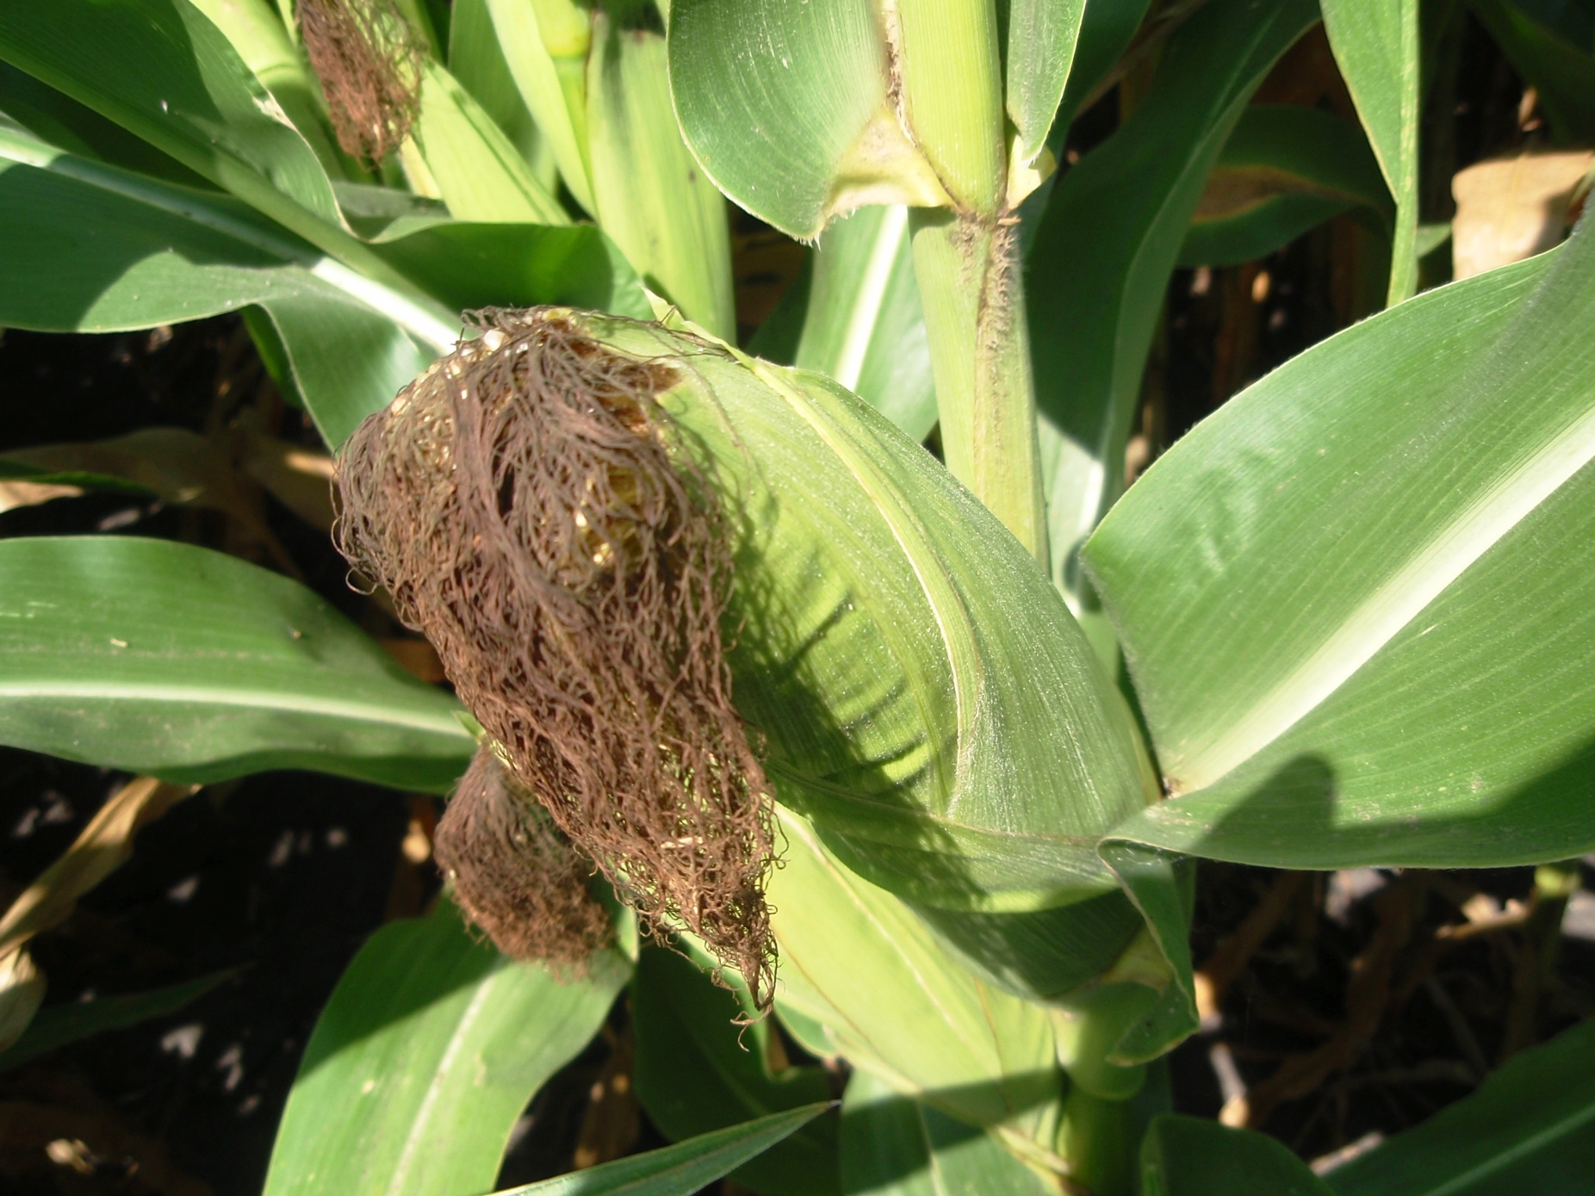
Corn Reproduction
www.allaboutcorn.umn.edu
Notes:
Narration: To understand why GMO pollen drift can be a problem in corn, let’s briefly review the steps in corn reproduction. If you would like to learn more about this topic, please click on the icon to link to a module from our All About Corn series.
Image: Jeff Coulter

Slide 25
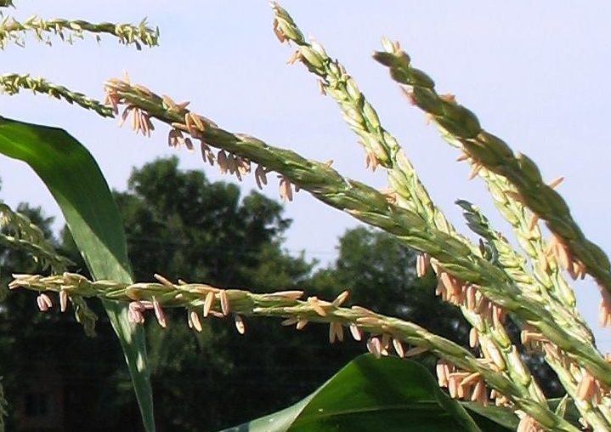
Pollen
Pollen emerges from anthers on tassels
Notes:
Narration: To produce kernels, corn needs to be pollinated. The corn plant develops tassels, which produce the pollen-bearing structures called anthers. Pollen is released from the anthers.
Image: Jeff Coulter, University of Minnesota

Slide 26
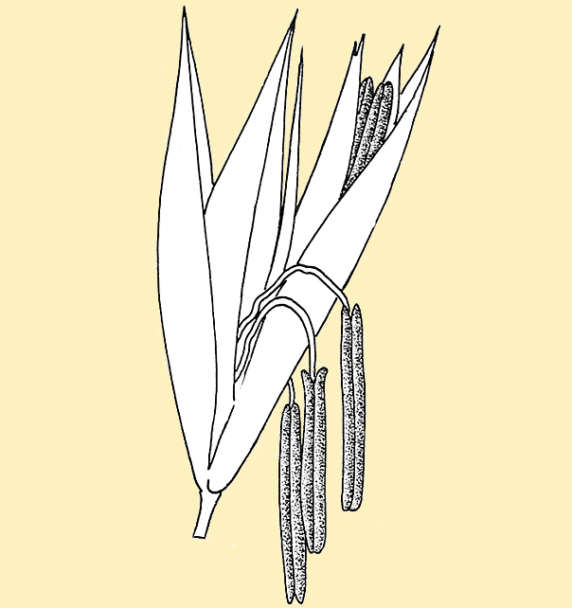
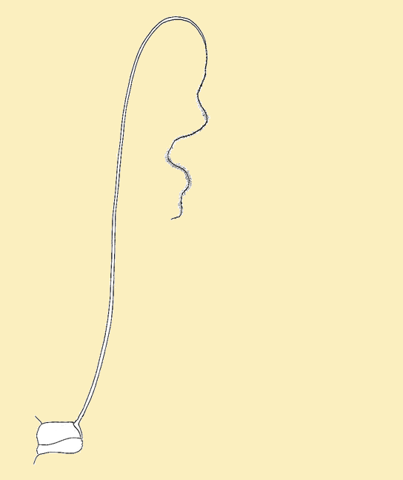
Pollination
D.G. Mackean, www.biology-resources.com
Pollen grain transferred to silk of another plant
Notes:
Narration: Pollen grains are carried, largely by wind, to other nearby corn plants. Pollination is when a pollen grain from the anther lands on the silk of a developing corn ear.
Images: D.G. Mackean, www.biology-resources.com

Slide 27
Fertilization
Pollen unites with ovule
Fertilized ovule forms corn kernel
D.G. Mackean, www.biology-resources.com
Notes:
Narration: Fertilization is the process where the pollen grain is transported down the silk to the ovule from which a kernel will develop. If the ovule is not fertilized, the kernel will not form.
Image: D.G. Mackean, www.biology-resources.com

Slide 28
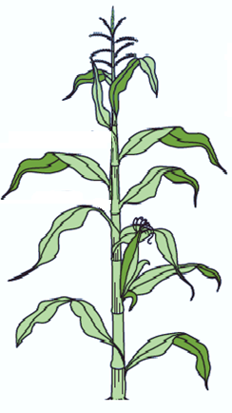
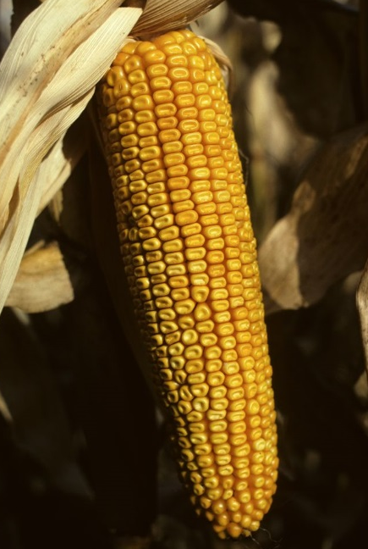
Kernel Development
Kernels with GMO parent will be GMO
GMO corn
Non-GMO corn
Notes:
Narration: The developing kernel contains genetic material from both parent plants, and will express traits from both. For example, a kernel that was fertilized by pollen from genetically modified Bt corn will produce the Bt toxin. Subsequently, this corn will be harvested and will test positive for GMOs. We’ll talk more a little later in this presentation about how to prevent this kind of unwanted cross-pollination.
Image: David L. Hansen, University of Minnesota

Slide 29
GMO Contamination
Planting stock
Pollen drift
Volunteer plants
Equipment
Notes:
Narration: Another avenue for GMO contamination is the presence of GMO volunteer plants in your fields, which can contaminate the crop that they are harvested with.
Image: David L. Hansen, University of Minnesota

Slide 30
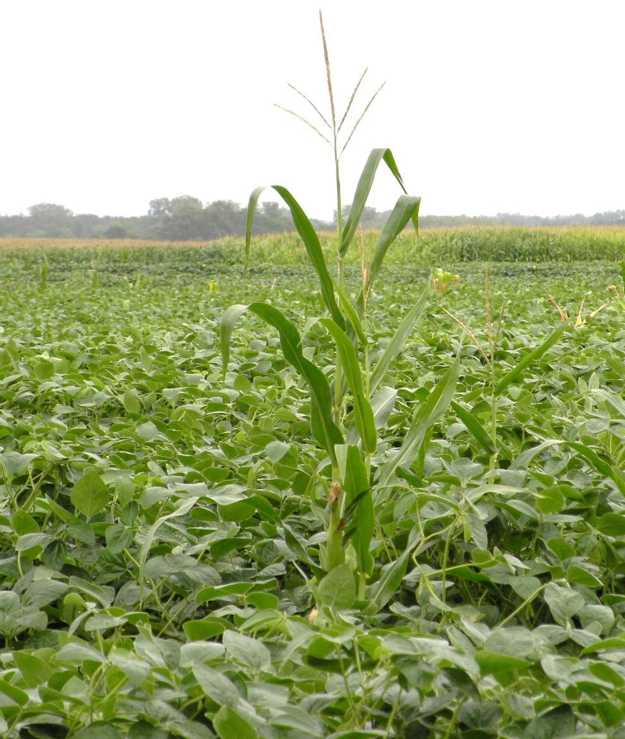
Volunteer plants
Inadvertently planted seed
Harvested with intended crop
May include feral plants in ditches and hedgerows
Notes:
Narration: Volunteer plants are those that are not intentionally planted and are harvested with your crop. GMO volunteer plants can happen if GMO seed was previously used in a field and remains in the seed bank or has been accidentally transported from a neighboring field, for example in equipment that was not thoroughly cleaned. This accidental seed replants itself and grows alongside your crop. Some crops, like alfalfa and canola, can become feral, meaning that they reseed themselves and produce self-sustaining weedy populations that can persist in and around crop fields. If these populations are GMO, they can also pose a contamination risk.
Image: Craig Sheaffer, University of Minnesota

Slide 31
GMO Contamination
Planting stock
Pollen drift
Volunteer plants
Equipment
Notes:
Narration: Equipment or storage facilities that have not been properly cleaned can also be a source of GMO contamination.
Image: David L. Hansen, University of Minnesota

Slide 32
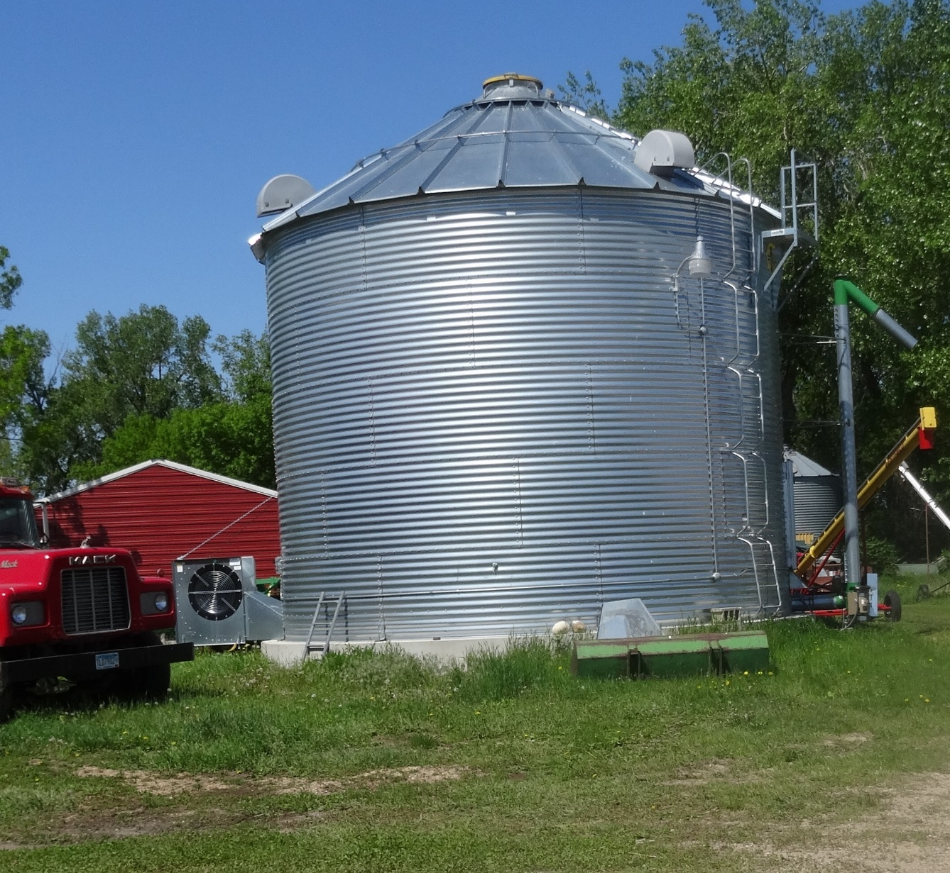
Equipment Contamination
GMO seed can be remnants in harvest, transport, or storage equipment
Notes:
Narration: GMO seed or grain can be retained or transported in equipment that has been handling GMO crops. This can be a problem when remnants of GMO grain mingle with your non-GMO crop during harvest, transport, or storage.
Image: Kristine Moncada, University of Minnesota

Slide 33
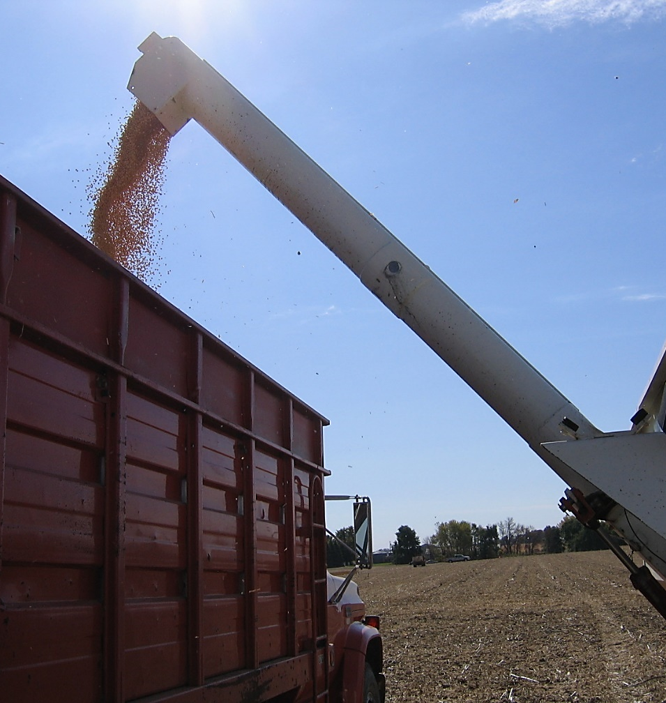
Equipment Contamination
Biggest risk in:
  Split operations using same equipment
  Borrowing equipment or hiring custom operators
  Transportation
Notes:
Narration: This kind of contamination is most likely if you have a split operation growing both organic and GMO crops, or are borrowing equipment or hiring custom operators, or using shared or custom transportation to haul harvested grain.
Image: University of Minnesota Extension

Slide 34
Preventing GMO Contamination
What is a GMO?
GMOs and organic agriculture
How contamination occurs
Consequences
Protecting yourself
Resources
Notes:
Narration: So now we’ve learned how contamination can occur, but what are the consequences when it does occur?
Image: Kristine Moncada, University of Minnesota

Slide 35
Value of organic crops loss from presence of GMOs--certified and exempt organic farms
2011 through 2014
Geographic area | Number of farms | Value of loss | Average value of loss per farm
United States | 92 | $6,108,322 | $66,395
Iowa | 8 | $33,840 | $4,239
Minnesota | 3 | $82,440 | $27,480
North Dakota | 1 | not reported | not reported
South Dakota | 2 | not reported | not reported
Wisconsin | 6 | not reported | not reported
Source: USDA. Census of Agriculture, 2014 Organic Survey
Notes:
Narration: Losses from GMO contamination can be a serious issue for organic farmers. According to the USDA, 92 farms reported that they lost value from their organic crops due to GMO contamination between 2011 and 2014. In Minnesota, three farms reported losing a total of $82,440 in value from their crops. There are likely many unreported cases.

Slide 36

Consequences of Contamination
NO loss of certification if correct practices are followed
USDA Organic Rule is process-based
Notes:
Narration: So what happens if the presence of engineered traits is detected in your organic crop? Well, if you have been following organically approved practices, but end up with contamination anyway, your organic certification should not be at risk. Organic certification is process-based, meaning that you will be in compliance if you follow the correct procedures to avoid prohibited substances including GMOs and take appropriate measures, as verified by your certifier, to protect against prohibited substances in all steps of the production process.

Slide 37

Consequences of Contamination
Loss of organic premium
No uniform standard or legal requirement
  Buyer policies
  Importer policies
Notes:
Narration: While your certification should not be at risk with inadvertent GMO contamination, you may be at risk of losing your organic market price, meaning you may have to sell your crop at conventional prices. Although there is not a uniform standard or testing requirement for organic products, some buyers may require testing to verify that GMO contamination is not present or is below a given threshold. Some foreign countries also require verification of non-GMO status for products entering their markets. If your crops contain GMO material, they may be rejected by buyers. This is, unfortunately, a problem that some growers have reported facing.

Slide 38
Recourse and Compensation?
No official legal stance on liability for lost revenue due to GMO contamination
Organic farmers currently bear full burden
Revenue
Lost
Notes:
Narration: So what happens if you find yourself with a contaminated crop through no fault of your own (such as in the case of a neighbor’s pollen drift)? Basically, under the current system, there is no compensation available. We may think of organic farmers as the victims in a contamination scenario, but in the US, there is not yet a lot of legal precedent in this area, and there is no official policy stating who is liable for lost revenues in these cases. Unlike in negligent cases of pesticide drift, where states may offer protections to victims, currently, it is up to the organic farmer to protect themselves against GMO drift and they bear the full burden of losses.

Slide 39
Preventing GMO Contamination
What is a GMO?
GMOs and organic agriculture
How contamination occurs
Consequences
Protecting yourself
Resources
Notes:
Narration: So now let’s talk a little about how you can protect yourself from GMO contamination and the associated loss of profits.
Image: Kristine Moncada, University of Minnesota

Slide 40
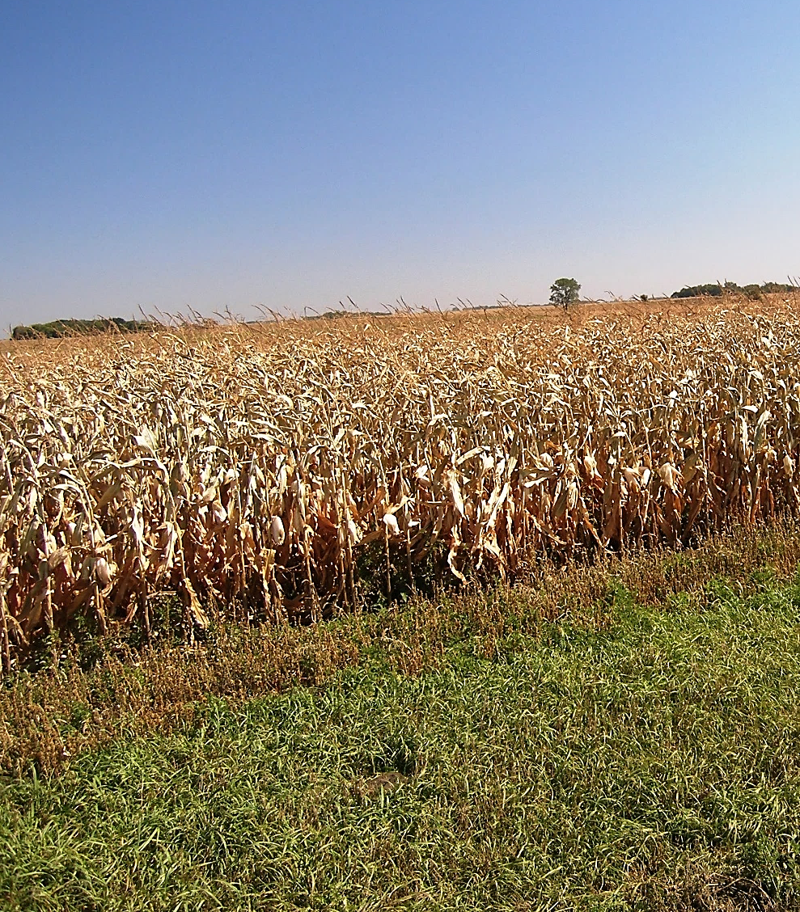
Protecting Your Product
Know the practices in your supply chain
Avoid cross-pollination
Monitor
Notes:
Narration: Since there isn’t much recourse for farmers whose crops get contaminated, the best thing you can do is protect your crop, from planting to sale. The first thing you can do is to know the practices of those you do business with.
Image: Carmen Fernholz

Slide 41
Know Your Supply Chain
Seed
Storage
Transport
Equipment
Notes:
Narration: Do you know your supply chain? You can do everything right during the growing season, but it won’t help if you are being supplied with contaminated seed, or if your crop is commingling with GMO grain in somebody else’s combine, truck, or storage facility.

Slide 42
Purchasing Non-GMO Seed
Use organic seed if commercially available
Non-organic seed (in transition)
  Obtain test results
  Consider third-party non-GMO certified seed
Notes:
Narration: If you purchase certified organic seed, it should not contain GMO material. Reputable organic seed companies have rigorous controls against contamination and conduct testing of the seed they sell for GMOs. However, in transition if you don’t purchase organic seed, you should take extra precautions to prevent prohibited substances such as GMOs in seed used. If you are using seed that isn’t certified organic, consider looking for seed with a third-party non-GMO certification. Obtain and keep all documentation in your records.
Image: David L. Hansen, University of Minnesota

Slide 43
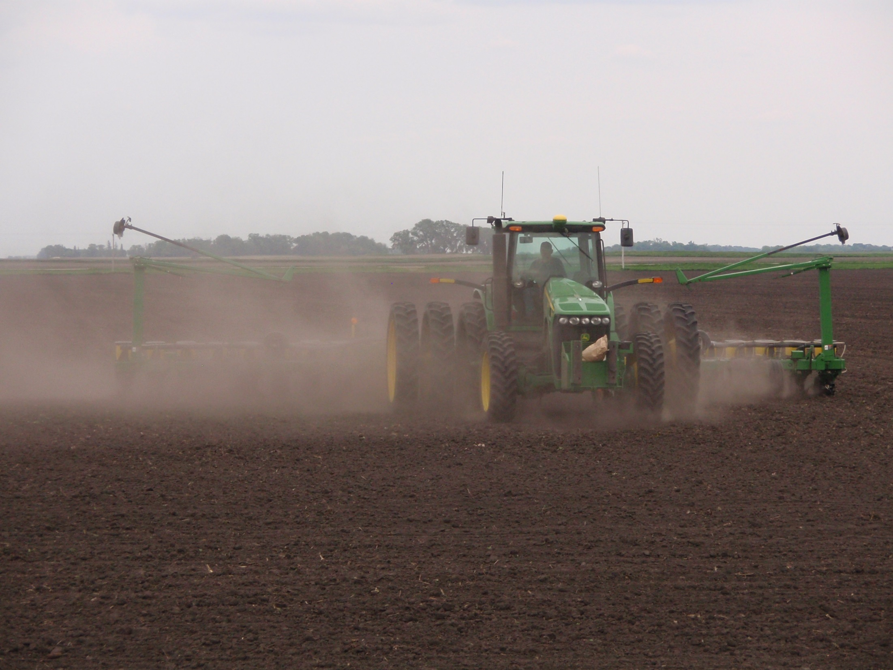
Clean Equipment and Storage
Your equipment (planters, combines, grain wagons, etc.)
Custom work equipment
Grain bins
Transport equipment (grain carts, semis, augers, elevators, legs, etc.)
Notes:
Narration: Planters and all other equipment should be clean and empty before they are used for organic crops. This includes not just your own equipment, but anyone else’s that does work in your field, as well as all equipment used to transport your crop from the field or to the elevator.
Image: Jeff Coulter, University of Minnesota

Slide 44
Cleaning Methods
Sweeping
Compressed air
Vacuum
Running equipment empty or purging with organic grain
Notes:
Narration: Proper cleaning may involve sweeping out equipment, blowing out debris with compressed air, vacuuming, and running the equipment empty or purging it with a small batch of organic grain.
Image: Jeff Coulter, University of Minnesota

Slide 45
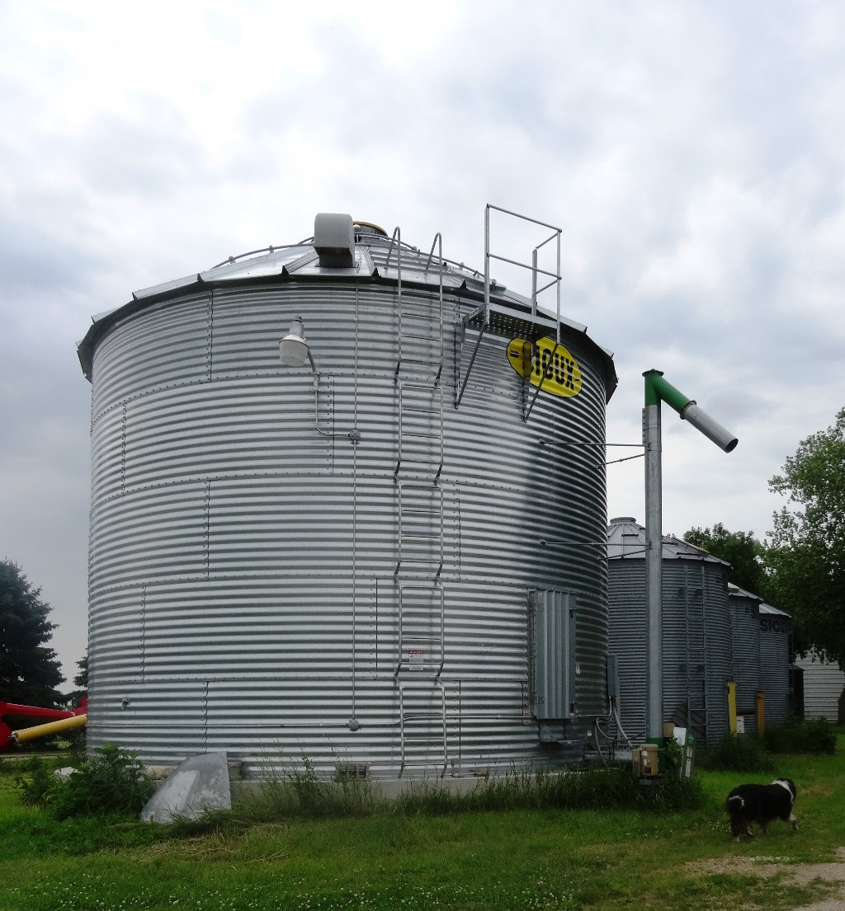
Clean Equipment and Storage
Record cleaning and storage procedures
Save all documents
  Own equipment
  Custom operators
Transport
  Clean transportation affidavits
  Bills of lading
Notes:
Narration: All cleaning and storage procedures should be recorded. You should save all records of your own activities as well as documents provided by custom operators. For transport of your grain, affidavits and bills of lading should document that your crop was loaded into clean wagons, trailers or other transport units. Make sure to keep copies for your records.
Image: Kristine Moncada, University of Minnesota

Slide 46

Know your buyers
Find out thresholds or tolerances (none may be specified)
  Ex. 0.9% for EU
If selling on contract, know contract requirements regarding GMO rejection levels
Organic
Grain Buyer
Notes:
Narration: You should also know your buyers, and know what form or level of contamination they will tolerate. For example, for products destined for EU markets, a threshold of less than 0.9% GMO content is generally required for the product to be considered non-GMO. If you are selling on contract, know what the contract’s requirements are regarding GMO rejection levels. Again, unintentional GMO presence does not mean your organic certification has to be lost, but rejection by buyers can harm the reputation of your farm and access to future sales.
Image: Pixabay

Slide 47

Protecting Your Product
Know the practices in your supply chain
Avoid cross-pollination
Monitor
Notes:
Narration: It’s also extremely important to make sure that your organic crops aren’t cross-pollinated with GMO crops, which could introduce the modified genes into your product.
Image: Carmen Fernholz

Slide 48
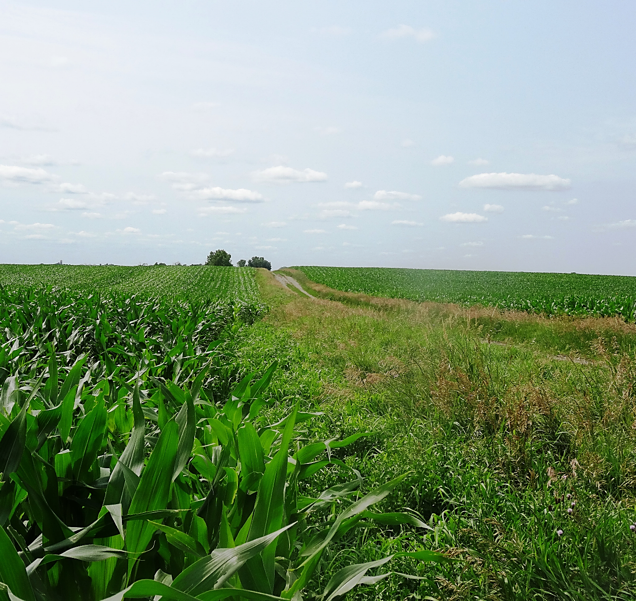
Know Surrounding Area
Talk with conventional neighbors
Monitor weeds, field edges for feral plants
Notes:
Narration: There are best management practices to prevent pollen drift in your fields. First, you need to know what GMO plants are nearby. Not only do you want to be aware of what your neighbors are planting and where, you want to know what might be persisting from previous plantings. With corn it should be pretty obvious if there are volunteer plants springing up, but alfalfa and canola can sometimes persist and spread as feral populations, as weeds in the field or on field edges. Canola can also cross with wild mustard relatives, which may then carry transgenes that can cross back into related crops.
Image: Kristine Moncada, University of Minnesota

Slide 49
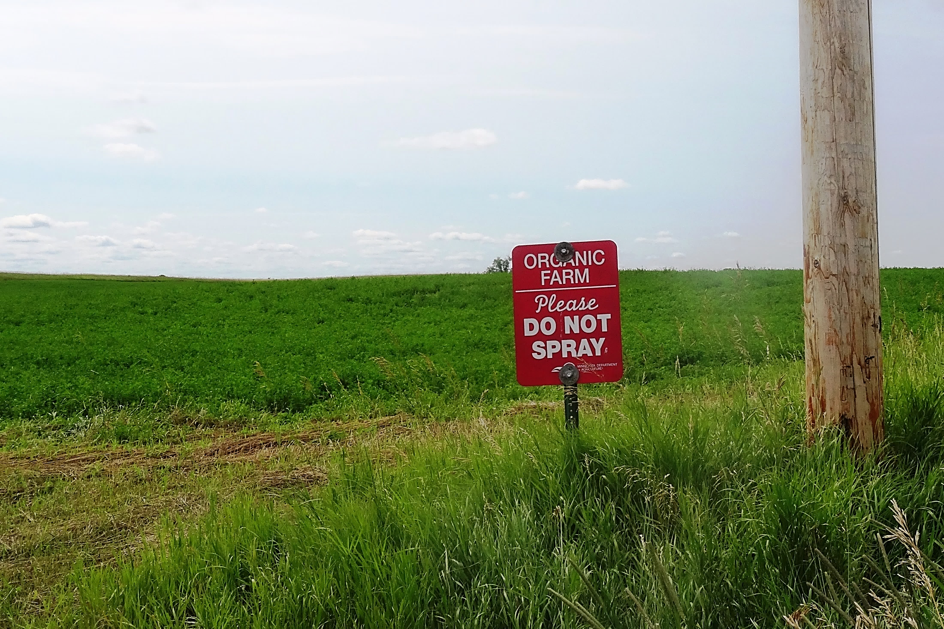
Mark Your Organic Land
Notes:
Narration: Conversely, it is important for conventional neighbors to know that you are growing organic or non-GMO products. In Minnesota, Do Not Spray signs are available from the Minnesota Department of Agriculture.
Image: Kristine Moncada, University of Minnesota

Slide 50


Separate GMO and
Non-GMO Crops
Distance
Time
Notes:
Narration: When you know where GMO plants are located, there are ways to keep their GMO pollen separated from your crops. This separation can be achieved either by distance or by time.

Slide 51
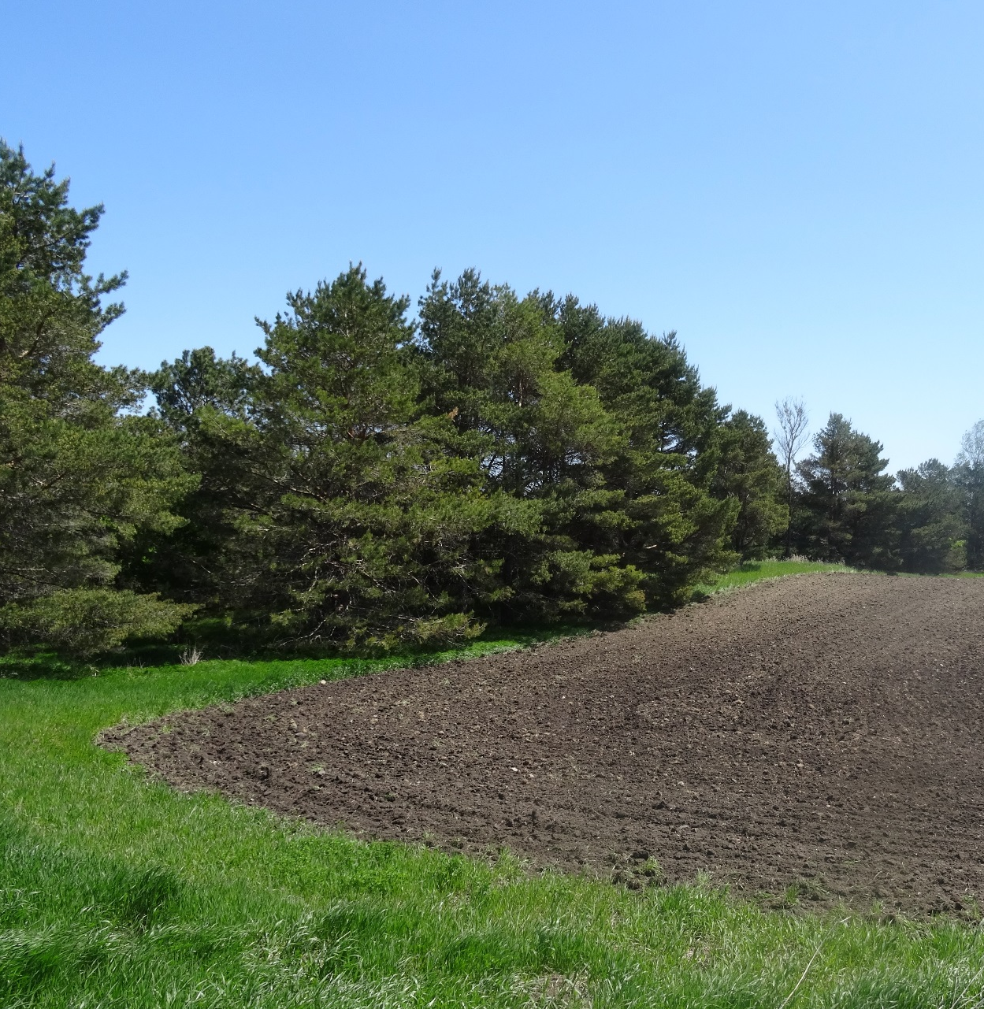
Separate by Distance
Field location
Plant buffers or windbreaks
  Increased height can sometimes increase effectiveness
Notes:
Narration: First, you can use distance to keep them separate by choosing fields on your farm that are as far as possible from GMO crops of that species. This goes back to communication with your neighbors for their cropping plans. You can also plant buffers or windbreaks to provide a physical barrier to pollen drift. To a limited extent, buffers can be adjusted by increasing width or adding trees to increase height, which can reduce the flow of windblown pollen. Your certifier will have recommendations for your buffers based on your risks.
Image: Kristine Moncada, University of Minnesota

Slide 52
Distances Needed to Prevent Cross-Pollination
Crop | Separation distance
Corn | 660 feet
Alfalfa (for forage) | 1500 feet when alkali or leafcutter bees are stocked as pollinators; 0.5 mile when honeybees are stocked
Canola | 660 feet from other canola, 0.25 miles from field mustard
Source: USDA APHIS
Notes:
Narration: The USDA publishes guidelines for how far plantings of GMO varieties must be to prevent gene flow out of the test fields. You are not required to maintain these distances, but you may find them a useful guideline when assessing whether a neighboring field of a GMO crop presents a contamination risk for your crop. For corn, 660 feet is considered sufficient to reliably prevent pollen drift. The distances required for alfalfa can be affected by the types of pollinating insects. Canola is required to be a quarter mile from field mustards, including weeds. Because these large separation distances are not always achievable, you may also need to use strategies to separate by time.

Slide 53
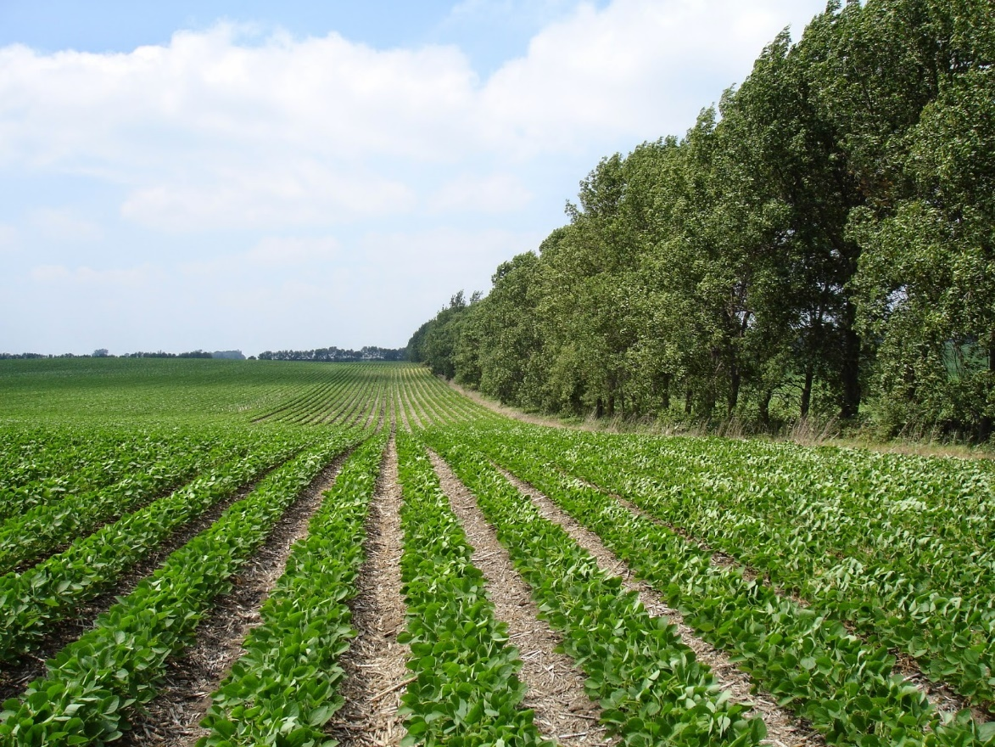
Refuge Placement
For Bt GMO crops
Request refuge placement to serve as buffer
  Some Bt products now use “refuge in the bag” rather than structured refuge
Notes:
Narration: There is an additional strategy that may help in the case of GMO crops with the Bt trait. If your neighbors are growing Bt corn, they are required to plant a non-Bt refuge area. One suggestion is to ask your conventional neighbors to place their refuges where they will serve as a buffer between their Bt crop and your organic crop. However, some Bt corn products now use so-called “refuge in the bag,” and are not required to have separate refuge areas.
Image: Gary Wyatt, University of Minnesota Extension

Slide 54
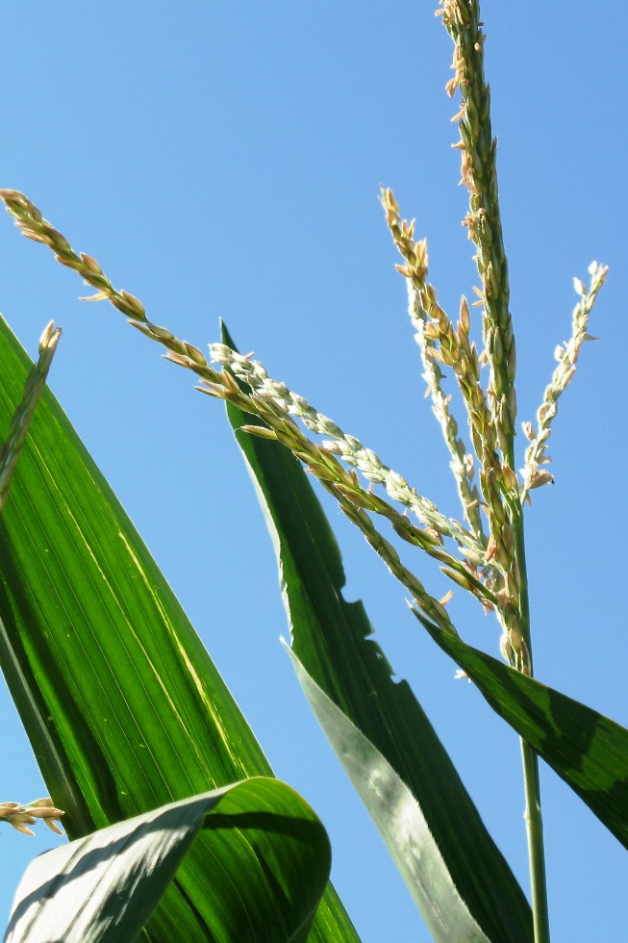
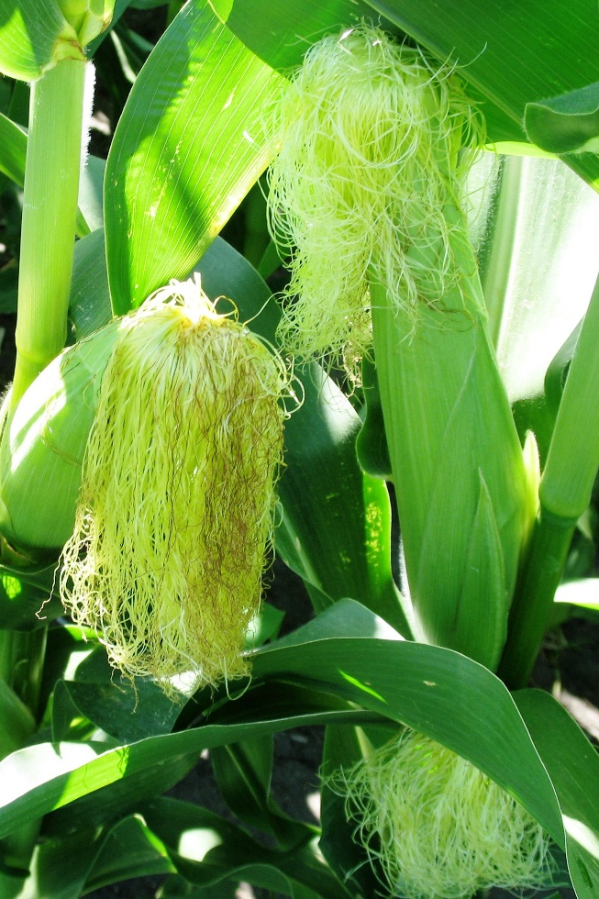
Separation by Time
GMO Pollen Shed
Non-GMO Silking
Notes:
Narration: In corn, you can protect your crop by ensuring that your corn’s pollination window does not overlap with neighboring GMO corn.
Images: Kristine Moncada, University of Minnesota

Slide 55
Separation = Minimum 1 Week,
Preferably 3-4 Weeks
Silk Receptive to Pollen –
up to 2.5 weeks
WEEK 1 2 3 4 5
Danger Zone
Pollen Shed -up to 2 weeks
Notes:
Narration: Pollen shed can last up to two weeks, while the corn silk receptiveness to pollen can be up to two and a half weeks. What you want to avoid is exposing your corn to neighbors' GMO pollen, as is shown in this example. At a minimum, you want a week between GMO and organic corn tasseling, and ideally 3-4 weeks, to account for unevenness in flowering times across different areas of the field.

Slide 56
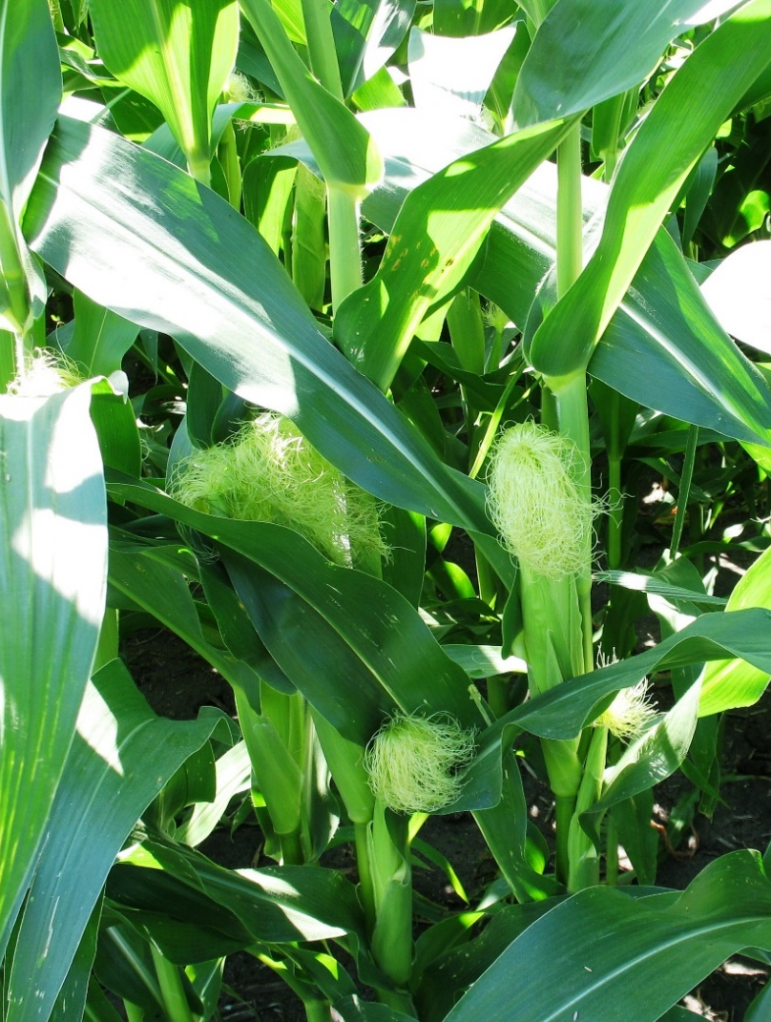
Options for Separation by Time
Stagger flowering times with neighboring GMO crops
  Different planting dates
  Different maturities
Notes:
Narration: Generally, organic farmers are going to be planting later than conventional farmers, so this means you want your neighbors’ corn to be finished with its pollen shedding stage before viable silks are present on your corn. You can also choose varieties with different days to flowering to help maximize this separation.
Image: Kristine Moncada, University of Minnesota

Slide 57
Protecting Your Product
Know the practices in your supply chain
Avoid cross-pollination
Monitor
Notes:
Narration: And you can monitor your fields to ensure that you are not harvesting volunteer plants that may carry transgenes, as well as monitoring your harvested crop.
Image: Carmen Fernholz

Slide 58

GMO testing
Test strips
  Inexpensive
  Detect single gene of interest
PCR and ELISA
  More expensive
  Lab-based
  Can be quantitative
  Detect all commercially available modified genes
  Used by buyer
Notes:
Narration: A variety of commercial tests are now available to detect and quantify the presence of engineered genes in crops. These can allow you to see whether your management practices are successfully preventing GMO contamination of your crops. Test strips provide an inexpensive way of screening for a particular gene that you are concerned about. Lab-based methods, such as PCR and ELISA, are expensive, but can quantify the amount of GMO material present, and can detect the full range of commercially available modified genes. These are more often used by buyers.
Image: Pixabay

Slide 59
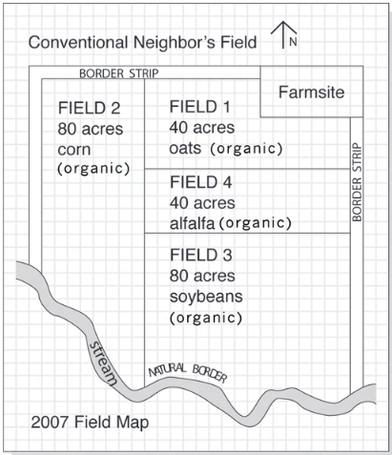
Keep Complete Records
Seed or crop test results
Production practices
Seed and input sources
Equipment cleaning
Planting records
Field maps showing buffer zones
Notes:
Narration: In addition to protecting your crops, it’s important to know and protect your access to markets for those crops, so that you won’t lose revenue to GMO contamination. Keeping records of your production practices, seed and input sources, and operations and equipment will help you to prevent contamination and identify the source of any contamination problems that may occur. Record-keeping will also protect your certification; you want to be able to demonstrate that you have been following the procedures required by the NOP for permitted seed and inputs and segregation of organic and conventional products.
Image: Riddle, J. and L. Gulbranson. 2011. Minnesota Guide to Organic Certification. Minnesota Institute for Sustainable Agriculture.

Slide 60
Take Samples
Collect your own samples
  High- and low-risk parts of field
  Independently test
Could help determine how contamination occurred
Possible to mitigate effects
Save samples
Notes:
Narration: As a preventative measure, you can collect samples of your crop prior to harvest. Sample high-risk and low-risk parts of your fields prior to harvest. You can have them tested on your own. It could help determine the source of contamination (or lack thereof). If contamination is found, but only in one part of a field, it may be possible to mitigate the effects by removing the contaminated portion of your crop. Keep extra samples in case you need to do additional testing.
Image: David L. Hansen, University of Minnesota

Slide 61
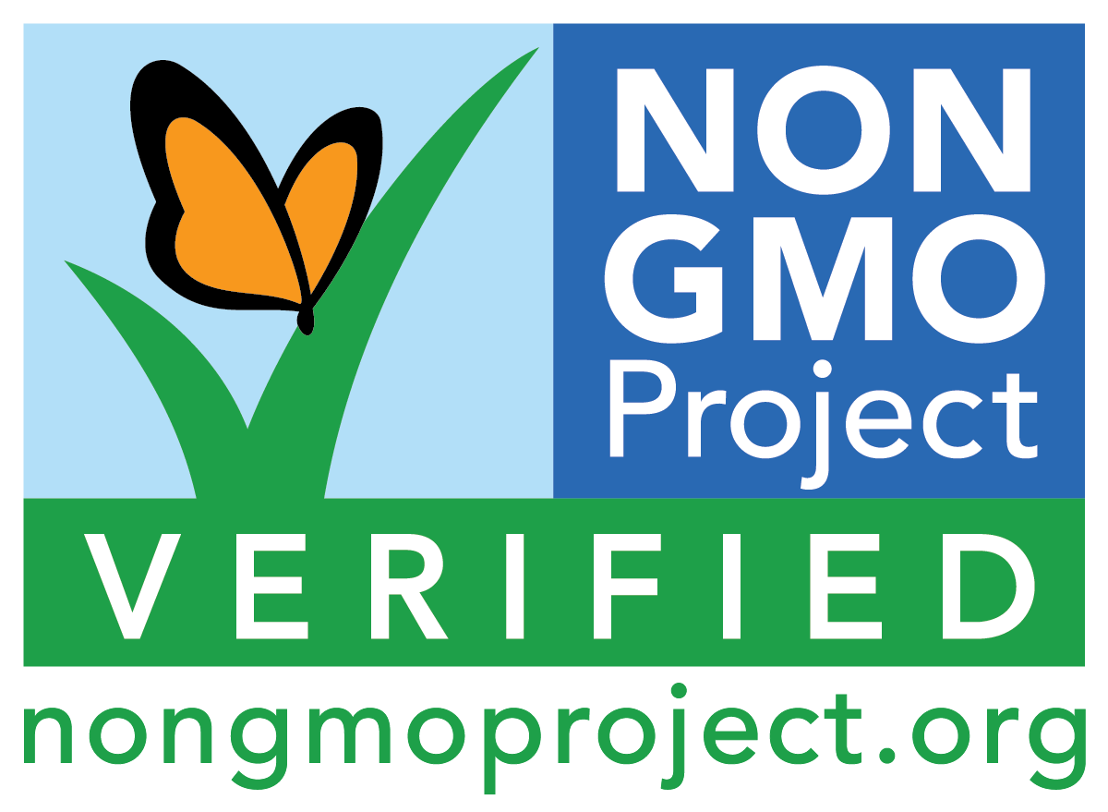
Non-GMO verification programs
For seed:
  Non-GMO Verification Project
  Safe Seed Pledge
For crops
  Non-GMO Verification Project
Notes:
Narration: You may find it useful to look for third-party verification of non-GMO status. The Non-GMO Verification Project offers a certification for seed. You can also look for seed suppliers who have taken the Safe Seed Pledge, an assurance that they will take a suite of measures to prevent GMO presence in their seed supplies. Particularly if you direct market or sell a value added product, you may also be interested in seeking non-GMO certification for your products, which provides assurance to buyers of their non-GMO status.

Slide 62
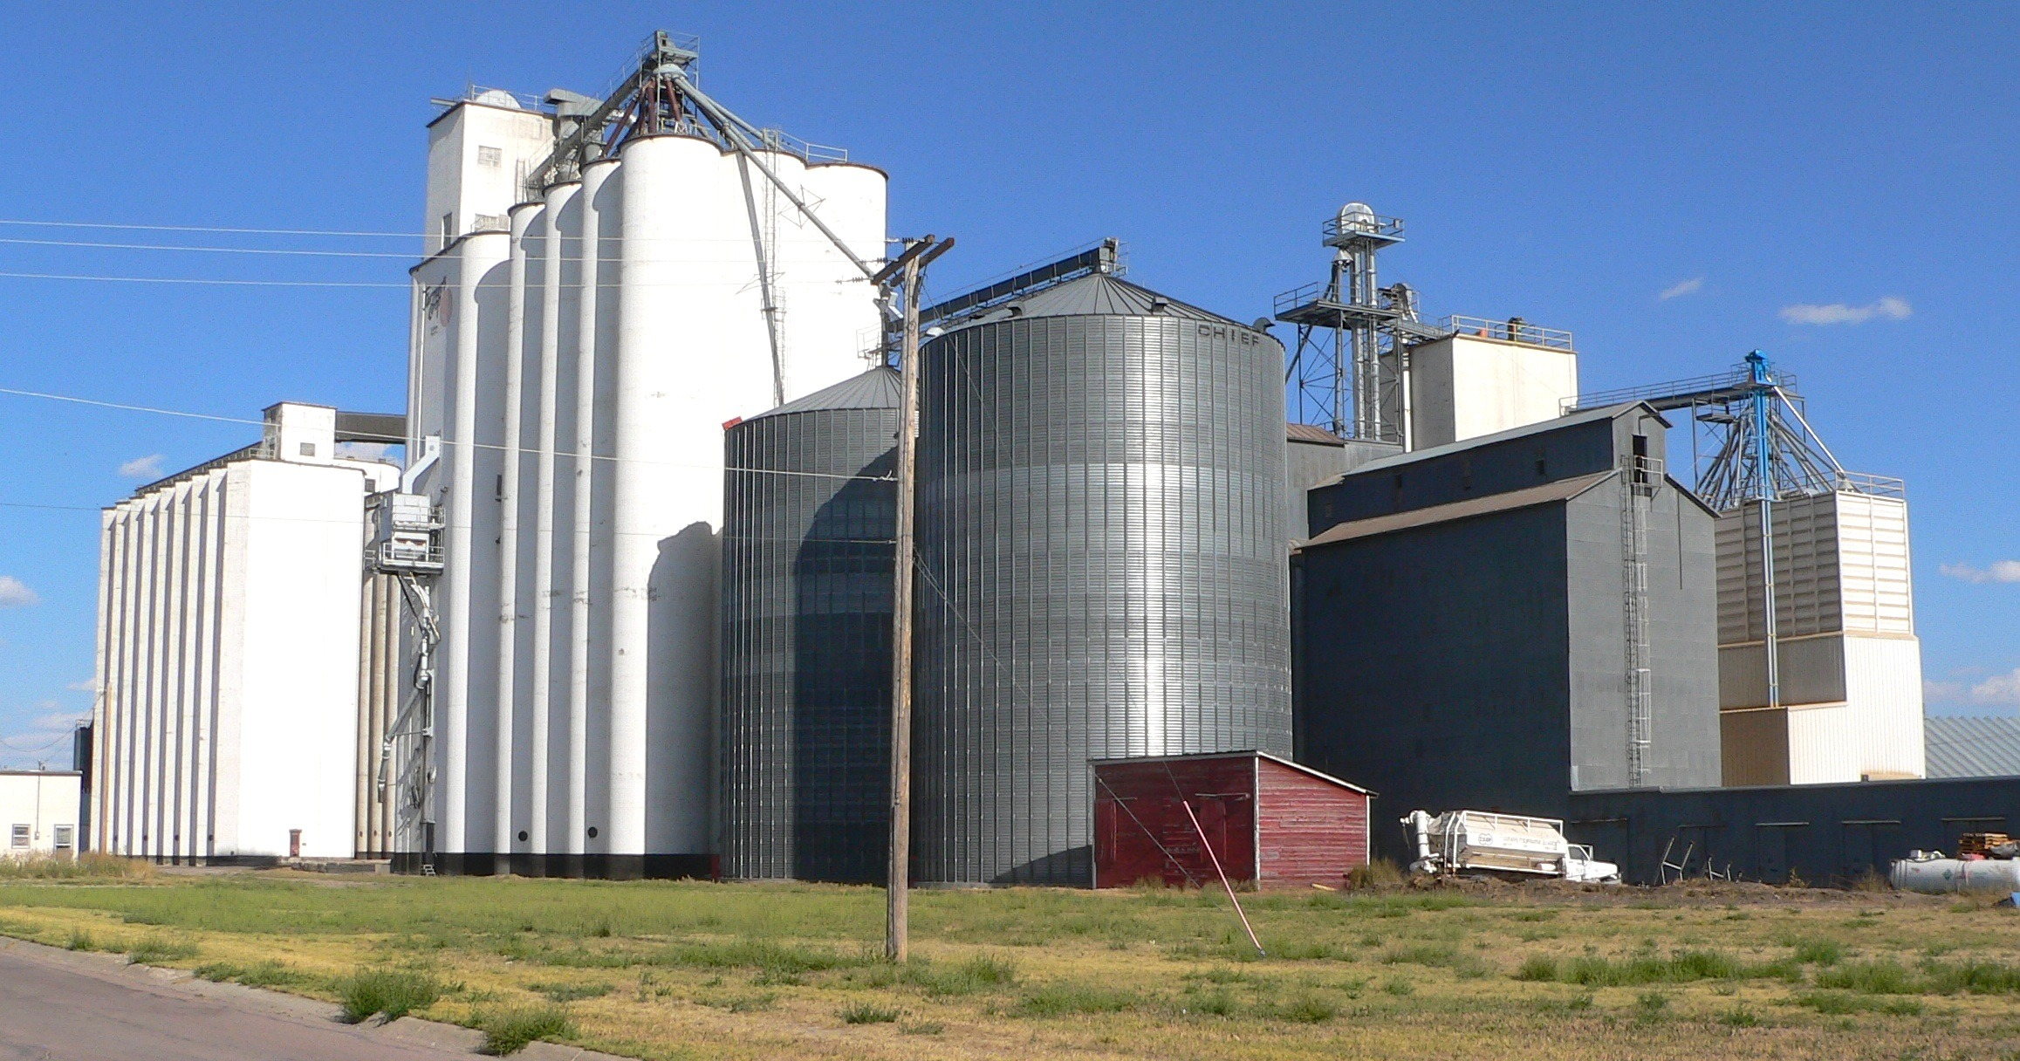
What to Do if GMOs Are Found
Request a second test to confirm GMO contamination
May need to sell crop as conventional
Notes:
Narration: If your crop is found to have GMO contamination, there are several steps you can take. First, request a second test to confirm that contamination has actually occurred. If it has, you may need to sell your crop as conventional, not organic or non-GMO. If your crop is food-grade, consider the organic feed-grade market, which may have less stringent requirements.
Image: Pixabay

Slide 63
What to Do if GMOs Are Found
  If you suspect pollen drift was a source of contamination
AND
GMO crop is registered as a pesticide (e.g. Bt corn)
Consider contacting state ag department regarding pesticide trespass
Notes:
Narration: If you suspect pollen drift was the source of the contamination and it is due to a GMO crop that is registered as a pesticide, such as Bt corn, you can consider contacting your state department of agriculture about investigating the incident as a pesticide trespass. However, as we mentioned before, there may not be legal recompense.

Slide 64
Preventing GMO Contamination
What is a GMO?
GMOs and organic agriculture
How contamination occurs
Consequences
Protecting yourself
Resources
Notes:
Narration: A variety of resources are available to help you stay informed and take action to protect your crops.
Image: Kristine Moncada, University of Minnesota

Slide 65
General Resources
GMO Contamination Prevention: What does it Take? – University of Minnesota
GMO Contamination webinar – eXtension
Farmers’ Guide to GMOs – Farmers’ Legal Action Group (FLAG)
Coexistence Resources – USDA
Minimum Separation Distance Guidelines – APHIS
List of GMO Testing Labs – NonGMO project
Sample Equipment Cleaning Log – CCOF
Search for Permitted Materials – Organic Materials Review Institute
Notes:
Narration: The University of Minnesota’s Southwest Research and Outreach Center has published a manual on preventing GMO contamination, and a webinar on the topic is available from eXtension. The Farmers’ Legal Action Group has published a guide to understanding GMO laws. The USDA has a collection of guidance documents on maintaining coexistence between GMOs and organic or other identity protected crops. You can also view the full guidelines on how to maintain effective separation to prevent unwanted cross-pollination. Other resources you may find useful are a list of GMO testing labs, a sample log for documenting equipment cleaning, and the Organic Materials Review Institute’s list of materials permitted in organic farming, which can help you find out whether inoculants or other inputs you may be considering are produced with genetic modification.

Slide 66
Keep Updated on Current GMOs
  Lists of current GMOs on the market:
  Non-GMO Sourcebook
  GMO Answers
  Status of permit requests for new GMO releases:
  Aphis
Notes:
Narration: Lists of current GMOs on the market are kept by both pro-GMO and anti-GMO sources. As seed companies develop new engineered crop varieties, these lists may change. If you want to follow new traits or crops under development, you can see permit requests and their status on the USDA-APHIS’s website. This database can be difficult to navigate, but it is important to note that this is publicly available information.

Slide 67
Preventing GMO Contamination
What is a GMO?
GMOs and organic agriculture
How contamination occurs
Consequences
Protecting yourself
Resources
Notes:
Narration: We have reached the end of our module. Thank you for watching!
Image: Kristine Moncada, University of Minnesota

Slide 68
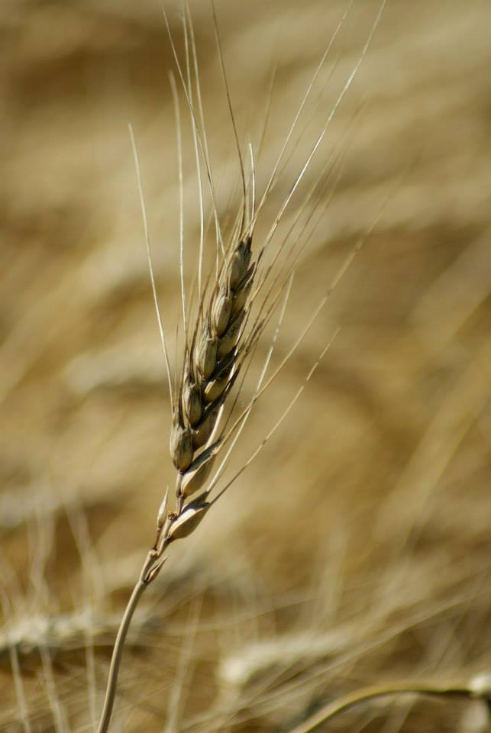

© 2017 Regents of the University of Minnesota. All rights reserved.
The University of Minnesota is an equal opportunity educator and employer.
This material is based upon work that is supported by the National Institute of Food and Agriculture, U.S. Department of Agriculture, under grant number 2013-51106-21005.
Notes:
Narration: This material is based upon work that is supported by the National Institute of Food and Agriculture.
Image: Constance Carlson, University of Minnesota

Slide 69
References
Conventional and Non-GMO Policy. Blue River Hybrids Organic Seed, Ames, IA. http://www.blueriverorgseed.com/resources/conventional-non-gmo-policy/144
McEvoy, M. 2011. Policy Memo 11-13: Genetically Modified Organisms. USDA AMS, Washington, DC. https://www.ams.usda.gov/sites/default/files/media/OrganicGMOPolicy.pdf
McEvoy, M. 2012. National Organic Program: Genetically Modified Organism (GMO). USDA AMS, Washington, DC. https://www.ams.usda.gov/sites/default/files/media/GMO%20Policy%20Training%202012.pdf
Moncada, K., C. Sheaffer, J. Coulter, J. Lamb, J. Sackett, and A. Jacobson. 2014. All About Corn: Corn Breeding 3. University of Minnesota, St. Paul, MN. http://www.allaboutcorn.umn.edu/lessons/corn-breeding
Monson, D. 2006. GMOs in agricultural inputs pose risks to organic, non-GMO farms. The Organic and Non-GMO Report, Fairfield, IA. http://www.non-gmoreport.com/articles/may06/gmo_risks_for_organic_farms.php
Neilsen, B. 2016. Silk Development and Emergence in Corn. Purdue University Corny News Network, West Lafayette, IN. https://www.agry.purdue.edu/ext/corn/news/timeless/Silks.html

Slide 70
References (cont.)
Neilsen, B. 2016. Tassel Emergence and Pollen Shed. Purdue University Corny News Network, West Lafayette, IN. https://www.agry.purdue.edu/ext/corn/news/timeless/tassels.html
Organic Seed Growers and Trade Association. 2016. GMO Corn Contamination 101. OSGATA, Washington, ME. http://www.osgata.org/2016/gmo-corn-contamination-101/
Riddle, J. 2004. The Inspector’s Notebook #2: Protecting the Integrity of Organic Grains During Harvest. Rodale Institute, Kutztown, PA. http://newfarm.rodaleinstitute.org/columns/inspector/2004/0804/081704.shtml
Riddle, J. 2012. GMO Contamination Prevention: What Does It Take? UMN Southwest Research and Outreach Center, Lamberton, MN. http://www.demeter-usa.org/downloads/GMO-Contamination-Prevention.pdf
Riddle, J. 2015. GMO Contamination: What’s an Organic Farmer To Do?. eXtension. http://articles.extension.org/pages/33163/gmo-contamination:-whats-an-organic-farmer-to-do-webinar
USDA. 2016. 2012 Census of Agriculture: Organic Survey (2014). USDA NASS, Washington, DC. http://www.agcensus.usda.gov/Publications/2012/Online_Resources/Organics/ORGANICS.pdf

