Slide 1
Cultural Weed Management
This material is based upon work that is supported by the National Institute of Food and Agriculture, U.S. Department of Agriculture, under grant number 2013-51106-21005.
Authors
Kristine Moncada
Jeff Gunsolus
Constance Carlson
Craig Sheaffer
Notes:
Narration: Welcome to our module on cultural weed management. In our previous module we gave an introduction to weed biology; now we will focus on how to manage weeds. Image: Kristine Moncada, University of Minnesota

Slide 2
Cultural weed management =
production practices that help manage weeds
Notes:
Narration: There are two main categories of weed management: cultural and mechanical. In this module, we will focus on Cultural Weed Management. We will discuss Mechanical weed control methods in our next module. So, what exactly does cultural weed management mean? It refers to the production practice decisions a farmer can make to inhibit weeds.
Image: David L. Hansen, University of Minnesota

Slide 3
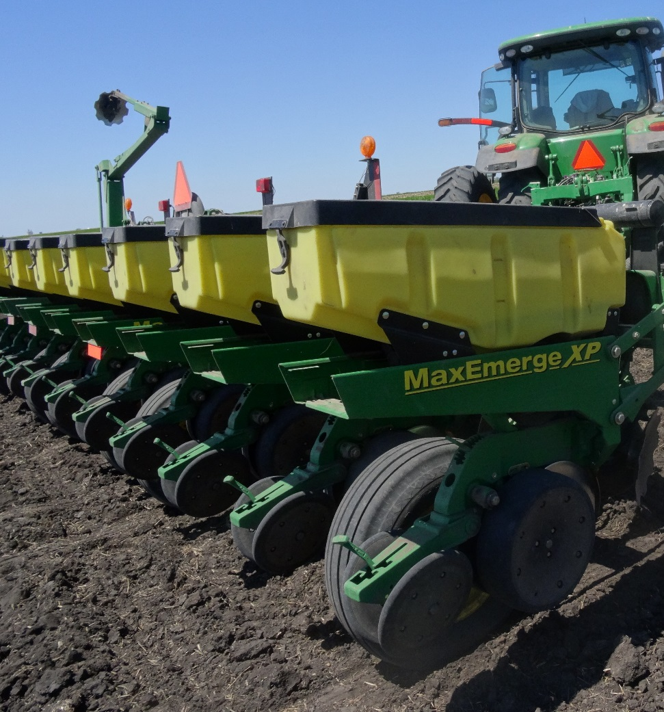
Cultural Weed Management
Rotation
Crop variety selection
Delayed planting
Planting rate
Prevention
Notes:
Narration: Cultural weed management most often is focused on preventing weeds. Examples of ways farmers can do this include: crop rotation and variety selection, delayed planting, and planting rate.
Image: Kristine Moncada, University of Minnesota

Slide 4
Rotation
Corn
Alfalfa
Alfalfa
Soybean
Wheat
Diversify with:
Perennials such as alfalfa
Small grains
Cover crops
5-year Rotation
Notes:
Narration: A diverse rotation is a strong tool in managing weeds. Different crops have different planting dates and growth habits that inhibit certain weeds. So, by changing things up, weeds have a harder time adapting. Adding perennials, small grains and cover crops are some of the ways to diversify a corn-and-soybean rotation and set back weeds. Please watch our modules entitled “Rotation” and “Cover Crops” for more information on those topics.

Slide 5
Benefits of Small Grains
Early competitive growth suppresses early weeds
Can be underseeded with red clover for even more weed control
←Small Grain
Legume→
Notes:
Narration: Growing crops with similar production practices will lead to weeds adapted to those practices. Including small grains in rotation is beneficial to a row crop production system because small grains have different planting and harvesting dates that interfere with early-emerging weeds. Small grains require narrower row spacing, which increases their competitive impact on later-emerging weeds. Another benefit is they can be underseeded with red clover or alfalfa to provide weed suppression after the grain is harvested. Image: Craig Sheaffer, University of Minnesota

Slide 6
Benefits of Alfalfa
Weeds are suppressed by continuous cover
Repeated mowing:
Depletes energy reserves of weeds
Can prevent them from setting seed
Notes:
Narration: Alfalfa is another important tool for managing annual weeds and can be helpful in reducing Canada thistle. As a perennial, alfalfa provides continuous soil coverage for up to 3 years. Weeds are suppressed by the continuous soil cover. The repeated harvesting of alfalfa depletes the energy reserves of weeds and can prevent them from setting seed. Image: David L. Hansen, University of Minnesota

Slide 7
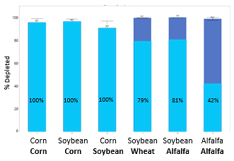
Weed Seed Depletion in Diverse Rotations
Predation/Degradation?
Emergence
% Depleted
% Emerged
Goplen et al, 2017
Notes:
Narration: A recent study in Minnesota examined the effect of rotation on giant ragweed seed emergence. They discovered lower levels of weed seed emergence in wheat and alfalfa as compared to corn and soybean. These results show that rotations with wheat and alfalfa are less favorable to giant ragweed emergence and contribute to seed bank depletion. The seed bank depletion is likely due to factors such as weed seed predation or degradation.

Slide 8
Winter Cover Crops in Rotations
Inhibit fall and early spring germinating weeds
Residue can have some short-term allelopathic effects that impede germination of some small-seeded weeds
Winter rye
Notes:
Narration: Winter cover crops can be a tool to manage weeds as well as protect soils. The growth of a winter cover crop such as winter rye or hairy vetch can suppress fall and very early spring weeds. The residue of winter rye in particular has been found to be allelopathic, which means it contains chemicals that can impede the germination of some small-seeded weeds. Image: Craig Sheaffer, University of Minnesota

Slide 9
Cultural Weed Management
Rotation
Crop variety selection
Delayed planting
Planting rate
Prevention
Notes:
Narration: You are probably familiar with the concept that different varieties have different traits and so perform differently. Competiveness is an example of a trait that can vary. As an organic producer, the competitiveness of the crop varieties you choose will become an important factor in weed management. Image: Kristine Moncada, University of Minnesota

Slide 10
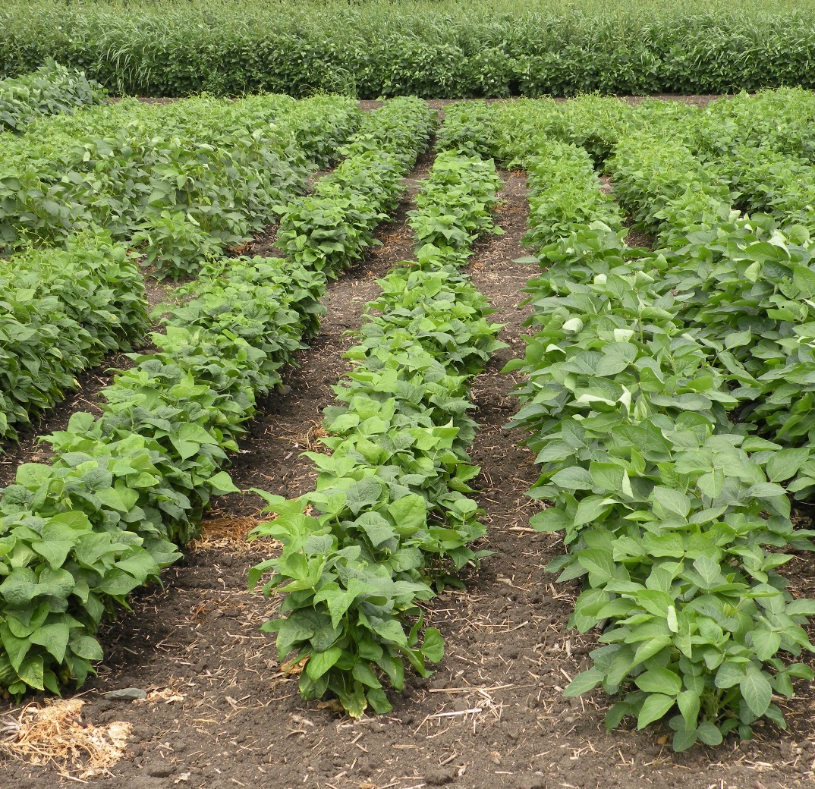
Crop Variety Selection
Crop varieties vary in their competitiveness
Some have:
Faster emergence
Greater growth rate
More rapid canopy closure
Better tolerance to weeds
Notes:
Narration: Crop varieties can vary in how adapted they are to organic systems. Take a look at this variety trial of organic dry beans where each row is a different variety. Their growth habits are obviously different. The variety in the center doesn’t have the vigorous growth of some of the others and has not developed much of a canopy in comparasion to the others. Some crop varieties may have greater competitiveness because they emerge faster, grow faster, close their canopies faster, or simply just have a better general tolerance to weeds. Some of this information on traits can be obtained from seed companies and variety trials, but in most cases, it is best to try out varieties or hybrids yourself to see if they perform competitively under your conditions. Image: Kristine Moncada, University of Minnesota

Slide 11
Cultural Weed Management
Rotation
Crop variety selection
Delayed planting
Planting rate
Prevention
Notes:
Narration: Depending on the crop, delayed planting may be a weed management option.
Image: Kristine Moncada, University of Minnesota

Slide 12
Delayed Planting
Allows for more weeds to germinate to be controlled with mechanical weed control
Can benefit corn and soybean production
Crop seed emerges faster in warm soils
Notes:
Narration: In Minnesota, organic producers often plant corn and soybean later than conventional growers. This is called “delayed planting” and it allows time before the crop is planted for more weeds to germinate. They then can be killed with mechanical weed control operations to reduce populations of early-emerging weeds. Later planting means the soils are warmer so corn and soybean will emerge more quickly. Delayed planting is not an option for early-planted cool season crops.

Slide 13
Delayed Planting
Effective on early-emerging weeds
Not effective on later-emerging ones or ones with prolonged emergence times
Lambsquarters
Notes:
Narration: Lambsquarters is an example of an early-emerging weed that may be controlled by delayed planting. Please note that later-emerging weeds such as waterhemp, or ones with prolonged emergence times, such as velvetleaf, will not be controlled with delayed planting. Delayed planting is not recommended for cool season crops such as small grains.
Image: Kristine Moncada, University of Minnesota

Slide 14
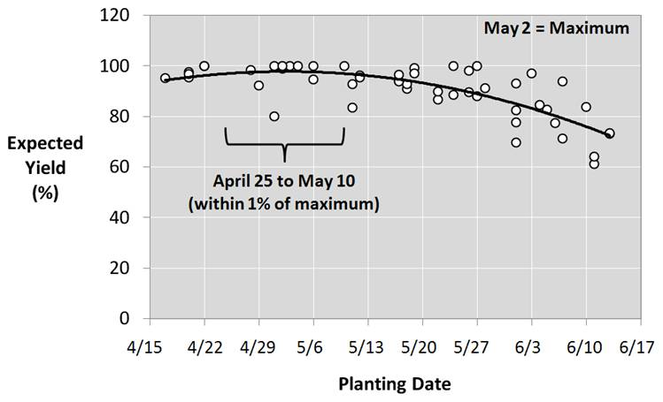
Drawback – Reduced Yields
Coulter, 2012. Response of corn grain yield to planting date at Lamberton, Morris, and Waseca, MN from 2009 to 2011.
Notes:
Narration: While crop seed can catch up in its growth somewhat when planted in warmer soils, one drawback of delayed planting is the potential for reduced yields. This graph shows that corn in much of Minnesota should be planted before May 10 for maximum yields. Often, organic producers will decide that even though delayed planting might result in slightly lower yields, the weed management benefits outweigh the yield hit. Delayed planting is never recommended for cool season crops, such as small grains, due to reduced yields and other reasons.

Slide 15
Cultural Weed Management
Rotation
Crop variety selection
Delayed planting
Planting rate
Prevention
Notes:
Narration: Not only does the optimum planting rate lead to optimum yields, it can give crops a competitive edge against weeds.
Image: Kristine Moncada, University of Minnesota

Slide 16
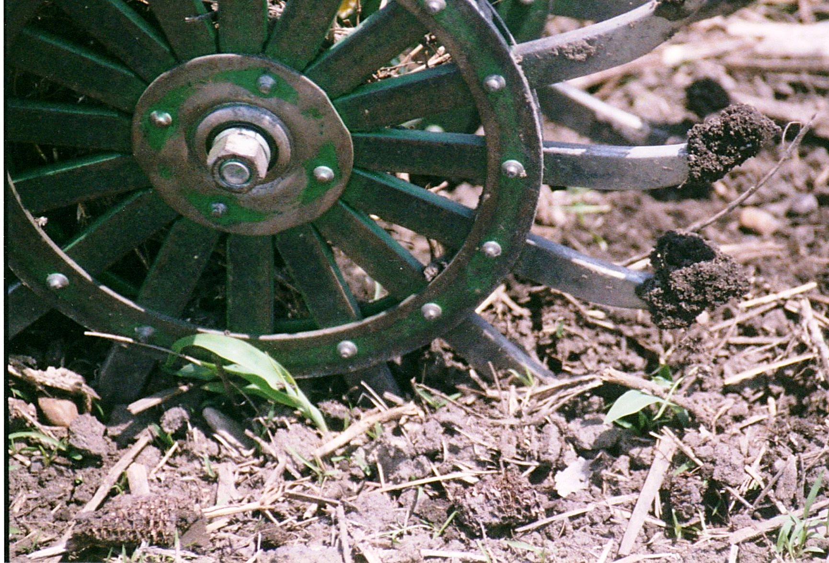
Mechanical Weed Control
Can reduce plant populations
Example = rotary hoeing can lead to a 10% reduction in crop stand
Notes:
Narration: Planting rate is especially critical for organic producers because mechanical weed control operations can reduce plant populations. For example, rotary hoeing can lead to a 10% reduction in crop stand.
Image: Carmen Fernholz

Slide 17
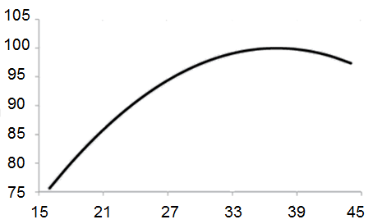
Planting Rate
Optimum
Planting at the optimum rate will increase crop competitiveness
Higher planting rates can compensate for stand losses due to mechanical weed control
% grain yield potential
Corn plant population (1000s/acre)
Source: Coulter, 2009
Notes:
Narration: Make sure to compensate for mechanical weed control casualties of your crop by increasing planting rate. One experienced organic farmer says to consider this additional seed cost to be equivalent to the cost of herbicide that you will no longer need as an organic producer. In Minnesota for example, most producers should have a final plant population for corn between 32,000 and 34,000 plants per acre. Consult other modules in this series or local extension publications for planting rate and population recommendations for crops in your area.

Slide 18
Cultural Weed Management
Rotation
Crop variety selection
Delayed planting
Planting rate
Prevention
Notes:
Narration: We will now discuss the most important aspect of cultural weed management – prevention.
Image: Kristine Moncada, University of Minnesota

Slide 19
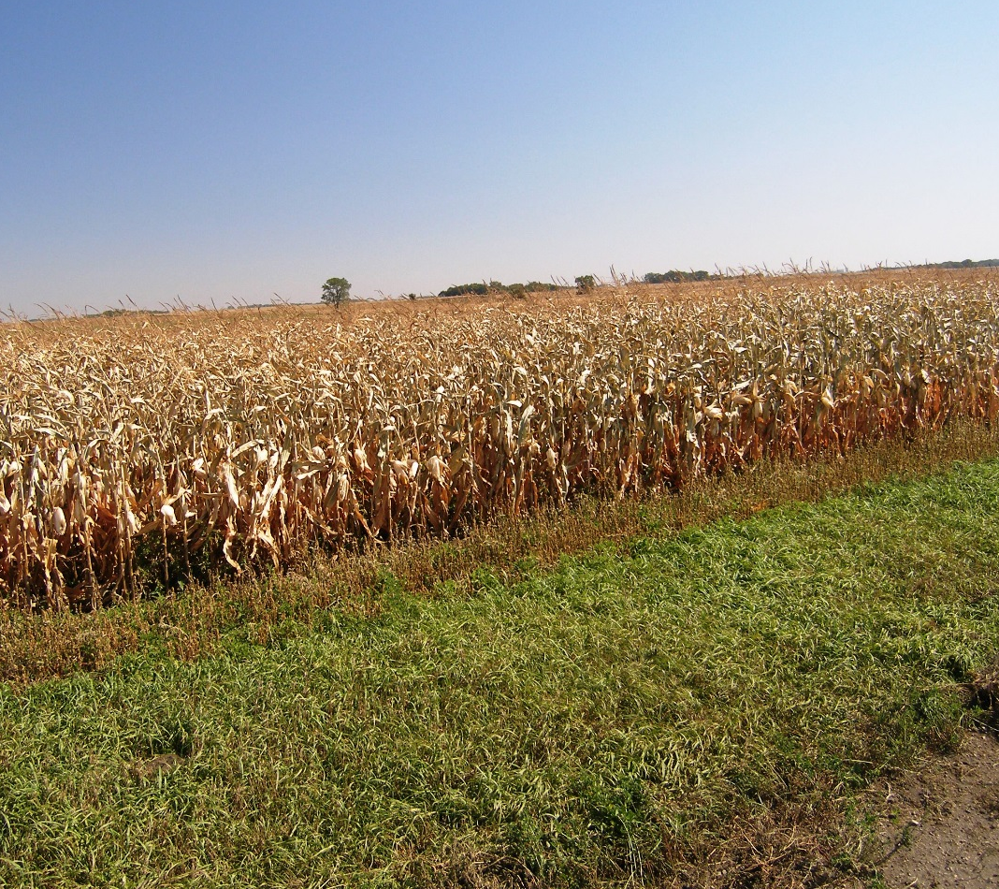
Prevention
Plant weed-free seed
Manage weeds in ditches, buffers and CRP land
Be aggressive about new weeds
Don’t allow weeds to go to seed
Mowed buffer
Notes:
Narration: As the old saying goes, an ounce of prevention is worth a pound of the cure. It is always better to prevent new weed problems. Plant seed that is free of weeds. Manage weeds in ditches, buffer strips, and Conservation Reserve Program land. If you notice a new weed “invasion”, take extra steps to prevent long-term establishment. To the best of your abilities do not let newly introduced weed species go to seed.
Image: Carmen Fernholz

Slide 20
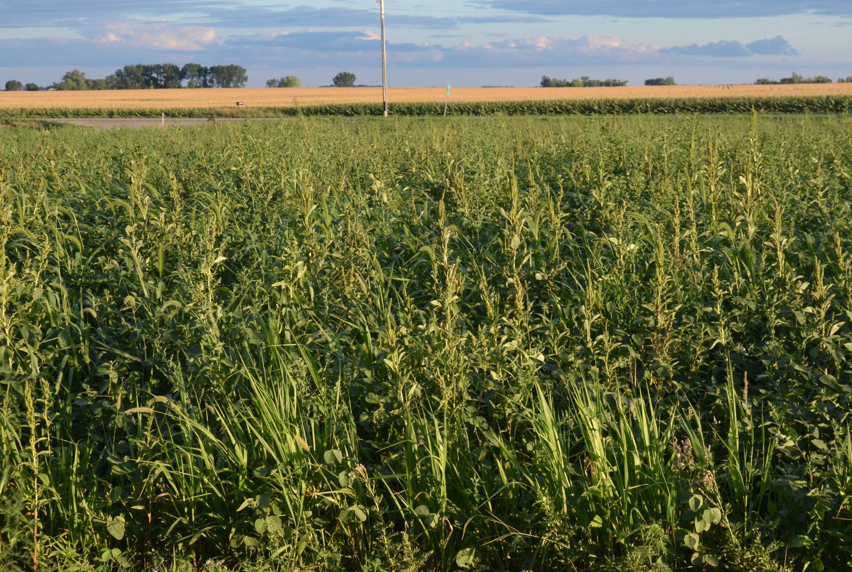
Just one year of weeds going to seed replenishes the weed seed bank
Notes:
Narration: Controlling weeds when they are young keeps them from producing seed. Why is it so important to prevent weeds from going to seed? In the Weed Biology module, we introduced the concept of the weed seed banks. Even if you have had several years of good weed control and have been successful in lowering the number of weed seeds in the bank, it only takes one year of poor weed control and allowing weed to go to seed to replenish the weed seed bank.
Image: Carmen Fernholz

Slide 21
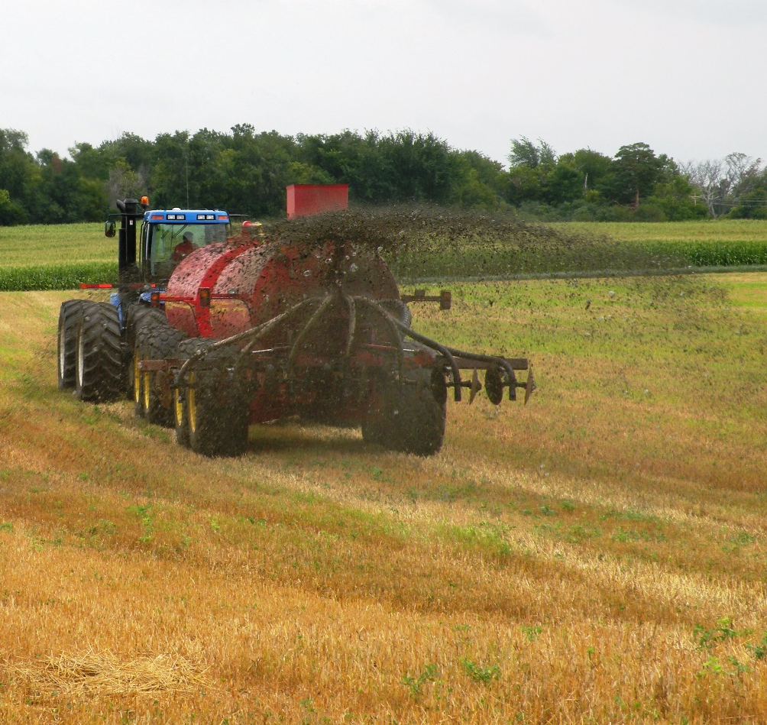
Weeds in Manure
Viable weed seed can survive digestion
Weed risks will depend on manure storage, livestock species, feed type and weed species
Be careful where you apply potentially weedy manure!
Notes:
Narration: Manure can be source of weeds. Many weed seeds pass through livestock digestive systems intact. Most significantly to farmers, manure can introduce new weed species. The level of weed risk in manure depends on how manure was stored, livestock species, type of feed and which weed seeds are consumed by the livestock. The fresher the manure is, the greater number of viable weed seeds there will be. As a general rule, weed seeds in hogs and cattle manure has the highest survival rates. If there is a manure source more likely to be weedy, put that on a conventional field instead. Image: University of Minnesota

Slide 22
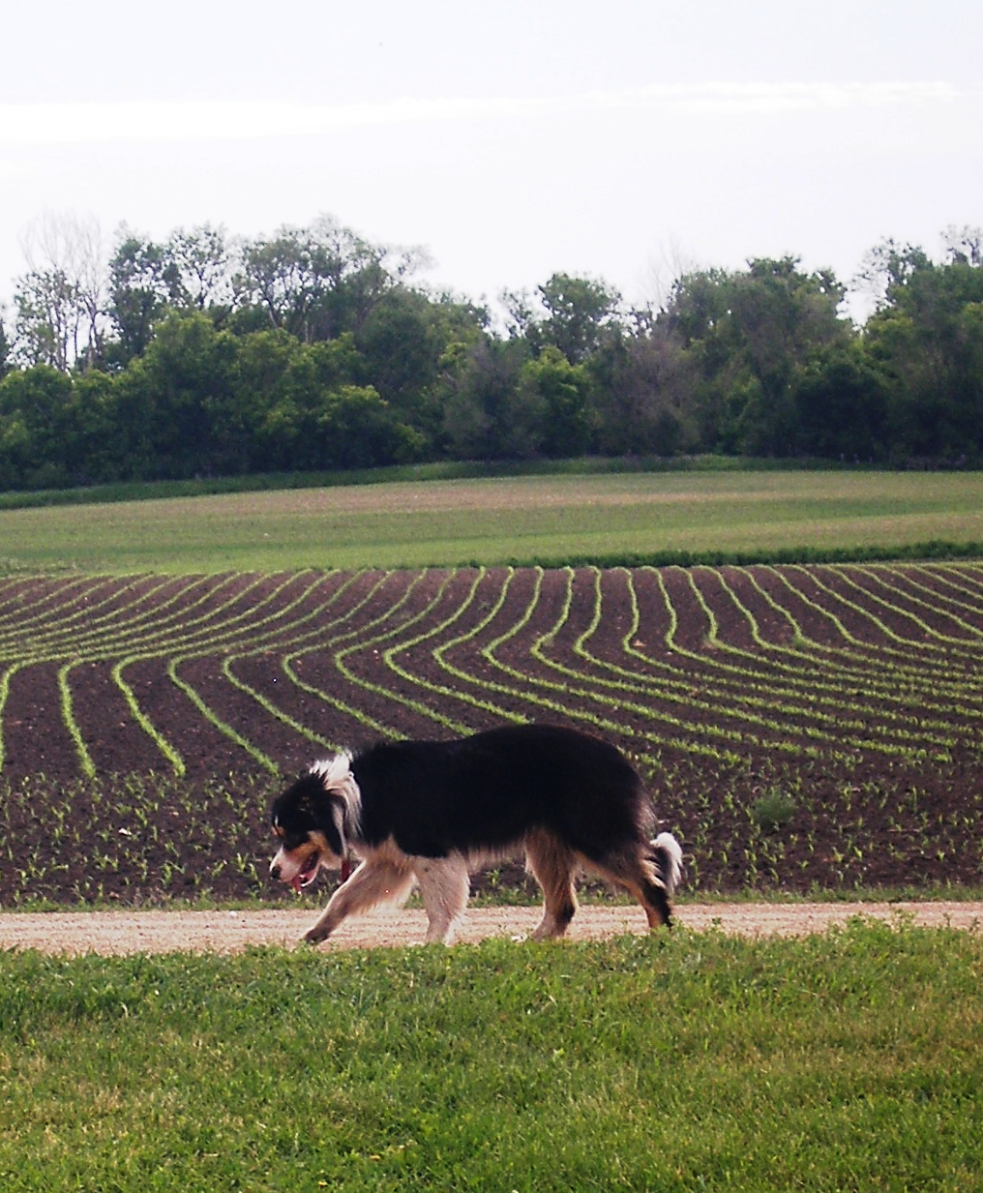
Scouting
Detection of weeds is critical
Note
Species
Emergence patterns
Keep weed maps and records on operation effectiveness
Notes:
Narration: Scouting is especially important for transitioning farmers. You will need to learn which weed species you have and note patterns in weed emergence to guide future mechanical weed control operations. It is critical to stay ahead of weeds and avoid playing catchup. As part of your recordkeeping, make maps of weed locations and record how effective your operations are. Image: Carmen Fernholz

Slide 23
Scouting Schedule
Early Spring
Early Summer
Early Fall
Notes:
Narration: One suggestion for a schedule to scout for weeds is three times a year. The most critical time to look for weeds is when they are most likely to be emerging, which would be in the early spring, early summer and early fall.

Slide 24
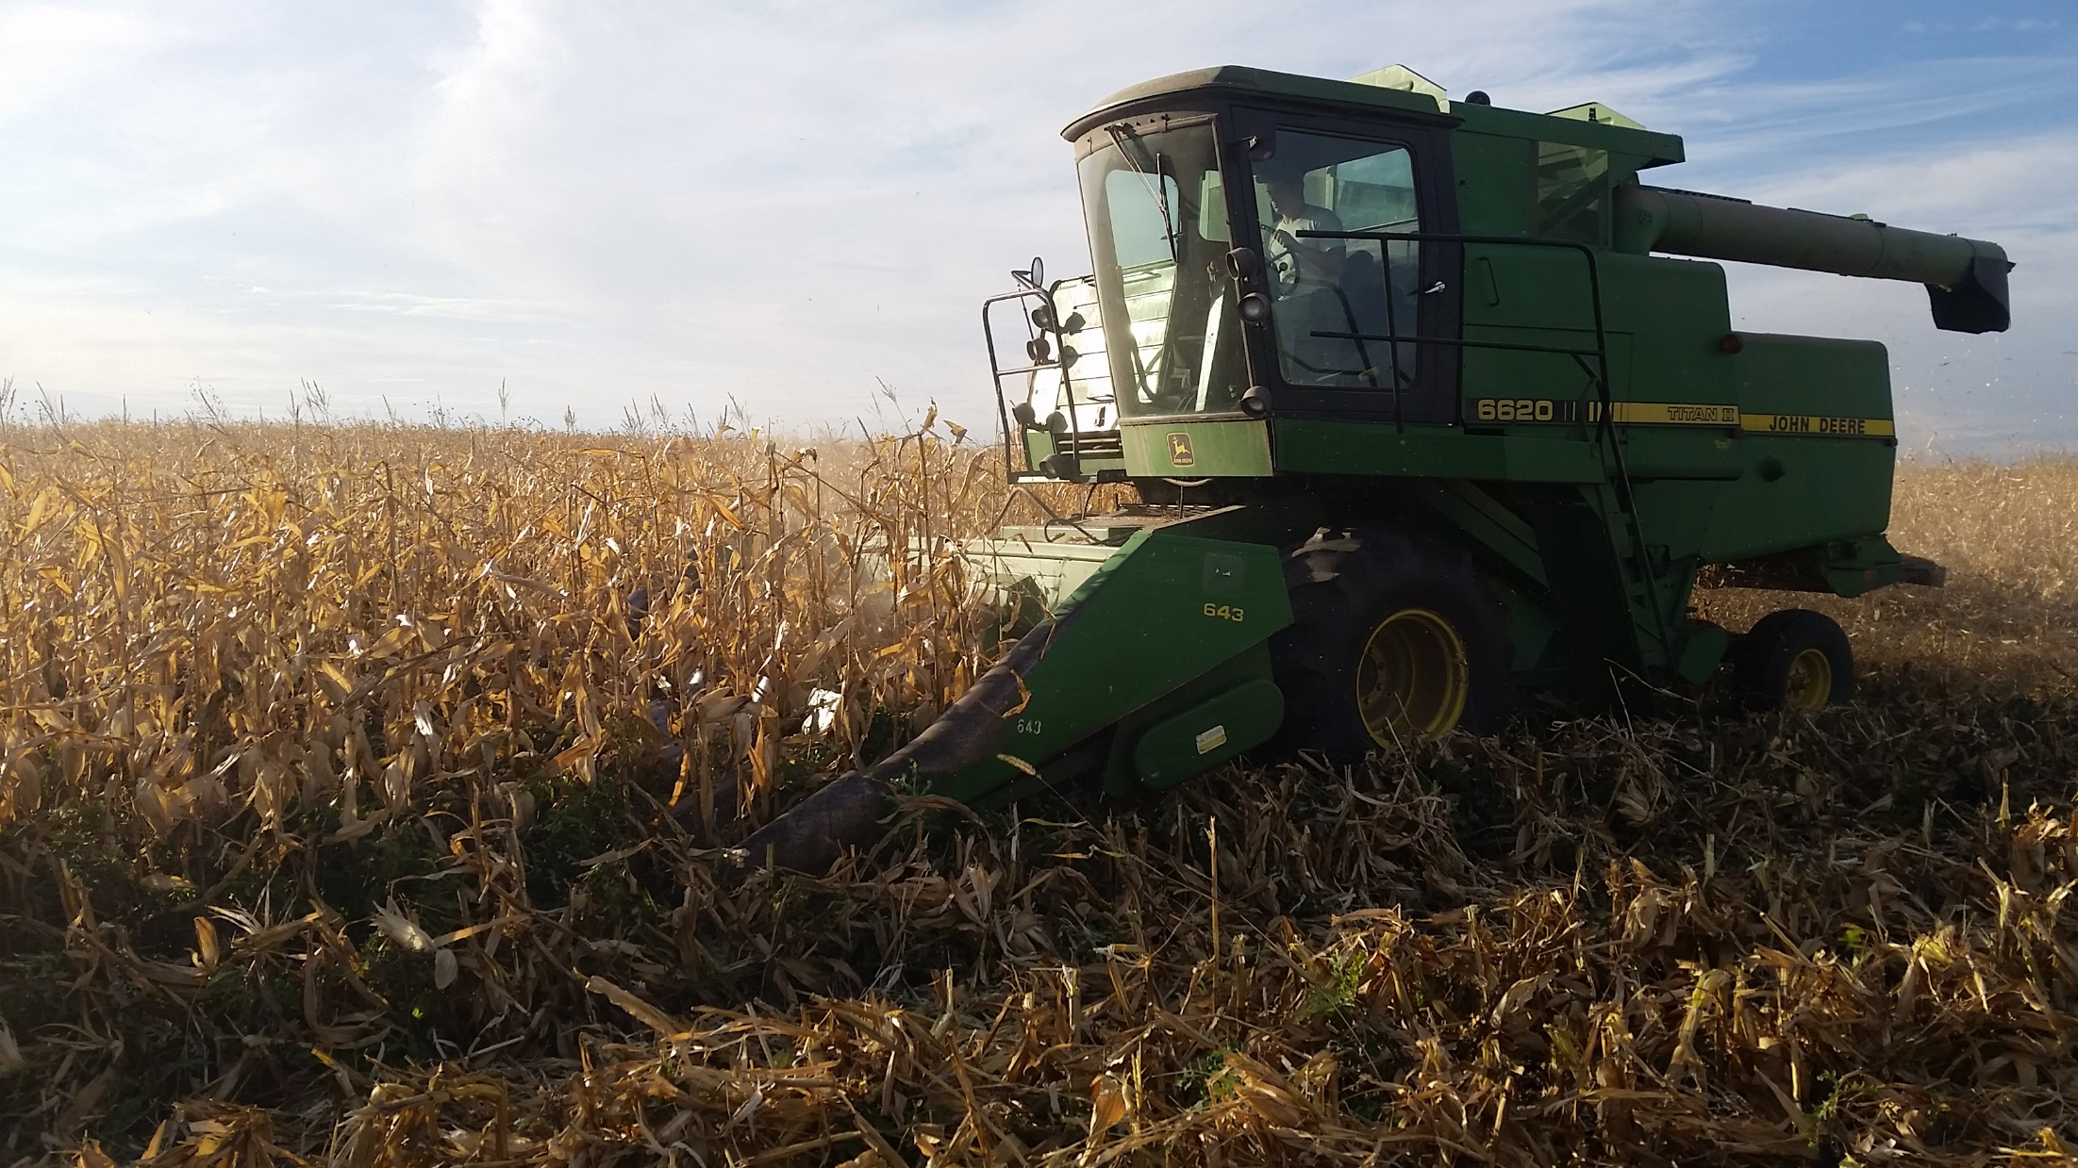
Conclusion
Notes:
Narration: By practicing the cultural weed management methods we have discussed in this module, we hope you will impact weeds and maintain good yields. Please watch the next module in our series – Mechanical Weed Management – for more ways to manage weeds. Weeds are one of the biggest concerns in organic farming so it is best to use all the tools you have!
Image: Carmen Fernholz

Slide 25
Resources
Transition to Organic Management – Rodale Institute
Sustainable Weed Management
Risk Management for Organic Producers - Weed Management
The Role of Crop Rotation in Weed Management
Control Practices in Organic Weed Management
Notes:
Narration: For more information on this topic, please visit these sites.

Slide 26
Cultural Weed Management
Rotation
Crop variety selection
Delayed planting
Planting rate
Prevention
Notes:
Narration: Thank you for watching our Cultural Weed Management module!
Image: Kristine Moncada, University of Minnesota

Slide 27
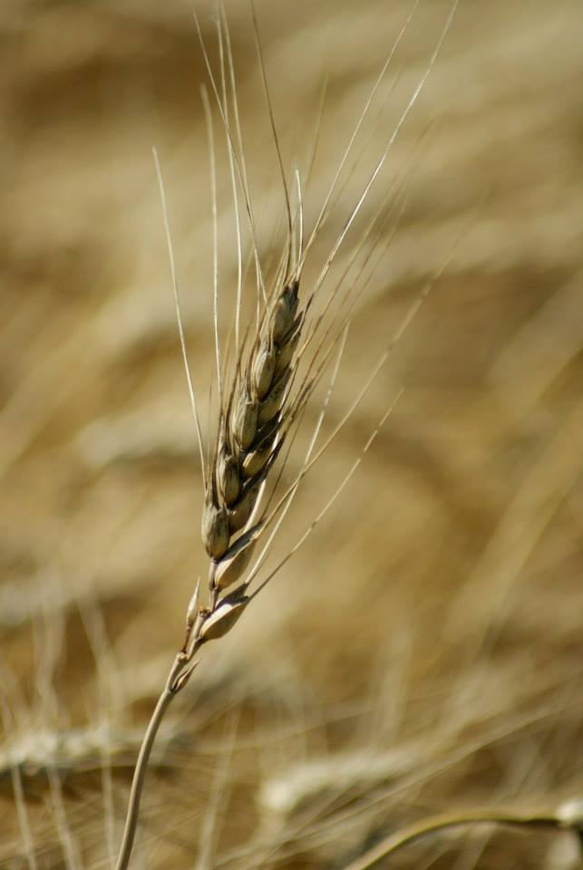
© 2017 Regents of the University of Minnesota. All rights reserved. The University of Minnesota is an equal opportunity educator and employer.
This material is based upon work that is supported by the National Institute of Food and Agriculture, U.S. Department of Agriculture, under grant number 2013-51106-21005.
Notes:
Narration: This material is based upon work that is supported by the National Institute of Food and Agriculture.
Image: Constance Carlson, University of Minnesota

Slide 28
References
Canadian Organic Growers. 2001. Organic Field Crop Handbook, 2nd edition. Canadian Organic Growers.
Coulter, J. 2012. Planting Date Considerations for Corn. University of Minnesota. http://blog-crop-news.extension.umn.edu/2012/03/planting-date-considerations-for-corn.html
Coulter, J. 2009. Optimum plant population for corn in Minnesota. M1244. University of Minnesota. http://www.extension.umn.edu/distribution/cropsystems/M1244.html
Curran, W. 2004. Weed Management in Organic Cropping Systems. Pennsylvania State University. http://extension.psu.edu/pests/weeds/organic/weed-management-in-organic-cropping-systems
Goplen, J.J., C.C. Sheaffer, R.L. Becker, J.A. Coulter, F.R. Breitenbach, L.M. Behnken, G.A. Johnson, and J.L. Gunsolus. 2017. Seedbank Depletion and Emergence Patterns of Giant Ragweed (Ambrosia trifida) in Minnesota Cropping Systems. Weed Science 65:52–60
Gunsolus, J. 1990. Mechanical and cultural weed control in corn and soybeans. American Journal of Alternative Agriculture 5:114-119.
Katovich, J., R. Becker, and J. Doll. Weed Seed Survival in Livestock Systems. University of Minnesota and University of Wisconsin. https://www.extension.umn.edu/agriculture/forages/pest/docs/umn-uw-ext-weed-seed-survival-in-livestock-systems.pdf
Mohler, C.L. 2001. Enhancing the competitive ability of crops. Pp. 269-321 in M. Liebman, C.L. Mohler and C.P. Staver (eds.) Ecological Management of Agricultural Weeds. Cambridge, U.K.: Cambridge University Press.
Sheley, M., M. Manoukian, and G. Marks. 2011. Preventing Noxious Weed Invasions. Montana State University Extension. http://store.msuextension.org/publications/AgandNaturalResources/MT199517AG.pdf

