Slide 1
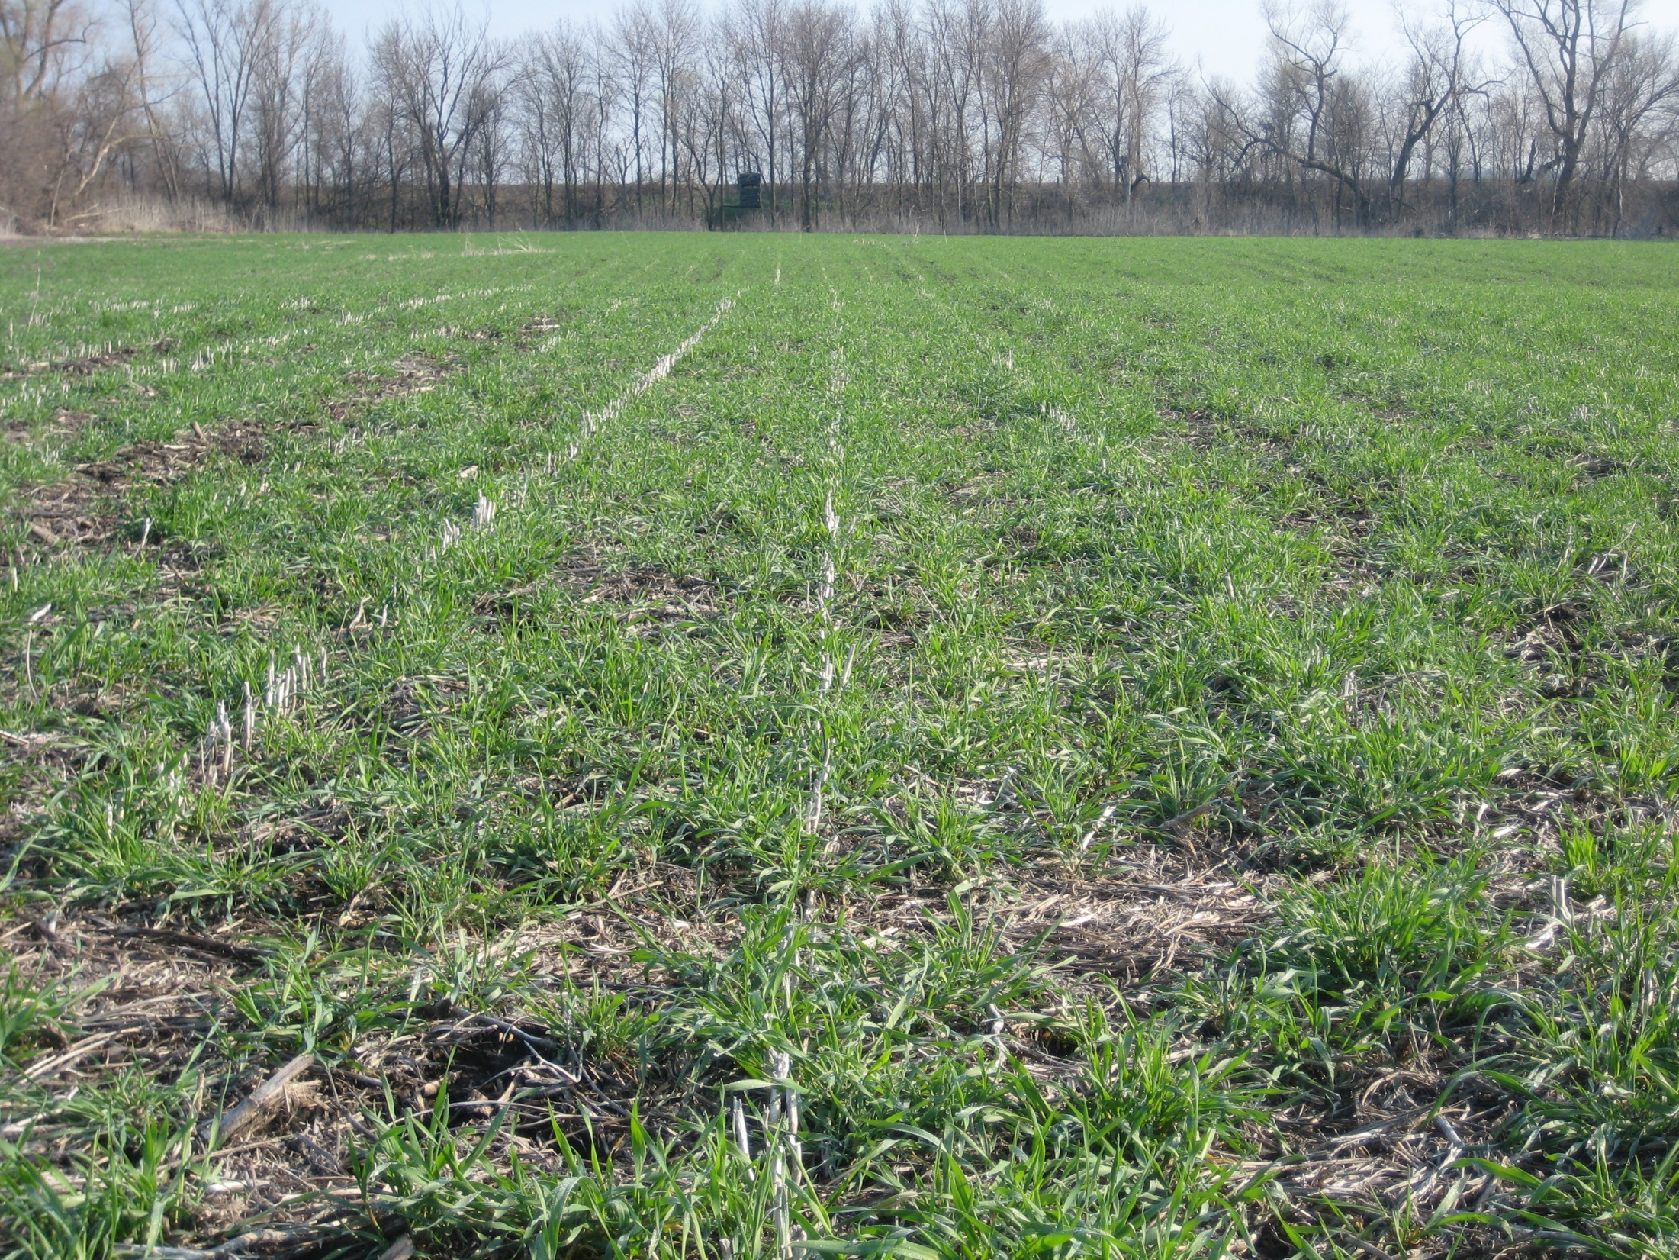
Cover Crops
Authors
Adria Fernandez
Claire Flavin
Kristine Moncada
Constance Carlson
Craig Sheaffer
This material is based upon work that is supported by the National Institute of Food and Agriculture, U.S. Department of Agriculture, under grant number 2013-51106-21005.
Notes:
Narration: Welcome to the Cover Crops module of our Transitioning to Organic series. Image: Jill Sackett Eberhart

Slide 2
Cover Crops
Introduction
Benefits
Cover Crop Options
Meeting Your Goals
Establishment & Termination
Rotations
Economics
Conclusion
Notes:
Narration: We’ll start with a brief introduction to cover crops: what they are, and why they’re used.
Image: Jill Sackett Eberhart

Slide 3
What Is a Cover Crop?
“Crops including grasses, legumes and forbs for seasonal cover and other conservation purposes. “
- Natural Resources Conservation Service
Notes:
Narration: The Natural Resources Conservation Service defines cover crops as “crops including grasses, legumes, and forbs for seasonal cover and other conservation purposes.” In other words, a cover crop is a crop you plant not to obtain a harvest, but to provide soil health, fertility, or conservation benefits.

Slide 4
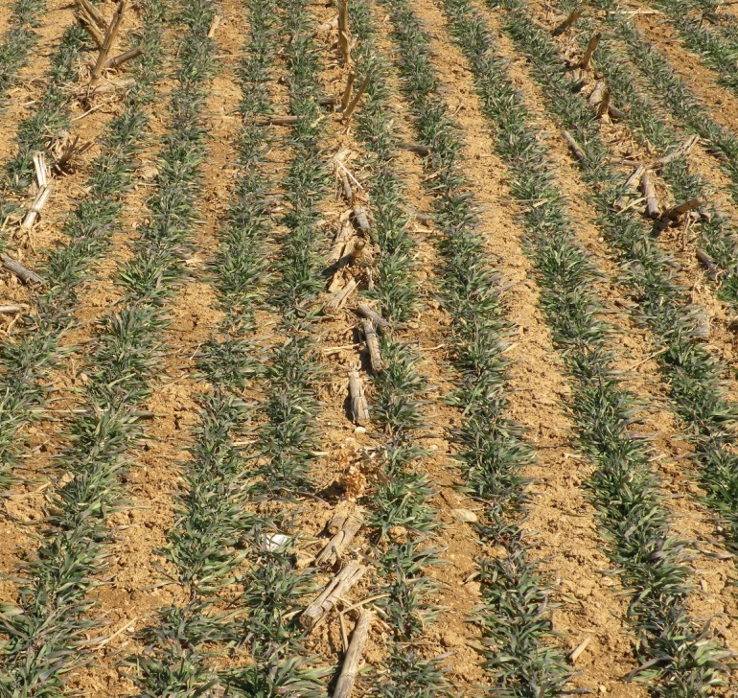
What Is a Cover Crop?
Typically planted after cash crop harvest
May also be used in fallow years
Reduces time when soil is bare
Also called plowdown or green manure
Plant material is incorporated rather than exported
Over-wintered rye
Notes:
Narration: Cover crops are typically planted after a cash crop is harvested, and can also be used in fallow years when no cash crop is planted. They are an alternative to leaving soil bare over winter, or at other times when cash crops are not growing. You may also hear cover crops referred to as plowdowns or green manures—these names indicate a key aspect of cover crops: that the plant material, or biomass, they produce is incorporated into the soil rather than exported from the farm in the form of grain or forage.
Image: Craig Sheaffer, University of Minnesota

Slide 5
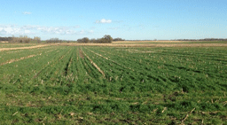
Cover Crops on Organic Farms
Not required for organic, but valued in rotations
Contribute to biological approach to pest, weed, and disease management
Notes:
Narration: Certified organic farmers are required by law to practice crop rotation under the USDA-National Organic Program (NOP). Although cover cropping is not specifically required, cover crops are an integral part of many organic rotations. The use of cover crops aligns well with the organic principle of using well-designed rotations to provide biological solutions to the challenges of
soil building and pest, weed, and disease management, and because of this, organic farmers are often leaders in cover crop innovation and adoption.
Image: Jared Goplen, University of Minnesota Extension

Slide 6
Cover Cropping in Organic Systems
Reduce erosion from wind and water
Increase soil organic matter content
Capture and recycle or redistribute nutrients in the soil profile
Promote biological nitrogen fixation
Weed suppression
Soil moisture management
Minimize and reduce soil compaction
Notes:
Narration: The NRCS identifies seven purposes for the use of cover crops that directly support the practice objectives identified by the National Organic program. These are: reducing erosion from wind and water, increasing soil organic matter content, capturing and recycling or redistributing nutrients in the soil profile, promoting biological nitrogen fixation, suppressing weeds, managing soil moisture, and minimizing and reducing soil compaction.

Slide 7
Cover Crops
Introduction
Benefits
Cover Crop Options
Meeting Your Goals
Establishment & Termination
Rotations
Economics
Conclusion
Notes:
Narration: Using cover crops on your farm can provide many benefits.
Image: Jill Sackett Eberhart

Slide 8
Benefits of Cover Cropping
Soil Health
Weed Control
Improved Water Quality
Pest & Disease Control
Enhanced Nutrient Cycling
Notes:
Narration: These can include improved soil health, water quality, weed control, pest and disease control, and enhanced nutrient cycling.

Slide 9
“Name the single biggest benefit you receive from cover crops…”
SARE Cover Crop Survey 2015-16
Notes:
Narration: When farmers were asked to name the biggest benefits that they received from cover crops, most chose options related to building and protecting soil: improved soil health, erosion control, and increased organic matter.

Slide 10
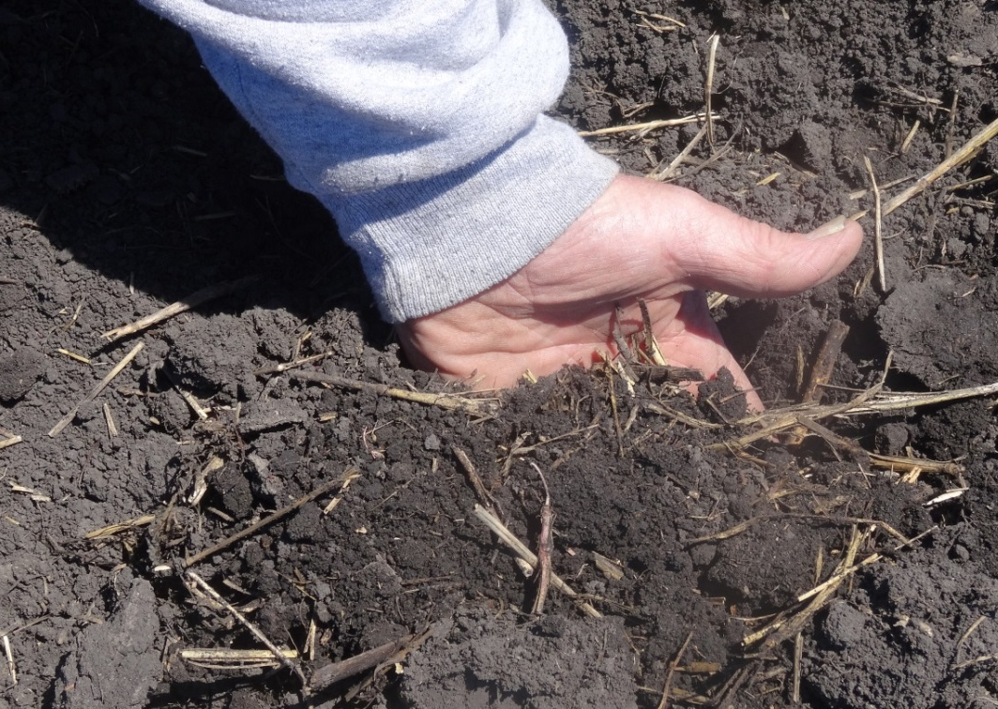
Soil Health: Increased Organic Matter
Incorporating cover crops adds biomass
Biomass is processed by microbes into soil organic matter
Notes:
Narration: When cover crop biomass is incorporated, it becomes food for soil microbial communities, contributing to building soil organic matter, which is essential to the structure, water holding capacity, and long-term fertility of soils. You can learn more about the role of soil organic matter in the “Soil Health and Fertility” modules in this series.
Image: Kristine Moncada, University of Minnesota

Slide 11
Soil Health: Improved Water Infiltration & Retention
Cover crop roots penetrate deep into soil, creating pathways for water infiltration
Soil compacted by continuous cropping
Soil with radish cover crop
Notes:
Narration: Cover cropping can also prevent and remedy soil compaction. When soils are compacted, soil particles are pressed together so that roots have trouble penetrating, and the soils lose the ability to absorb water easily, leading to increased runoff, erosion, and low subsoil moisture. Cover crops can reduce compaction by extending their roots deep into the soil, which also creates pathways for rainwater to infiltrate and reach the subsoil.
Image: SARE Cover Crop Image library

Slide 12
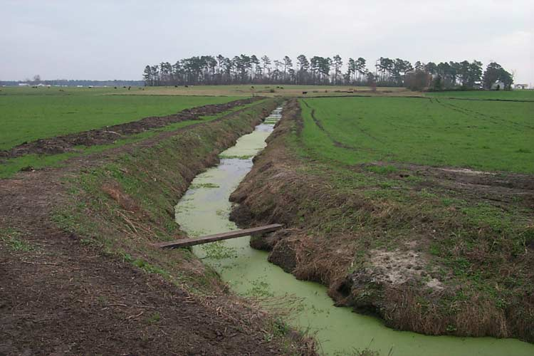
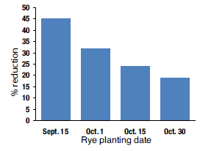
Improved Water Quality
Reduction in nitrate leaching with rye cover cropping
Reduced sediment runoff
Retention of nutrients on farm
Adapted from Feyereisen et al., 2006
Notes:
Narration: In addition to improving and protecting soils, cover crops can protect water quality on your farm and downstream. By holding soil physically in place and preventing erosion, cover crops can reduce sediment loads entering waterways. But cover crops also take up nutrients that might be vulnerable to runoff and leaching--you may hear cover crops used for this purpose referred to as “catch crops.” Catch crops hold nutrients, particularly nitrogen and phosphorus, on your farm and prevent them from becoming pollutants downstream.
Image: USGS

Slide 13
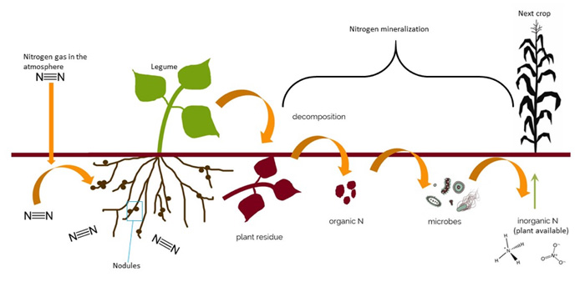
Improved Nutrient Cycling
Nutrient capture and/or biological N fixation
Increased microbial activity leading to faster residue cycling
Notes:
Narration: Another benefit of cover crops is improved nutrient cycling. Cover crops not only take up excess soil nutrients, but in the case of legume species, they can also fix, or transform, nitrogen from the atmosphere into plant-available forms. These nutrients are then released into the soil when the incorporated cover crop biomass decomposes. The addition of organic matter to the soil also supports increased soil microbial activity, leading to faster breakdown and release of nutrients from crop residues.

Slide 14
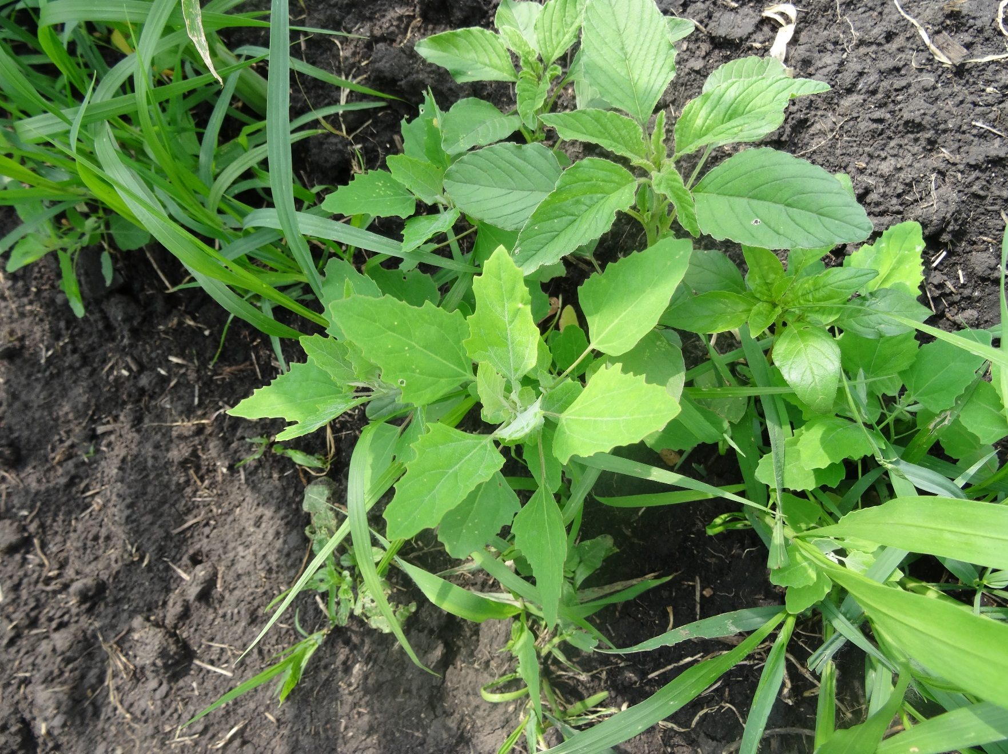
Weed Control
Notes:
Narration: Many farmers find cover crops helpful in controlling weeds. Cover crops can suppress weeds by competing with them for water, sunlight, and nutrients at times when there would otherwise be bare soil with no competition. Some cover crops also have an allelopathic affect, meaning that they produce chemical compounds that suppress the germination and growth of other species.
Image: Kristine Moncada, University of Minnesota

Slide 15
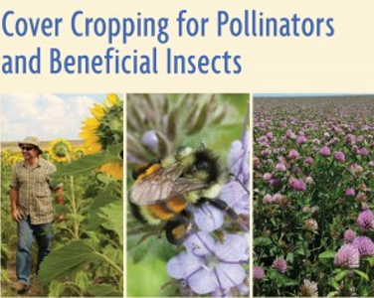
Pest and Disease Control
Notes:
Narration: Cover crops also diversify rotations, which can interrupt pest and disease cycles by breaking up the presence of pest or pathogen host plants with periods of non-host species. Some cover crops can also provide habitats for beneficial insects, including natural enemies of crop pests.
Image: SARE

Slide 16
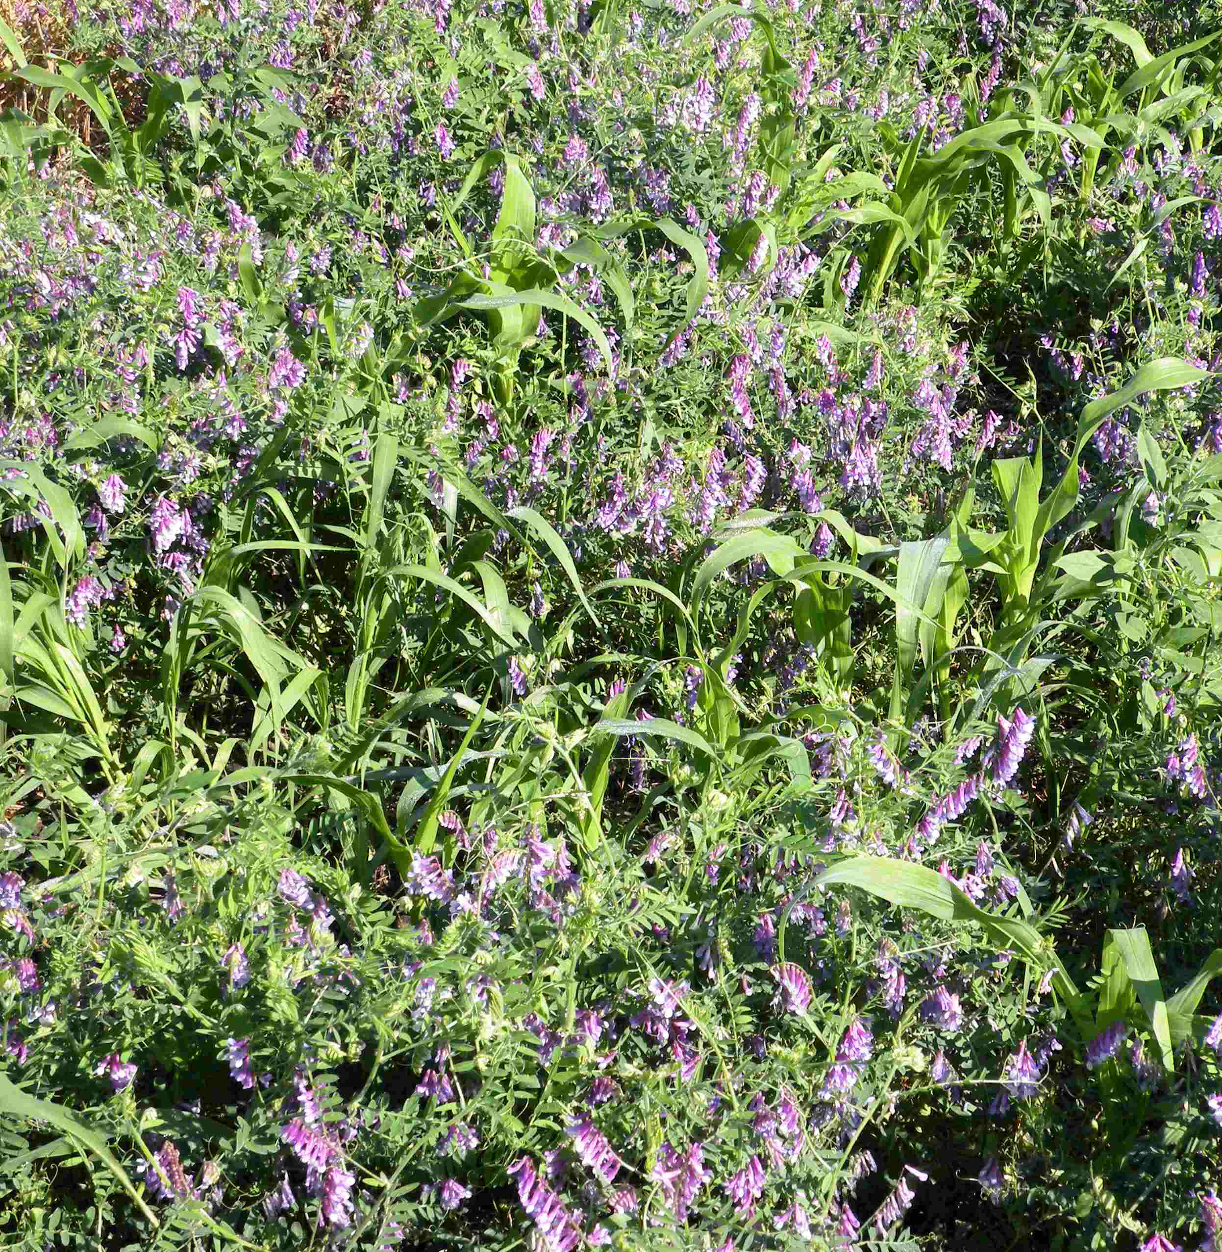
Cover Crop Risks
Increased management, labor, and seed costs
Depletion of soil moisture or nutrients
Interference with cash crop establishment
Cooler soil temperatures
Excessive residues
Allelopathy
Hairy vetch cover crop overgrowing corn cash crop
Notes:
Narration: Though they have many benefits, there are also risks associated with using cover crops. Using cover crops requires additional investments in management effort, labor, and seed and planting costs. Cover crops also draw on soil moisture and nutrient supplies, and can affect their availability to following crops. Cover crops can sometimes interfere with cash crop establishment by slowing soil warm-up, or if residues prevent good seed placement and seed-soil contact or have allelopathic effects on the crop plant.
Image: University of MInnesota

Slide 17
Cover Crops
Introduction
Benefits
Cover Crop Options
Meeting Your Goals
Establishment & Termination
Rotations
Economics
Conclusion
Notes:
Narration: To make cover cropping work for you, you will need to choose cover crops and practices that can benefit your main crops while minimizing the potential risks.
Image: Jill Sackett Eberhart

Slide 18
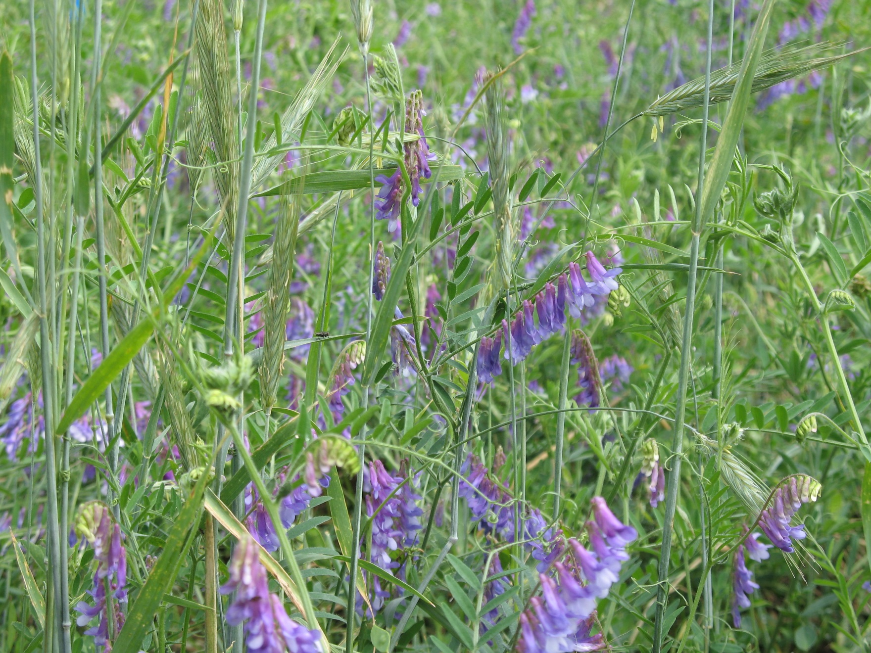
Cover Crop Species
Winter rye and hairy vetch mix
Notes:
Narration: An enormous range of plant species can potentially be used as cover crops. However, in practice, there are only a handful that most farmers find practical for use in the Upper Midwest. To maximize benefit and minimize risk, you’ll want to start by thinking about what purpose you want the cover crop to serve and where you want it to fit in your rotation. This allows you to consider the set of crops suitable for a given purpose, and select one with a growth period that fits your cropping schedule.
Image: Craig Sheaffer, University of Minnesota

Slide 19
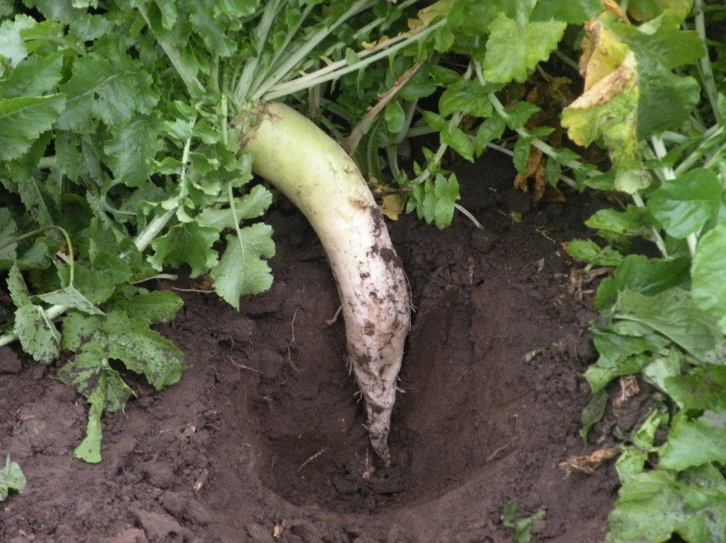
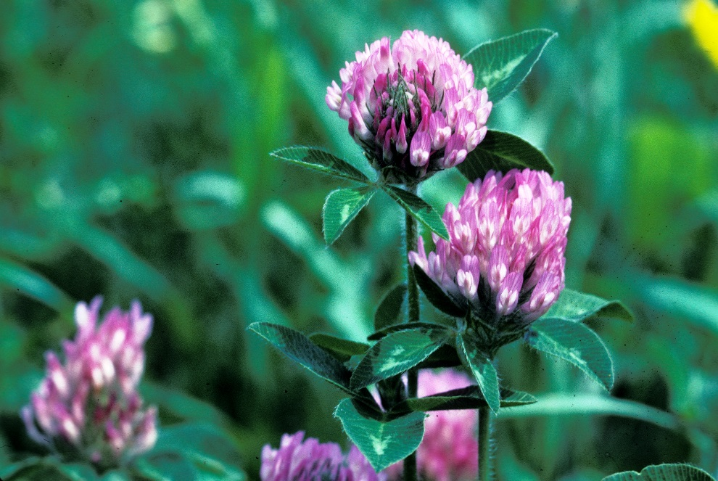
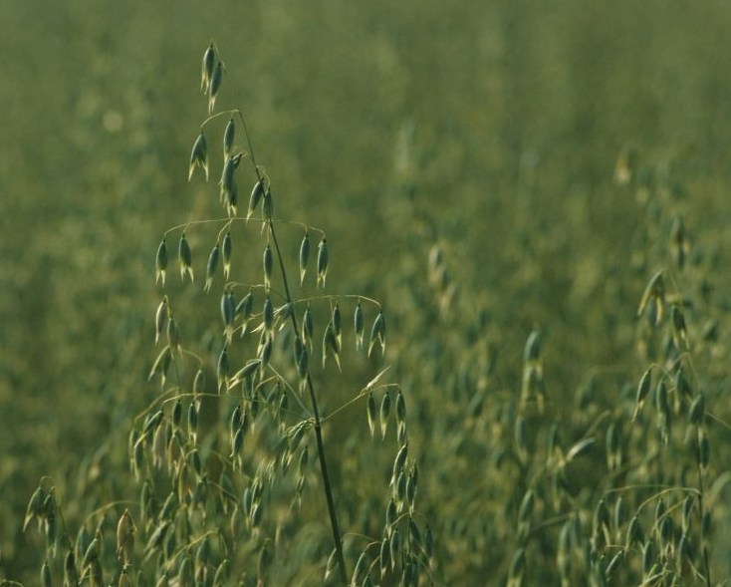
Cover Crop Characteristics
Legume, grass, or broadleaf
Overwintering vs. winter-killed
Notes:
Narration: Cover crop options include legumes, grasses, and broadleaf species, and also include overwintering and winter-killed choices. Winter-hardy crops like rye or red clover will provide a living cover to protect soil during the winter, and will have time to develop more biomass as their growth period extends into the spring; however, terminating these hardy crops can be challenging and require multiple tillage passes. If you are planning to follow the cover with an early spring-planted cash crop, it may be more convenient to use a cover crop that will winter-kill. Images: David L. Hansen, University of Minnesota (oat, red clover); Craig Sheaffer, University of Minnesota (radish)

Slide 20
Cover Crops for Northern Environments
Constraints: short growing seasons, harsh winter conditions
Most commonly used include:
Winter rye
Annual ryegrass
Spring oats
Hairy vetch
Red clover
Brassicas
Notes:
Narration: Cover crop choices for northern environments are constrained by the short growing season and harsh winter conditions. To succeed in Minnesota systems, cover crops must be capable of emerging and growing strongly in the relatively brief, cool period between cash crop harvest and a fall freeze; and those intended to overwinter must withstand intense cold and variable snow cover. The cover crops that are most commonly used in the region include winter rye, annual ryegrass, spring oat, hairy vetch, red clover, and brassicas.
Image: University of Minnesota Extension

Slide 21
Winter Rye
Cool-season annual grass
Very winter-hardy
Suppresses weeds
Can be used for spring grazing or harvested for grain
High water use
Notes:
Narration: Winter rye is a cool-season annual grass with strong winter-hardiness. It produces thick, high-biomass stands that suppress weeds and can also be used for spring grazing. If allowed to mature, it can also be harvested for grain. However, winter rye also has relatively high water demand, so it may not be suitable in situations where soil moisture is limited. Image: Craig Sheaffer, University of Minnesota

Slide 22
Annual Ryegrass
Quick to establish, even at cool temperatures
Winter-kills; no need to terminate
Provides winter soil protection and spring water infiltration
Moderate water use
Notes:
Narration: Annual ryegrass, unlike winter rye, will not produce grain when fall-planted. Annual ryegrass is quick to establish, and will winter-kill, so it does not need to be terminated in the spring. A good winter rye stand will provide physical protection of the soil through the winter, and will help with infiltration of spring rainfall. Annual ryegrass is a moderate water user.

Slide 23
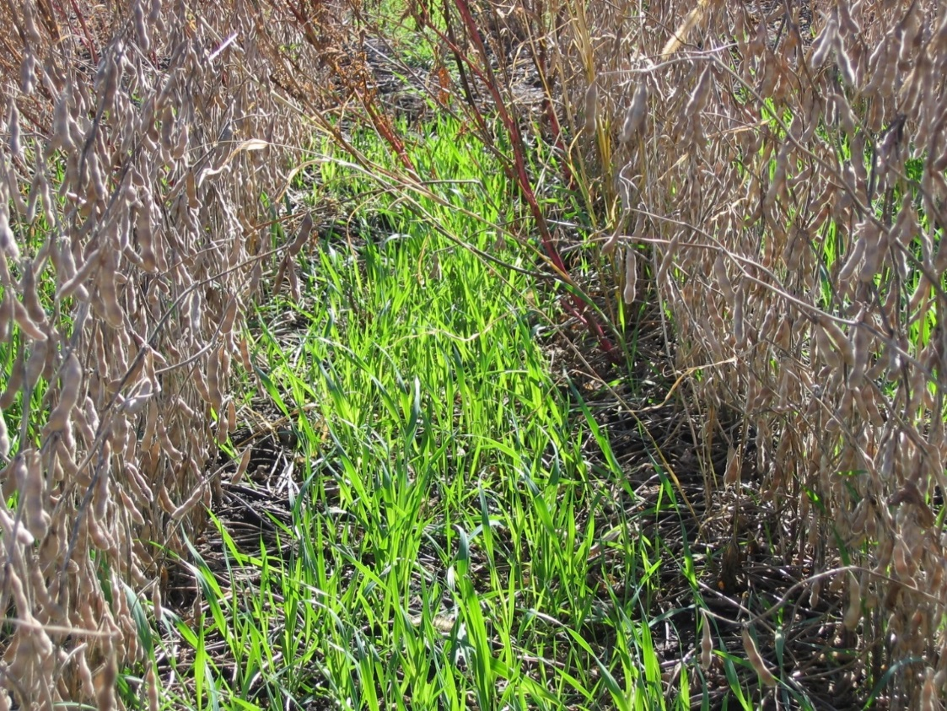
Spring Oat
Quick-growing in fall
Winter-kills
Moderate water use
Inexpensive, low risk
Can be seeded into standing soybean
Notes:
Narration: Like annual ryegrass, spring oat is an annual cereal that can be planted in the fall and will establish quickly in cool temperatures, and then winter-kill. Its water demand is moderate, and many farmers find it to be an inexpensive, low-risk cover crop. Oats can be seeded into standing soybean, to allow the cover to begin growing before the soybean is harvested.
Images: David L. Hansen, University of Minnesota (oats); University of Minnesota (oats in soybean)

Slide 24
Hairy Vetch
Strong nitrogen fixer
Overwinters, though somewhat unreliably
Low-medium water use
Notes:
Narration: Hairy vetch is a nitrogen-fixing legume that can produce heavy, high-biomass stands and is often winter-hardy in Minnesota environments, although its hardiness is not fully reliable. Vetch is a low-to-medium water user.
Image: Claire Flavin

Slide 25
Red Clover
Short-lived perennial legume
Often grown as forage, but can be used as cover crop
Can be underseeded with small grains
Good winter-hardiness
Nitrogen source
Notes:
Narration: Another legume option is red clover, a short-lived perennial that is often grown as a forage, but can also be used as a cover crop. Many farmers like to underseed red clover into a crop of small grain, allowing the clover to continue to grow after the grain is harvested. Red clover has good winter-hardiness and can be a strong nitrogen fixer.
Image: David L. Hansen, University of Minnesota

Slide 26
Brassicas
Mustards, turnips, rapeseed/canola, radishes
Rapid fall growth, then winter-kill
Tender biomass degrades quickly
Sometimes used as biofumigants
Notes:
Narration: Many species of brassicas can be used as cover crops, including mustards, turnips, rapeseed or canola, and radishes. These crops put on rapid growth in the fall, and most species will winter-kill, leaving tender biomass that degrades quickly. There has also been ongoing research on the potential of some brassica species to be used as biofumigants to control pathogens or nematodes, but results have been mixed.
Image: Adria Fernandez, University of Minnesota

Slide 27
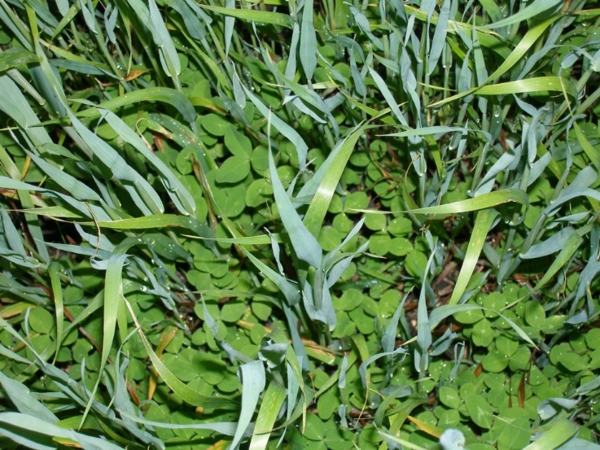
Cover Crop Mixtures
Common two-species mixtures are hairy vetch/winter rye and peas/oats
May be difficult to get all components to establish
Notes:
Narration: Many farmers are interested in mixing cover crop species to gain multiple benefits from a single planting. Common combinations include hairy vetch with winter rye, and peas with oats. A range of commercially blended mixes are also available. These mixes can add diversity; however, particularly with more complex blends, it can be difficult to get all components to establish, which may result in uneven stands. You may find it safer to start with single species cover crops, then experiment with mixes as you gain more familiarity.
Image: Carmen Fernholz

Slide 28
Cover Crops
Introduction
Benefits
Cover Crop Options
Meeting Your Goals
Establishment & Termination
Rotations
Economics
Conclusion
Notes:
Narration: How you use cover crops will depend on your goals for your farming operation.
Image: Jill Sackett Eberhart

Slide 29
Selecting Cover Crops Based on Your Farm’s Goals
Cover Crop Goal | Winter Cover Crop
Nitrogen source | Hairy vetch, red clover
Nitrogen scavenging | Winter rye
Provide soil organic matter | Winter rye
Erosion control | Winter rye, oats, annual ryegrass
Improved soil structure | Brassicas
Control weeds | Hairy vetch, winter rye, oats, annual ryegrass, brassicas
Lessen disease pressure | Brassicas
Provide nectar and habitat for beneficial insects | Hairy vetch, red clover, brassicas, buckwheat
Notes:
Narration: To choose a cover crop, you will want to first consider what goals you want to achieve, explore the crops that contribute to those goals, and select one that fits the slot that you need it to fill in your rotation. Purposes you may be interested in include providing or scavenging nitrogen, building soil organic matter, controlling erosion, improving soil structure, suppressing weeds, controlling diseases, and providing habitat for beneficial insects.

Slide 30
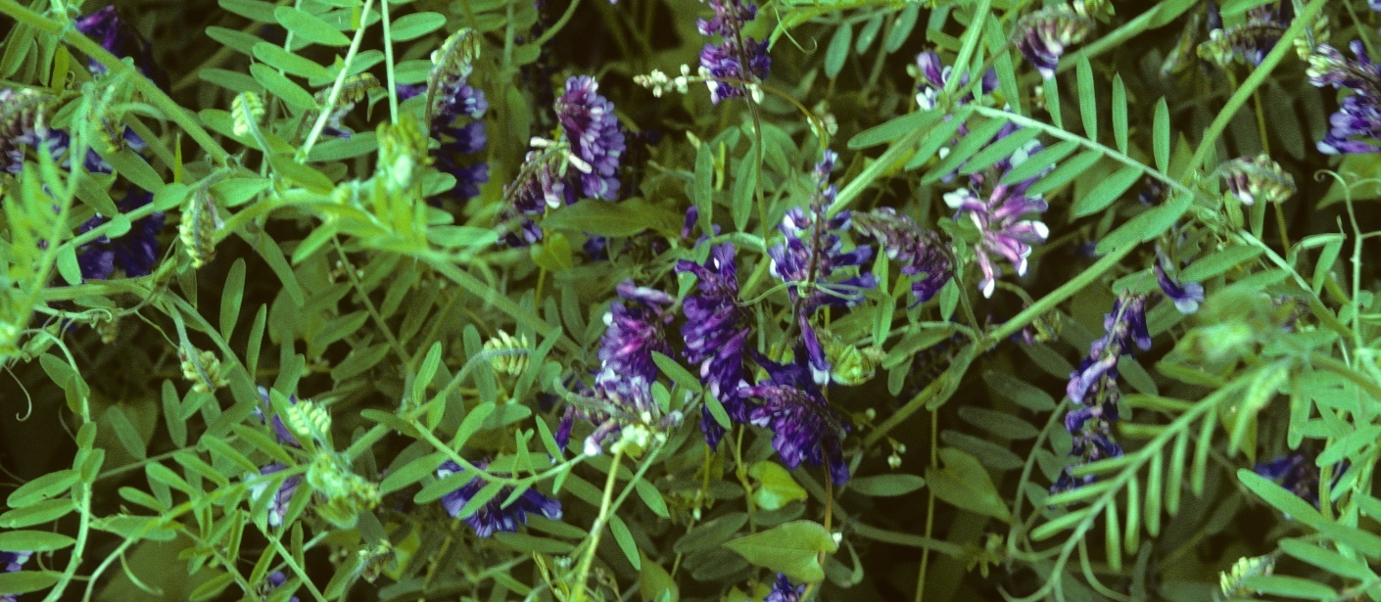
Nitrogen Fixers and Scavengers
Legumes fix atmospheric N
Should be planted with appropriate Rhizobium inoculant
Grasses and broadleaves can scavenge N
Notes:
Narration: If you are hoping to use cover crops to contribute to your soil’s nitrogen levels, you’ll want to choose a legume crop with strong biological N fixation potential such as a vetch or clover. These crops should be planted with an appropriate Rhizobium inoculant to ensure that they will nodulate and fix nitrogen. If your soil contains excess soluble nitrogen that you are concerned about losing to leaching, grass and broadleaf cover crops can help hold that nitrogen on your farm. A tender broadleaf, for example a radish, will winter-kill and release scavenged nitrogen relatively quickly, while a grass crop will degrade more slowly and keep nitrogen supplies immobilized for longer. Image: University of Minnesota

Slide 31
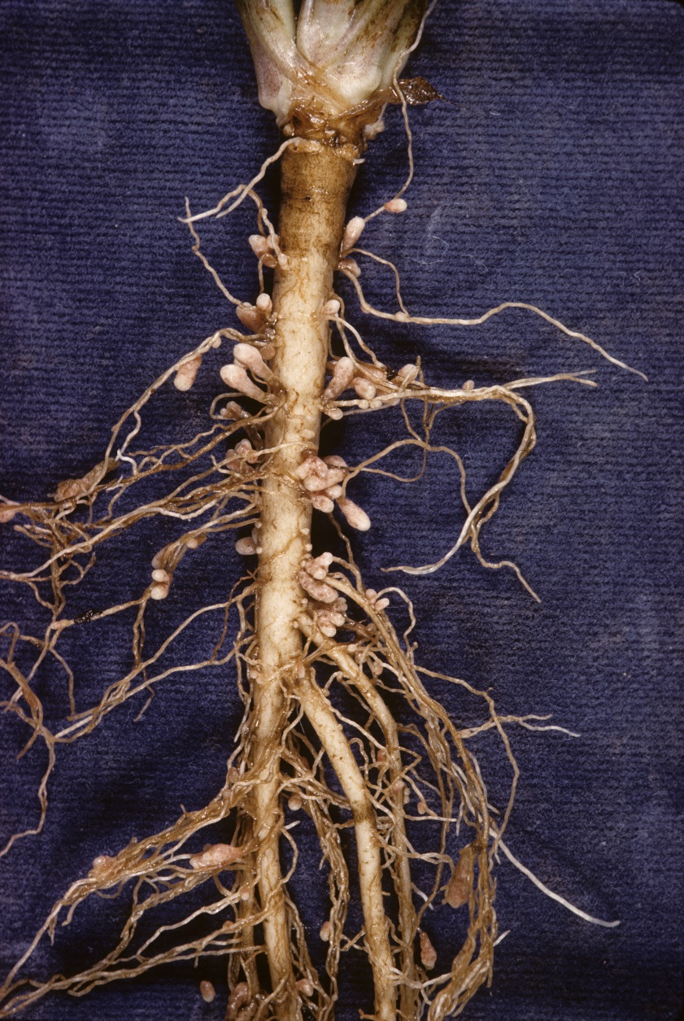
Nitrogen Credits from Cover Crops
Crop | < 6” growth | > 6” growth
Alfalfa | 40 | 60-100
Red clover | 40 | 50-80
Hairy vetch | 40 | 40-90
Red clover roots
Laboski & Peters, 2012
Notes:
Narration: Legume cover crops can provide a nitrogen credit, or reduction in the amount of fertilizer nitrogen needed, to a following cash crop. Although general guidelines exist, there are a lot of unknowns when determining N credits, so we recommend testing N levels in your soil before making fertilizer decisions. Further information on legume N credits is available in the “Soil Health and Fertility” module in this series.
Image: David L. Hansen, University of Minnesota

Slide 32
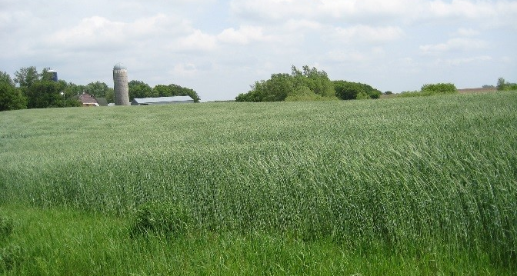
Building Soil Organic Matter
High biomass crops
Winter-hardy to enable spring growth
Recalcitrant (slow to degrade) materials
Notes:
Narration: If your primary purpose is to build the organic matter level in your soil, you will want to use a high-biomass cover crop. Overwintering crops will put on more biomass than winter-killed ones, and grasses, particularly winter rye, tend to be particularly strong biomass producers. Grasses also have a relatively high ratio of carbon to nitrogen in their biomass, which makes them relatively recalcitrant, or slow to degrade after incorporation. This contributes to the long-term building of stabilized soil organic matter.
Image: Jill Sackett Eberhart

Slide 33
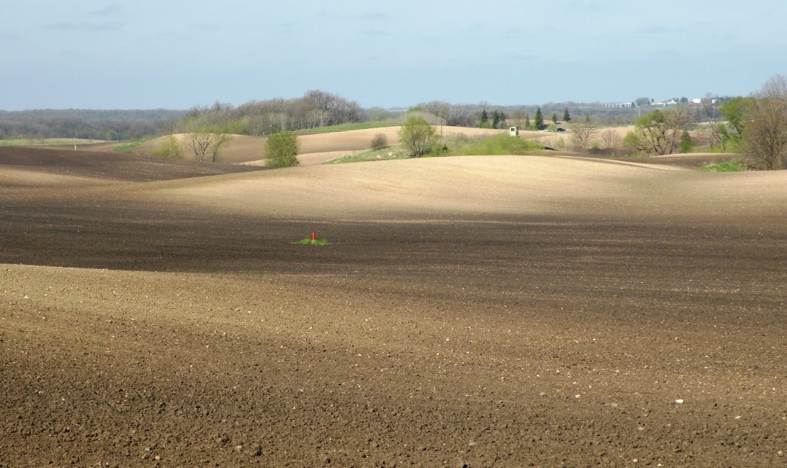
Erosion Control
Crops with dense root systems
Thick, fast-growing stands
Eroded topsoil
Notes:
Narration: If your goal is to hold soil in place and prevent erosion, you’ll want to choose a cover crop with a dense root system and thick, fast-growing stands. Winter rye, annual ryegrass, and oats are good options for erosion control.
Image: Craig Sheaffer, University of Minnesota

Slide 34
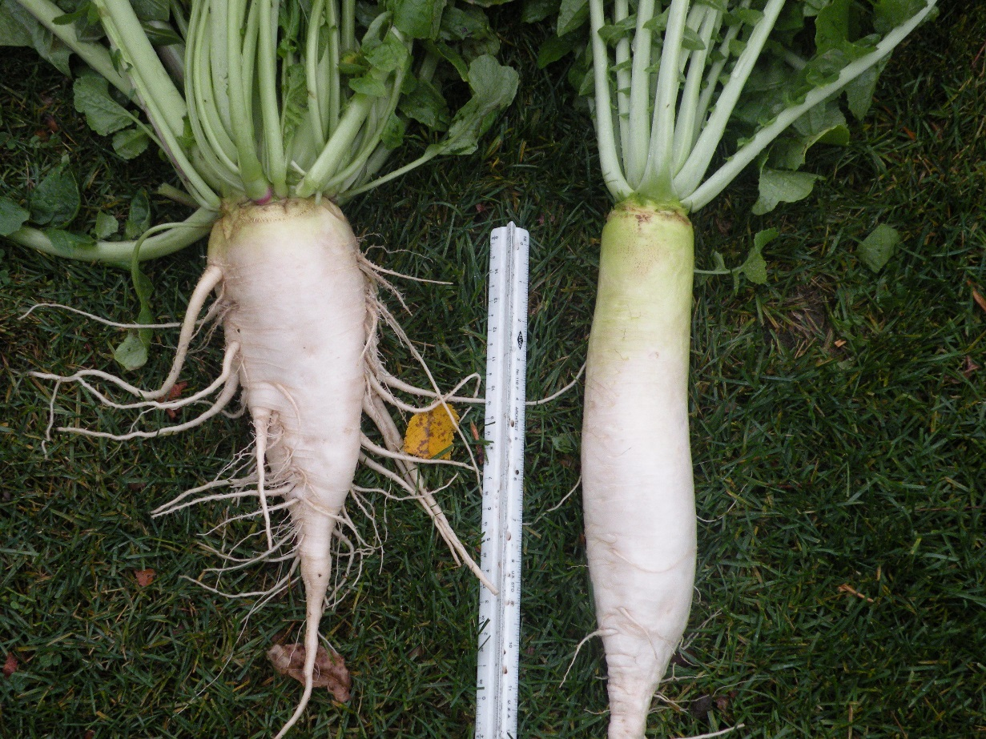
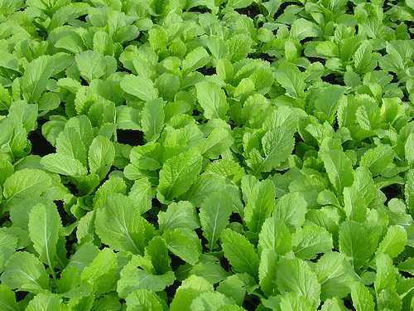
Improved Soil Structure
Strong, deep-penetrating crop roots
Notes:
Narration: If your goal is to improve soil structure and break up compaction, crops with strong, deep-penetrating roots will be helpful. Brassica crops, especially tillage or oilseed radish varieties, are particularly useful. In the long term, cover crops that contribute to soil organic matter will also promote well-structured soils.
Images: Carmen Fernholz (root); Adria Fernandez, University of Minnesota (brassica leaves)

Slide 35
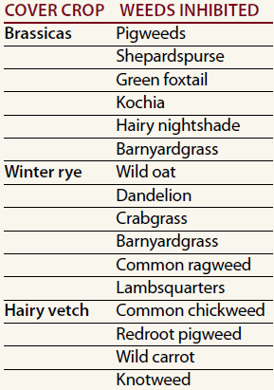
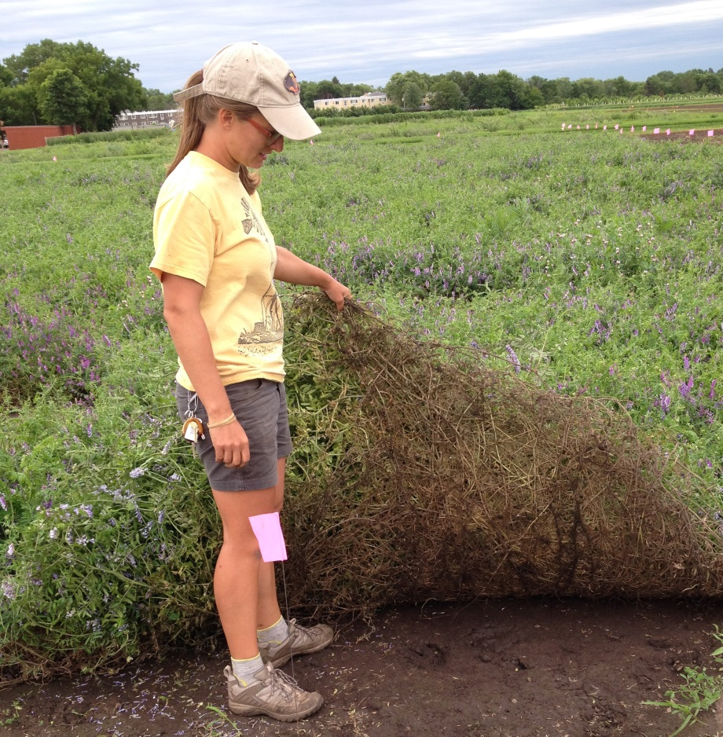
Weed Control
Dense canopy-forming crops
Crops with allelopathic effects
Hairy vetch cover crop. St Paul, MN
Moncada & Sheaffer, 2010
Notes:
Narration: For weed control, you will want to choose species that can serve as smother crops, forming a dense canopy that excludes weeds. Hairy vetch, winter rye, oats, annual ryegrass, and brassicas can be effective at controlling weeds. Cover crops may provide additional weed suppression through allelopathy, or the release of chemicals that suppress weed germination and growth.
Image: Claire Flavin

Slide 36
Disease Control
Interrupt pathogen growth environment by planting non-host species
Choose cover crops from different families than major crops
Brassicas may have limited suppressive effect on fungal pathogens
Notes:
Narration: To control disease by reducing pathogen buildup, you should choose cover crops from plant families that are not related to your main crops, so they will not be hosts to the same pathogenic organisms. Brassica covers, like radish or mustard, are a good choice for this in most Midwest rotations. Brassica crops have also been shown, in some cases, to have a limited suppressive effect on certain fungal pathogens, but this effect is variable, and you should think of it as a possible extra little bonus, rather than a reliable benefit of brassica cover crops.
Image: Carmen Fernholz

Slide 37
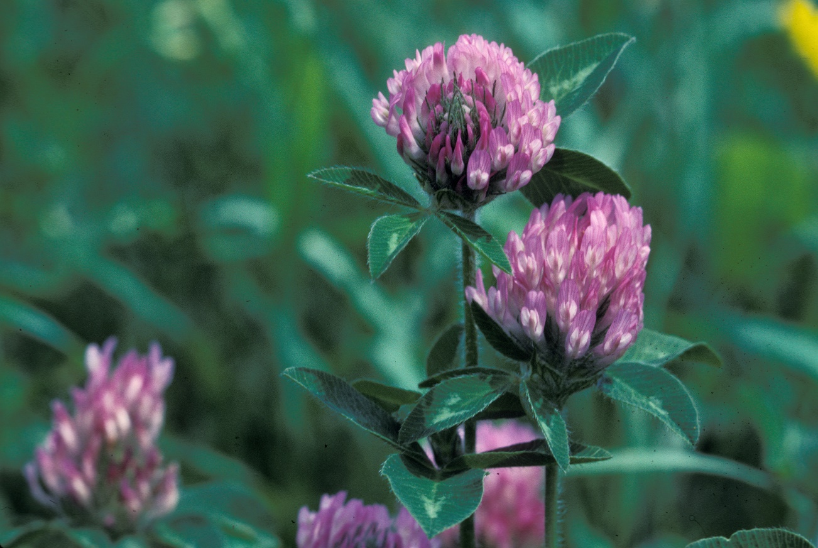
Habitat for Beneficial Insects
Flowering crops feed pollinators and attract predatory insects
Notes:
Narration: Row-crop-dominated Midwestern agricultural landscapes tend to have very few flowering plants to provide nectar to bees and other ecologically important pollinators. Hairy vetch, red clover, buckwheat, and mustards and other brassicas all have flowers that are good food sources for pollinators. These crops can also provide habitat for predatory insects, such as hoverflies, lady beetles, and predatory wasps, that feed on crop pests.
Image: David L. Hansen, University of Minnesota

Slide 38
Midwest Cover Crop Selection Tool
Midwest Cover Crops Council ­ Cover Crop Decision Tool
NEW UPDATE!
HOVER OVER COVER CROP,
CLICK TO
REVIEW THE INFORMATION SHEET.
Location
Cash Crop
Soil
Attribute
Location Information
Select a state
None or Prevented Planting
Plant Date:
Harvest Date:
Cash
Crop
Select a drainage
Flooding?
Drainage Information
Goal #1
Goal #2
Goal #3
Select an attribute
Select an attribute
Select an attribute
http://mccc.msu.edu/covercroptool/covercroptool.php#
Notes:
Narration: Several organizations offer decision tools to help you determine which cover crops may be beneficial on your farm. The Midwest Cover Crops council has developed an online resource that will suggest cover crop options depending on your location, cash crop, soil drainage conditions, and system goals. You can use the tool for free at the link shown here.

Slide 39
Cover Crops
Introduction
Benefits
Cover Crop Options
Meeting Your Goals
Establishment & Termination
Rotations
Economics
Conclusion
Notes:
Narration: In this section, we will introduce how to establish and terminate cover crops.
Image: Jill Sackett Eberhart

Slide 40
Seed Sourcing
Available from commercial seed suppliers
Varieties may not be specified
Choose local sources for winter-hardiness
Notes:
Narration: Getting good cover crop establishment starts with getting the right seed. Many seed companies will supply cover crop seed, but in many cases, you are likely to find that varieties are not specified. If you’re planting an overwintering cover crop, check with your supplier to ensure that it is winter hardy for your location. With hairy vetch in particular, it’s important to source seed locally, because types originating in other states have been observed to be much less reliably hardy in Minnesota environments.

Slide 41
Establishing Cover Crops
 | Minimum germination temperature | Establishment window
 |  | July |  |  |  | August |  |  |  | September |  |  |  | October
Winter rye | 34
Annual ryegrass | 40
Spring oat | 38
Hairy vetch | 60
Red clover | 41
Brassicas | 40-45
Midwest Cover Crops Council
 | Establishment is reliable
 | Establishment is possible, but risky
Notes:
Narration: The window for establishing cover crops to ensure a good stand varies by species. Winter rye can successfully establish anytime between mid-July and early October. Annual ryegrass and spring oat should be planted by mid-August to ensure good stands before a freeze, while hairy vetch and red clover have a fairly narrow window in early August for reliable establishment. Brassica establishment windows will vary by species, but they are generally best planted in August.

Slide 42
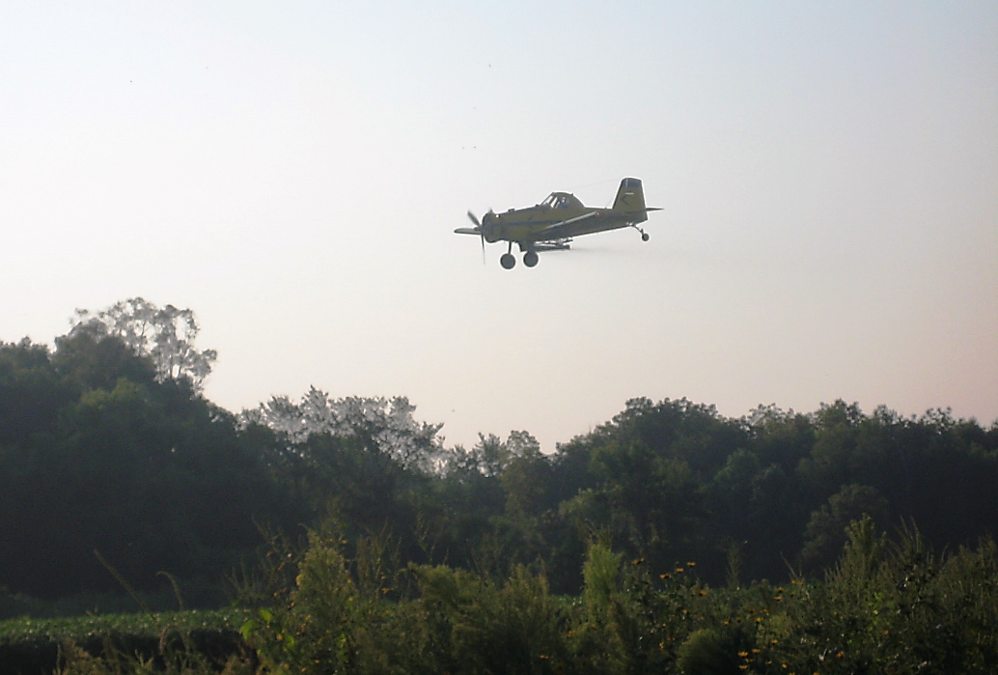
Planting Methods
Drilling
Broadcasting
With or without incorporation
Aerial or overhead seeding
Generally better for smaller-seeded crops
Notes:
Narration: Cover crops can be planted with a drill, or can be broadcast, after which they may be incorporated or left on the surface. Some growers hire agricultural pilots to broadcast an aerial seeding into standing crops, and specialized overhead seeders are also being developed for this purpose. In general, when broadcasting or flying on cover crops, smaller seeds are a better choice, including brassicas, cereal rye or barley. Larger seeded crops, like peas, should not be broadcast or flown on.
Image: Jill Sackett Eberhart

Slide 43
Planting Methods
SARE Cover Crop Survey 2014-2015
Notes:
Narration: In SARE’s survey of farmers using cover crops, the most commonly used planting method was drilling, followed by aerial seeding and broadcast seeding with incorporation. Some farmers also found alternate methods, including using fertilizer spreaders to distribute seed or planting with corn and soybean equipment.

Slide 44
Methods Matter!
Broadcast
Broadcast & Incorporate
Notes:
Narration: Planting method can have a big effect on how strong of a stand you’re going to get from a cover crop. If the soil is moist, all of these seeding methods are viable options. If the soil is dry, leaving the seeds on the soil surface will reduce germination and coverage during the fall, so it’s important to drill or incorporate. In these images, you can see the difference that incorporation has made in germination.
Images: M. Scott Wells, University of Minnesota

Slide 45
Seeding Rates
 | Seed rate (lb/A)
 | Broadcast | Drilled
Winter rye | 90-160 | 60-120
Annual ryegrass | 20-30 | 10-20
Spring oat | 100-140 | 80-110
Hairy vetch | 25-40 | 15-20
Red clover | 10-12 | 8-10
Brassicas | 8-30, depending on species | 5-13, depending on species
SARE, 2007
Notes:
Narration: You should check with your seed supplier for recommended planting rates, but in general, higher rates will be needed if you are broadcasting seed onto the soil surface versus drilling or incorporating the seed.

Slide 46
Terminating Cover Crops
Achieving full kill
Preventing damage from residues to following crop
Allelopathy
Planting interference
Notes:
Narration: The main considerations when terminating cover crops are achieving full kill, so that the cover crop will not persist as a weed in the following crop, and ensuring that cover crop residues will not damage the following crop, either through allelopathic effects or by interfering with planting. For example, cover crop residues can be dragged by the seeder, preventing proper seed placement.
Image: Kristine Moncada, University of Minnesota

Slide 47
Preferred Termination Methods
Notes:
Narration: Farmers surveyed by the NRCS indicated that they preferred most often to terminate cover crops by tilling. Others preferred mowing, or chose crops that would winter-kill.

Slide 48
Termination
Termination options |  | Risk of regrowth
With incorporation | Moldboard plow | Low
 | Chisel plow | Moderate
No incorporation | Disking | Moderate
 | Flail chop | Moderate
 | Rotary mow | High
 | Roll and crimp | High
Notes:
Narration: Winter rye, hairy vetch, and clovers may be particularly difficult to kill, and may require more aggressive methods. In general, moldboard plowing will result in the lowest risk of regrowth, but is also the most disruptive to the soil. Chisel plowing, disking, and flail chopping carry moderate risk of regrowth, while rotary mowing and roller-crimping are more likely to allow regrowth. The growth stage of the cover crop is an important consideration; crops that have entered their reproductive stage are less likely to re-grow, but will also leave less tender, more persistent residues.

Slide 49
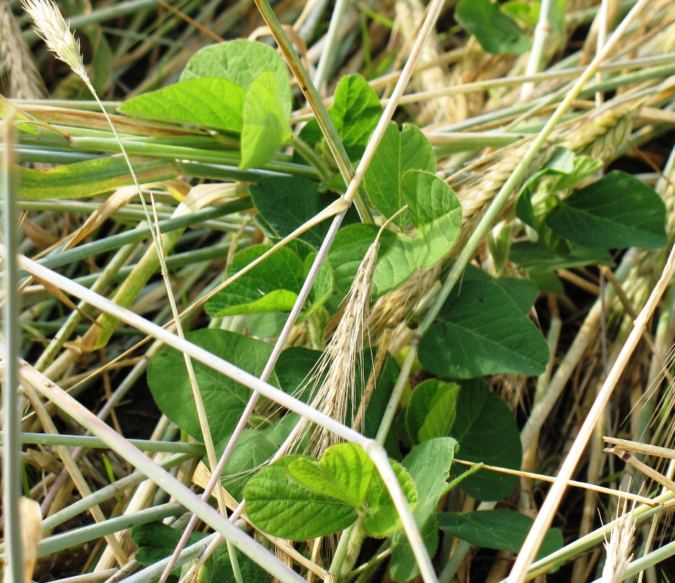
Establishing the Following Crop
Terminate cover crops before desired planting date
1 week if incorporated
10 days if surface residue
Some crops (e.g. soybean) tolerate fresh cover crop residue well
Soybean in winter rye residue
Notes:
Narration: To protect your main crop from allelopathic effects, pest pressure, or planting problems due to cover crop residues, it’s generally best to terminate your cover crops a little while before you plan to plant the main crop. At least one week is recommended if the cover crop residue is incorporated, or at least ten days if the residue remains on the soil surface. However, some crops, like soybeans, tolerate cover crop residue well and may be planted into freshly terminated cover crop mulch.

Slide 50
Cover Crops in Organic No-Till
Notes:
Narration: In recent years, there has been quite a bit of research toward the development of organic no-till methods, in which heavy cover crop stands, generally rye and/or vetch, are killed by mowing or roller-crimping and left in place to serve as a weed-suppressing mulch, into which the following crop is directly planted. These techniques have proved successful in some regions, but can be challenging in northern environments with short growing seasons. Cover crops must be terminated at the right maturity stage to prevent regrowth, which is sometimes too late to allow timely cash crop planting. A thick layer of mulch can also delay soil warming, and weeds that succeed in penetrating the mulch layer can be very difficult to manage. However, many farmers have expressed interest in the prospect of cover-crop-based organic no-till, and research is ongoing.
Image: University of Minnesota

Slide 51
Cover Crops
Introduction
Benefits
Cover Crop Options
Meeting Your Goals
Establishment & Termination
Rotations
Economics
Conclusion
Notes:
Narration: Finding ways to fit cover crops into your rotation is a little like putting together a jigsaw puzzle. We’ll look a little bit at how cover crops can be used to diversify corn-and-soy-based rotations.
Image: Jill Sackett Eberhart

Slide 52
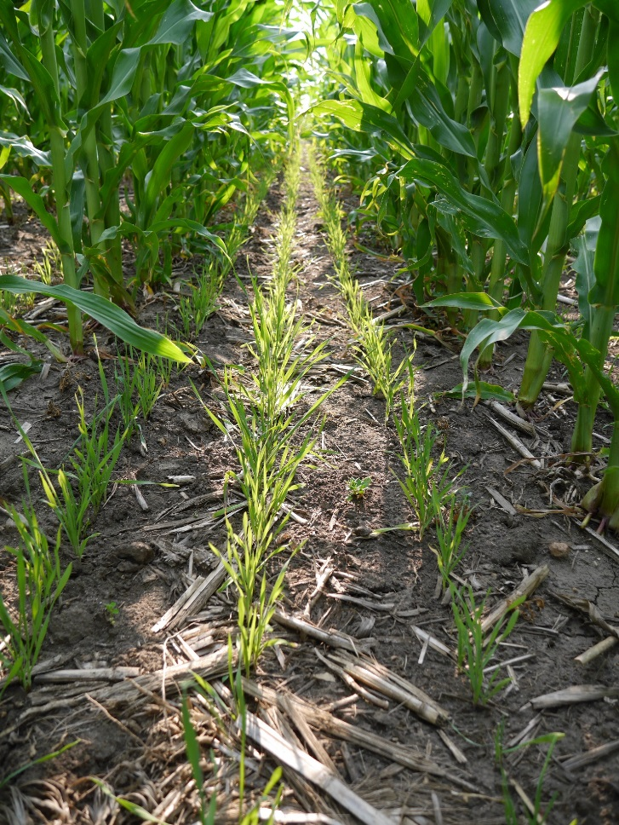
Cover Crops in Rotation
Corn-soybean with rye cover
Good option during transition
Year 1 – Corn-rye
Year 2 – Soybean
Notes:
Narration: One of the most common cover cropping practices in corn-soy systems is planting rye after the corn crop. Winter rye seed can be drilled into corn stubble, or is sometimes broadcast into a standing corn crop to allow the rye to establish before corn harvest. The rye is then terminated in the spring before soybean planting. This can be helpful as the rye will suppress early-emerging weeds before soybean planting, and soybeans are very tolerant of cereal rye residue, so their establishment should not be adversely affected. A corn-rye-soy rotation can be a good foundation for a farmer transitioning to organic.
Image: Reagan Noland

Slide 53
Typical Rotations
Year 1 – Corn-rye
Year 2 – Soybean
Year 3 – Small grain-hairy vetch
Corn-soy-small grain with rye and vetch covers
Legume provides N for subsequent corn crop
Notes:
Narration: The corn-soy rotation can be further diversified by adding a small grain. Because the small grain can be harvested earlier, it presents an opportunity for earlier cover crop planting resulting in greater biomass accumulation. This is a good opportunity for a nitrogen-fixing legume like hairy vetch to build up a large N contribution before the rotation goes back to corn, which has high nutrient demands. Corn generally performs very well after a legume, and will also benefit from the nitrogen credit associated with the legume stand.

Slide 54
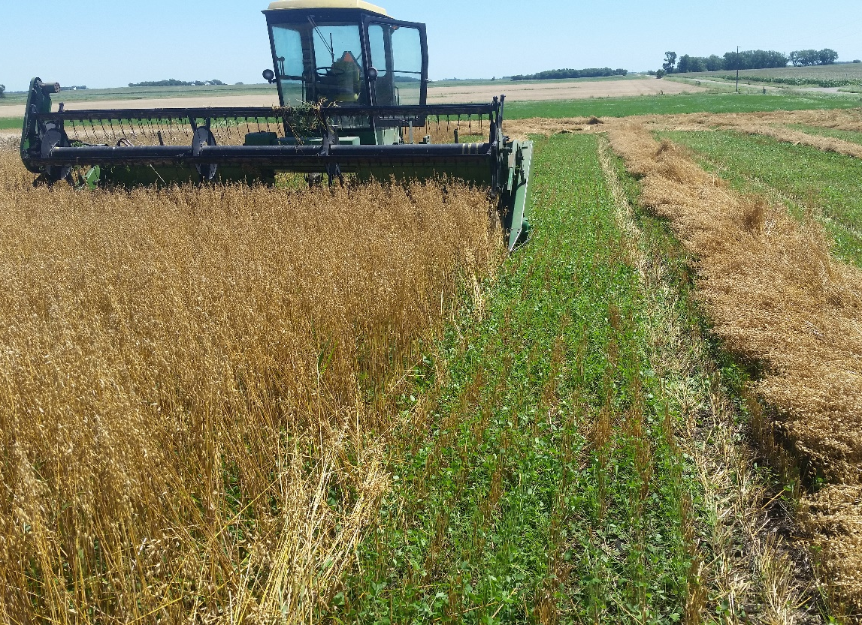
Typical Rotations
Corn-soy-small grain with underseeded clover
Year 1 – Corn
Year 2 – Soybean
Year 3 – Small grain underseeded with red clover
Notes:
Narration: Another way of incorporating a legume cover crop into a corn-soy-small grain rotation is to underseed red clover along with the small grain. When the small grain is harvested, the clover will continue to grow until it is incorporated before corn planting. This technique is used successfully by many organic farmers in our region.
Image: Carmen Fernholz

Slide 55
Quote from a Farmer…
“ We raise short-season crops. For us, that has meant raising organic dry edible beans, sweet corn, or peas. It allows us to raise more cover crops that get closer to full biomass production before termination.”
– Jon Luhman, Dry Creek Farms, MN
Notes:
Narration: The more you can include crops other than corn and soybeans in your rotation, the easier it will be to fit in cover crops. The Alternative Crops and Small Grains modules in this series can help you get started with crops that may be new to you. As Minnesota farmer Jon Luhman states, “We raise short-season crops. For us that has meant raising organic dry edible beans, sweet corn, or peas. It allows us to raise more cover crops that get closer to full biomass production before termination.”

Slide 56
Cover Crops
Introduction
Benefits
Cover Crop Options
Meeting Your Goals
Establishment & Termination
Rotations
Economics
Conclusion
Notes:
Narration: With cover cropping, like with any new practice, you’ll want to assess how it will affect your farm’s bottom line before you get started.
Image: Jill Sackett Eberhart

Slide 57
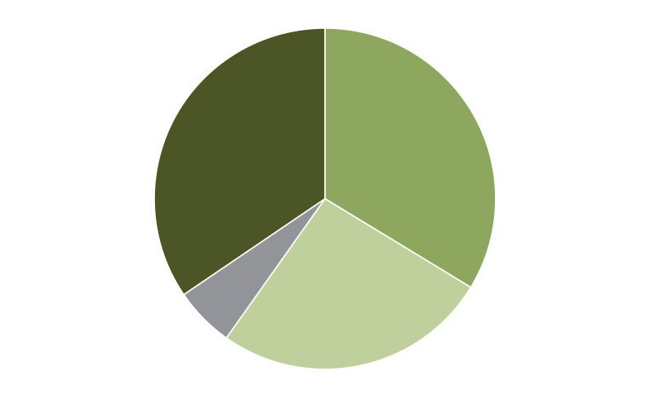
Cover Crop Profitability
34.5%
Not enough data or experience
to tell
33.7%
Cover crops increase profitability
5.7%
Cover crops decrease profitability
26.1%
Cover crops do not affect profitability
SARE Cover Crop Survey, 2015-2016
Notes:
Narration: Of the cover crop-using farmers surveyed by SARE, about a third said that cover crops increased their overall profitability, while less than 6% reported a decrease in profitability. The rest reported that cover crops did not affect profitability, or they did not have enough data or experience to tell. The effects of cover crops on your farm’s profitability will depend on the balance of costs and returns that you obtain from cover cropping.

Slide 58
Cover Crop Costs
Seed cost
Planting
Termination
Estimated cost of establishing cover crops
Notes:
Narration: The costs associated with cover crops are the price of the seed and the costs of planting and termination, either in your time and fuel—as well as potentially new equipment--or in paid labor or custom work. In the SARE cover crop survey from 2015-2016, the average cost of cover crop seed was around $30/acre and the cost of establishment was around $17/acre.

Slide 59
Cover Crop Returns
Rotation effects
N credit
Incentives
Soil protection
Economic returns to cover cropping
Notes:
Narration: The economic returns to cover crops come in the form of yield benefits to your cash crops and reductions in the need for purchased inputs. These will include a nitrogen credit for legume cover crops, the positive effects of rotation on crop yields, and the role of cover crops in building and protecting soil, leading to better water and nutrient retention. Many of these returns are difficult to quantify. There may also be incentives available from programs such as EQIP, which we’ll discuss a little more in a moment.

Slide 60
Cropping Systems Calculator
https://landstewardshipproject.org/forms/cscdownload
Notes:
Narration: A useful resource for predicting how cover cropping will shake out financially on your farm is the Land Stewardship Project’s Cropping Systems Calculator. This is a tool that allows you to compare the projected economic returns of different rotations, and is available at the link shown here.

Slide 61
Cover Crops
Introduction
Benefits
Cover Crop Options
Meeting Your Goals
Establishment & Termination
Rotations
Economics
Conclusion
Notes:
Narration: Let’s conclude our module with some tips for lowering your risk when using cover crops. We will also provide some excellent resources if you want to learn more on this topic.
Image: Jill Sackett Eberhart

Slide 62
Conclusions
Clarify your primary goals or objectives of the cover crop
Identify the best time and place for a cover crop in your system
Choose well-established practices
Experiment on small acreage
Investigate funding opportunities
Notes:
Narration: Steps to getting started with cover crops include clarifying your primary goals and objectives—what do you want to achieve with cover cropping? You’ll also want to look at your cash crop rotation and identify the best time and place for a cover crop in your system. Then you can select a cover crop that will meet these goals in the time and space that you have available. There are a few steps you can take to reduce the risks associated with trying out cover crops. First, choose well-established practices. That will let you learn from others’ experiences. Second, experiment on a small acreage first. And third, look for funding opportunities that can help defray the costs of growing a cover crop.
Image: Jill Eberhart Sackett

Slide 63
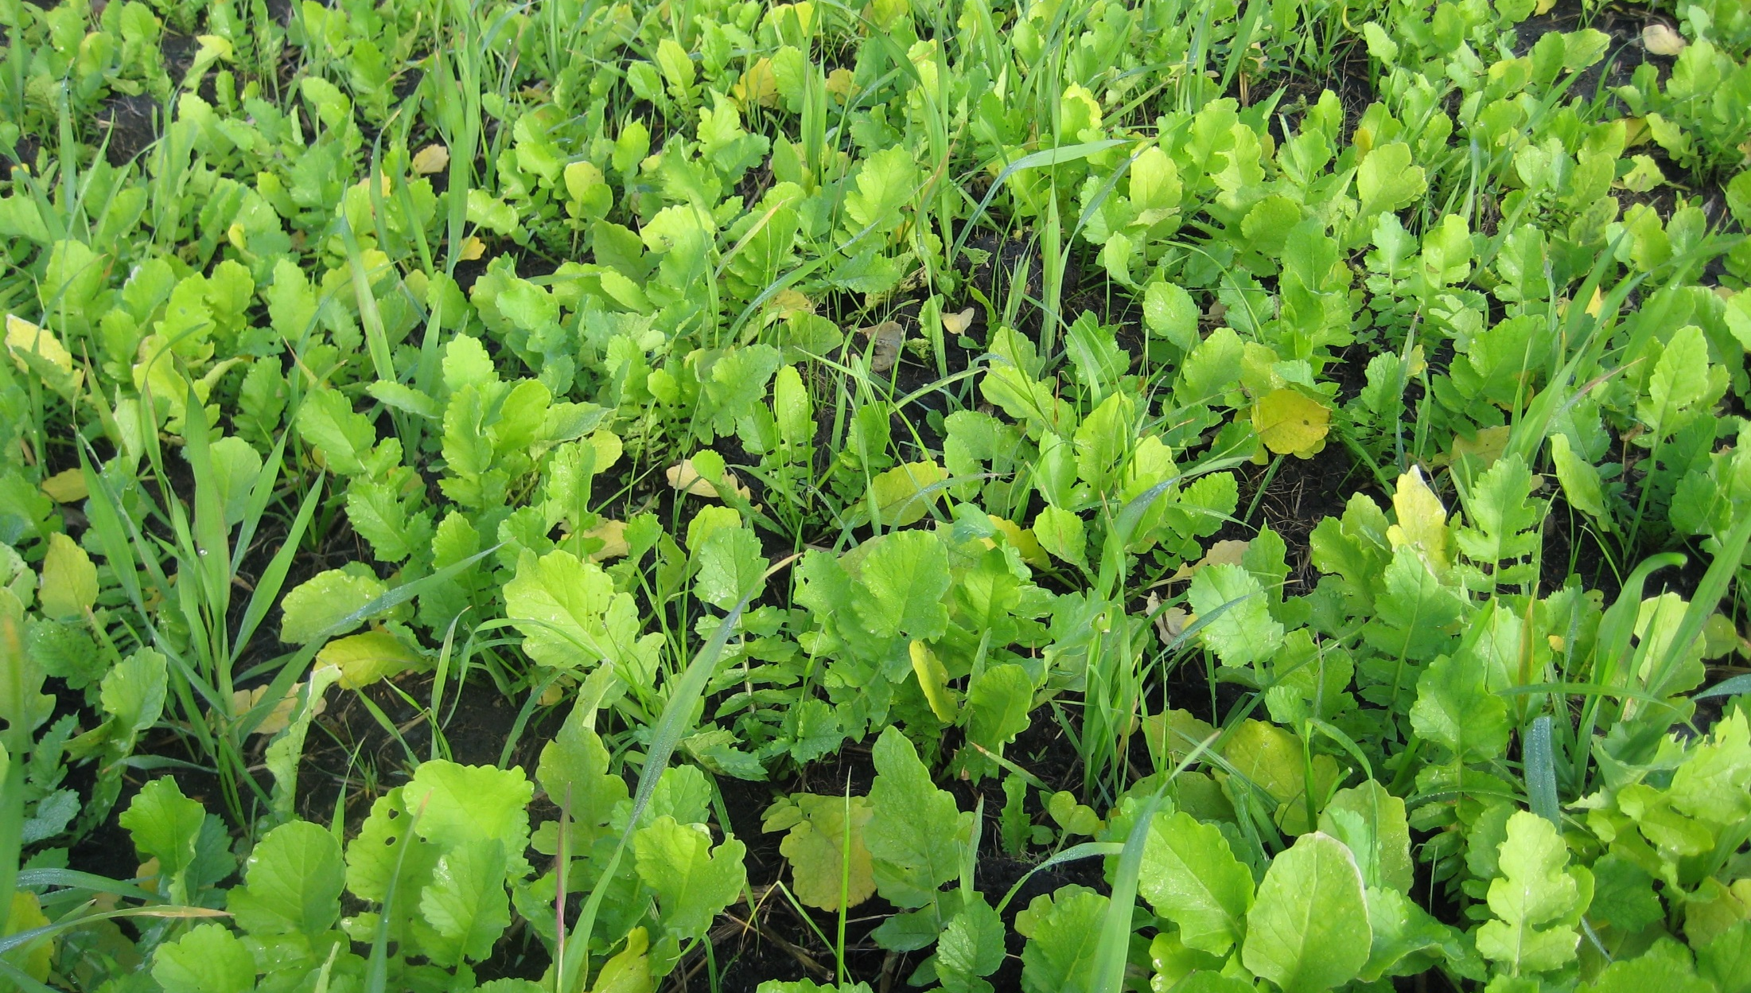
Cover Crop Funding Opportunities
Environmental Quality Incentives Program (EQUIP)
Conservation Stewardship Program (CSP)
Contact your local Extension or NRCS office for currently available opportunities
Notes:
Narration: Federal programs such as the Environmental Quality Incentives Program or the Conservation Stewardship Program may provide incentives or cost share for cover cropping. The availability of these programs varies from year to year, so contact your local Extension or NRCS office to find out about current opportunities.
Image: Jill Sackett Eberhart

Slide 64
Resources - Tools
MCCC’s Cover Crop Selection Tool (link): http://mccc.msu.edu/covercroptool/covercroptool.php
Chippewa 10% Project’s Cropping Systems Calculator: https://landstewardshipproject.org/forms/cscdownload
SARE publications: Managing Cover Crops Profitably: http://www.sare.org/Learning-Center/Books/Managing-Cover-Crops-Profitably-3rd-Edition
Notes:
Narration: There are several online tools for helping your incorporate cover crops in your system…

Slide 65
Additional Resources
Midwest Cover Crops Council
Forever Green Initiative
Green Lands Blue Waters
Land Stewardship Project
Rodale Institute
Managing Cover Crops Profitably
NRCS
SARE
Albert Lea Seed
Notes:
Narration: …as well as many publications. Be sure to check them out!

Slide 66
Cover Crops
Introduction
Benefits
Cover Crop Options
Meeting Your Goals
Establishment & Termination
Rotations
Economics
Conclusion
Notes:
Narration: We’ve reached the end of our Cover Crops module – thanks for watching!
Image: Jill Sackett Eberhart

Slide 67
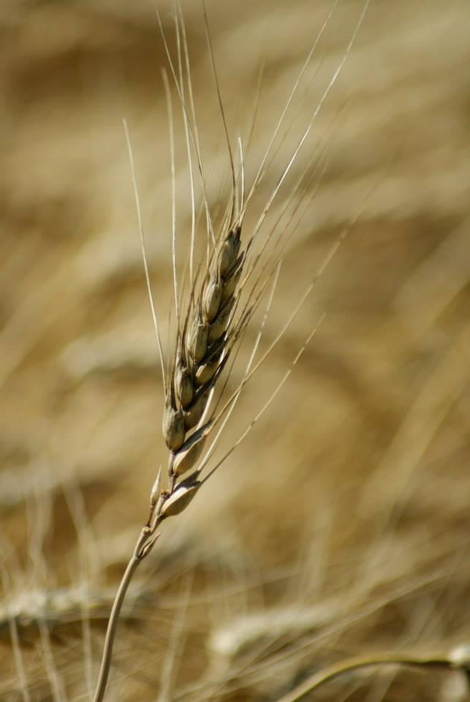
© 2017 Regents of the University of Minnesota. All rights reserved. The University of Minnesota is an equal opportunity educator and employer.
This material is based upon work that is supported by the National Institute of Food and Agriculture, U.S. Department of Agriculture, under grant number 2013-51106-21005.
Notes:
Narration: This material is based upon work that is supported by the National Institute of Food and Agriculture.
Image: Constance Carlson, University of Minnesota

Slide 68
References
Conservation Technology Information Center and NCR-SARE. 2016. Annual Report Survey 2015-2016: Cover Crop Survey July 2016. https://www.sare.org/Learning-Center/Topic-Rooms/Cover-Crops
Luhman, J. 2017. Seeking a Trifecta of Success: Prioritizing Profitability, Lifestyle & the Environment When Planning a Rotation. The Land Stewardship 35(1):18-19. http://landstewardshipproject.org/repository/1/2079/lsl_1_2017.pdf
Laboski, C. and J. Peters. 2012. Nutrient application guidelines for field, vegetable, and fruit crops in Wisconsin. University of Wisconsin. http://learningstore.uwex.edu/assets/pdfs/A2809.pdf
Moncada, K. and C. Sheaffer. 2010. Winter Cover Crops Chapter in the Risk Management Guide for Organic Farmers. University of Minnesota. https://organicriskmanagement.umn.edu/sites/organicriskmanagement.umn.edu/files/winter_cover_crops.pdf

Slide 69
References (cont.)
Noland, R., N. Little, and M.S. Wells. 2016. New cover cropping opportunities in Minnesota. University of Minnesota Extension. https://www.extension.umn.edu/agriculture/soils/cover-crops/new-cover-crop-opportunities/
SARE. 2007. Managing Cover Crops Profitably, 3rd ed. https://www.sare.org/Learning-Center/Books/Managing-Cover-Crops-Profitably-3rd-Edition
USDA-NRCS. 2010. Organic Production: Using NRCS Practice Standards to Support Organic Growers. Cover Crop Practice Fact Sheet. https://www.nrcs.usda.gov/Internet/FSE_DOCUMENTS/stelprdb1043183.pdf
USDA-NRCS. 2016. Allelopathy and Cover Crops. http://www.nrcs.usda.gov/Internet/FSE_PLANTMATERIALS/publications/mopmstn2825.pdf

